Slide 1
Workshop Series
2023/11/24
Flink Workshop
working with state

Slide 2
THE AGENDA
show what is hidden by AWS
Flink’s Architectural Decisions about State
Code Time

Slide 3
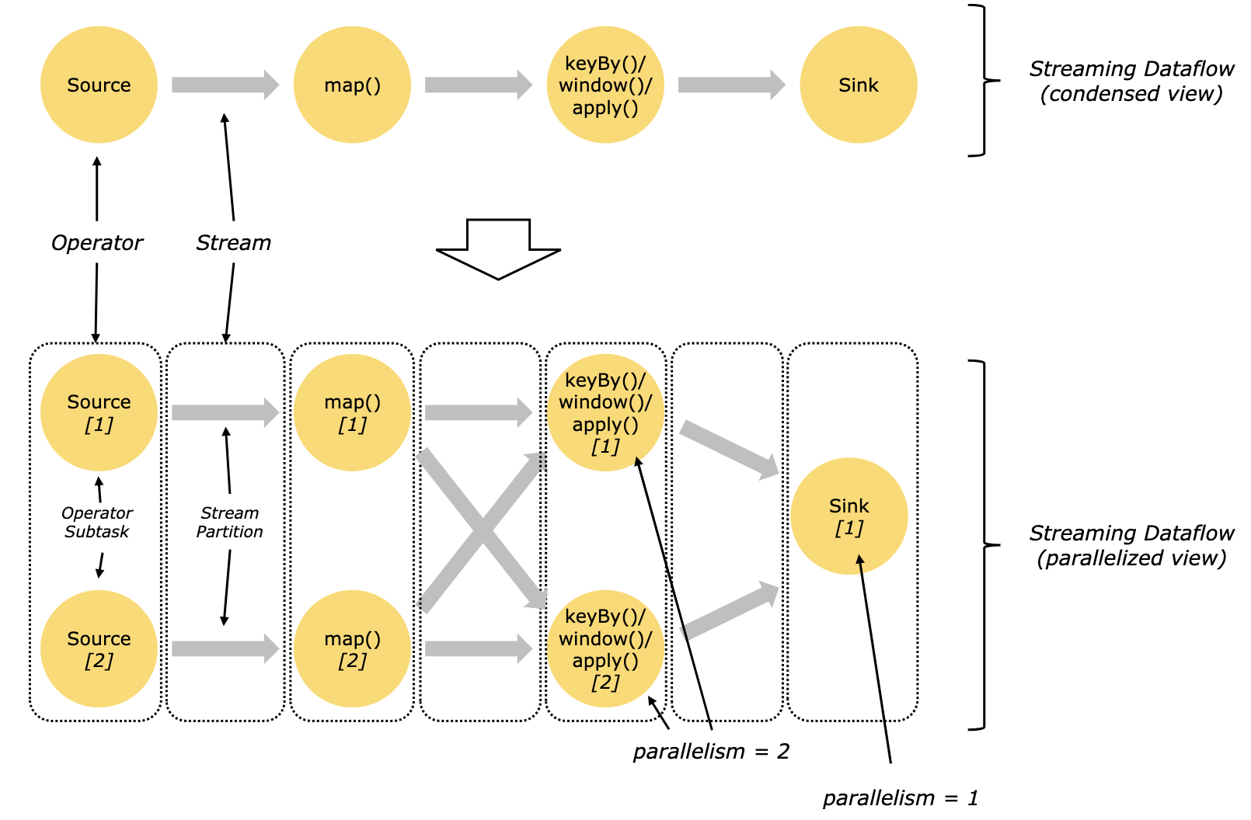

THE ARCHITECTURAL CONSIDERATIONS
#1 State is localized per subtask
Except for Operator State that is used to build stateful Source and Sink and the Broadcast State used under special occasions, we most of the time deal with Keyed State - state that lives along side with a subtask – an instance of a parallel operator.
This approach contrasts to a centralized approach – managing state with an external data store.

Slide 4
Localized State
The localized state is essential for parallelism,
but it comes at a cost – logical partition of data stream
Parallelism
without logical partition
Parallelism
with logical partition
No Parallelism
Stateful Operator
Stateful Operator
incomplete state 60%
complete state
for data with key=b
Stateful Operator
60%
key=b
unbounded
data flow
unbounded
data flow
unbounded
data flow
40%
key=a
A Computation Unit
(task slot, thread, process, VM...)
unmanaged
data distribution
data structure & partition
design in prior
complete state
for data with key=a
scalability bottleneck
incomplete state 40%

Slide 5


THE ARCHITECTURAL CONSIDERATIONS
#2 (only) Internal State Consistency
Consistency refers to a quality for the streaming system being effectively unimpacted by temporary downtimes – no loss of information, faithful execution of designed behaviors and produce accurate result.
Flink guarantees this consistency using checkpoint.
The ultimate effect is that each checkpoint represents a fully recoverable clone of an application, albeit in an earlier progress.
In addition to custom state, operable by application code, internal state also includes runtime meta state, unprocessed buffer and other framework-land information inaccessible by application’s code.
The checkpoint mechanism is a thing an external state store can not do out-of-box, if not simply impossible.
Timeline
meta state
checkpoint #1
checkpoint #2
checkpoint #3
custom state
in/out buffer state
...

Slide 6
Internal State Consistency
Flink can only provide internal consistency using Checkpoint, it does not guarantee end-to-end consistency.
Ultimately, we want the result as if there were no disruptions
Flink Application
Source
System
Sink
System
Checkpoint cannot reproduce the data happened after the time when this checkpoint is taken and before the disruption occurs.
As the time is rewound, history is replayed. Checkpoint cannot prevent the same output from being sent to the sink system again.
Notes:
upon disruption in the Flink app.
Flink recovers itself by rewinding to a checkpoint, usually the most recent one.
Checkpoint can fully recover each operator’s custom state, can recover unprocessed buffer and runtime meta; what it cannot do
is reproduce the data happened after this checkpoint and before disruption occurs.

Slide 7
Internal State Consistency
A Fault Tolerant, End-to-End Exactly Once Streaming System
Flink Application with Checkpoint
Source
System
Sink
System
Replay-able
Source System
Idempotent
Sink System
Notes:
upon disruption in the Flink app.
Flink recovers itself by rewinding to a checkpoint, usually the most recent one.
Checkpoint can fully recover each operator’s custom state, can recover unprocessed buffer and runtime meta; what it cannot do
is reproduce the data happened after this checkpoint and before disruption occurs.

Slide 8
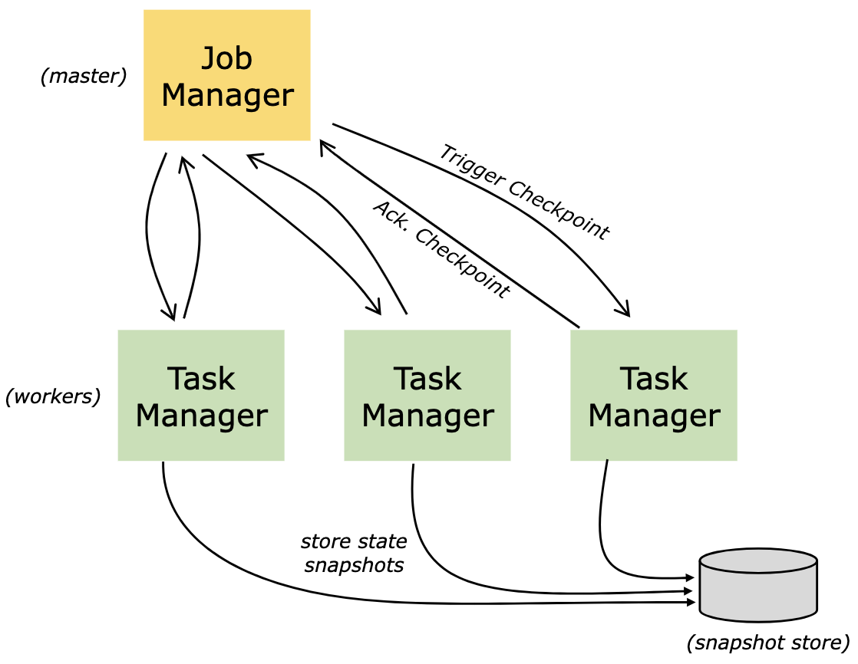
THE ARCHITECTURAL CONSIDERATIONS
#3 State Backend, Representation, Durability and Memory Consumption
Taking a checkpoint always spills out state files into a durable storage medium (e.g., local and remote file system).
The choice of state backend (HashMapStateBackend / EmbeddedRocksDBStateBackend) will affect the formation of these state files – state files from different backends are not compatible.
Choosing a state backend is an architectural decision - once decided, there is little room to change sporadically later.
Luckily, no matter which one is chosen, application development can hardly detect the existence of the state backend and the difference between these two occurs only in quite edgy cases.

Slide 9
State Backend
HashMapStateBackend
bounded by allocated memory capacity (taskmanager.memory.managed.size)
native-JVM representation
EmbeddedRocksDBStateBackend
bounded by the size of storage medium (effectively unlimited when using remote storage service)
RocksDB representation
RocksDB-limited amenity:
incremental checkpoint => faster checkpointing but slower recovery
RocksDB native metrics for monitoring
Advanced RocksDB-specific optimizations

Slide 10
Code Time
https://github.com/bing-hsu/flink-workshop

