Slide 1

Google Play Store Data Analysis
IST – 687 Introduction to Data Science
Syracuse University
Spring 2019
Andrea Bradshaw Phillip A. Garver Barbara A. Jaehn Bing-Je Wu
Notes:
DRAFT Narration:
For our project our Team chose to analyze Google Playstore apps.

Slide 2
Analysis Process
Data Collection, Cleaning, and Definitions
Data Exploration
Business Question
Modeling and Algorithms
Actionable Insights
Next Steps
Notes:
DRAFT Narration:
Our analysis process was typical.
We downloaded data, performed munging, and first glance analytics to develop business questions.
We then took a deeper dive in performing analysis to answer business questions and developed models and algorithms to determine if Installs (and revenue) could be predicted.
Note: check slides follow order on this slide

Slide 3
Data Collection
The csv data set “Google Play Store Apps” was downloaded from:
https://www.kaggle.com/lava18/google-play-store-apps/version/6#googleplaystore.csv
'data.frame': 10841 obs. of 13 variables:
$ App : Factor w/ 9660 levels "- Free Comics - Comic Apps",..: 7206 2551 8970 8089 7272 7103
$ Category : Factor w/ 34 levels "1.9","ART_AND_DESIGN",..: 2 2 2 2 2 2 2 2 2 2 ...
$ Rating : num 4.1 3.9 4.7 4.5 4.3 4.4 3.8 4.1 4.4 4.7 ...
$ Reviews : Factor w/ 6002 levels "0","1","10","100",..: 1183 5924 5681 1947 5924 1310 1464 3385
$ Size : Factor w/ 462 levels "1,000+","1.0M",..: 55 30 368 102 64 222 55 118 146 120 ...
$ Installs : Factor w/ 22 levels "0","0+","1,000,000,000+",..: 8 20 13 16 11 17 17 4 4 8 ...
$ Type : Factor w/ 4 levels "0","Free","NaN",..: 2 2 2 2 2 2 2 2 2 2 ...
$ Price : Factor w/ 93 levels "$0.99","$1.00",..: 92 92 92 92 92 92 92 92 92 92 ...
$ Content.Rating: Factor w/ 7 levels "","Adults only 18+",..: 3 3 3 6 3 3 3 3 3 3 ...
$ Genres : Factor w/ 120 levels "Action","Action;Action & Adventure",..: 10 13 10 10 12 10 10
$ Last.Updated : Factor w/ 1378 levels "1.0.19","April 1, 2016",..: 562 482 117 825 757 901 76 726
$ Current.Ver : Factor w/ 2834 levels "","0.0.0.2","0.0.1",..: 122 1020 468 2827 280 116 280 2393
$ Android.Ver : Factor w/ 35 levels "","1.0 and up",..: 17 17 17 20 22 10 17 20 12 17 ..
Notes:
DRAFT Narration:
Our initial download from Kaggle contained about 10,000 rows with 13 variables scraped from the web in February 2019.
Note that almost all the data was of the data type ‘Factor’.
Scraped date: February 3, 2019

Slide 4
Data Cleaning
Downloaded data was examined and the following munging performed: 10841 original rows
One bad record with data shifted 1 column was deleted: 10840 rows remaining
Columns were renamed – periods were replaced with underscores
Duplicate rows were removed: 483 rows removed, 10357 rows remaining
NA & NaN records were removed: 1467 rows removed, 8890 rows remaining
Removed Last_Updated, Current_Ver, and Android_Ver columns
Identical App rows (except the number of Reviews) were eliminated; the App row with the maximum number of Reviews was retained: 679 rows removed, 8211 final rows
Notes:
DRAFT Narration:
The downloaded set required some clean up before analysis could start.
Clean up required removing a bad record, duplicate rows, removing certain columns that were not appropriate for our analysis, and renaming columns.
We also made a decision to eliminate rows that were missing entries in certain fields (NAs).
In our initial examination of the data, it was also noted that certain Apps had duplicate rows with the same information exception of the number of reviews.
These duplicate rows were removed from the analysis and only the row with the highest number of reviews was retained.

Slide 5
Data Cleaning
Converted Reviews to numeric mode.
Size attribute -
Text characters removed: and
Units standardized to kilobytes; and
Data mode changed from factor to character.
Installs -
Text character “+” was removed.
Data mode was converted to numeric.
Parsed Genres into Genre and SubGenre columns.
Notes:
DRAFT Narration:
We also changed the data types of several fields depending on the type of analysis we planned to perform.
This included removing characters and standardizing units.
One field, Genres, sometimes contain a suffix for SubGenre. We parsed the original Genre field into Genre and SubGenre fields.

Slide 6
Data Definitions
Column Name | Column Definition
App | Application name
Category | Category the app belongs to
Rating | Overall user rating of the app (as when scraped)
Reviews | Number of user reviews for the app (as when scraped)
Size | Size of the app (as when scraped)
Installs | Number of user downloads/installs for the app (as when scraped)
Type | Paid or Free
Content Rating | Age group the app is targeted at - Children / Mature 21+ / Adult
Genres | An App can belong to multiple genres (apart from its main category). For example, a musical family game may belong to Music, Game, and Family genres.
SubGenres | Any secondary Genre listed for the App. If no SubGenre is present the field contains ‘None’
Notes:
DRAFT Narration:
Before performing our analysis, we made sure that we understood which information was in which fields.
For the purpose of tonight discussion, please note that the ‘Rating’ field is the user rating (values between 1 and 5)
AND
Content_Rating is similar to movie ratings.

Slide 7
Clean Data Frame Ready for Analysis
'data.frame': 8211 obs. of 11 variables:
$ App : Factor w/ 8194 levels "- Free Comics - Comic Apps",..: 1 2 3 4 5 6 7 8 9 10 ...
$ Category : Factor w/ 33 levels "ART_AND_DESIGN",..: 6 30 7 12 29 30 30 24 24 24 ...
$ Rating : num 3.5 4.5 4.7 3.6 3.2 3.9 4.2 4 4.5 4.4 ...
$ Reviews : num 115 259 573 21433 4 ...
$ Size : chr "9318.4" "203" "54272" "21504" ...
$ Installs : num 10000 10000 10000 1000000 100 500000 1000000 100 1000 5000 ...
$ Type : Factor w/ 2 levels "Free","Paid": 1 1 1 1 1 1 1 2 1 1 ...
$ Price : num 0 0 0 0 0 0 0 0.99 0 0 ...
$ Content_Rating : Factor w/ 6 levels "Adults only 18+",..: 4 2 4 4 2 2 2 2 2 2 ...
$ Genre : chr "Comics" "Tools" "Communication" "Entertainment" ...
$ SubGenre : chr "None" "None" "None" "None" ...
Notes:
DRAFT Narration:
This left us with 8211 rows and 11 variables ready for analysis.

Slide 8
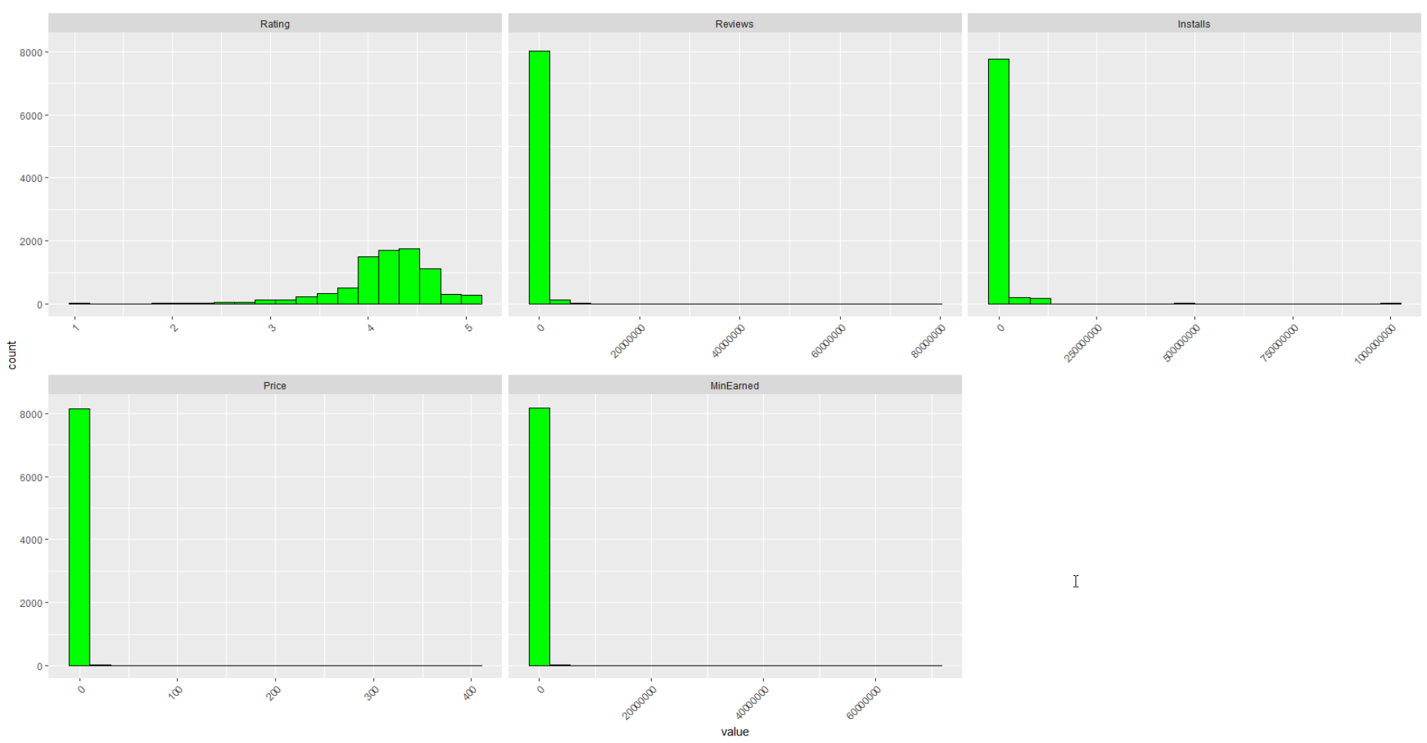
Data Exploration
Histograms of Numeric Data Elements
Notes:
What is this slide showing? What does it tell us?
DRAFT Narration:
Look at iris dataset and Professor’s lecture – extra lecture.

Slide 9
Ratings and Installs
Exploring Ratings and Installs
Notes:
DRAFT Narration:
NOTE:
‘Analysis as Dependent Variables’ make no sense
What other factors influence (raise) ratings and installs (the more installs the more revenue)
The higher the ratings the more installs?

Slide 10
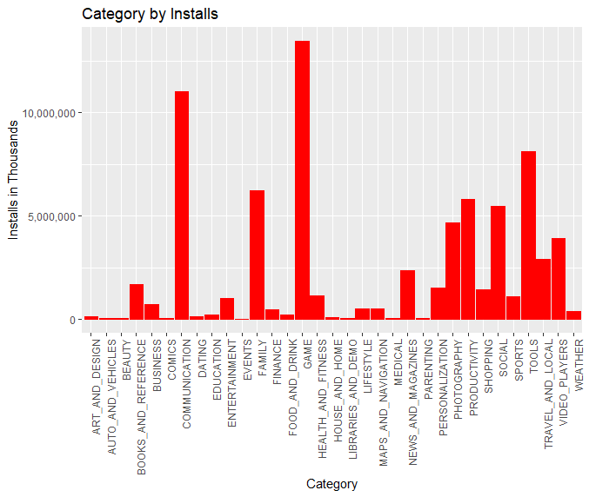
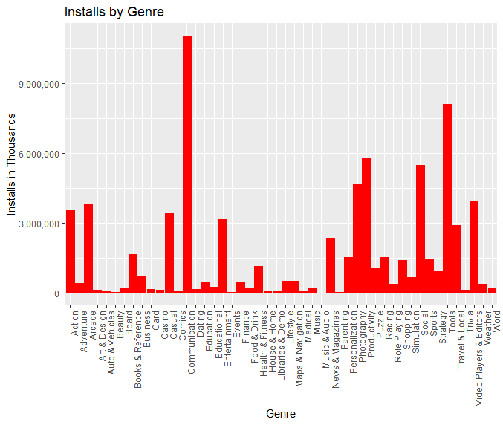
Installs by Category and Genre
By Category: Game, Communication, and Tools
By Genre: Communication, Tools, and Productivity
Notes:
DRAFT Narration:
The highest Installs by Category were in Game, Communication, and Tools while
by Genre were in Communication, Tools, and Productivity.
NOTE: All Categories have Genre that are the same as the Category with the exception of Family and Game Categories.

Slide 11
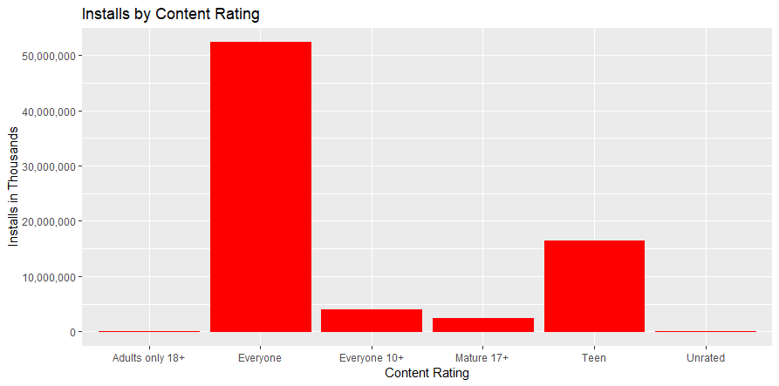
Installs by Content Rating
Apps with the Content Rating ‘Everyone’ had a significantly higher number of Installs than any other Content Rating
Notes:
DRAFT narrative:
Apps with the Content Rating ‘Everyone’ had a significantly higher number of Installs than any other Content Rating.
Other content ratings were Adults Only 18+, Everyone 10+, Mature 17+, Teen, and Unrated.
NOTE:

Slide 12
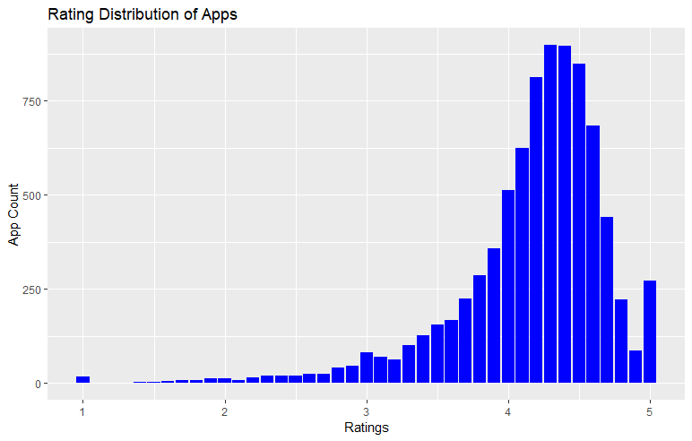
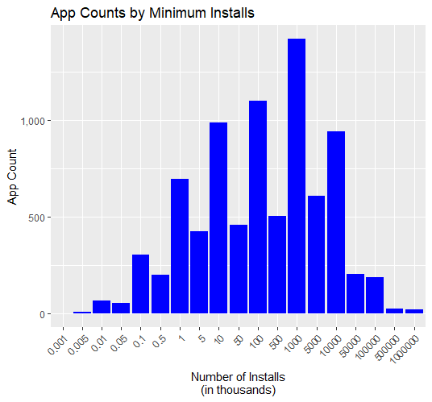
Installs by Average Rating
Average Rating = 4.173
Average Installs = 9,179,208
Notes:
DRAFT Narration:
The is the User Rating
NOTE:
Did the highest rated Apps have the highest rate of installs?
Was there a correlation between rating and installs?
Cannot determine corr between rating and installs.

Slide 13
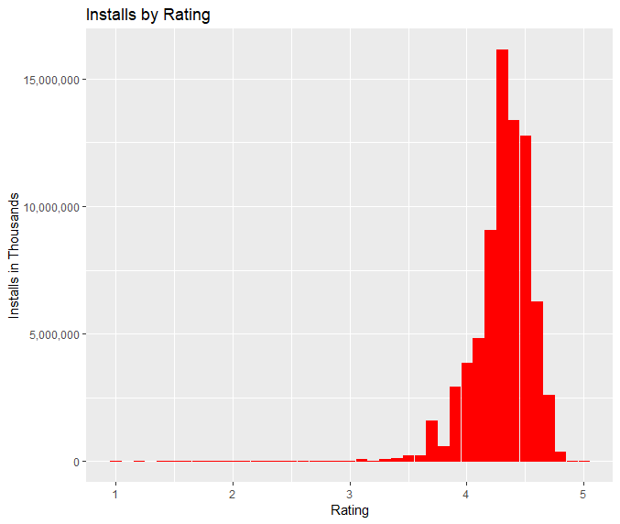
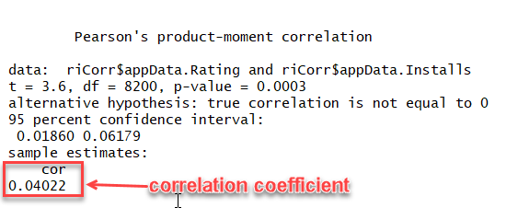
Installs and Rating Correlation
Although the data visualization shows a skewed normalized distribution shape the Pearson Product-Movement correlation test determines a correlation coefficient of .04 -- too low to indicate a correlation between Ratings and Installs.
Notes:
DRAFT Narration:
We were curious if the highest rated Apps had the highest rates of Installs.
Oddly, Rating was not correlated with number of installs.
NOTES:
This result seems strange – should we revisit? It certainly looks like higher rated Apps are Installed more often.

Slide 14
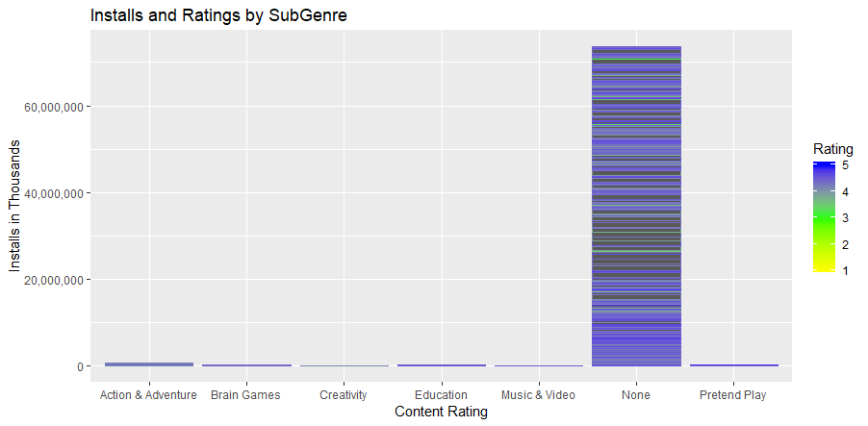
Installs and Ratings with SubGenres
Apps with SubGenres do not have significantly higher Installs or Ratings
Notes:
DRAFT Narrative:
When we examined the field ‘Genres’ in the raw data set we noticed that some records also contained subgenre data in the same field.
We broke the field into a true Genres field and a subgenre field but became curious as to if subgenre was a driver of App installations.
It was found not to be a significant driver and so was dropped from our analysis.
NOTE: Do Rating and Installs differ significantly for Apps with SubGenres?

Slide 15
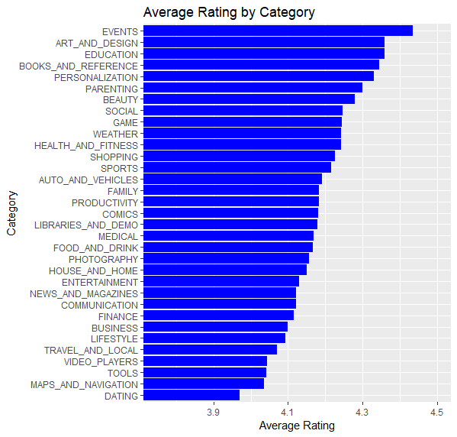
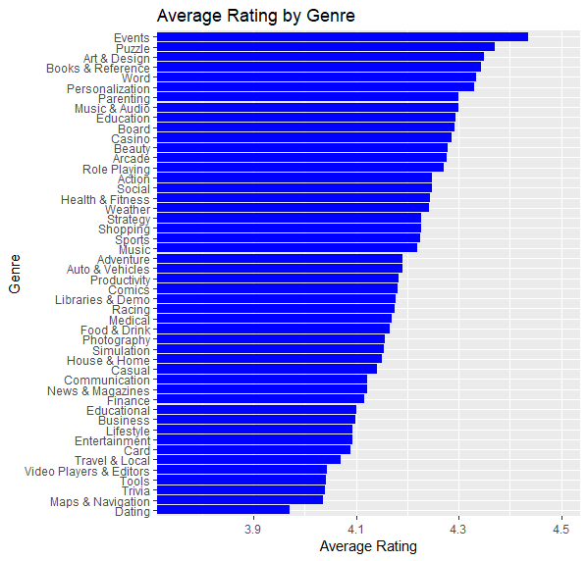
Category and Genre by Rating
Highest Rated Category ‘Events’: mean = 4.436
Highest Rated Genre ‘Events’: mean = 4.436
Notes:
DRAFT Narrative:
We were curious if certain Categories or Genres had consistently higher ratings.
We want to point out that the x-axis has been rescaled to compress values between 0 and 3.75 so that the differences between Category and Genre can be more easily seen.
For min/max values for Category were xxx and xxx for Genre.
NOTE:
Was there a significant difference between the highest rated and the lowest rated in either Category or Genre?

Slide 16
Business Question
Can Revenue be predicted?
Notes:
DRAFT Narrative:
Using the information gathered during data exploration we formulated our Business question – if we were to develop an App which variables will increase the probability of generating a high revenue.
Note:
An ‘in-App purchase’ is a purchase made while the App is running. Many free (and sometimes paid) Apps allow the user to purchase additional elements.
Our dataset does not contain information on in-App purchases, but they may be a significant revenue generator.

Slide 17
Revenue
Analysis of Minimum Amounts Earned Excluding in-App Purchases (Revenue = Minimum Installs * App Price)

Slide 18
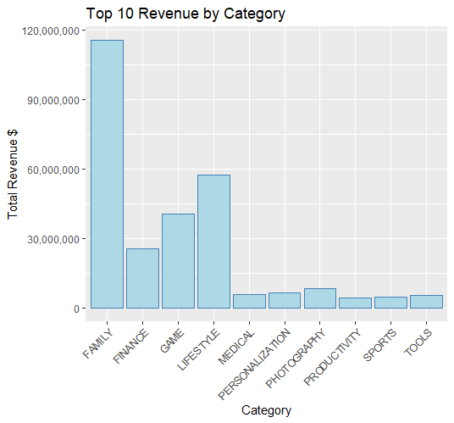
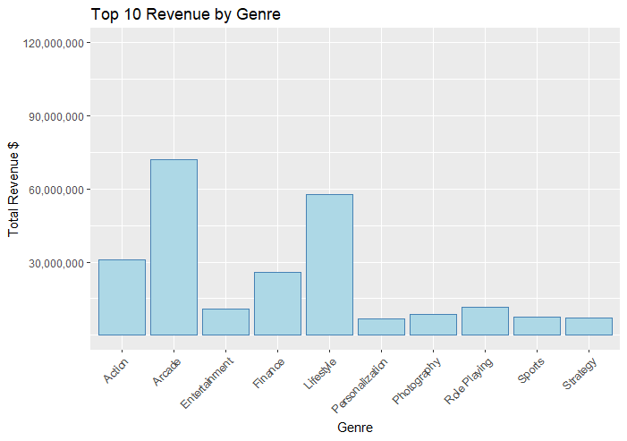
Revenue by Category and Genre
Notes:
DRAFT Narration:
We were interested in the relationships between Category and/or Genre and Revenue.
The Genre field was interesting mirroring Category except when the Category was Family or Game.
The highest earning Category was Family followed by LifeStyle.
Of the Genre Arcade had the highest revenue followed by LifeStyle.
Notice graphs are not scaled to each other – note 60 million mark.
Assumption:
These are paid Apps.
There are two ways an App can generate Revenue – pay to download the App and make purchases while the App is running (in-App purchases).
Revenue by Category and Genre generate the highest Revenue?

Slide 19
Modeling and Algorithms
Random Forest
&
Support Vector Machine
Notes:
DRAFT Narrative:
We became interested in the question -- would we be able to develop a model to predict Revenue (price * Number Of Installs).
randomForest – pick out linear regression or classification worked well with out data set
Install as the dependent variable.

Slide 20
Modeling and Algorithms Used
Random Forest Algorithms
‘randomForest’ Package in RStudio
K-Fold Cross Validation
‘Caret’ Package in RStudio
Support Vector Machine Algorithms (KSVM)
‘kernlab’ Package in RStudio
Radial Basis "Gaussian” kernel
Linear kernel
Polynomial kernel
Notes:
In order to develop our model, we implemented two algorithms, random forest algorithm and support vector machine algorithm. K-fold cross validation is a technique that we used to prevent our model from overfitting. Basically, it divides the data set into number of subsets and runs those subset to test the model repetitively. And the Package we used is Caret.
For the Support Vector Machine Algorithms, we ran three different kernels. We used Gaussian kernel, linear kernel and Polynomial kernel to see if we can get a better model for our dataset.

Slide 21
Data Used for both ML Approaches
'data.frame': 8211 obs. of 10 variables:
$ Category : Factor w/ 33 levels "ART_AND_DESIGN",..: 6 30 7 12 29 30 30 24 24 24 ...
$ Rating : num 3.5 4.5 4.7 3.6 3.2 3.9 4.2 4 4.5 4.4 ...
$ Reviews : num 115 259 573 21433 4 ...
$ Installs : num 10000 10000 10000 1000000 100 500000 1000000 100 1000 5000 ...
$ Type : Factor w/ 2 levels "Free","Paid": 1 1 1 1 1 1 1 2 1 1 ...
$ Price : num 0 0 0 0 0 0 0 0.99 0 0 ...
$ Content_Rating: Factor w/ 6 levels "Adults only 18+",..: 4 2 4 4 2 2 2 2 2 2 ...
$ Genre : Factor w/ 48 levels "Action","Adventure",..: 13 43 14 18 41 43 43 32 32 32 ...
$ SubGenre : Factor w/ 7 levels "Action & Adventure",..: 6 6 6 6 6 6 6 6 6 6 ...
$ SizeCategory : Factor w/ 9 levels "0-1000KB","100001-125000KB",..: 7 1 6 3 7 1 1 3 3 7 ...
Notes:
Datasets used in machine learning analysis must meet certain data requirements, so we transformed our dataset accordingly.
Also this new and clean dataset is used for SVM.

Slide 22
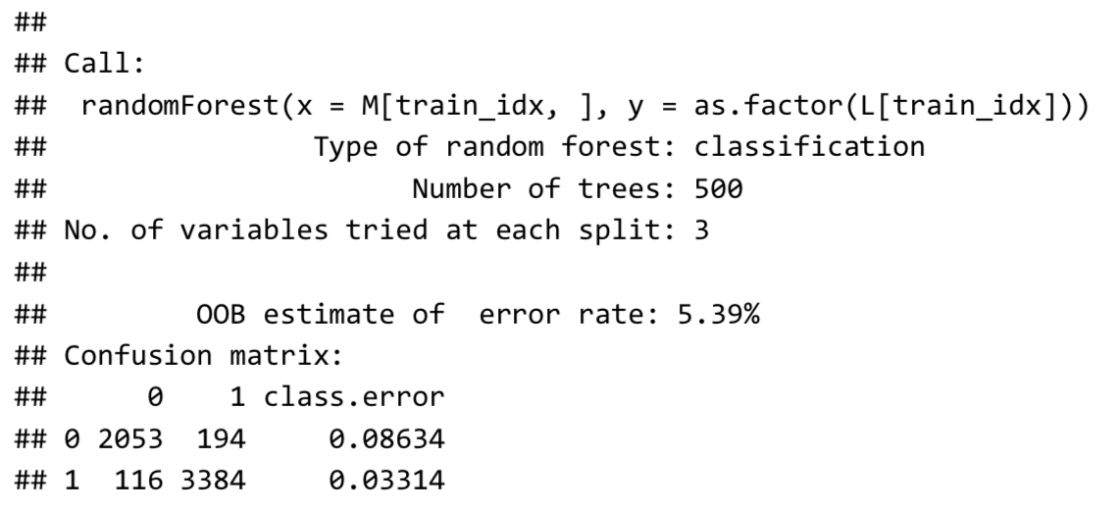
Random Forest
Notes:
After we ran the random forest model, we got a pretty good result. Our random forest model has only 5% of error rate. And we make sure it is not overfitting to our training data by implementing the k-fold cross validation procedure.

Slide 23
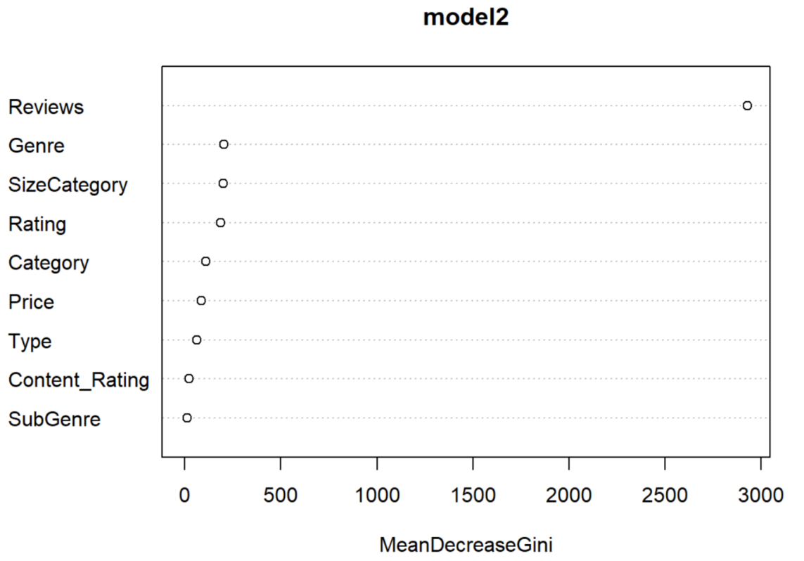
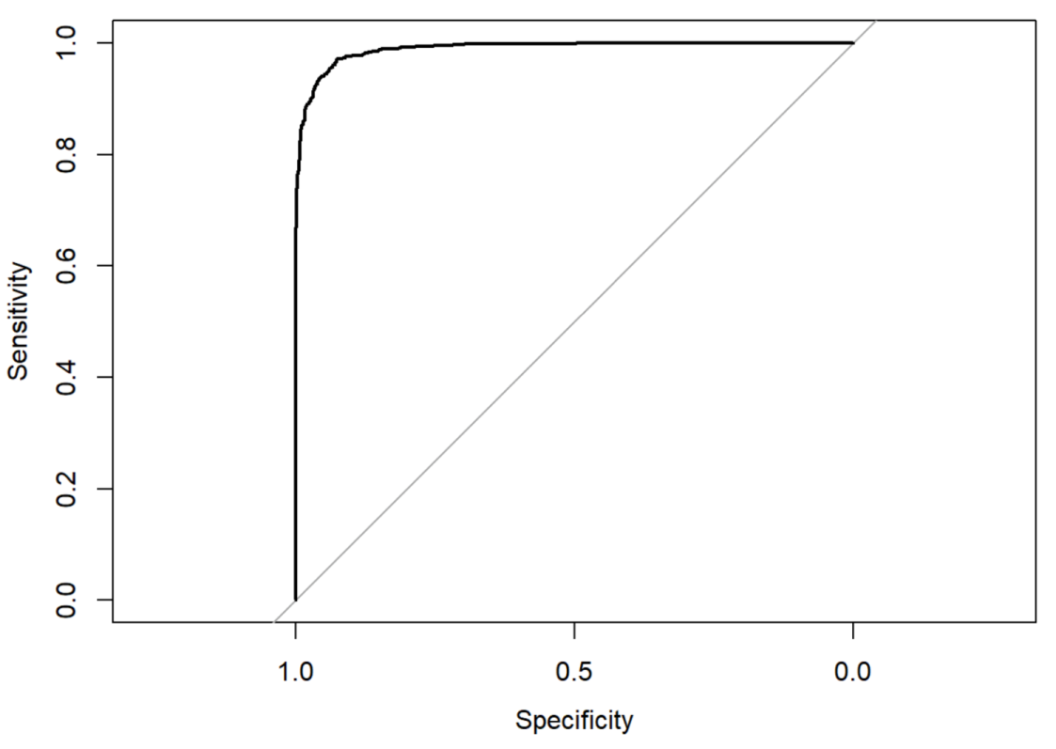
Random Forest
Notes:
So, we further take a look at Importance Plot and ROC plot.
The left graph is showing that which feature is important. Here we can see Reviews is very important to our model.
The right graph shows how good the model is. Here the bold line toward the top left corner shows the indication that this model has a high accuracy rate.
Because we already have considered the overfitting issue and taken the action on it. So, we are satisfied with the performance of the model and moved on to the Support vector machine algorithm.

Slide 24
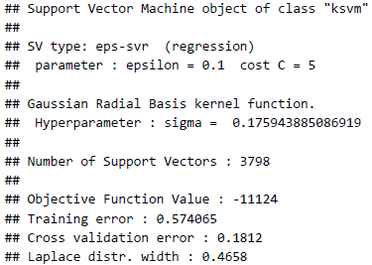
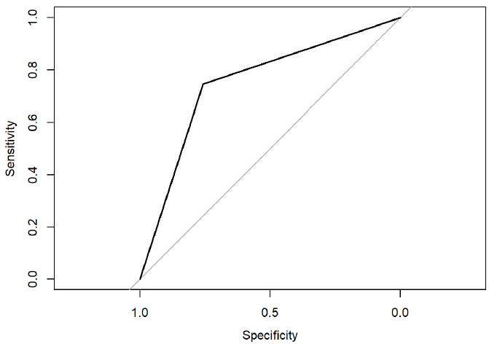

Support Vector Machine (Gaussian Radial Basis)

Slide 25
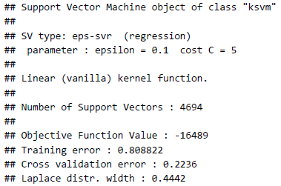
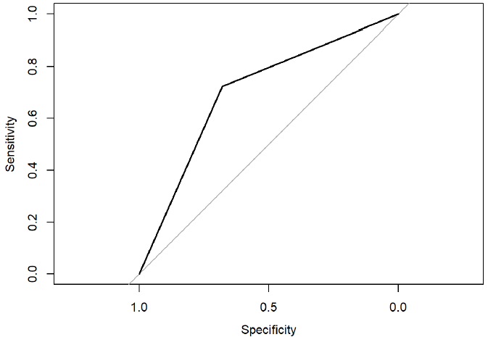

Support Vector Machine (Linear Vanilla)

Slide 26
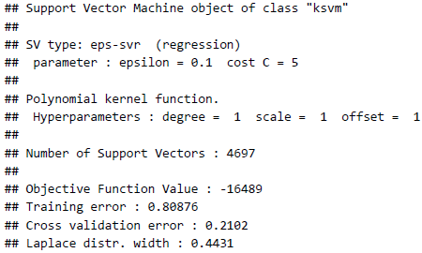
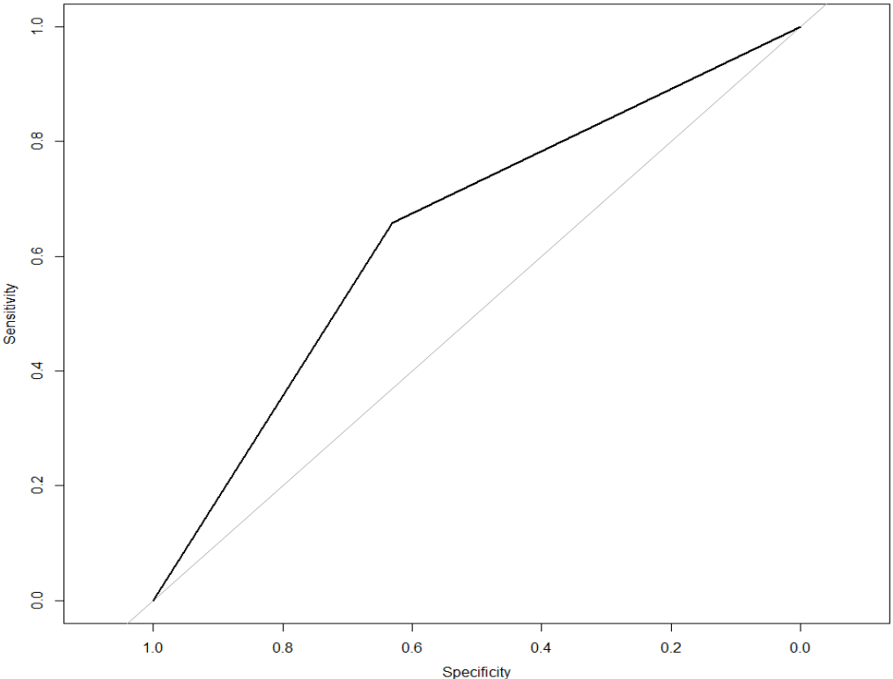
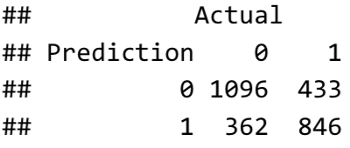
Support Vector Machine (Polynomial)

Slide 27
Actionable Insights
We can predict the probability
with about 95% accuracy
of an App having Installs >= 100,000 and
generating Revenue at download

Slide 28
Next Steps
Data we wish we had –
In-App purchases –
We suspect that in-App purchases are significant revenue generators.
The actual revenue per use may be much higher than the amount the user pays to download the App.
Perhaps a binary available/not available field.
Reviews were difficult to evaluate –
Evaluation was somewhat circular –
Apps must be installed to be reviewed;
Apps with a higher rate of Install will have more Reviews.
Question for consideration –
How close (or far) from the connotation of the classification can an app actually be to benefit from the install effect?

