Slide 1

Improving Your Web Site
December 4, 2000

Slide 2
A common premise
You have a site
You’ve improved it in many ways
  Added info, org or arrangement, graphics
Still not doing all you want it to
  low traffic
  complaints, or too many Q’s still asked
  sponsors losing interest
  site’s grown wild
  other

Slide 3
A common reason
Natural tendency 1: design by intuition
Tendency 2: design for sponsors
Both have some validity
But left out are the most frequent users
A la TV, if don’t satisfy them, nothing else matters

Slide 4
A solution
Redesign, more scientifically
Formally identify your sponsors’ goals
Identify your key audiences
Find out who they are, what they need
Examine your site re: the above
Redesign, keeping good from old site, adding rest to satisfy key audiences, & following usability principles

Slide 5
Class topics
Know your audiences,
know their needs
Evaluate your site
Plan for redesign
Design
  structure
  templates
Test the system
Populate & beyond
Q&A

Slide 6
Know your audience
All good design flows from knowing:
  who you’re trying to serve
  their characteristics
  what they need from you
Knowledge requires learning
Bad example: the old Disney site
Good example: American Council of the Blind (acb.org)

Slide 7
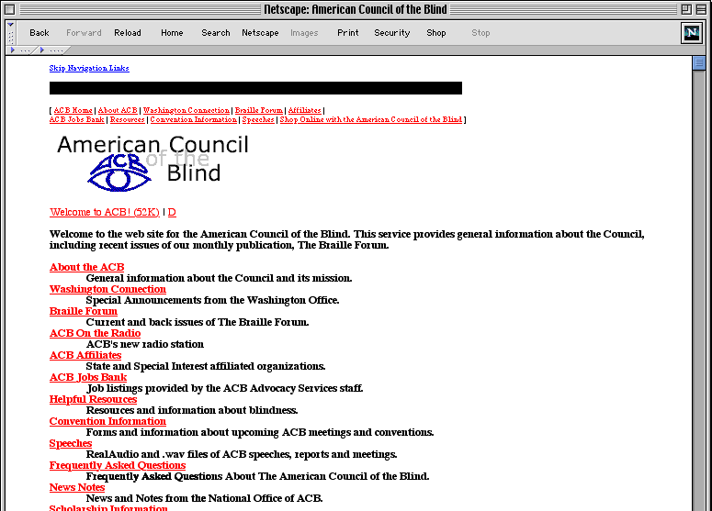

Slide 8
Ways to know your audience
Review logs, with a grain of salt
Interpret any existing feedback
Look at peer orgs’ sites
Identify & prioritize your audiences
Role-play to estimate their info needs
(better) try Usage-Centered design
Reach out and talk to users!

Slide 9
Face-to-face
Bad? news: no substitute for it
  Common sense/intuition are faulty
  Web best practices don’t exist yet
  Audiences will always have unique needs, preferences, knowledge
Good news:
  Our users are easily reachable
  Don’t need a large sample

Slide 10
Some types of interaction
Focus groups & interviews
  hear user requirements, impressions
Essential use cases
  identify usability problems
Intercepts
  test a single aspect of the site
Card sorting
  suggest org methods & labeling solutions
Notes:
Focus groups are here
Testing is great to identify problems
Set benchmarks that can be used to measure later improvement

Slide 11
Focus groups/interviews
~7-10 people or 1-on-1
Time limit: ~1 hour-1:30
Goals: get people talking about
  past experiences with site
  what worked/what didn’t
  what they expect from such a site
  what would be nice to have, ideal, fantastic
Caveat: these are only impressions
Notes:
Trouble because peer pressure may influence opinions, also shy people won’t talk in a group

Slide 12
Essential use cases
1-on-1 observation
~30 minutes each / ~15-30 subjects
Watch person carry out specific tasks
Tends to reveal org, nav, labeling, and info presentation problems
Example: ITweb

Slide 13
Intercepts
1-on-1
Very brief (~3-5 minutes)
Quick way to test one feature of a site
Examples:
  ITweb menus
  Wolverine Access labeling

Slide 14
Card sorting
Can do 1-on-1 or with a group
Stack of 3x5 cards with topics
Person sorts them into groups, then gives each group a label
Good for showing what users call things and how they organize the subjects
Caveat: give thought to setup

Slide 15
Keys to interaction
Research successful methods
Plan the session to get specifically at the things you want to know
Pre-test your methodology
Get a good representation of users
Be careful not to lead answers
At U-M, you’ll need prior approval (IRB)
80% of user frustration results from
20% of the site’s problems

Slide 16
Evaluate your site - how to
Review your test data
Go through feedback
Ask office folks for most frequent Qs
Check logs
  pages w/ key info=most popular?

Slide 17
Evaluate your site - how to 2
Cognitive walkthrough
Storyboard current site
'links to you' - who finds what valuable
(brief!) online survey of limited duration
Then evaluate via following Qs
  (2+ people)

Slide 18
Evaluate your site (sponsors)
Re-examine your business goals
  worksheet is often the best
  give to each sponsor, then collect
  If differences, discuss at meeting
Examine site wrt these goals/priorities
Interview sponsors: perceived success
Have your sponsors’ goals changed since the site was developed?

Slide 19
Evaluate your site (audience)
Since designing the current site:
  Have any key audiences changed?
  Has the priority order changed?
  Have their needs changed?
How well is the current site geared toward your key audiences?

Slide 20
Evaluate your site (info)
Does the info on your current site answer the questions that bring your key audiences to your site?
  What info is underrepresented?
  what info is missing altogether?
  the right mix of your messages and theirs
  TV paradigm 70/30

Slide 21
Evaluate your site (present.)
Is info presented in the best way for them?
  key info prominent
  right language tone
  right knowledge level
  helpful/non-distracting layout/graphics/etc.
  useful, consistent navigation?

Slide 22
Notes to take
Specifically what is not working
  Take down now any immediate ideas on experiments to try to solve the problem
What is working well (to keep)
  Justification: why you assume it is working
If don’t document well, will likely repeat mistakes in redesign
Success indicators - measurables

Slide 23
Plan for redesign (staff)
Ideal vs. real
  charts
  All Media Guide (80+), Apple.com (30+)
If can spend anywhere:
  graphics
  initial testing
  programming
Plan for maintenance

Slide 24
Plan for redesign (time)
Best: under-estimate and over-deliver
70% of time is research
Last 30% is design/testing/population
You won't feel like you're getting anywhere til right near the end
Critical to do steps in the right order

Slide 25
Plan for redesign
Other considerations
  How will you measure success?
  How often should you report/present to sponsors?
  How to set sponsors’ expectations
    6 mos-1 year for success indicators

Slide 26
Design (structure)
Before layout
Just like designing a building
Once structure established, all else flows
If layout first, structure implied/constrained w/o having been given conscious thought
If unsure of users’ idea of best structure, do card sorting

Slide 27
Info architecture
Information architecture involves several aspects of a site:
  Information organization
  Navigation systems
  Labeling systems
Info arch is like electricity; no one notices it unless it isn’t working

Slide 28
Functional types of sites
Shopping sites
Community sites
Entertainment sites
Identity sites
Learning sites
Information sites
Hybrids
Function strongly influences organization of
information and navigation methods
Best to start with a single type and expand

Slide 29
Organization schemes
All sites have a scheme
Alphabetical
Chronological
Geographical
Topical
Task-oriented
Audience-specific
Metaphor-driven
Hybrid
Notes:
• All sites have a scheme
• Many sites use a mixed scheme, and many of these are confusing to users
• Can have multiple schemes on one page, but must be clearly separated
• Common problem: arranging information around your department’s org chart

Slide 30
Org schemes (continued)
When exploring schemes:
  Overcome the urge to arrange by the type of resource or your department’s structure
  Think of your audiences’ information needs
  Think of your audiences’ mindsets
  Make sure all known items fit
  Realize you may need to rework info to fit
  Plan to accommodate future additions
  Prototype schemes and test if possible
Notes:
• ITweb is still tring to overcome its division of help resources by type of resource
• Eventually, it would be better to divide the resources into learning tools and troubleshooting tools, but first have to integrate what would become the troubleshooting info

Slide 31
Types of Org Structure
Hierarchy
  Good for top-level pages
  Broad/shallow vs. narrow/deep
Hypertext
  Good for flexible movement between items
  Not good as a primary structure
Relational database
  Good for giving multiple views of info
Notes:
Besides thinking of ways to categorize the information, you have to think of how the info will be physically structured. How will a user move from one piece of info to another? What method best achieves the site’s mission?

Slide 32
Navigation
Navigation: tools used to keep users on the path to their goals
Successful navigation systems:
  Are appropriate to the site’s purpose
  Support users’ goals and behaviors
  Are easily learned (affordance)
  Are consistently applied

Slide 33
Which nav systems to use?
Types used depend on type of site
For an information site, ask:
General Qs:
  Where am I?
  Where can I go?
  How can I get there?
  How can I get back to where I once was?
Purpose-oriented Qs:
  How do I find the exact info
  I need?
  What if I’m not sure what to look for?
  Will the info be right for me?
  Can I trust this info?

Slide 34
Navigation aids
Global
  Main menus
  Table of contents
  Other indexes
  Search
  “Home” link
Local
  Submenus
Guides
  Guided tour
  Solution center
  FAQs
Related resources
Shortcuts
Context aids
Jumplinks
Hypertext

Slide 35
Navigation aids (continued)
Hypertext
  Drill-down method (overview or immersive)
  Make sure link text is in context, descriptive, & concise
  Embedded links are often overlooked, so
  if important link, separate it from other text

Slide 36
Browser-based aids
Navigational tools built into browser
Not clear that users understand go/history menus, frames, scrolling
  So don’t rely on these
Research supports idea that users are used to the Back button
  So don’t break this convention (via new windows, auto redirects, etc.)

Slide 37
Labeling
Microcontent that represents macrocontent; sets user expectations
Menu items, page titles, headings, links
Due to users’ scanning tendencies, the accuracy of this is critical
Poor labeling has consistently been revealed as a top problem in ITD testing

Slide 38
Labeling tips
Be descriptive rather than cute
Place critical words at beginning
“Talk” in users’ language
  Avoid org-speak unless users really know it
Develop labeling systems, not labels
  Be consistent (verb tense, caps, etc.)
  If metaphor, make sure it works for all info
When have a system, test it with users
Notes:
Talk in user’s language:
If have search function, use search logs to find their terminology

Slide 39
Design (template)
Now is the time for this
Create storyboards to find flow
Think about key audiences for look & feel
Experiment with +1 idea
Remember usability

Slide 40
Usability
BIG caveat: no Web best practices yet
Usability pros are closest to experts
Some global ideas
But many idiosyncrasies of each ‘local’ audience
Use advice only as a starting point

Slide 41
Quick Usability Review
Make templates printable
  tables 530, 100% or no width
Keep colors readable and predictable
  color weakness, consistency
  links, colored text
Optimize graphics/page download
Notes:
• Reading from computer screens is about 25% slower than reading from paper

Slide 42
Quick Usability Review 2
People scan info sites before reading,
  use microcontent well
Write for the Web
  shorter/concise, inverted pyramid
Be careful of using technology
  can't access, don't want to be bothered
Follow ADA guidelines (Bobby)

Slide 43
What to include on front page
Main menu items
Identification
  who group is, site’s purpose
Critical contact info
  phone, email, hours, location
Any info that changes regularly
Shortcuts to top Q’s/info/tools
Teasers

Slide 44
Reducing maintenance
Page templates and coding standards
  Helps daily maintenance and make changing graphic look much easier
Single source often-repeated info
  Via server-side includes, databases, document management systems
Reduce office work and speed service by automating certain processes for users

Slide 45
Test the system yourself
Populate a few use cases, and run through them (cognitive walkthrough)
Have others try walkthrough
  If testing, use office folks as pre-test
Check for consistency
Environment test

Slide 46
Environment Testing
Even at U-M, have a lot of different Web viewing environments
View the site:
  On Mac & Windows (& maybe X Windows)
  Using different versions of browsers
  With monitors set at different resolutions
  In ‘lynx’ (on login.itd.umich.edu)

Slide 47
Populate and beyond
Enlist help with major steps; clean up after
Use opportunity to clean content
  Re-work info that needs to be in different form
  Set up a style guide and implement it
  Validate code, check links/spelling, accuracy and timeliness of info
  Put in place a calendar of such updates
  Prune when warranted

Slide 48
Populate and beyond 2
Cleaning up (continued)
  Redirects for info that’s changed URL
  Explanations for info that’s gone
  Remove “new” signs on info that isn’t new anymore
  Remove ‘under construction’ signs
  “last updated” dates; use “last verified”
Be consistent

Slide 49
Q & A? http://www.umich.edu/~bing/improving2/

