Slide 1

Improving Your Web Site - I
September 27, 2000

Slide 2
We’ve Got a Site; Why Improve?
Having a site is a great first step, but...
Competition (Web site is students’ third criteria for choosing a school)
Good service (even ‘monopoly’ sites can generate ill will if frustrate visitors)
Please internal customers
  bosses & info providers
Reduce maintenance work

Slide 3
A really great site...
Understands its visitors and gives them what they need (not just what the site’s sponsors want them to have)
Makes tasks and info retrieval quicker and easier to do online than by phone or in person
Delights visitors with resources they wanted but hadn’t thought to ask for

Slide 4
A really great site also...
Leaves a great impression on visitors of the group’s competence and caring
Attracts new audiences constantly with new pathways into its growing set of resources
Helps its sponsors achieve their goals
Relieves staff of some mundane work

Slide 5
Ways to Improve a Site
Make sure you’re giving your visitors all that they need
Provide a pleasant experience (2 parts)
(break)
Offer visitors other things they’d likely want
Make sure you’re pleasing your bosses
Attract and keep new audiences
(Q&A)

Slide 6
Give visitors what they need
We should be advocates for our visitors
  they have no one else to look out for them
  they’ll leave if we ignore their needs
We shouldn’t fall into the trap of assuming we know all their needs
  Bad: the original Disney site
  Good: American Council of the Blind

Slide 7
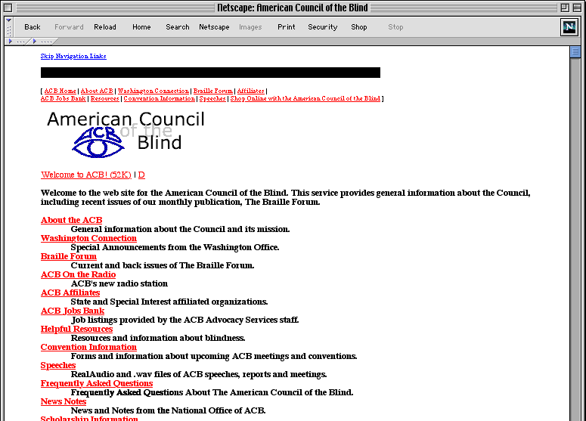

Slide 8
So how do we learn?
Unless test, it’s guesstimation
Identify & prioritize your audiences
Ask your group for common inquiries
Role-play to estimate their needs
Check peer sites
(caveat: your visitors may be unique)
Review logs, with a grain of salt
Try to talk with people who visit the site

Slide 9
Exercise 1:
Guesstimate audiences/needs for
culinary arts department site
(worksheet)

Slide 10
Analyze your content
Does the info you provide answer the questions that bring your key audiences to your site?
  The right mix of your messages and theirs
  TV paradigm 70/30
Is it presented in the best way for them?
  Quick/easy to find?
  key Qs prominent?
  right language tone?
  right knowledge level?
  Helpful/non-distracting layout/graphics/etc.?

Slide 11
Provide a pleasant experience pt.1
Most important: pleasant = efficient
Caveat: No Web best practices yet
Web usability professionals do testing, so are our most accurate sources
The following is based on their findings...

Slide 12
Is it efficient to get to info?
Location of key info within the site
  buried or prominent?
  fix via menus, shortcuts, etc.
Location of info on the page (scrolling)
  fix via moving info, jumplinks
Scannability
  fix via microcontent (headings, links)

Slide 13
Is it efficient to get help?
Site map (at-a-glance)
FAQs (popular; alternate org method)
Search (atomz, Swishgate)
Contact info (human assistance)
Place links to these in consistent places on every page

Slide 14
Is it efficient to download?
Ecommerce shoppers leave after 8 secs.
Rule of thumb: text + graphics files <= 40k
(<=10 seconds over optimal 56k modem)
Easiest fix: limit and optimize graphics
Could be display problems:
  images at top of page
  height/width tags
  chunking long text
  cleaning up html tables, font tags, etc.

Slide 15
Exercise 2:
Optimize graphics on culinary department site’s front page

Slide 16
Is it easy to print out?
Beware if use tables to format pages
Newer browsers fit to print, but not all do, and scaled page can be unreadable
To remedy this:
  Set page width at 530 pixels max
  or
  Set page width at 100%
  or
  Don’t specify a width

Slide 17
Is it efficient to get elsewhere?
Can visitors easily get to sub-areas of the site, and to other related sites?
  Fix by navbars, submenus,
  LSA & U-M links

Slide 18
Can a variety of visitors handle the technology?
Be careful of technology that requires plug-ins, DHTML, Javascript, Java, frames, etc. Some visitors can’t use one or more of these; some just refuse to
Be aware that pages may look very different on Mac vs. PC, in different browsers/versions, on different monitors, and at different screen resolutions; test.

Slide 19
Exercise 3:
Check culinary arts page:
  Efficient to get to key info?
  Efficient to get to help?
  Efficient to download?
  Efficient to get elsewhere?
  Can a variety of users handle the tech?
How to correct?

Slide 20
Provide a pleasant experience pt.2
Less tangible, but still important:
  Issues of look and feel
  Length, knowledge level, and tone of text
  Editing errors

Slide 21
Graphics/layout
Graphics should be:
  Professional (conveying professionalism)
  Appropriate (not excessive or distracting)
  Ideally handled by a Web graphic designer
  Can use stock photos/clip art
  Definitely consult with bosses on graphics
  Layout can be borrowed
  When in doubt, less is much more

Slide 22
Color
Avoid background/text combinations that are hard on the eyes
Use default link colors, unless you know contrast, color-weakness, readability, and detectability issues; then be sure users know which color is visited link
Be consistent in your use of color

Slide 23
Writing for the Web
Research indicates reading is 25% slower onscreen than in print
  so write 50% less text (concise, concise)
Bullet points instead of long prose
Use language familiar to users and appropriate to the tone of the site
Use inverted pyramid style
Rely on drill-down hypertexting

Slide 24
Text Presentation
Use bolding, placement for emphasis
  Avoid color, underlining, italics & <blink>
Take care when specifying font sizes
Can’t choose exact font, but can choose clusters
Consider line length

Slide 25
Neat = trustworthy
Be sure of your content
  Check links regularly
  Check spelling of text and be consistent
  Check accuracy and timeliness of info
  Use “last verified” vs “last updated”
  Put in place a calendar of such updates

Slide 26
Exercise 4:
Check culinary arts page:
  Graphics/layout appropriate, professional?
  Colors ok?
  Text right for the subject, audience, etc.?
  Content seem neat?
What could be improved?

Slide 27
Break

Slide 28
Offer other things your visitors would likely want
After fufilling their needs pleasantly, delighting key audiences is next goal
Goals:
  switch visitor from task to browsing role
  establish a relationship with visitor
  entice visitor to return to site regularly

Slide 29
Where to get content
Get ideas:
  Benchmark (look at peer/related sites)
  Check feedback from visitors
  Check with subject experts
Solicit group members for original content (this is best source)
Ideally, a regular column or stream, but have to be committed to regular work

Slide 30
Where to get content 2
Link lists ‘ok’
  Beware: visitors leaping
  List scope is original
  Items are reviewed (summarized, rated)
  Items are updated and added to frequently
  Visitors are encouraged to suggest items
Tools (Web applications) are great
  often requires programming
  Sometimes free (e.g., discussion tool)

Slide 31
Where to get content 3
Add human touch to site
  photos of real people
  virtual tours (very popular)
  ‘guides’
    maybe a student with photo, bio, and an invitation to contact her/him with questions
    maybe a staff member; “Ask Jim”
  Web log; shows regular activity
  sign up for e-mail synopsis of newsletter

Slide 32
Exercise 5:
Go to Web search for a couple minutes
  Try to find good resources for culinary site
Suggest some our staff might develop
Place on site
(but keep subordinate to key info)

Slide 33
Please your boss(es)
This is not really so low on priority list
  If you achieve previous improvements, will go a long way to achieve these
Bosses’ voices will most often be louder than visitors
Bosses are very important customers, but have to balance with needs of visitors

Slide 34
Improvements: the boss’ view
Helping to achieve their direct goals
  increased interest in group
  positive feedback
  increased application for academic programs
  better touch with alumni
  etc.

Slide 35
Improvements: the boss’ view 2
Enhancing staff efficiency
  Simplifying site maintenance
  Online tools (e.g., business card ordering)
  Fewer e-mails/calls for mundane requests
Getting their messages out more efficiently and to more people
  30/70 rule of TV

Slide 36
Improvements: the boss’ view 3
Idiosyncrasies & office politics
  “I like blue”, “List Tim first”
  some is unavoidable
  can mitigate some with hard data
    educate them, then please those educated folks
  keep them interested in/supportive of site
    Clarify goals/expectations; find ways to measure them
    Regular, brief reports (logs, inquiries, milestones)
    Ask opinions where flexible (steering group?)

Slide 37
Attract new audiences
Visitors with disabilities are the most important of these
Some folks need help to access our site
  graphics can’t be seen by blind users,
  text readers have problems with frames and some tables, etc.
We have a legal responsibility

Slide 38
The need to respond
ADA now applies to gov’t Web sites
AOL lawsuit highlights new attitude
Study: many U-M sites not compliant
Good news: fairly easy to meet needs and gain a new audience

Slide 39
How can I check my site?
Run Bobby
What kinds of things might I find wrong?
  Lack of alt attributes in image tags
  Incomplete imagemap coding
  Questionable table structure
  Lack of alternatives to non-standard technology (e.g., noframes or noscript)
  Check it out: http://www.cast.org/bobby

Slide 40
Other audiences
Try identifying secondary audiences and their needs
Some audiences’ needs will have been met when you created the delighters for main audience.
  now you just need to promote to these other audiences...

Slide 41
Promoting your site
Meta tags
Submit to search engines/directories
Contact sites they might visit to let that site know you exist
Try exchanging links (we’ll link if you do)
The more links to you, the better (exponential return in traffic)

Slide 42
Exercise 6:
Review new culinary arts page vs. old
Other ideas for improvement?

Slide 43
Q & A? http://www.umich.edu/~bing/improving1

