Slide 1
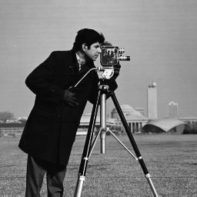
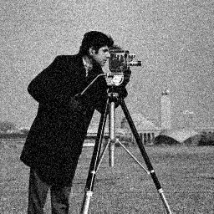
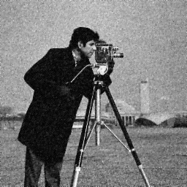


GD
Original image
Noised image
Iteration 1
Iteration 10
Iteration 100

Slide 2



nesterov
Original image
Noised image
Iteration 1
Iteration 10
Iteration 100

Slide 3






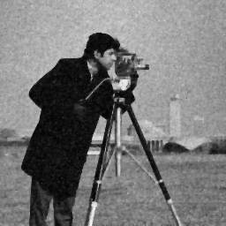
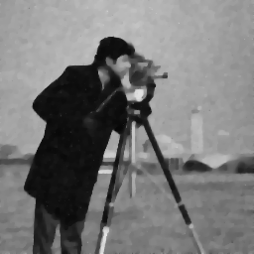

Stochastic, lambda = 0.9
S=16
S=8
Original image
Noised image
S=4
Iteration 1
Iteration 10
Iteration 100

