Slide 1
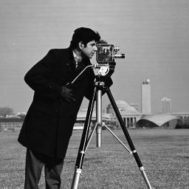
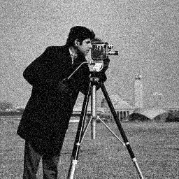
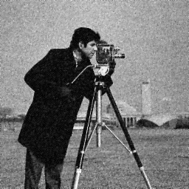


GD
Original image
Noised image
Iteration 1
Iteration 10
Iteration 100

Slide 2



nesterov
Original image
Noised image
Iteration 1
Iteration 10
Iteration 100

