Slide 1
VE230 Mid2 Review Class
Shangquan

Slide 2
Announcement
Exam Time & Place: 2018/12/10, Mon. 10:00-12:00 Dong Xia Yuan 215
Cheating Sheet: May not be allowed
Calculator: May not be helpful
Topics: All.
Review Materials: Slides, Books, HWs, Quizes, etc.
Big Office Hour: 12/9, Sun. 18:20-20:00 326E JI Building
Paper checking for Mid2: After this review

Slide 3
Concept
Maxwell equations
Faraday’s law
EMF
Lenz law

Slide 4
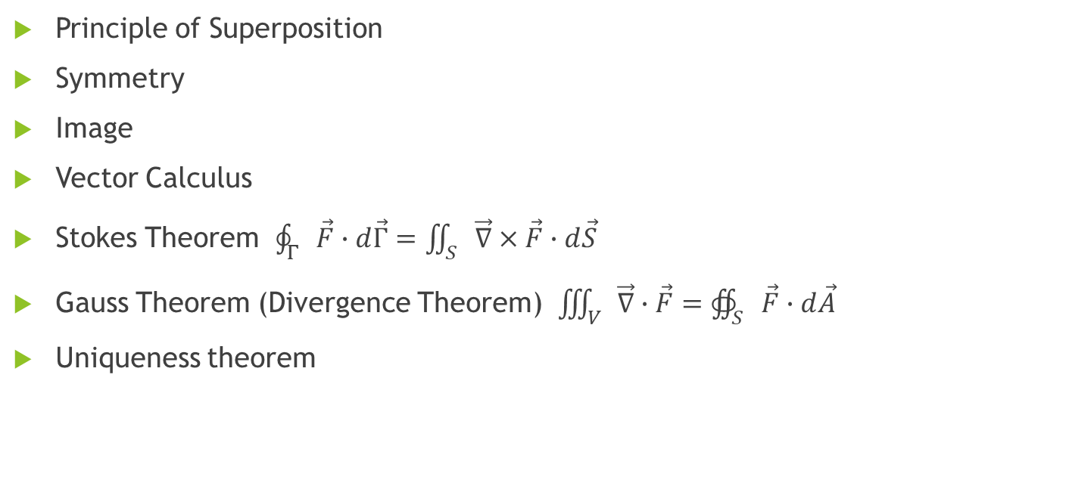
Tools & Methods
Principle of Superposition
Symmetry
Image
Vector Calculus
Stokes Theorem $\oint_{Γ}{\vec{F}∙ⅆ\vec{Γ}=\iint_{S}{\vec{∇}×\vec{F}∙ⅆ\vec{S}}}$
Gauss Theorem (Divergence Theorem) $\iiint_{V}{\vec{∇}∙\vec{F}=∯_{S}{\vec{F}∙ⅆ\vec{A}}}$
Uniqueness theorem

Slide 5
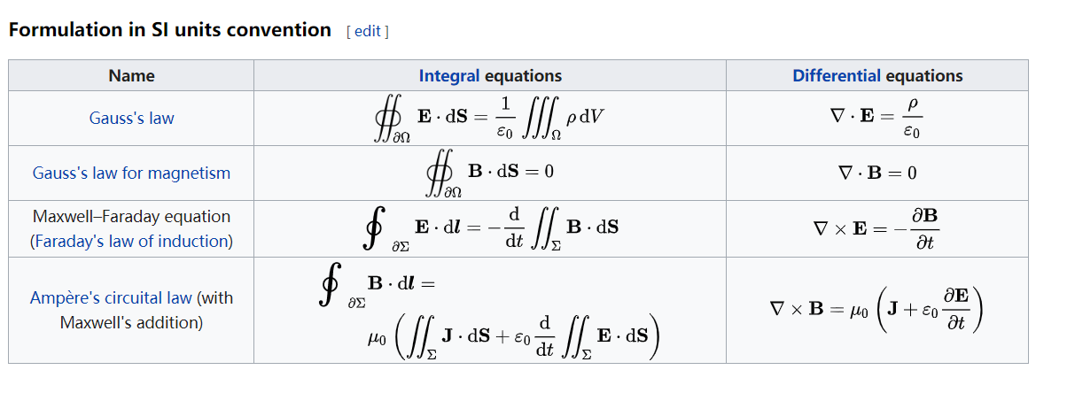
Maxwell Equations
From Wikipedia: https://en.wikipedia.org/wiki/Maxwell%27s_equations

Slide 6
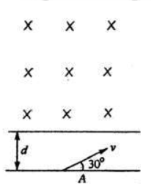
Exercise (moving in B)
There is magnetic field in the upper half of the space. At distance d below the edge, there is a particle with m and +q moving with speed v as shown in figure. Give that after a period of time, the particle will come back to the position A, please
Find v
Find the time t.

Slide 7
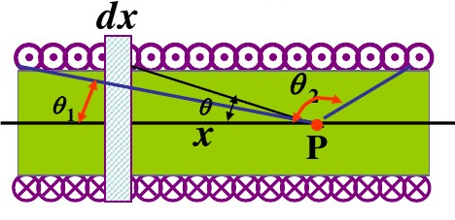
Exercise (B from I)
1. Find the magnetic field at a point P in a solenoid.
2. How about the solenoid is infinitely long. (Also try
Ampere’s circuital law)

Slide 8
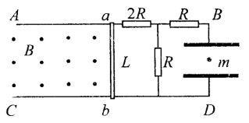
Exercise (EMF)
The system is shown as the figure. There is B in the left half of the region. There is a particle m between the capacitor.
1. When ab is moving at v0 towards left, the particle is still. Find its charge q.
2. If ab is initially still and start moving with acceleration a1, find the particle’s acceleration of different time.

Slide 9
