Slide 1
VE370 RC6
VE370 TA Group

Slide 2
Lecture Recap
Control Hazard

Slide 3
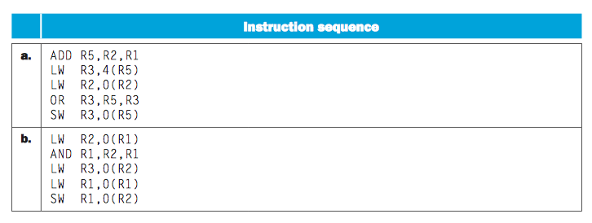
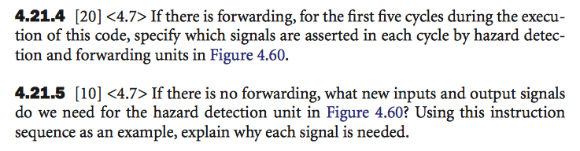
HW 4.21

Slide 4
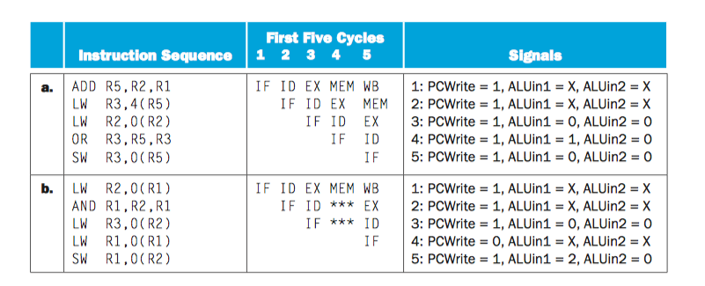
4.21.4
PCWrite
=IF/IDWrite
=~ID/EXZero

Slide 5
4.21.5
Additional Inputs:
register Rd from the ID/EX pipeline register
the output number of the output register from the EX/MEM pipeline register.
No additional outputs are needed. We can stall the pipeline using the three output signals that we already have.
Text explanation: The instruction that is currently in the ID stage needs to be stalled if it depends on a value produced by the instruction in the EX or the instruction in the MEM stage. So we need to check the destination register of these two instructions. For the instruction in the EX stage, we need to check Rd for R-type instructions and Rd for loads. For the instruction in the MEM stage, the destination register is already selected (by the Mux in the EX stage) so we need to check that register number (this is the bottommost output of the EX/MEM pipeline register). The additional inputs to the hazard detection unit are register Rd from the ID/EX pipeline register and the output number of the output register from the EX/MEM pipeline register. The Rt ﬁeld from the ID/EX register is already an input of the hazard detection unit in Figure 4.60.
No additional outputs are needed. We can stall the pipeline using the three output signals that we already have.

Slide 6
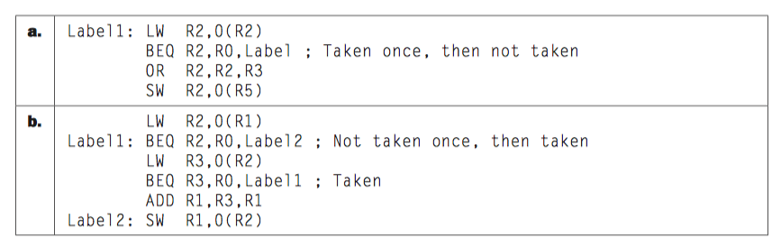
4.22

Slide 7
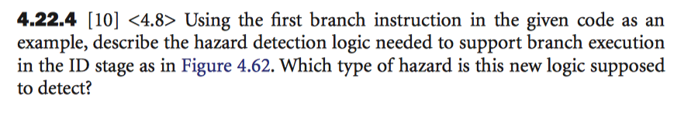
4.22.4
Dependent of former instruction -> need the instruction from previously calculated -> ID stage while previous one not finished calculating -> STALL!
Similar for load strategy.
Text explanation: The hazard detection logic must detect situations when the branch depends on the result of the previous R-type instruction, or on the result of two previous loads. When the branch uses the values of its register operands in its ID stage, the R-type instruction’s result is still being generated in the EX stage. Thus we must stall the processor and repeat the ID stage of the branch in the next cycle. Similarly, if the branch depends on a load that immediately precedes it, the result of the load is only generated two cycles after the branch enters the ID stage, so we must stall the branch for two cycles. Finally, if the branch depends on a load that is the second-previous instruction, the load is completing its MEM stage when the branch is in its ID stage, so we must stall the branch for one cycle. In all three cases, the hazard is a data hazard.
Note that in all three cases we assume that the values of preceding instructions are forwarded to the ID stage of the branch if possible.

Slide 8
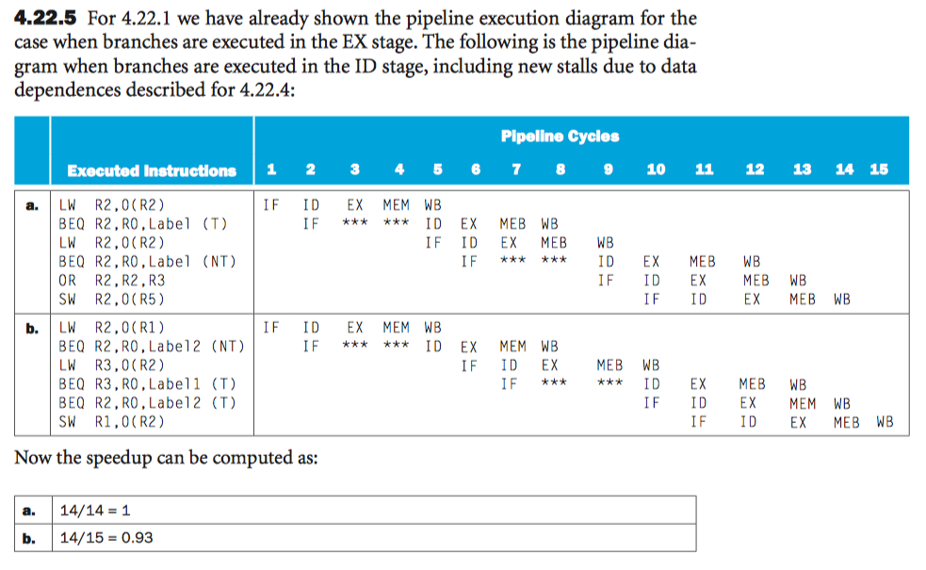
4.22.5

Slide 9
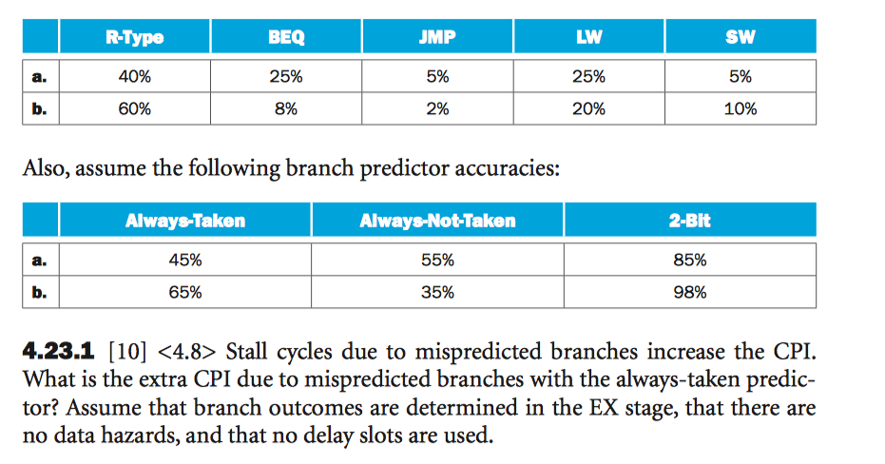
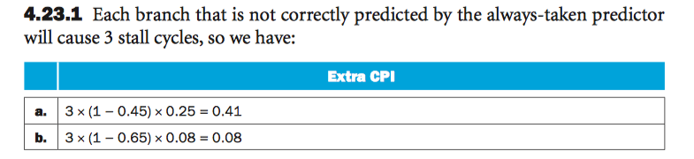
4.23
Answer:

Slide 10
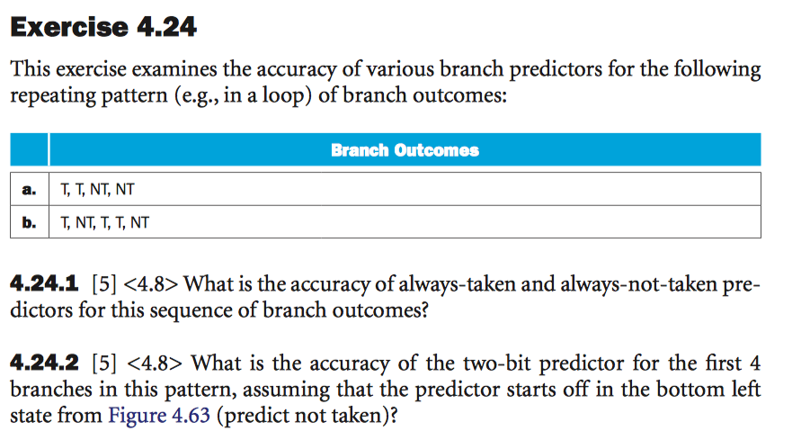
4.24

Slide 11
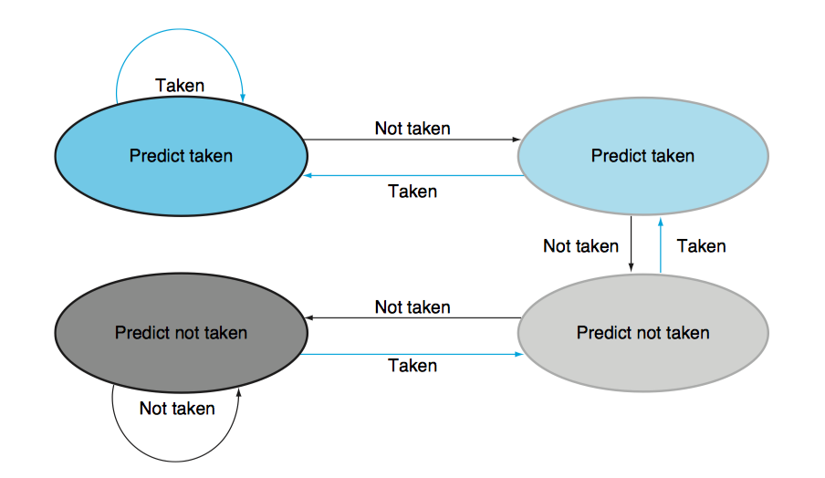
4.24

Slide 12
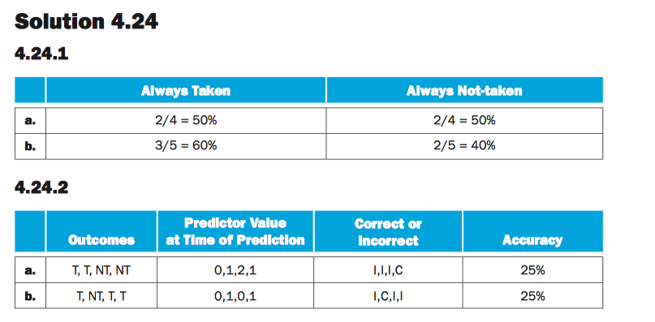
4.24

Slide 13
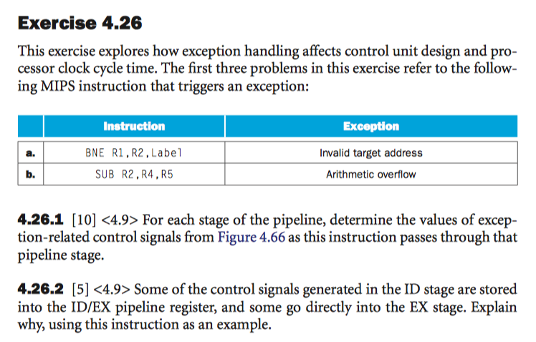
4.26

Slide 14
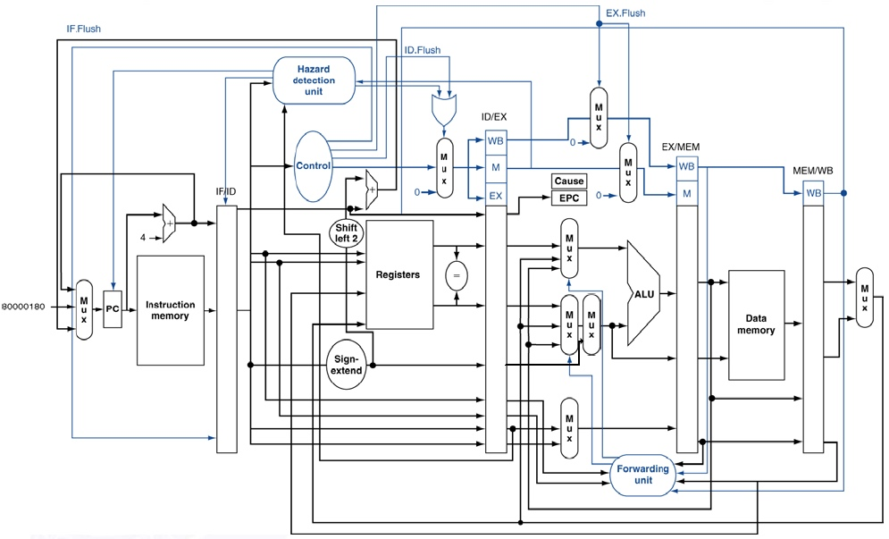
4.26

Slide 15
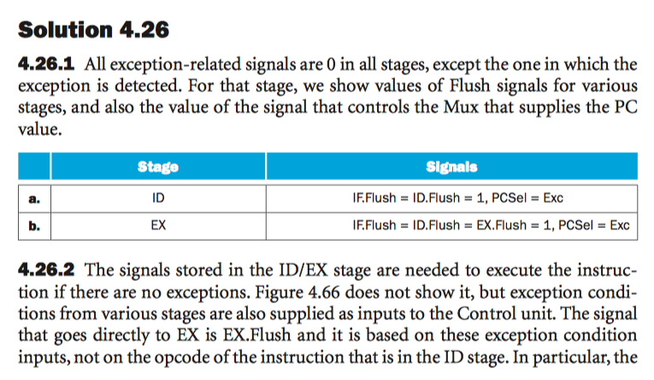

Slide 16
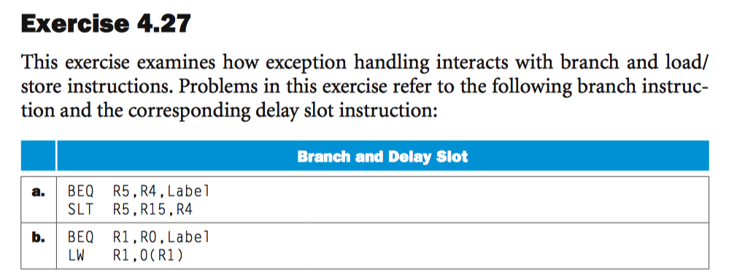
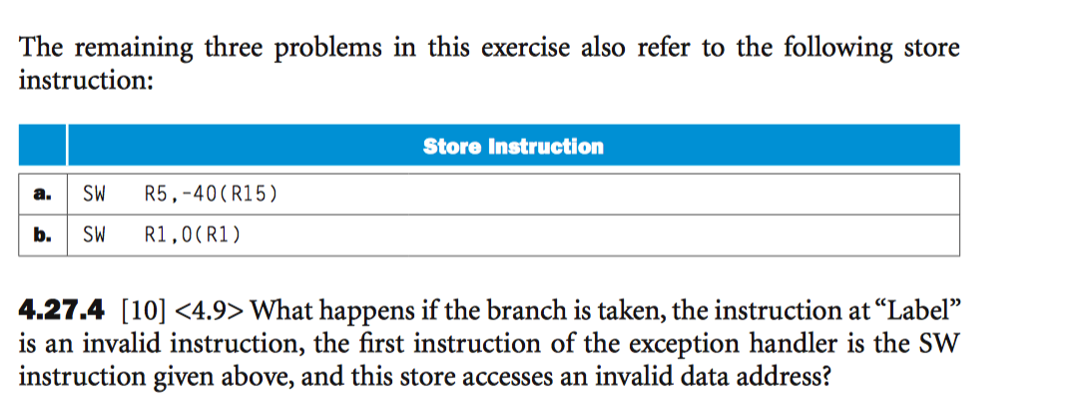
4.27

Slide 17
4.27.4
The processor cancels the store instruction and other instructions (from the “Invalid instruction” exception handler) fetched after it,
then begins fetching instructions from the invalid data address handler. A major problem here is that the new exception sets the EPC to the instruction address in the “Invalid instruction” handler, overwriting the EPC value that was already there (address for continuing the program). If the invalid data address handler repairs the problem and attempts to continue the program, the “Invalid instruction” handler will be executed. However, if it manages to repair the problem and wants to continue the program, the EPC is incorrect (it was overwritten before it could be saved). This is the reason why exception handlers must be written carefully to avoid triggering exceptions themselves, at least until they have safely saved the EPC.

