Slide 1
VE370 RC1

Slide 2
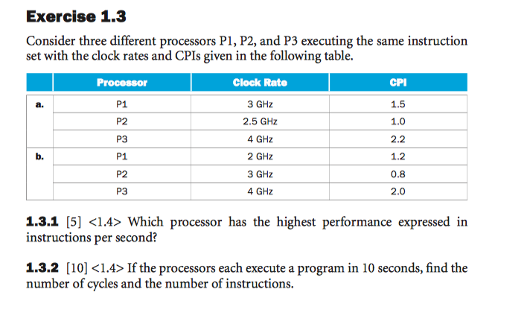


Slide 3
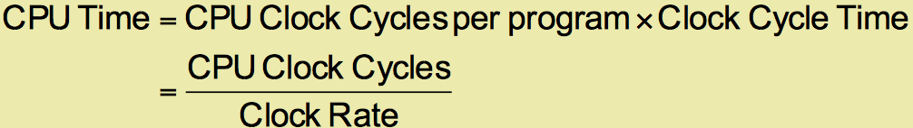
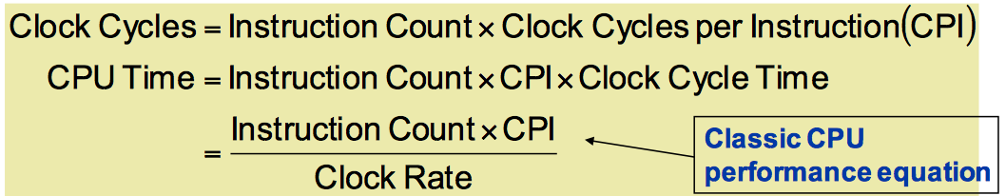
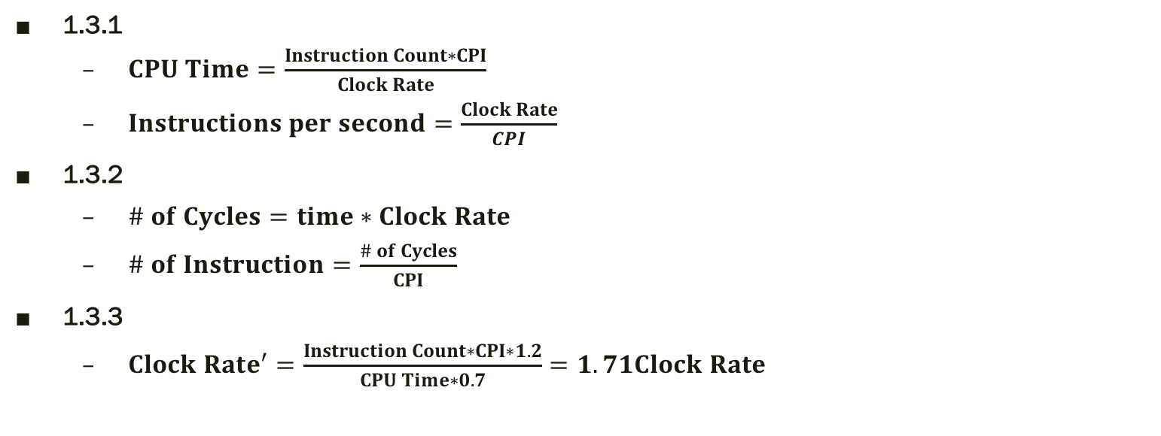
1.3.1
$CPU Time=\frac{Instruction Count∗CPI}{Clock Rate}$
$Instructions per second=\frac{Clock Rate}{CPI}$
1.3.2
$\# of Cycles=time∗Clock Rate$
$\# of Instruction=\frac{\# of Cycles}{CPI}$
1.3.3
$Clock Rate^{′}=\frac{Instruction Count∗CPI∗1.2}{CPU Time∗0.7}=1.71Clock Rate$

Slide 4
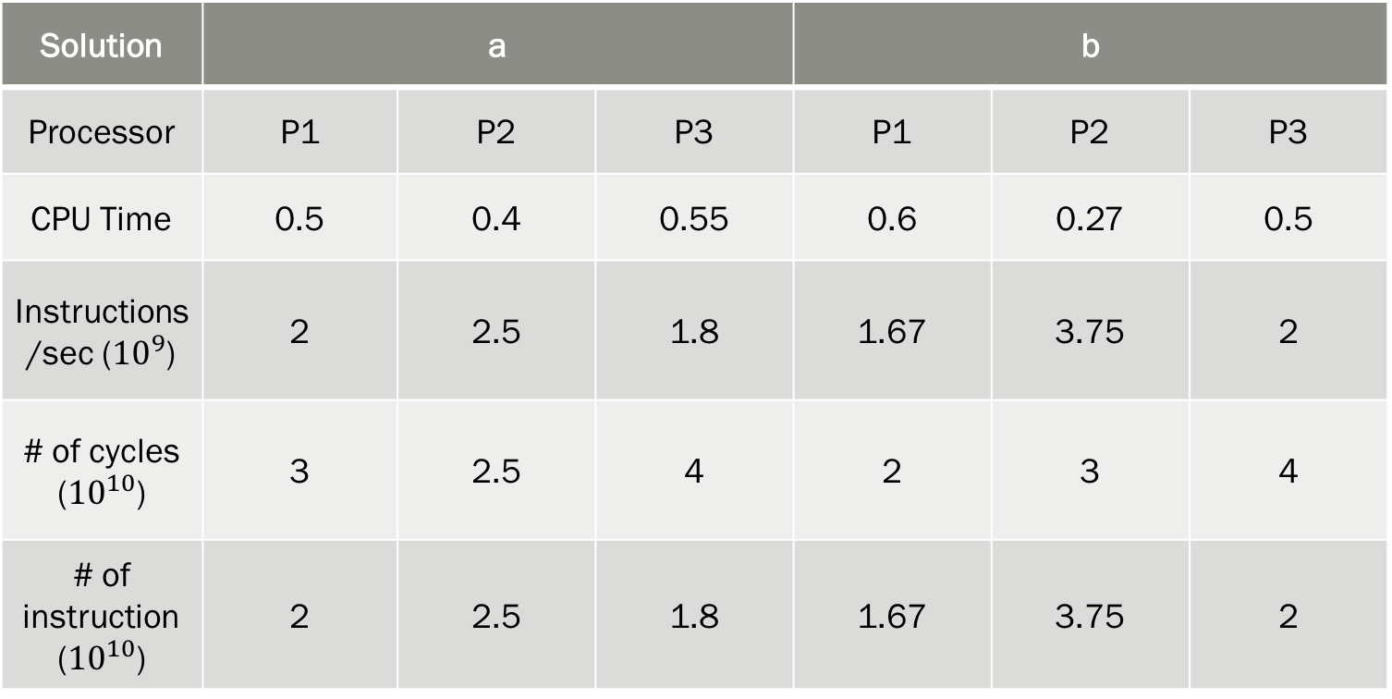
Solution | a |  |  | b
Processor | P1 | P2 | P3 | P1 | P2 | P3
CPU Time | 0.5 | 0.4 | 0.55 | 0.6 | 0.27 | 0.5
Instructions/sec (${10}^{9}$) | 2 | 2.5 | 1.8 | 1.67 | 3.75 | 2
# of cycles (${10}^{10}$) | 3 | 2.5 | 4 | 2 | 3 | 4
# of instruction (${10}^{10}$) | 2 | 2.5 | 1.8 | 1.67 | 3.75 | 2

Slide 5
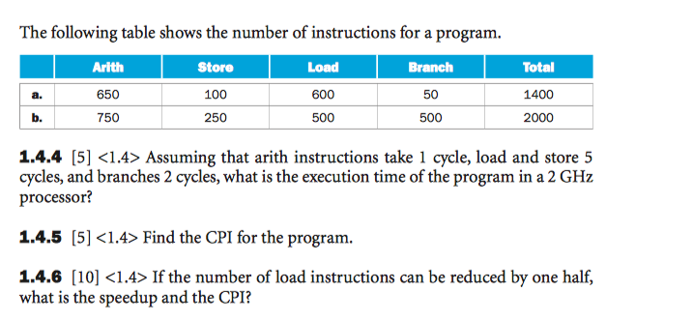
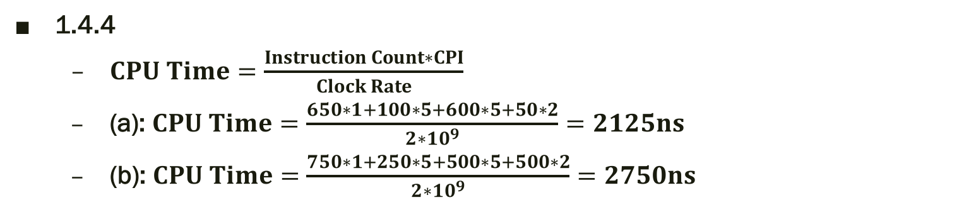
1.4.4
$CPU Time=\frac{Instruction Count∗CPI}{Clock Rate}$
(a): $CPU Time=\frac{650∗1+100∗5+600∗5+50∗2}{2∗10^{9}}=2125ns$
(b): $CPU Time=\frac{750∗1+250∗5+500∗5+500∗2}{2∗10^{9}}=2750ns$

Slide 6
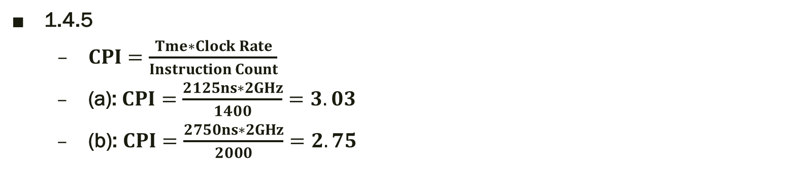
1.4.5
$CPI=\frac{Tme∗Clock Rate}{Instruction Count}$
(a):$CPI=\frac{2125ns∗2GHz}{1400}=3.03$
(b): $CPI=\frac{2750ns∗2GHz}{2000}=2.75$

Slide 7

1.4.6
(a):
$CPU Time=\frac{650∗1+100∗5+300∗5+50∗2}{2∗10^{9}}=1375ns$
$Speed−up=\frac{2125}{1375}$
$CPI=\frac{1375ns∗2GHz}{1100}$
(b):
$CPU Time=\frac{750∗1+250∗5+250∗5+500∗2}{2∗10^{9}}=2125ns$
$Speed−up=\frac{2750}{2125}$
$CPI=\frac{2125ns∗2GHz}{1720}$

Slide 8
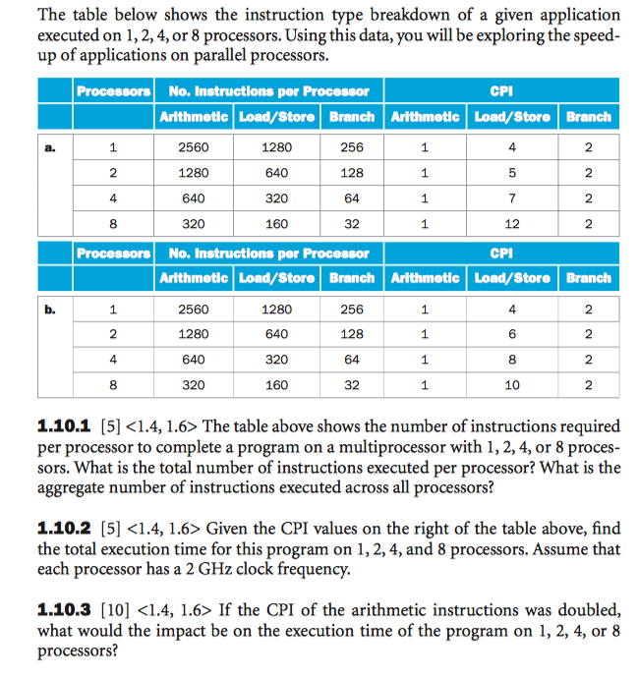
1.10.1
Take the 8 processors as an example
# of instructions per processors=320+160+32=512
Total number of instructions=512*8
processor | # of instructions per processors | Aggregate # of instructions
1 | 4096 | 4096
2 | 2048 | 4096
4 | 1024 | 4096
8 | 512 | 4096

Slide 9
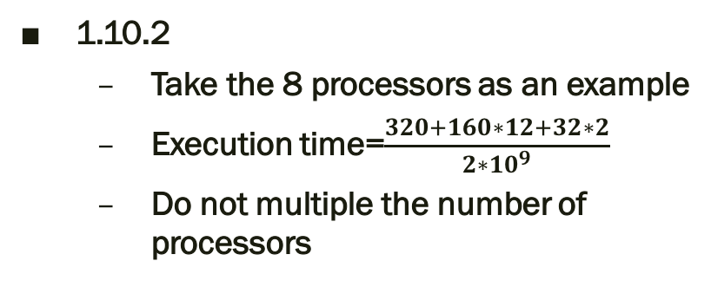

1.10.2
Take the 8 processors as an example
Execution time=$\frac{320+160∗12+32∗2}{2∗10^{9}}$
Do not multiple the number of processors
a | processors | Execution time (ns)
 | 1 | 4096
 | 2 | 2368
 | 4 | 1505
 | 8 | 1152
b | processors | Execution time (ns)
 | 1 | 4096
 | 2 | 2688
 | 4 | 1664
 | 8 | 992
1.10.3
Execution time=$\frac{320∗2+160∗12+32∗2}{2∗10^{9}}$

Slide 10
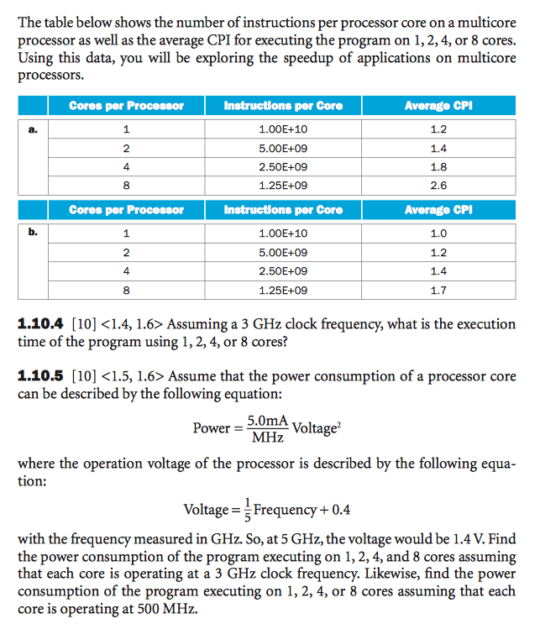
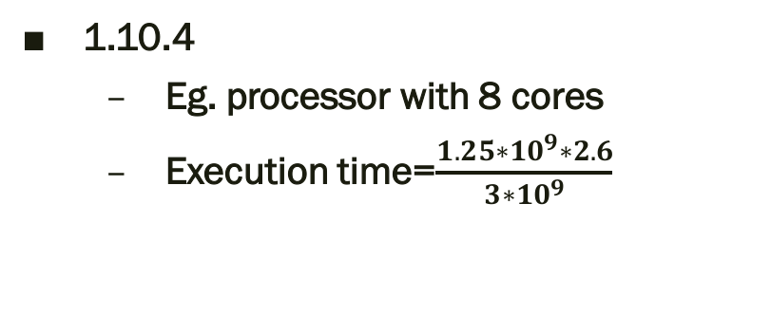
1.10.4
Eg. processor with 8 cores
Execution time=$\frac{1.25∗10^{9}∗2.6}{3∗10^{9}}$
a | Cores per processor | Execution time (s)
 | 1 | 4
 | 2 | 2.33
 | 4 | 1.5
 | 8 | 1.08
b | Cores per processor | Execution time (s)
 | 1 | 3.3
 | 2 | 2
 | 4 | 1.17
 | 8 | 0.71

Slide 11
1.10.5
3GHz: Voltage=1V
500MHz: Voltage=0.5V
a | Cores per processor | Power (3GHz) | Power (500MHz)
 | 1 | 5 | 1.25
 | 2 | 10 | 2.5
 | 4 | 20 | 5
 | 8 | 40 | 10

Slide 12
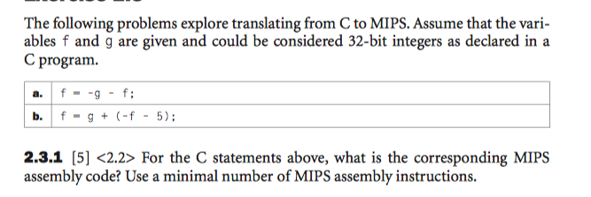
Assume f as $s0, g as $s1
(a)
sub $t0, $0, $s1 temp= -g
sub $s0, $t0, $s0 f= temp -g
(b)
addi $t0, $s0, 5 temp=f+5
sub $s0, $s1, $t0 f=g-temp

Slide 13
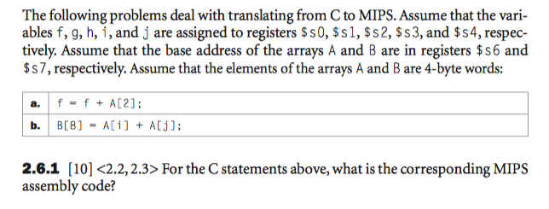
(a)
lw $t0, 8($s6) temp=A[2] load the content of A[2]
add $s0, $s0, $t0 f=f+temp f=f+A[2]
(b)
sll $t0, $s3, 2 temp0=i*4 get the offset of A[i]
add $t0, $t0, $s6 temp0+=A get the address of A[i]
sll $t1, $s4, 2 temp1=j*4 get the offset of A[j]
add $t1, $t1, $s6 temp1+=A get the address of A[j]
lw $t2, 0($t0) temp2=A[i] load the content of A[i]
lw $t3, 0($t1) temp3=A[j] load the content of A[j]
Add $t4, $t2, $t3 temp4=A[i]+A[j]
sw $t4, 32($s7) B[8]=A[i]+A[j] store the content back to B[8]

Slide 14
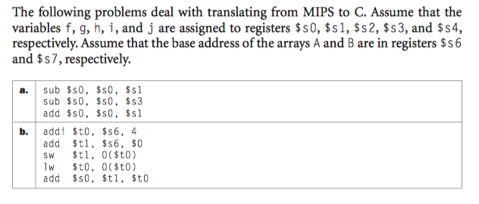

$s0=f - g;
$s0=f – g - i;
$s0=f - g – i + g;
$t0=address of A[1];
$t1=base address of A;
A[1]=address of A[0];
$t0=address of A[0];
f=base address of A + base address of A
(a)
f=f-i;
(b)
f=2A;

Slide 15
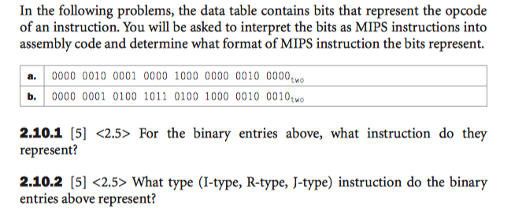
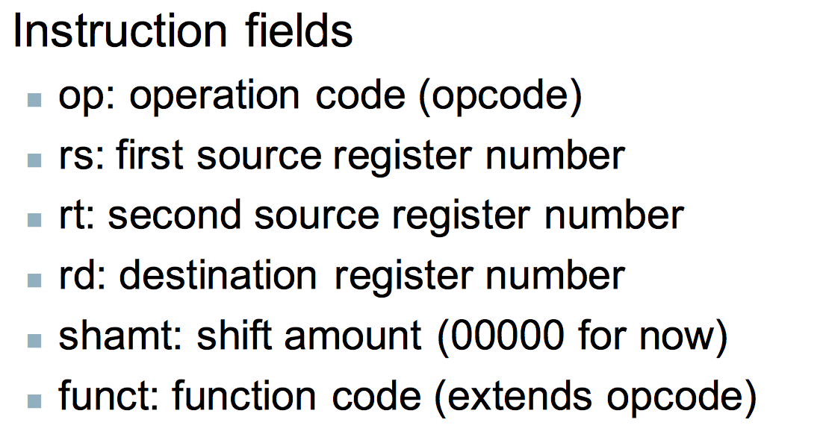
2.10.1 & 2.10.2
(a) add $s0, $s0, $s0 --------R-type
(b) sub $t1, $t2, $t3 ----------R-type
op | rs | rt | rd | shamt | func
000000 | 10000 | 10000 | 10000 | 00000 | 100000
0 | 16 | 16 | 16 | 0 | 32
op | rs | rt | rd | shamt | func
000000 | 01010 | 01011 | 01001 | 00000 | 100010
0 | 10 | 11 | 9 | 0 | 34

Slide 16
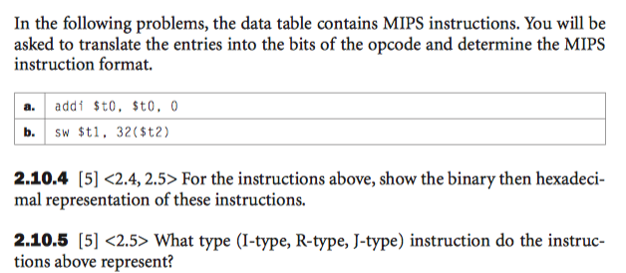
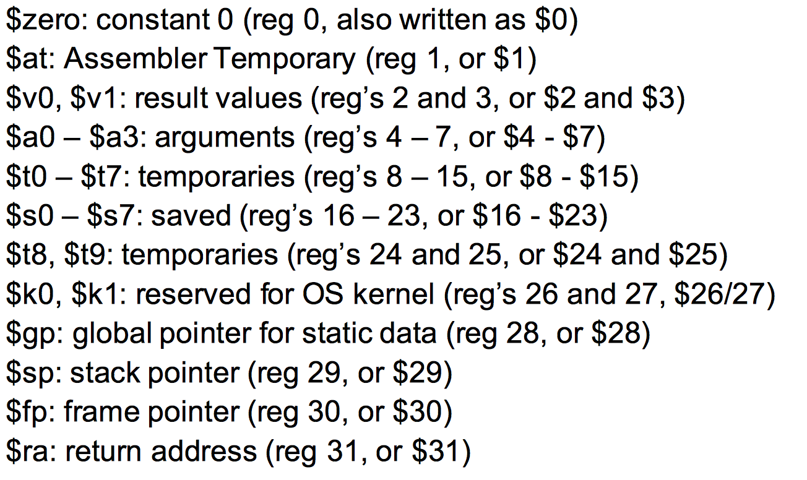
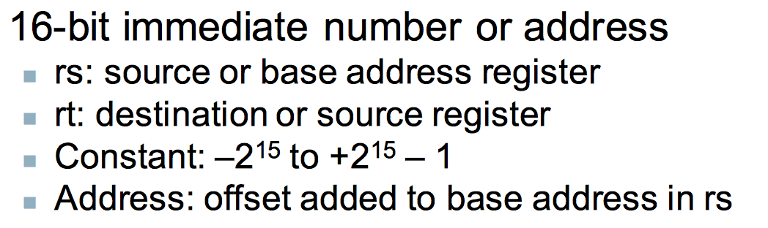
2.10.4 & 2.10.5
(a) addi $t1, $t1, 0 --------I-type
(b) sw $t1, 32($t2)----------I-type
op | rs | rt | constant
001000 | 01001 | 01001 | 0
8 | 9 | 9 | 0
op | rs | rt | constant
101010 | 01010 | 01001 | 0000000000100000
2b | a | 9 | 20

Slide 17
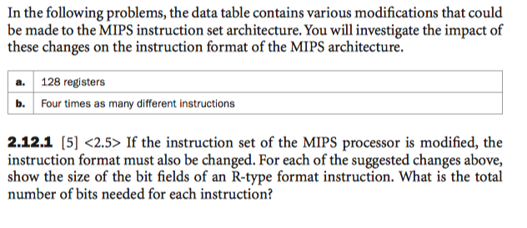
2.12.1
(a)
(b)
op | rs | rt | rd | shamt | func | total
6 | 7 | 7 | 7 | 5 | 6 | 38
op | rs | rt | rd | shamt | func | total
6 | 5 | 5 | 5 | 5 | 8 | 34

Slide 18

2.12.2
(a)
(b)
op | rs | rt | constant | total
6 | 7 | 7 | 16 | 36
op | rs | rt | constant | total
8 | 5 | 5 | 16 | 34

Slide 19
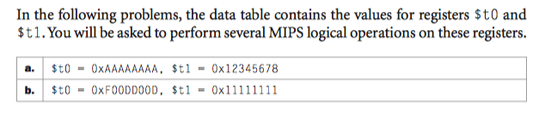
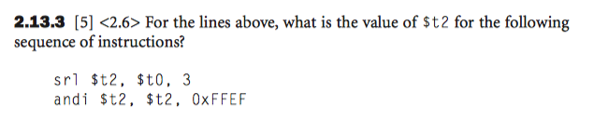
2.13.3
(a)
srl: $t2=0001 0101 0101 0101 0101 0101 0101 0101 (010)
andi: $t2=0001 0101 0101 0101 0101 0101 0100 0101
(b)
srl: $t2=0001 1110 0000 0001 1011 1010 0000 0001
Andi: $t2=0001 0101 0101 0101 1011 1010 0000 0001

Slide 20
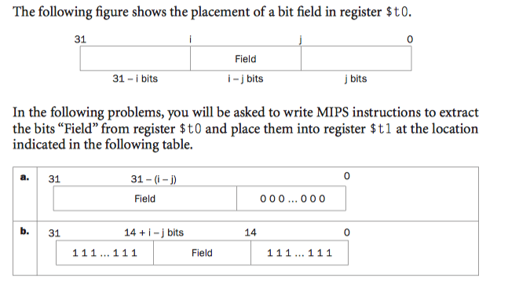

2.14.1
(a)
add $t1, $t0, $0
sll $t1, $t1, 10
andi $t1, $t1, 0x8000
(b)
add $t1, $t0, $0
sll $t1, $t1, 9
ori $t1, $t1, 0x3ffff
add $t2, $t1, $0
lw $t2, 0($s0)
srl $t2, $t2, 16
ori $t2, $t2, 0x8000
sh $t2, 0($s0)
lw $t1, 0($s0)
Wrong figure
31 |  | 22 |  | 5 | 4 |  | 0
15bits |  |  | 17bits |  | 5bits
31 |  | 15 | 14 |  | 0
17bits |  |  | 15bits
31 | 30 |  | 14 | 13 |  | 0
1bit | 17bits |  |  | 14bits

Slide 21
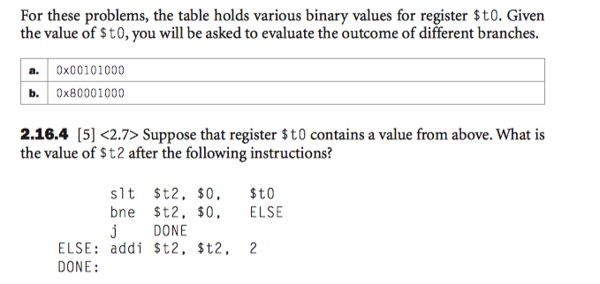
$t2=(0<$t0)?1:0
If $t2!=0 jump to ELSE
Jump tp DONE
ELSE: $t2+=2
2.16.4
(a)
$t1=0x00101000>0➔$t2=1➔$t2=3
(b)
$t1=0x80001000<0➔$t2=0➔$t2=0

Slide 22
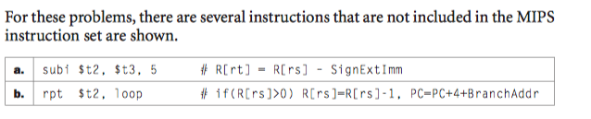

2.17.2
(a)
addi $t2, $t3, -5
(b)
slt $t0, $0, $t2
bne $t0, $0, IF
IF: addi $t2, $t2, -1
j LOOP

Slide 23
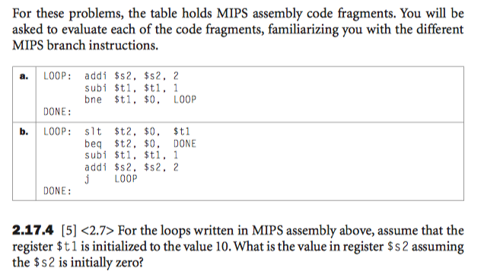
do{$s2+=2
$t1+=-1}
While( $t1!=0)
While($t1>0)
$t1+=-1
$s2+=2
2.17.4
(a)
$s2=20
(b)
$s2=20

Slide 24
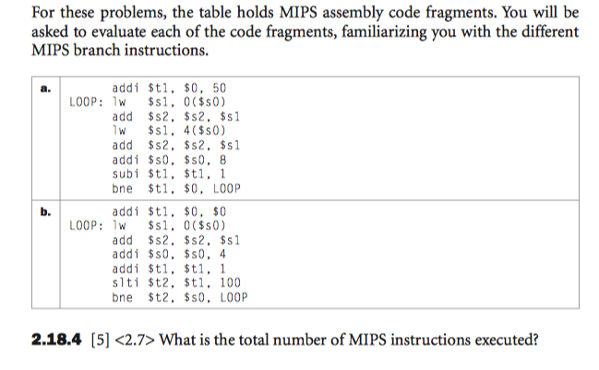
$0
2.18.4
(a)
1+7*50=351
(b)
1+6*100=601

Slide 25
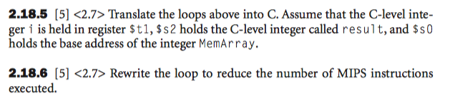
2.18.5
(a)
int i=50;
do {
result+=MemArray[100-2i];
result+=MemAray[101-2i];
i - -;
}while(i!=0)
(b)
int i=0;
do{
result+=MemArray[i];
i++;}while{i<100}
2.18.6
Consider the address directly without I
addi $t1, $s0, 400
LOOP: lw $s1, 0($s0)
add $s2, $s2,$s1
lw $s1, 4($s0)
add $s2, $s2,$s1
addi $s0, $s0, 8
bne $t1, $s0, LOOP

