Slide 1
VE370 Mid Review
VE370 TA Group

Slide 2
Part 1: Context
CPU Performance
Assembly Basic
Convention between Assembly and C
Memory related operations
Addressing
Function Call Convention
Linker

Slide 3
CPU Performance
CPI, IC, Tc
Pay attention to the unit

Slide 4

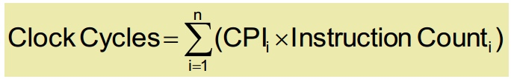
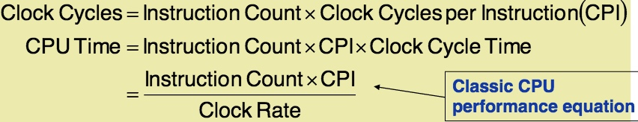
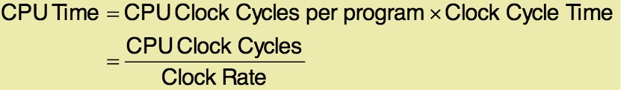
CPU Performance

Slide 5
Assembly Basic
4 principles:
Simplicity
Smaller
Fast common case
Compromise (similar formats)
Basic Blocks
How to load 32-bit Constants

Slide 6
Assembly Basic
R-type, J-type, I-type
Different positions of rs, rt, rd in MIPS vs. machine code

Slide 7
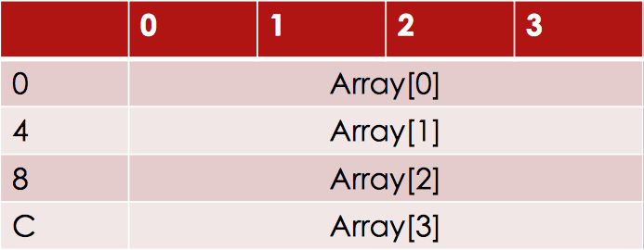
Assembly to C
Array in C is like

Slide 8
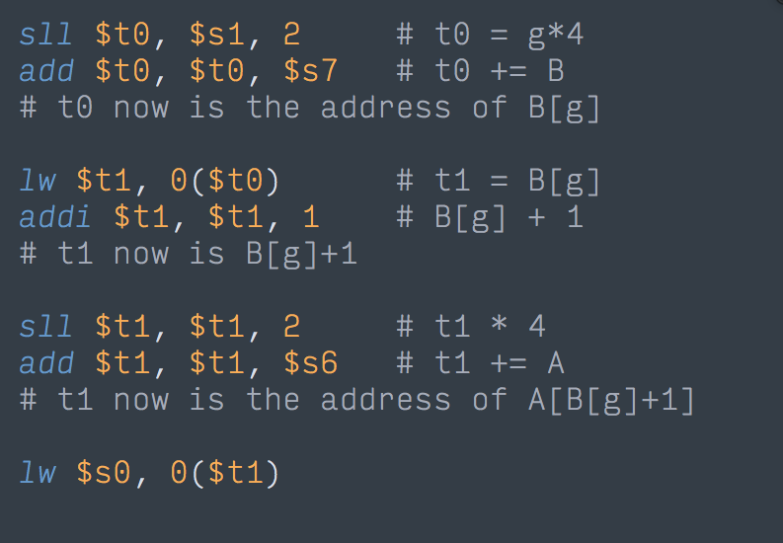
Assembly to C
f = A[B[g]+1];
g: $s1
B: $s7
A: $s6

Slide 9
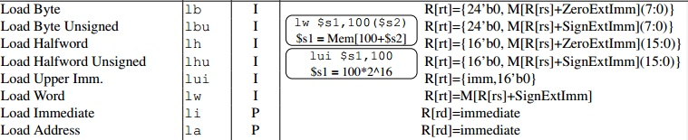

Memory related
lw, lh, lb: sign extended
E.g.
lui $t0, 4096 # get the address 0x1000 0000
lb $s1, 2($t0)

Slide 10
Memory related
lw, lh, lb: sign extended
E.g.
lui $t0, 4096 # get the address 0x1000 0000
lb $s1, 2($t0) -> 0xFFFF FF89

Slide 11
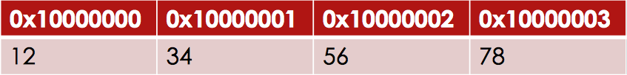
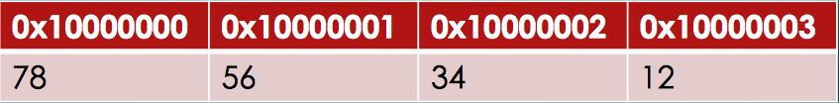
Memory Related
Big Endian: Most significant byte stored at least address of a word
(MIPS is Big Endian)
E.g. 0x12345678 in Big endian
In Small endian

Slide 12
Addressing
Immediate (e.g. addi)
Register (e.g. add)
Base (e.g. lw)
PC-relative (Target address = new PC + offset * 4, new PC = PC +4 )
Pseudodirect (e.g. j and jal)
(on L3 P19)

Slide 13
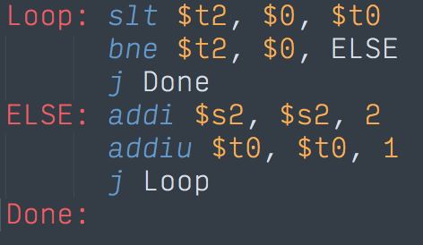
Addressing
Address | Code
0x1000 0400 | 000000 00000 01000 01010 00000 101010 (R)
0x1000 0404 | 000101 01010 00000 0000000000000001 (I)
0x1000 0408 | 000010 00000000000000000100000110 (J)
0x1000 040c | 001000 10010 100100000000000000010 (I)
0x1000 0410 | 001001 01000 010000000000000000001 (I)
0x1000 0414 | 000010 00000000000000000100000000 (J)

Slide 14
Function Call Convention
Before Calling
change $sp to save $a0~$a3
Overwrite $a0~$a3
During calling
Store $ra and any $s0~$s7 that will be used on stack
Execute and get $v0 $v1
Restore $s0~$s7
Restore(pop) frame
After Calling
Restore $a0~$a3

Slide 15
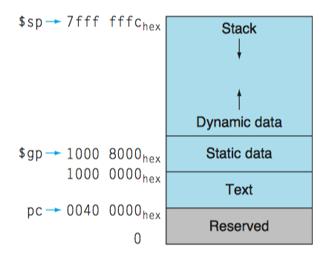
Linker
$gp initialized at center of static data
Instructions stored in Text segment (from 0x0040 0000 towards up, won’t exceed 0x1000 0000)
Data stored in Static Data segment (from 0x1000 0000 towards up, won’t exceed 0x1001 0000)

Slide 16
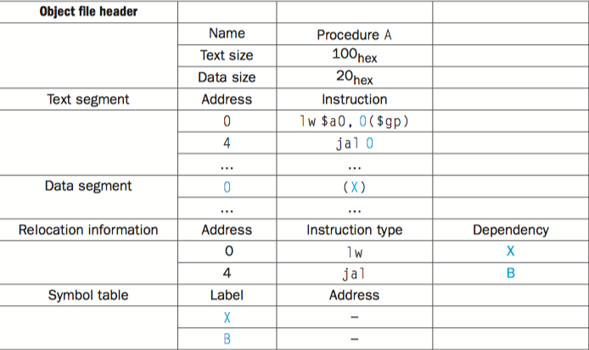
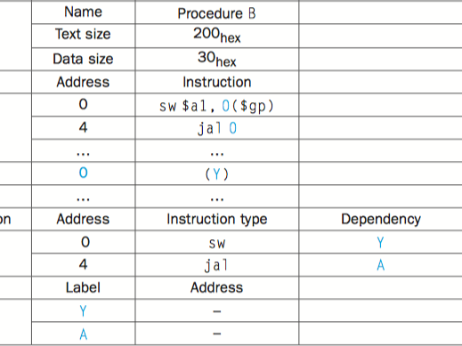
Linker
A
B

Slide 17
Linker, Cont’d
20Hex
100Hex

Slide 18
Linker, Cont’d
30hex
20Hex
200hex
100Hex

Slide 19
Linker, Cont’d
A
B

Slide 20
Linker, Cont’d
A
B

Slide 21
Linker, Cont’d
A
B

Slide 22
Linker, Cont’d
A
B

Slide 23
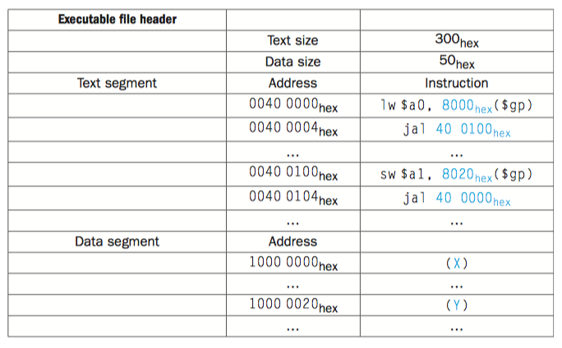
Linker Cont’d
2’s complement
Absolute Address

