Slide 1
VE370 RC7
Yuxin & Tianze

Slide 2
Lecture Slides
Local/Spatial Locality
Block, word, byte address
What does what addressable mean?
Hit vs. Miss
Direct Mapped, set associative, fully associative
Write back, write through

Slide 3
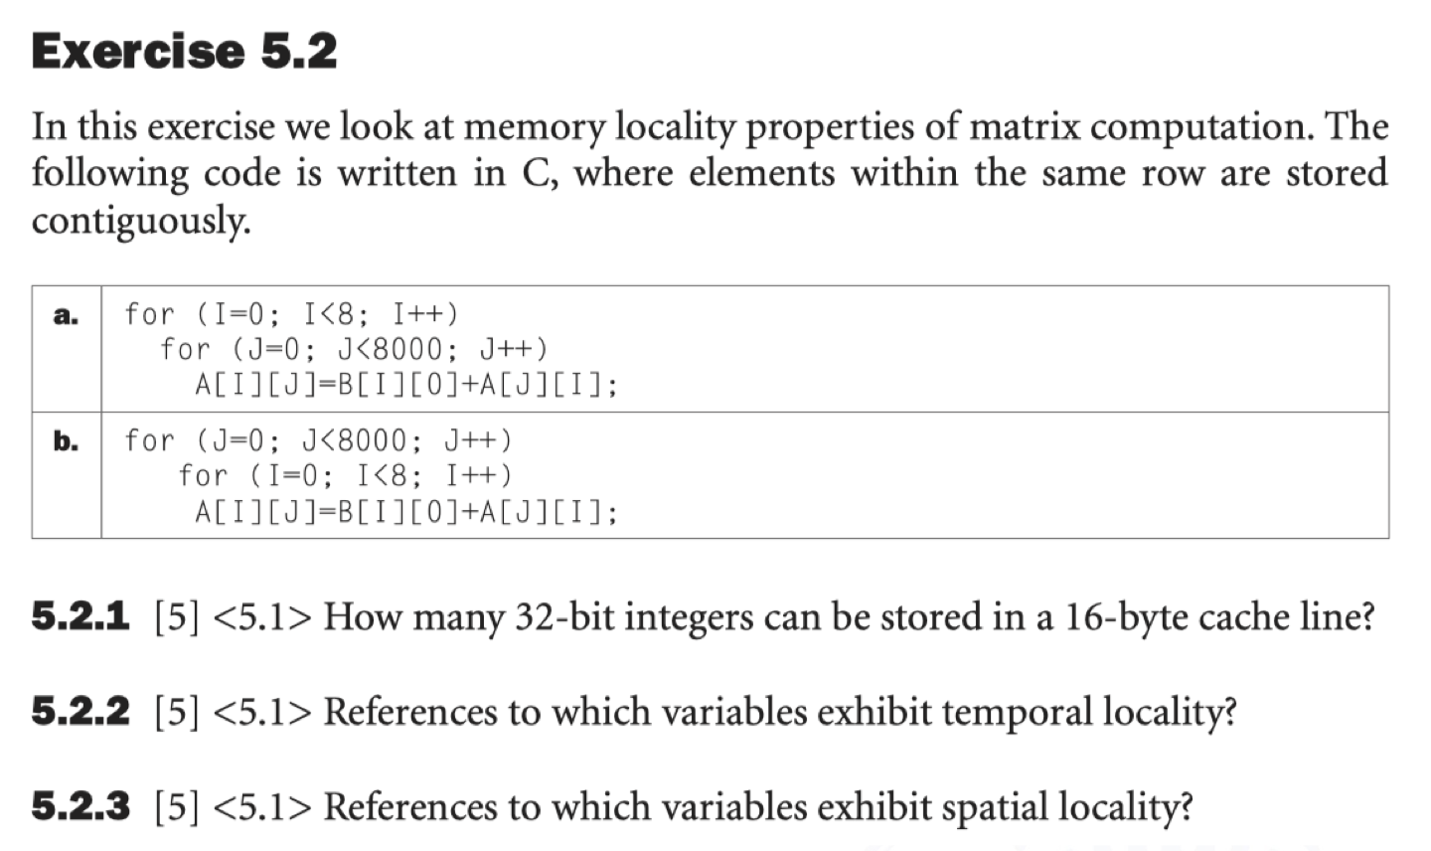
Exercise 5.2
5.2.1
4 integers
5.2.2
(a). I, J, B[I][0]
(b). I, J
5.2.3
(a). A[I][J]
(b). A[J][I]

Slide 4
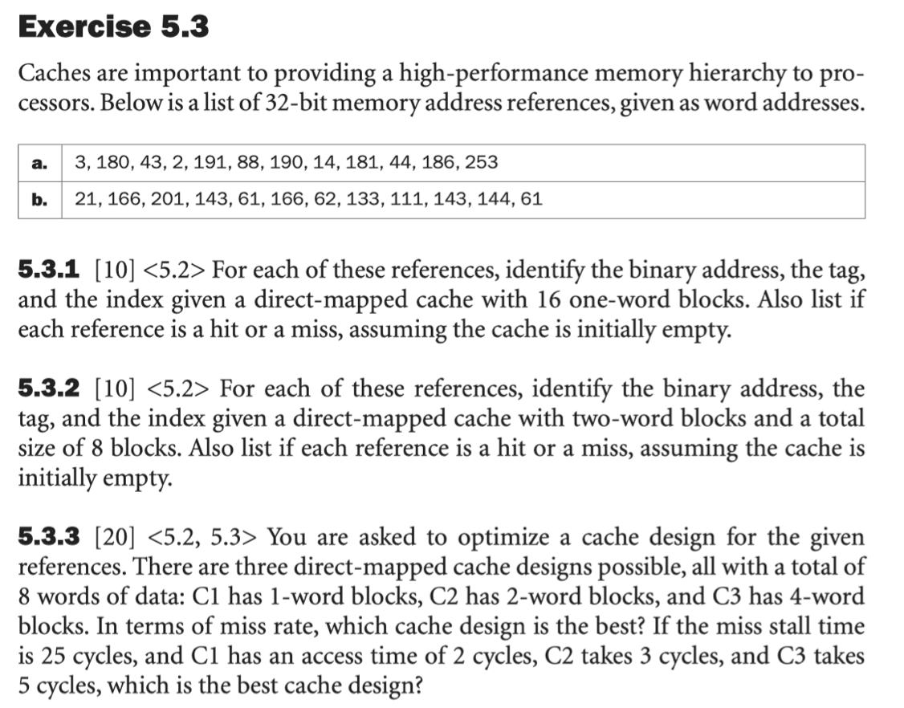
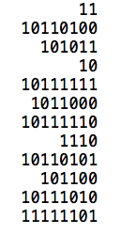
Exercise 5.3.1
tag
Word Index

Slide 5
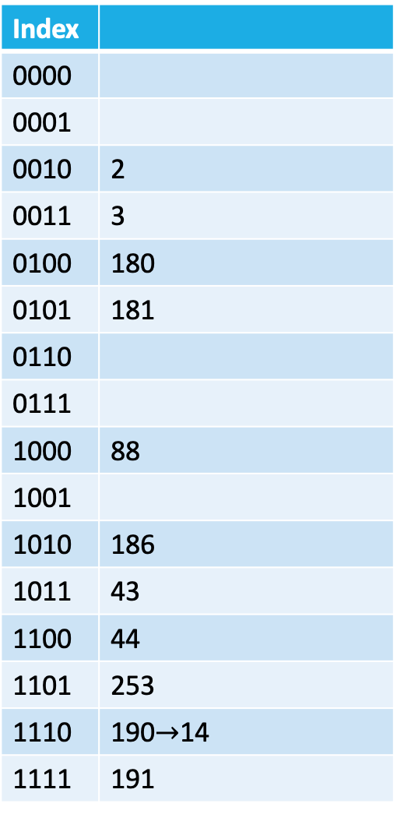
Index
0000
0001
0010 | 2
0011 | 3
0100 | 180
0101 | 181
0110
0111
1000 | 88
1001
1010 | 186
1011 | 43
1100 | 44
1101 | 253
1110 | 190$→$14
1111 | 191
 | Binary address | tag | index | h/m
3 | 11 | 0 | 0011 | miss
180 | 10110100 | 1011 | 0100 | miss
43 | 101011 | 10 | 1011 | miss
2 | 10 | 0 | 0010 | miss
191 | 10111111 | 1011 | 1111 | miss
88 | 1011000 | 101 | 1000 | miss
190 | 10111110 | 1011 | 1110 | miss
14 | 1110 | 0 | 1110 | miss
181 | 10110101 | 1011 | 0101 | miss
44 | 101100 | 10 | 1100 | miss
186 | 10111010 | 1011 | 1010 | miss
253 | 11111101 | 1111 | 1101 | miss

Slide 6
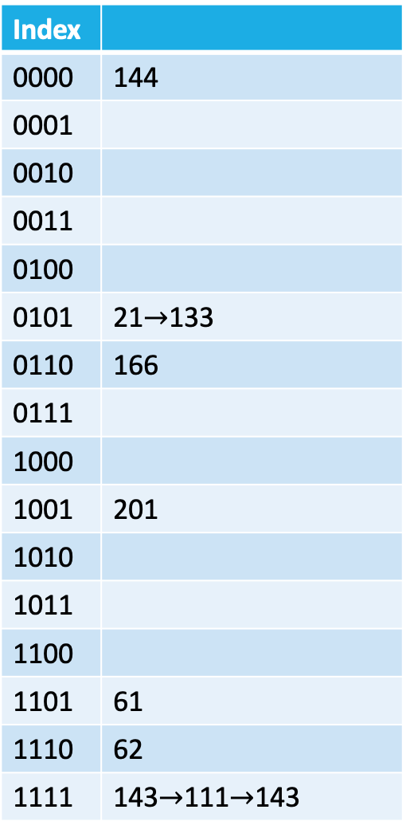
Index
0000 | 144
0001
0010
0011
0100
0101 | 21$→$133
0110 | 166
0111
1000
1001 | 201
1010
1011
1100
1101 | 61
1110 | 62
1111 | 143$→$111$→$143
 | Binary address | tag | index | h/m
21 | 10101 | 1 | 0101 | miss
166 | 10100110 | 1010 | 0110 | miss
201 | 11001001 | 1100 | 1001 | miss
143 | 10001111 | 1000 | 1111 | miss
61 | 111101 | 11 | 1101 | miss
166 | 10100110 | 1010 | 0110 | hit
62 | 111110 | 11 | 1110 | miss
133 | 10000101 | 1000 | 0101 | miss
111 | 1101111 | 110 | 1111 | miss
143 | 10001111 | 1000 | 1111 | miss
144 | 10010000 | 1001 | 0000 | miss
61 | 111101 | 11 | 1101 | hit

Slide 7
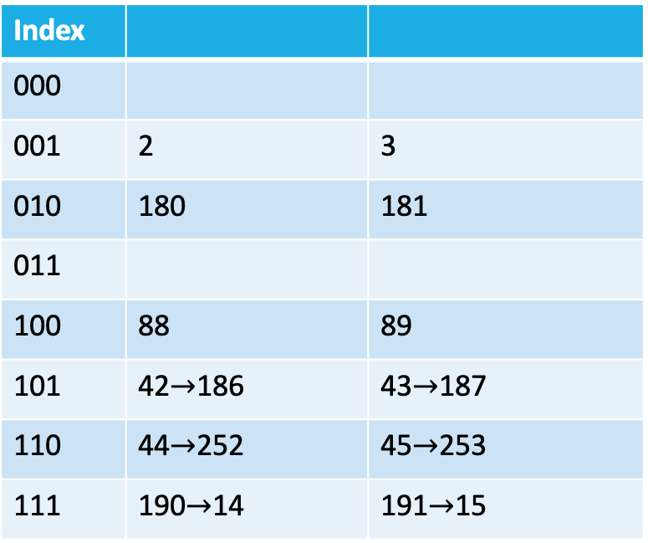
 | Binary address | tag | index | h/m
3 | 11 | 0 | 001 | miss
180 | 10110100 | 1011 | 010 | miss
43 | 101011 | 10 | 101 | miss
2 | 10 | 0 | 001 | hit
191 | 10111111 | 1011 | 111 | miss
88 | 1011000 | 101 | 100 | miss
190 | 10111110 | 1011 | 111 | hit
14 | 1110 | 0 | 111 | miss
181 | 10110101 | 1011 | 010 | hit
44 | 101100 | 10 | 110 | miss
186 | 10111010 | 1011 | 101 | miss
253 | 11111101 | 1111 | 110 | miss
Index
000
001 | 2 | 3
010 | 180 | 181
011
100 | 88 | 89
101 | 42$→$186 | 43$→$187
110 | 44$→$252 | 45$→$253
111 | 190$→$14 | 191$→$15

Slide 8
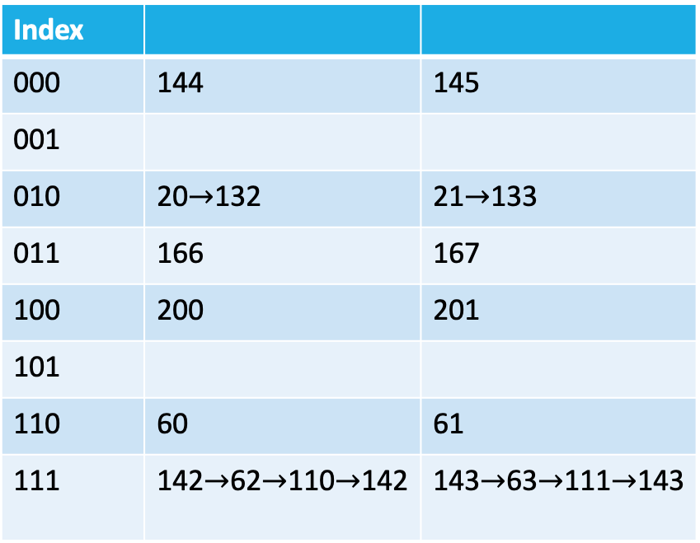
 | Binary address | tag | index | h/m
21 | 10101 | 1 | 010 | miss
166 | 10100110 | 1010 | 011 | miss
201 | 11001001 | 1100 | 100 | miss
143 | 10001111 | 1000 | 111 | miss
61 | 111101 | 11 | 110 | miss
166 | 10100110 | 1010 | 011 | hit
62 | 111110 | 11 | 111 | miss
133 | 10000101 | 1000 | 010 | miss
111 | 1101111 | 110 | 111 | miss
143 | 10001111 | 1000 | 111 | miss
144 | 10010000 | 1001 | 000 | miss
61 | 111101 | 11 | 110 | hit
Index
000 | 144 | 145
001
010 | 20$→$132 | 21$→$133
011 | 166 | 167
100 | 200 | 201
101
110 | 60 | 61
111 | 142$→$62$→$110$→$142 | 143$→$63$→$111$→$143

Slide 9
Exercise 5.3.3
 | Binary address | Index for C1 |  | Index for C2 |  | Index for C3
3 | 11 | 011 | miss | 01 | miss | 0 | miss
180 | 10110100 | 100 | miss | 10 | miss | 1 | miss
43 | 101011 | 011 | miss | 01 | miss | 0 | miss
2 | 10 | 010 | miss | 01 | miss | 0 | miss
191 | 10111111 | 111 | miss | 11 | miss | 1 | miss
88 | 1011000 | 000 | miss | 00 | miss | 0 | miss
190 | 10111110 | 110 | miss | 11 | hit | 1 | hit
14 | 1110 | 110 | miss | 11 | miss | 1 | miss
181 | 10110101 | 101 | miss | 10 | hit | 1 | miss
44 | 101100 | 100 | miss | 10 | miss | 1 | miss
186 | 10111010 | 010 | miss | 01 | miss | 0 | miss
253 | 11111101 | 101 | miss | 10 | miss | 1 | miss
C1: 0 hit stall time=27*12
C2:2 hits stall time=25*10+3*12
C3: 1 hit stall time=25*11+5*12

Slide 10
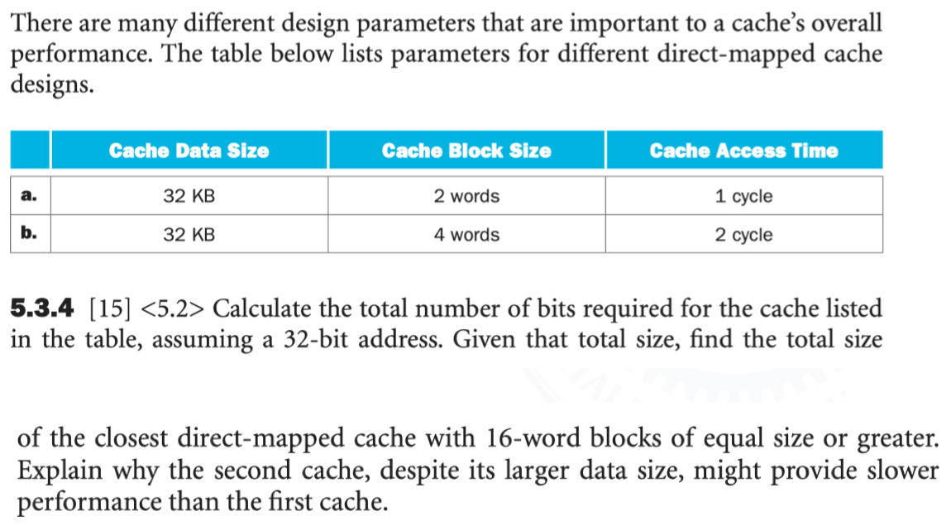
Exercise 5.3.4

Slide 11
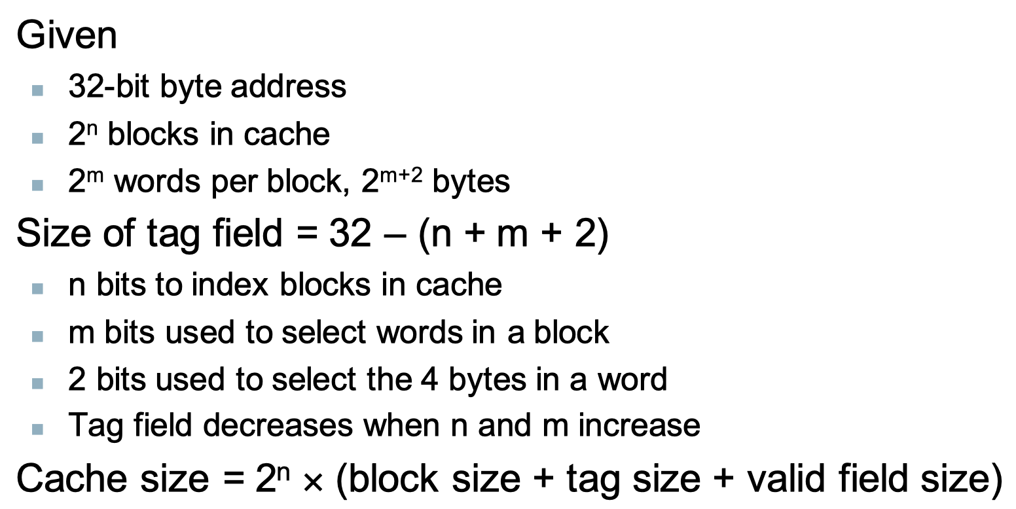
Exercise 5.3.4

Slide 12
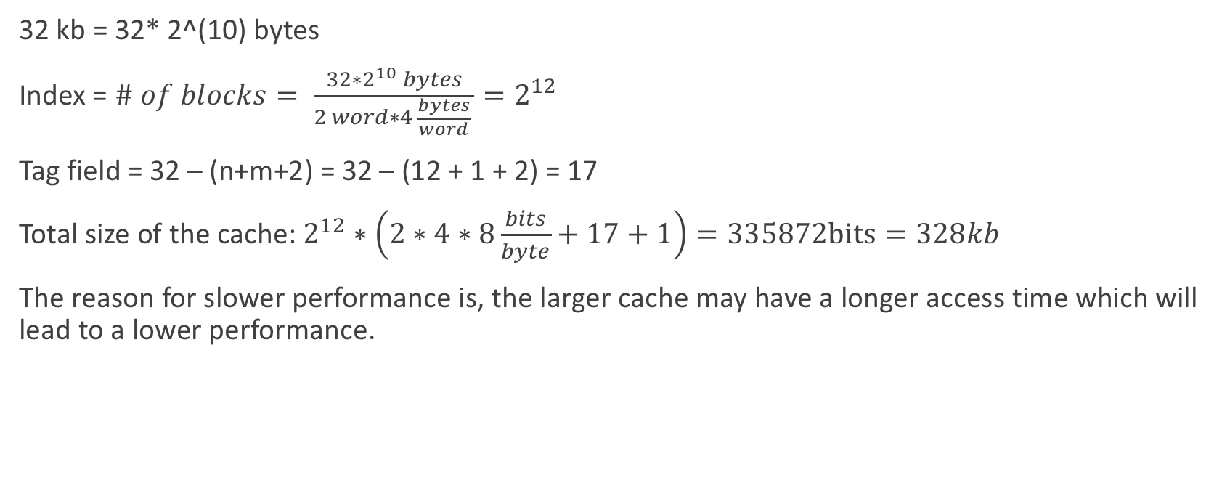
Exercise 5.3.4
32 kb = 32* 2^(10) bytes
Index = $\# of blocks= \frac{32∗2^{10} bytes}{2 word∗4 \frac{bytes}{word} }=2^{12}$
Tag field = 32 – (n+m+2) = 32 – (12 + 1 + 2) = 17
Total size of the cache: $2^{12}∗\left(2∗4∗8\frac{bits}{byte}+17+1\right)=335872bits=328kb$
The reason for slower performance is, the larger cache may have a longer access time which will lead to a lower performance.

Slide 13
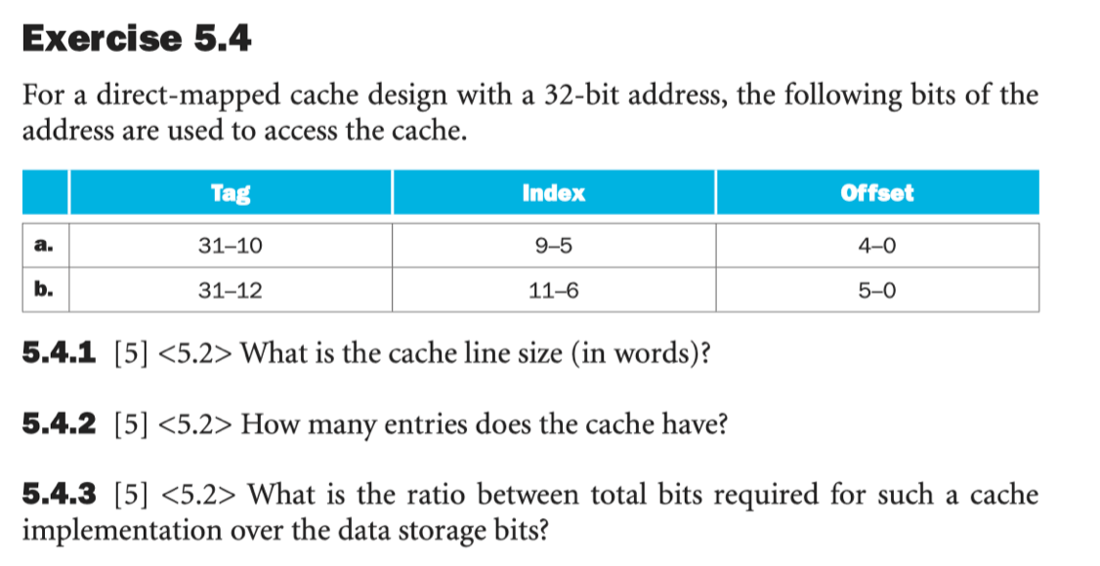
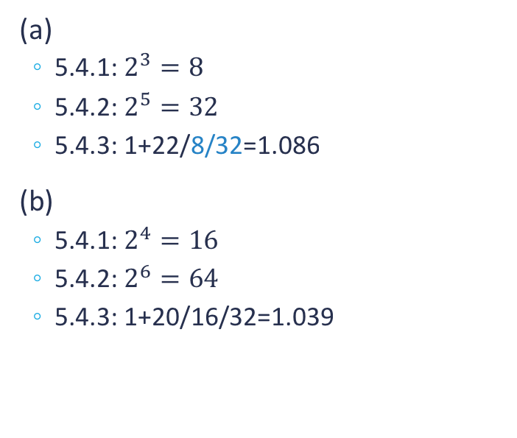
Exercise 5.4.1-5.4.3
(a)
5.4.1: $2^{3}=8$
5.4.2: $2^{5}=32$
5.4.3: 1+22/8/32=1.086
(b)
5.4.1: $2^{4}=16$
5.4.2: $2^{6}=64$
5.4.3: 1+20/16/32=1.039
Each tag corresponds to: # of blocks* # of words/ block

Slide 14
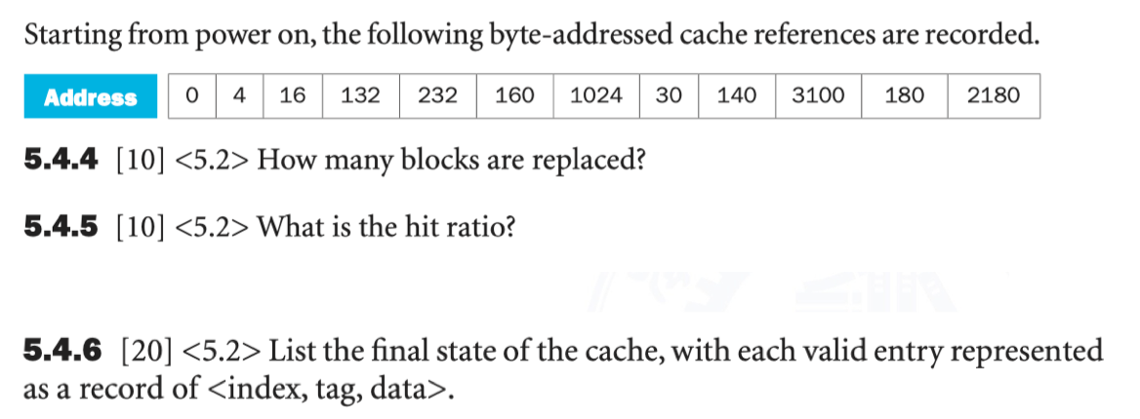

Exercise 5.4.4-5.4.5
5.4.4: 3
5.4.5: $\frac{4}{12}=0.33$
 | 0 | 4 | 16 | 132 | 232 | 160 | 1024 | 30 | 140 | 3100 | 180 | 2180
Index | 0 | 0 | 0 | 100 | 111 | 101 | 0 | 0 | 100 | 0 | 101 | 100
H/M | M | H | H | M | M | M | M | M | H | M | H | M
Replace | N | N | N | N | N | N | Y | Y | N | Y | N | Y

Slide 15
Exercise 5.4.6
Index | Tag | Data
00000 | 11 | Mem[3072]
00100 | 10 | Mem[2176]
00101 | 0 | Mem[160]
00111 | 0 | Mem[224]
 | 0 | 4 | 16 | 132 | 232 | 160 | 1024 | 30 | 140 | 3100 | 180 | 2180
Index | 0 | 0 | 0 | 100 | 111 | 101 | 0 | 0 | 100 | 0 | 101 | 100
H/M | M | H | H | M | M | M | M | M | H | M | H | M
Replace | N | N | N | N | N | N | Y | Y | N | Y | N | Y

Slide 16
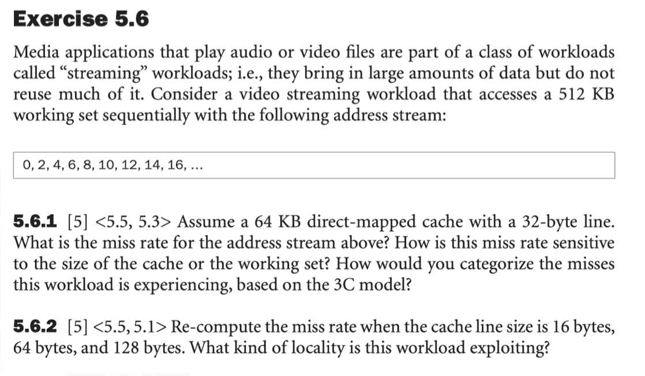
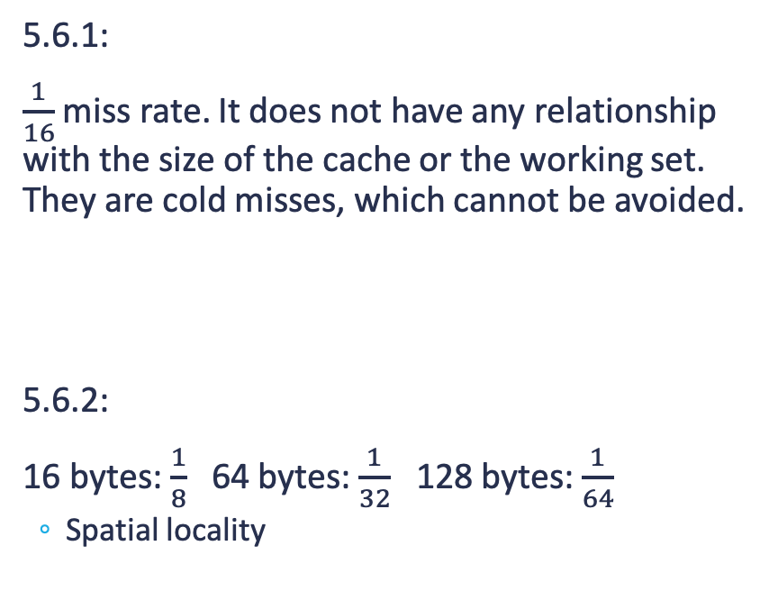
Exercise 5.6
0 | 2 | 4 | 6 | 8 | 10 | … | 30 | 32
M | H | H | H | H | H | H | H | M
5.6.1:
$\frac{1}{16}$ miss rate. It does not have any relationship with the size of the cache or the working set. They are cold misses, which cannot be avoided.
5.6.2:
16 bytes: $\frac{1}{8}$ 64 bytes: $\frac{1}{32}$ 128 bytes: $\frac{1}{64}$
Spatial locality
byte address
0 | 2 | 4 | 6 | 8 | 10 | 12 | 14 | 16
M | H | H | H | H | H | H | H | M

