Slide 1
Final Review L12
VE370

Slide 2
Contents
VM
TLB

Slide 3
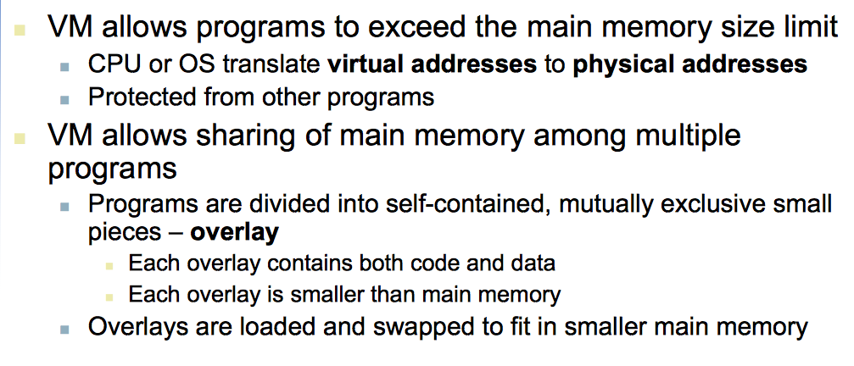
VM
Why VM

Slide 4
VM
Page
Page fault

Slide 5
Page table
Translator for program

Slide 6
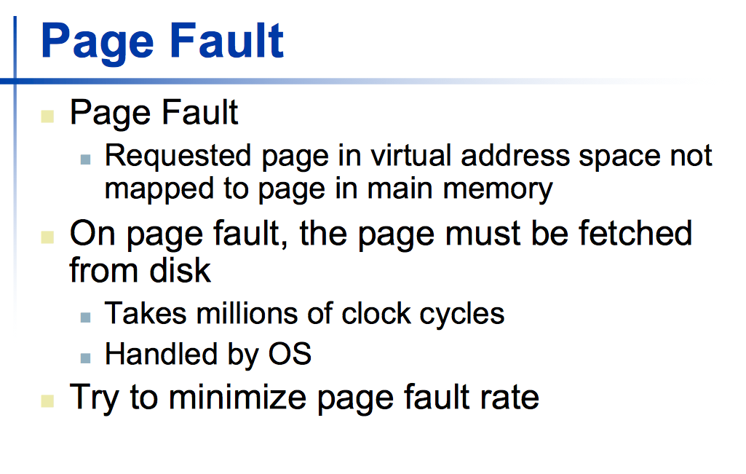
Page fault

Slide 7
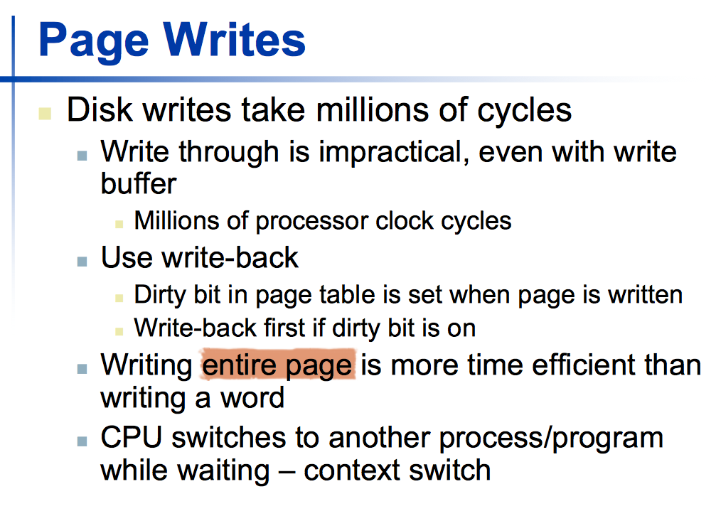
Handling page fault

Slide 8
Page fault - replacement rule
LRU

Slide 9
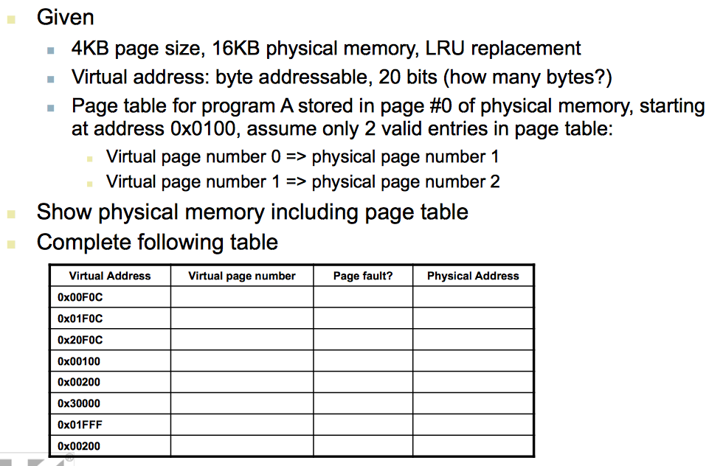
In class exercise

Slide 10
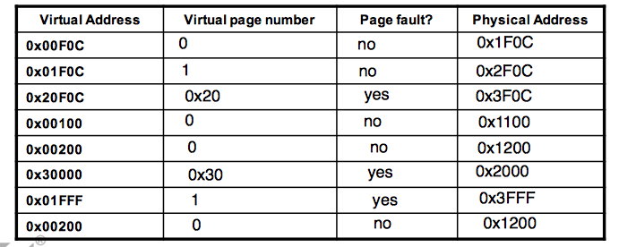
In class exercise

Slide 11
TLB
Part of page table + Valid, dirty, reference
Full Associativity
One translation per TLB entry

Slide 12
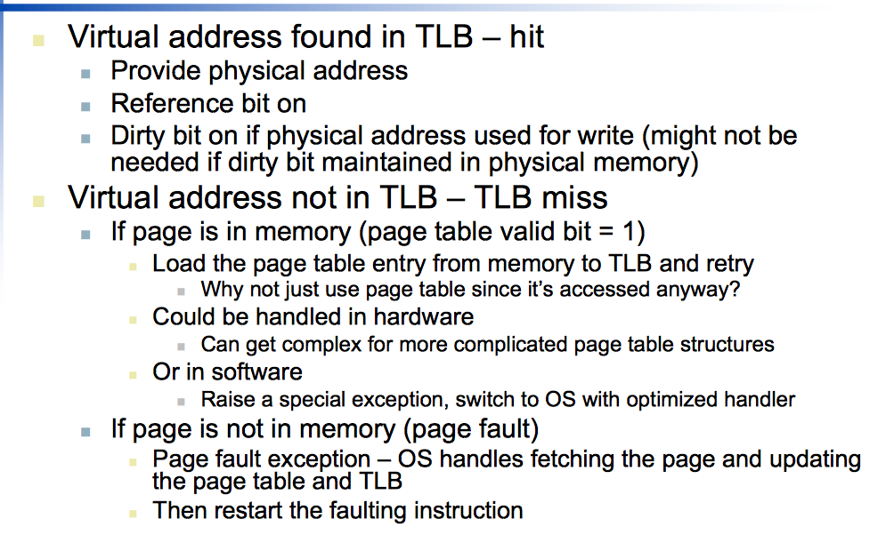
TLB hit or miss

Slide 13
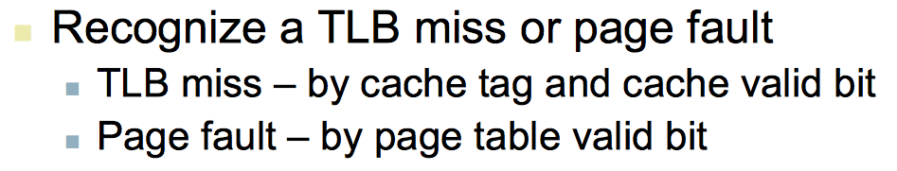
TLB miss vs. Page fault

Slide 14
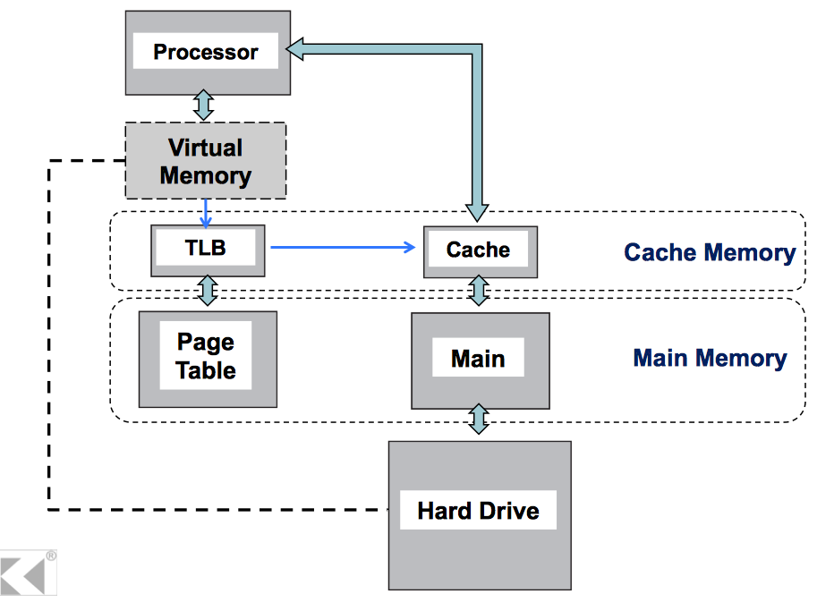
TLB, Cache layout

Slide 15
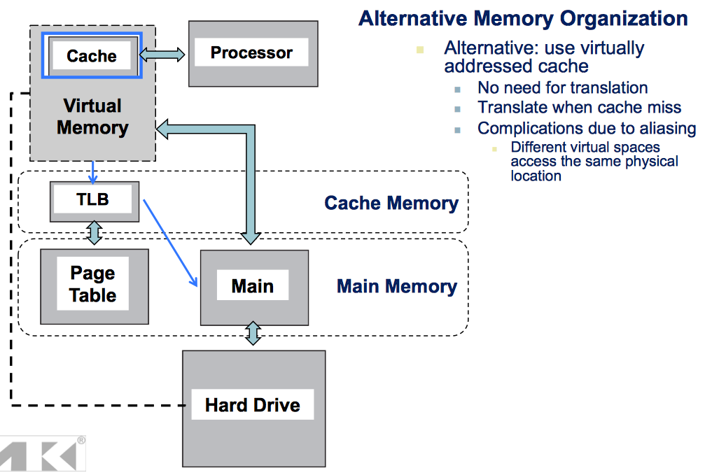
Alternative layout

Slide 16
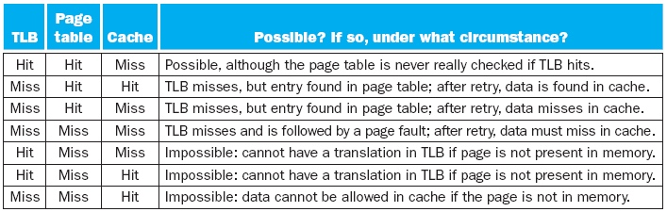
TLB, Page table and cache relation

Slide 17
A hint for your review on memory
Check L11 page 31-38, whether you can understand all the concepts

