Slide 1
Ve370 Review

Slide 2
exception

Slide 3
Exception
32-bit register in MIPS：
Exception Program Counter (EPC) = address of interrupted instruction + 4
CAUSE: Service the exception or interrupt according to the causes
Cause and EPC not necessarily in EX stage.
After exception is handled: PC= EPC-4
Vectored Interrupts：
Single Entry Point: MIPS
Multiple Entry Point: each entry point for one cause

Slide 4
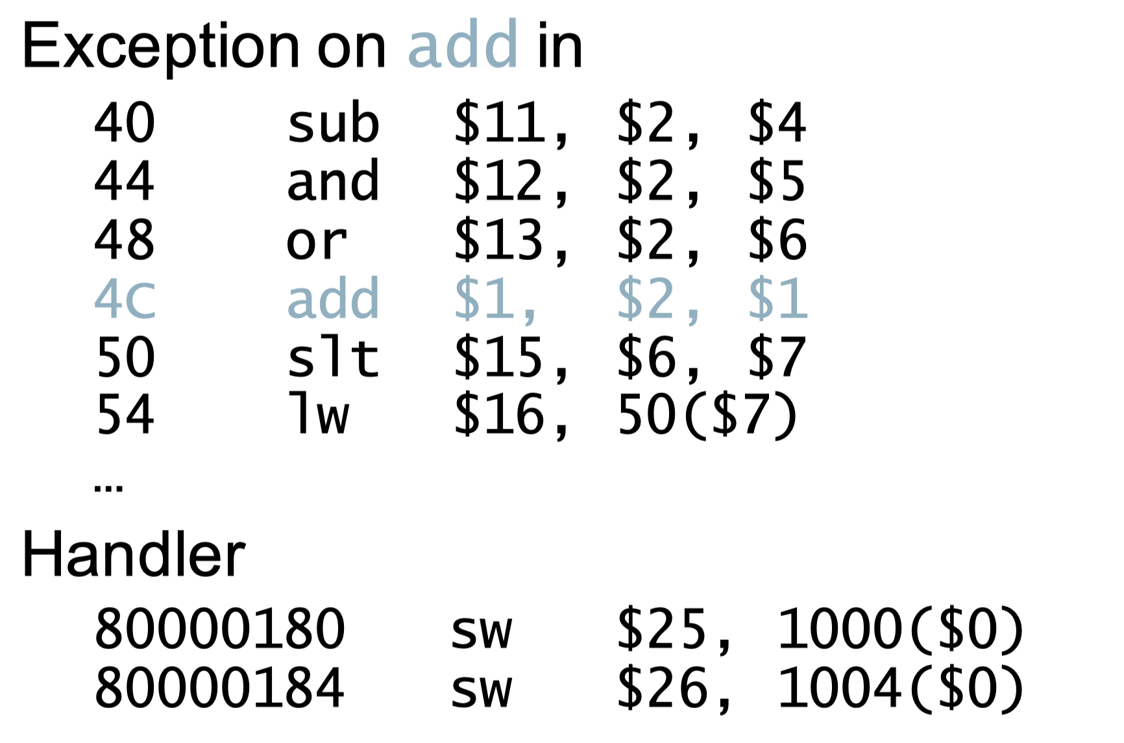
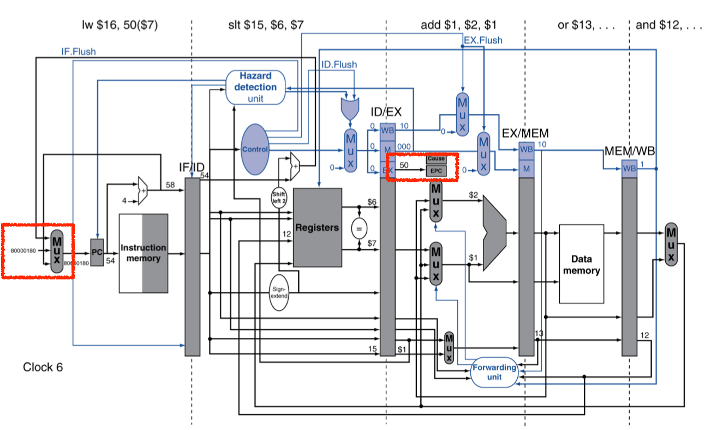
EPC=50
PC=80000180

Slide 5
cache

Slide 6
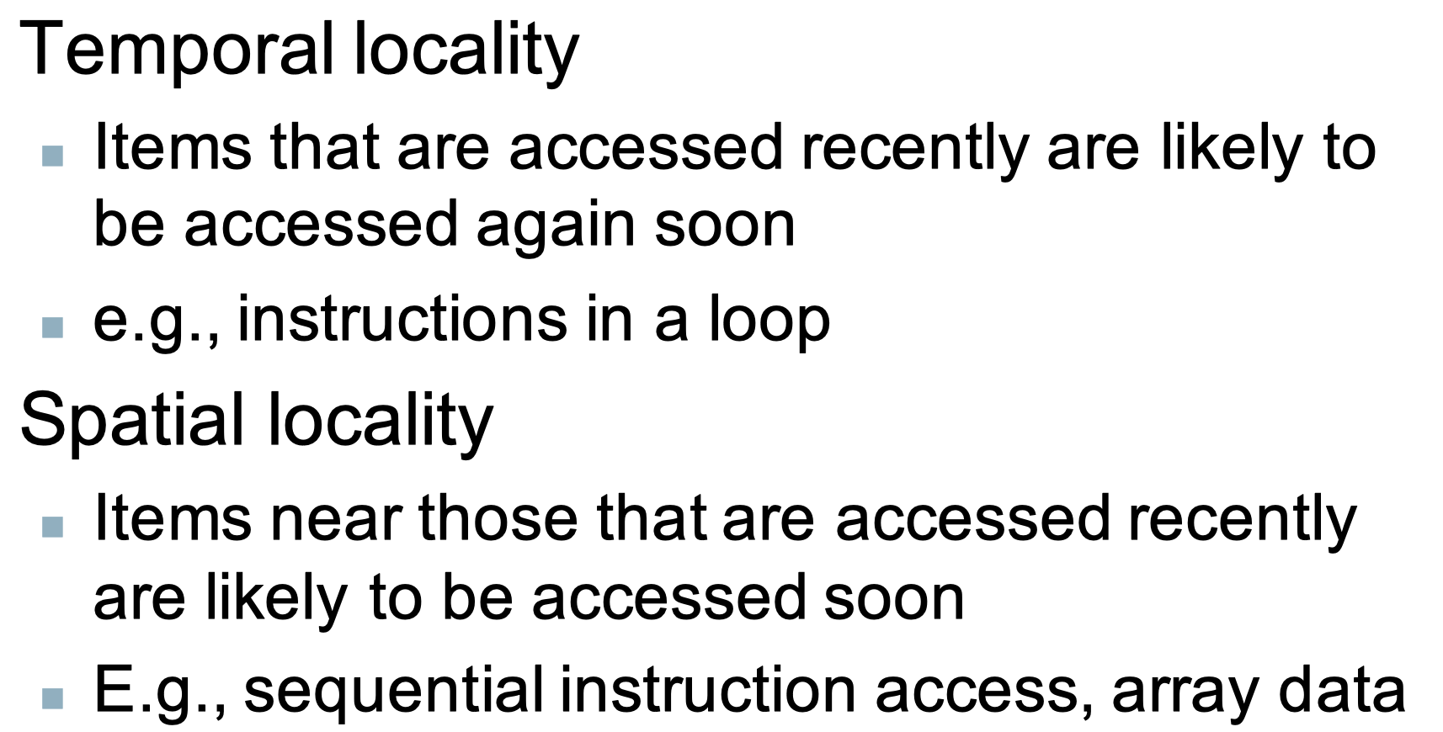
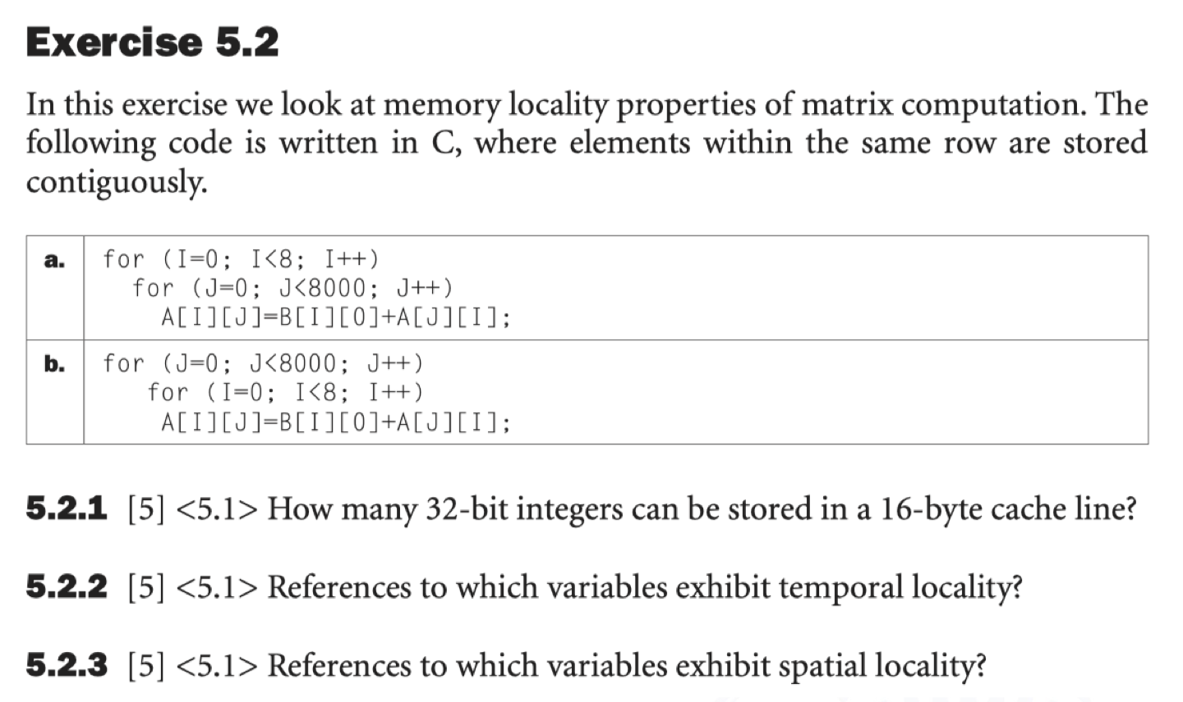
Locality
5.2.2
(a). I, J, B[I][0]
(b). I, J
5.2.3
(a). A[I][J]
(b). A[J][I]

Slide 7
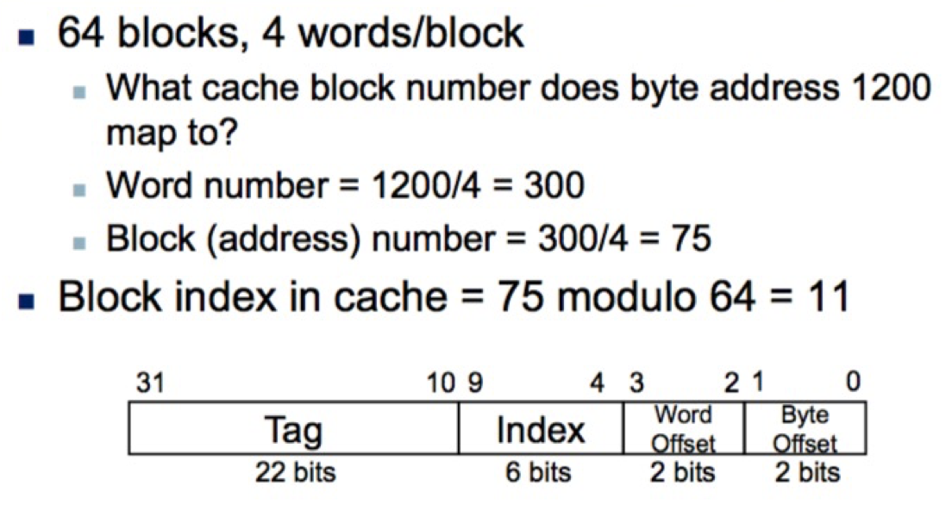
Address
Direct-mapped Cache, 2 words per block, 4 blocks in the cache
Byte address: 1111_1111_0000_0001
Word address: 1111_1111_0000_00 (2 words/block)
Block address: 1111_1111_0000_0
• Divided by 4 = shift left two bits
• modulo 4 = take the last two bits

Slide 8
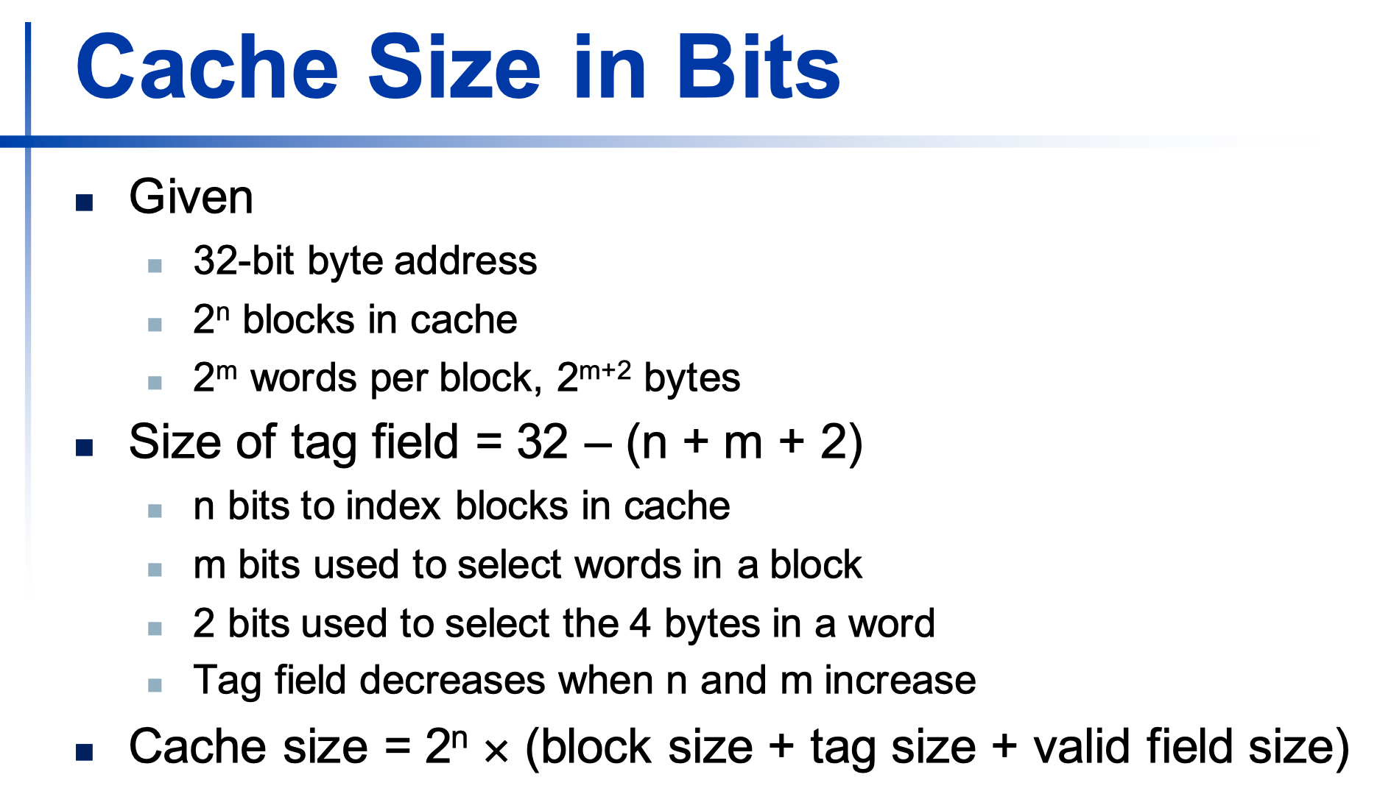
Cache Design – Direct-mapped Cache
Direct-mapped Cache, 2 words per block, 4 blocks in the cache
Byte address: 1111_1111_0000_0001
Word address: 1111_1111_0000_00 (2 words/block)
Block address: 1111_1111_0000_0
Cache Index: 0_0 (4 block/cache)
Tag: 1111_1111_000
Check Hw7 5.3
Cache index = (Block address in memory) modulo (Number of blocks in cache)

Slide 9
Cache Design – Set Associative Cache
Two-way set associative Cache, 2 words per block, a total size of 8 words
Byte address: 1111_1111_0000_0001
Word address: 1111_1111_0000_00 (2 word/block)
Block address: 1111_1111_0000_0
Cache Index: 0 (2 sets/cache)
Tag: 1111_1111_0000
Block Offset: 0
Set address = (Block address) modulo (number of sets in cache)
To locate a block in a set, need to compare n times
The block offset is the address of the desired data within the block.
HW 8 5.8
Replacement: LRU and MRU

Slide 10
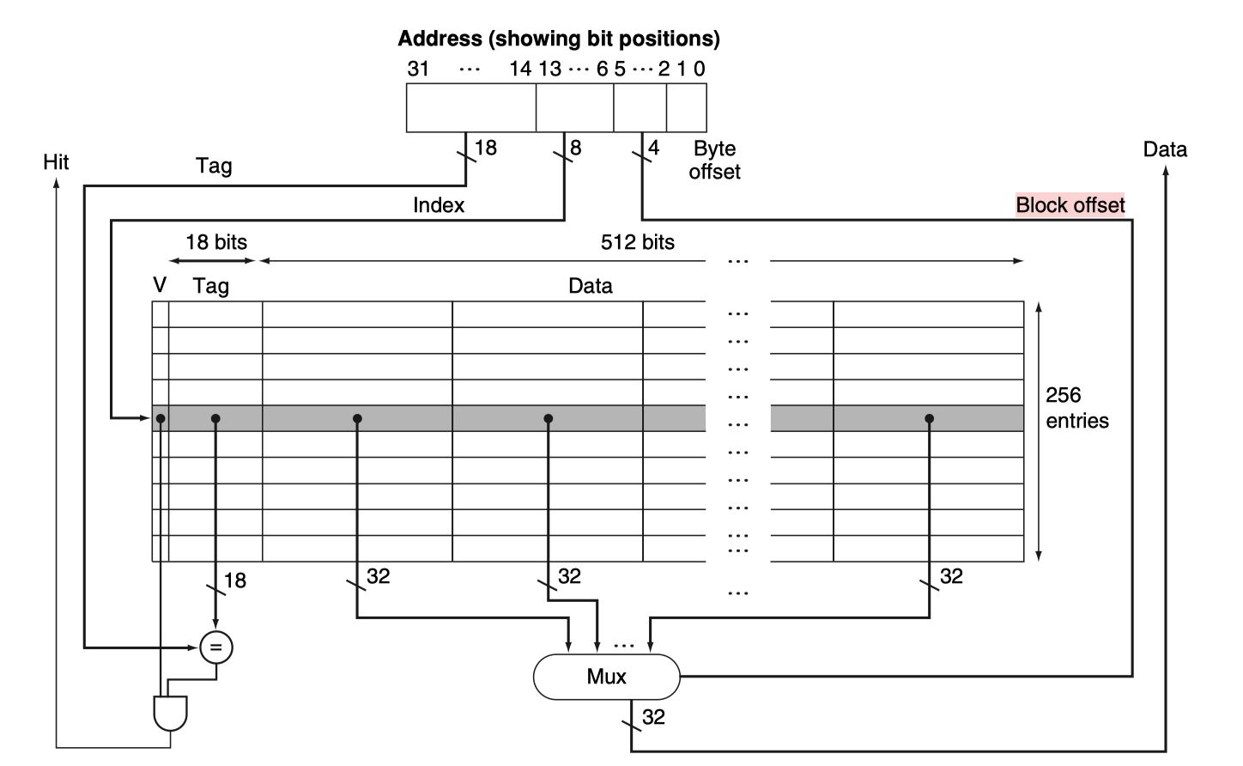
Cache Design – Set Associative Cache
The 16 KB cache contains 256 blocks with 16 words per block.
Tag: 18 bits
Cache Index: 8bits
Block Offset: 4 bits
Byte Offset: 2 bits

Slide 11
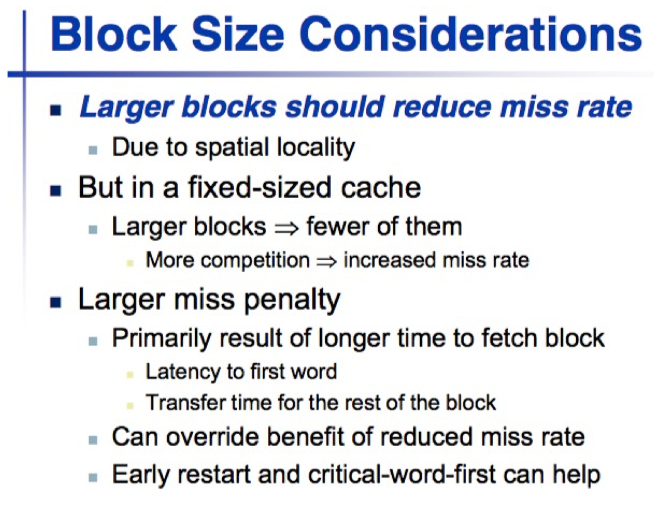
Cache Design – Block Size
A larger cache has a longer access time,
Leading to lower performance
HW7 5.3.4

Slide 12
Cache Design – Keeping Track of Modified Data
Write Through
Naive version:
Cannot tolerate any inconsistency between cache and lower memory
Pay access time to cache and lower memory
A write hit actually acts like a miss
Write buffer version:
The write buffer's job is to keep track of all the pending updates to L2, so that L1 can move on.
The write buffer is finite. CPU stalls if buffer is full
Write Back
dirty bits, update memory only when to be replaced
A hit required two steps:
check match
write data
A miss to a dirty block: two accesses to L2. Double miss penalty.
One to let it know about the modified data in the dirty block
Another to fetch the actual missed data.

Slide 13
Cache Design – Write Misses
Write Allocation
Make room for the new data on a write miss.
No Write Allocation
Write directly to memory
Generally, write-allocate makes more sense for write-back caches and no-write-allocate makes more sense for write-through caches, but the other combinations are possible too.
HW8 5.5.2

Slide 14
Cache Design – Design Combination
L1 miss, send write request to L2
L2 hit or not
Y
Allocate block in L2 as a victim
Victim dirty or not
Y
Put it into write buffer. Forward into memory
Issue write miss to memory
Data installed in L2
Data installed in L1
Resume Execution

Slide 15
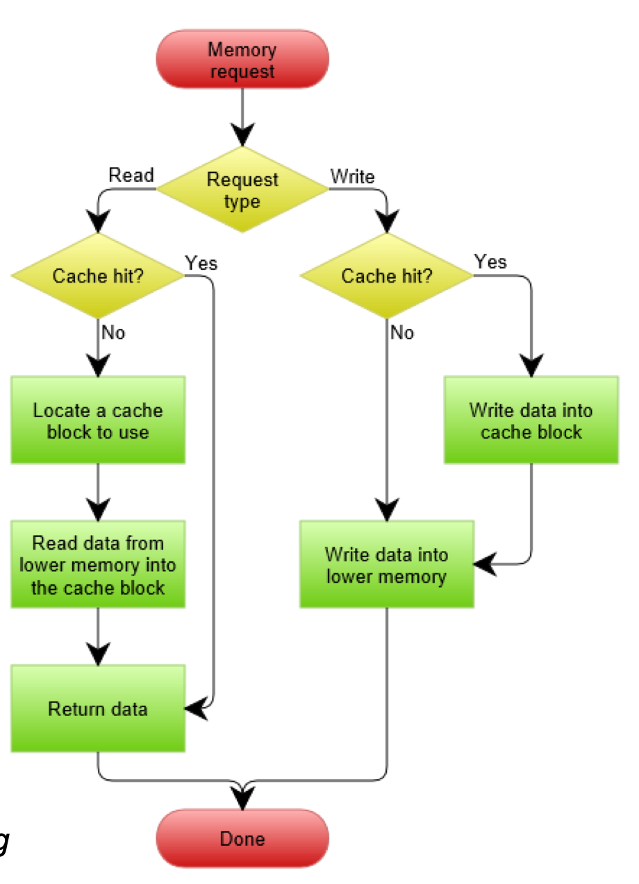
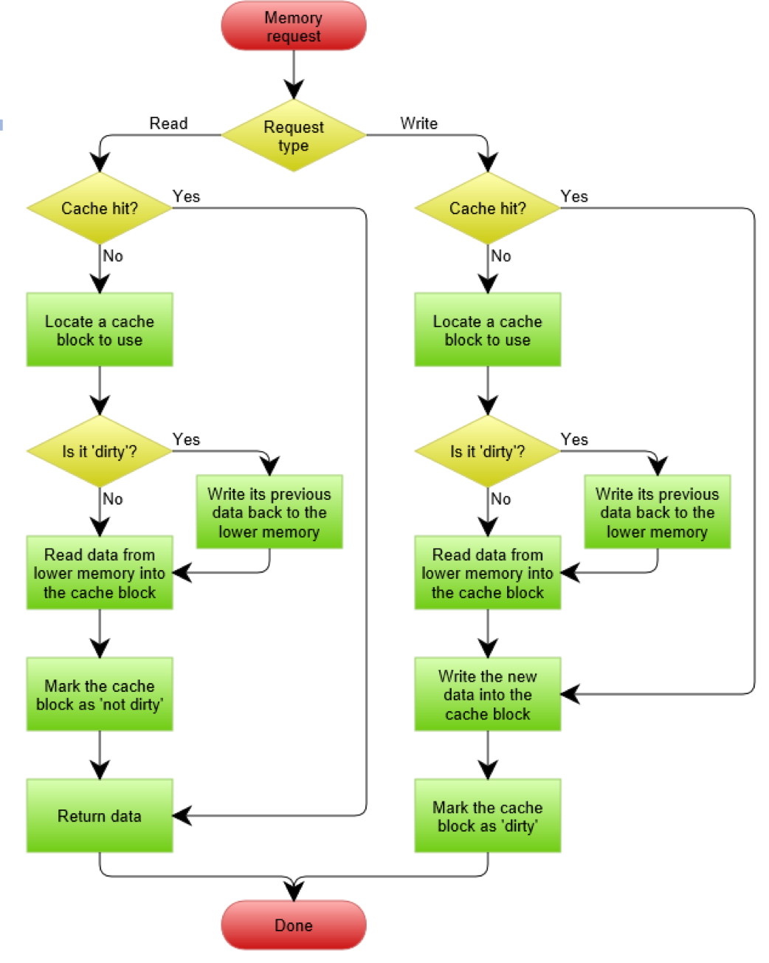
Cache Design – Design Combination
Write through with no write allocation
Write back with write allocation

Slide 16
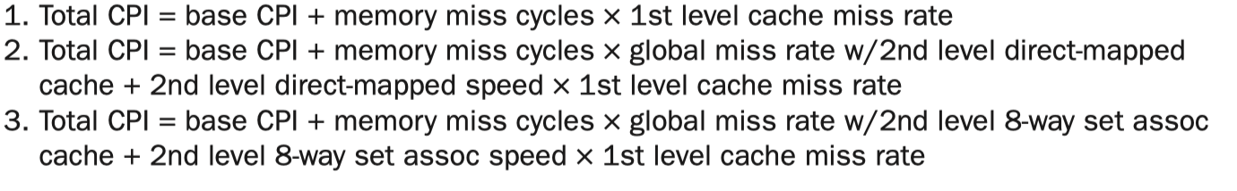
Cache Design – Miss Penalty
Total CPI = base CPI + Miss (stall) cycles per instruction
Average memory access time (AMAT)
AMAT = Hit time + Miss rate × Miss penalty
HW 8 5.5
Multilevel Cache
CPI = base CPI + L1 miss rate * L2 hit rate * L1 miss penalty (cycles per instruction) + L1 miss rate * L2 miss rate * (L1 miss penalty + L2 miss penalty + main memory hit time)(cycles per instruction)
HW8 5.7, 5.8.4

