Slide 1
VE370 RC8

Slide 2
Lecture Slides

Slide 3
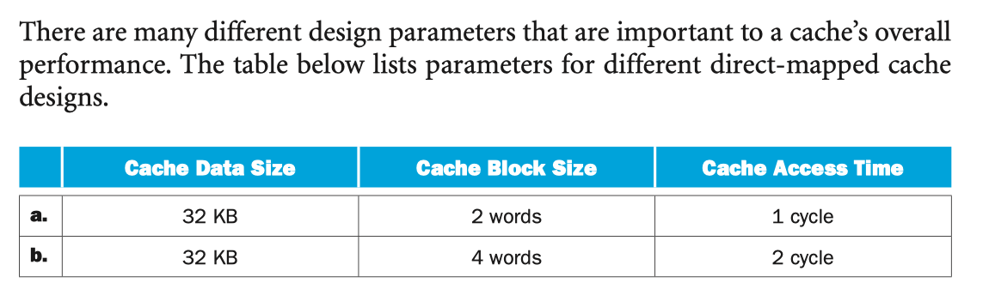
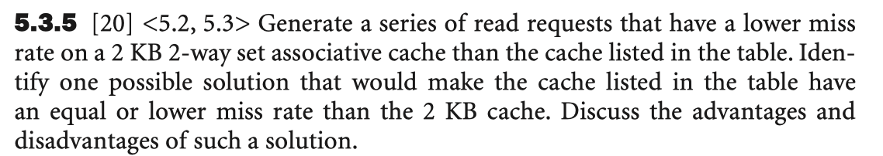
Exercise 5.3.5
To have a lower miss rate on a 2KB 2-way set associative cache:
Eg. 2KB cache, 16-word per block, 2-set
word address: 0, 64, 0, 64, ….
0 and 64 are in the same set.
For a larger direct-mapped cache to have a lower or equal miss rate than a smaller 2-way set associative cache, it would need to have at least double the cache block size. The advantage of such a solution is less misses for near by addresses (spatial locality), but with the disadvantage of suffering longer access times.

Slide 4
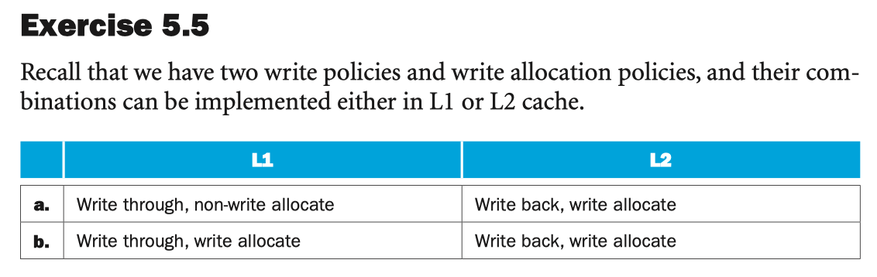
Exercise 5.5.2
a.
If L1 miss, send write request to L2.
If L2 hit, write data to L2, set the dirty bit.
If L2 miss, allocate cache block for the missing data, select a replacement victim.
If victim dirty, put it into the write-back buffer, which will be further forwarded into memory.
Issue write miss request to the memory.
Data arrives and is installed in L2 cache.
Write data to L2, set the dirty bit.
Processor resumes execution.

Slide 5
Exercise 5.5.2
b.
1. If L1 miss, send write request to L2.
2. If L2 hit, write data to L2, set the dirty bit. (go to step 8)
3. If L2 miss, allocate cache block for the missing data, select a replacement victim.
4. If victim dirty, put it into the write-back buffer, which will be further forwarded into memory.
5. Issue write miss request to the memory.
6. Data arrives and is installed in L2 cache.
7. Write data to L2, set the dirty bit.
8. Data arrives and is installed in L1 cache.
9. Processor resumes execution and hits in L1 cache

Slide 6
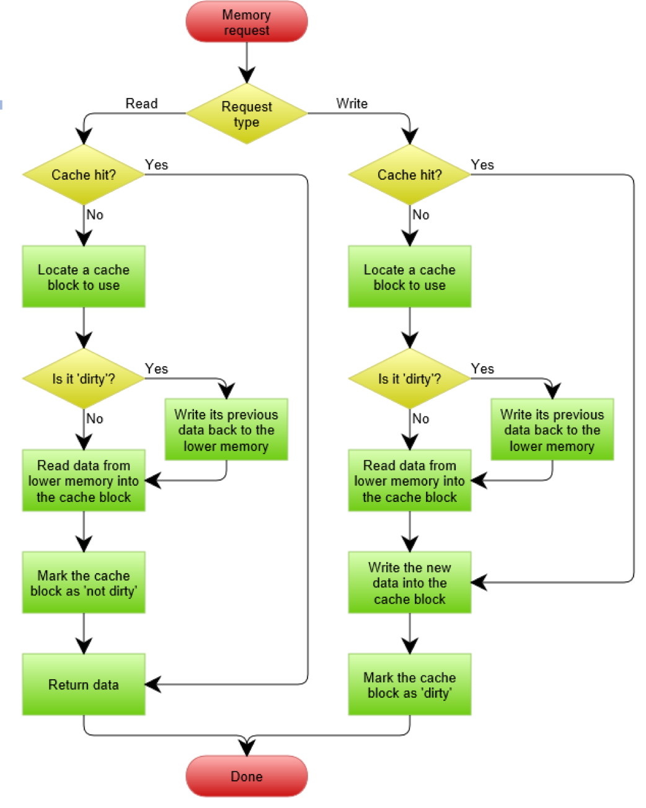
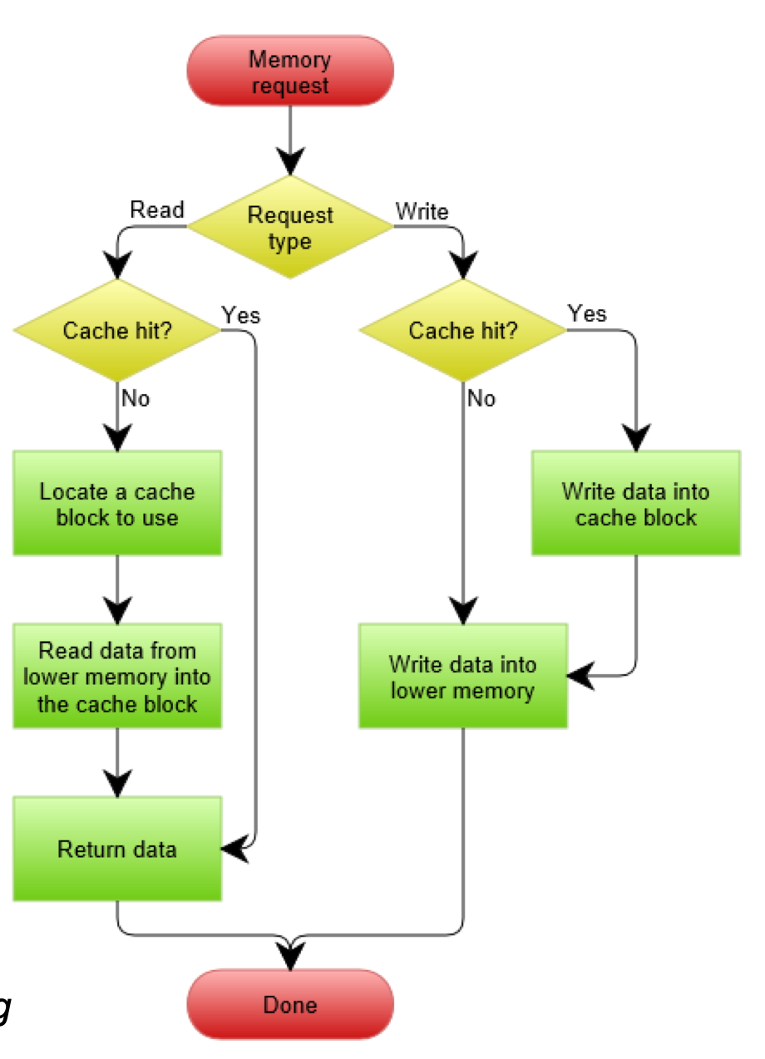

Slide 7
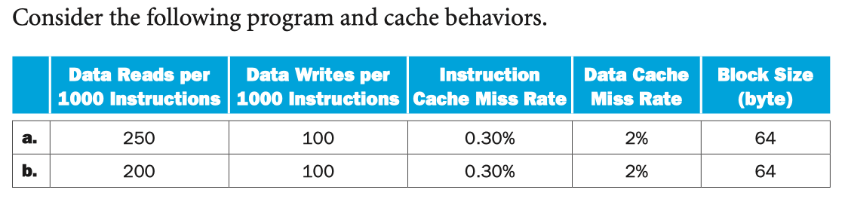
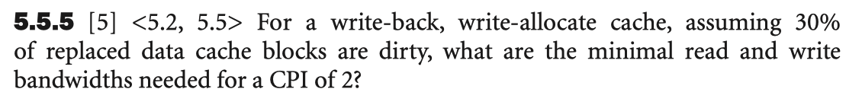
Exercise 5.5.5

Slide 8
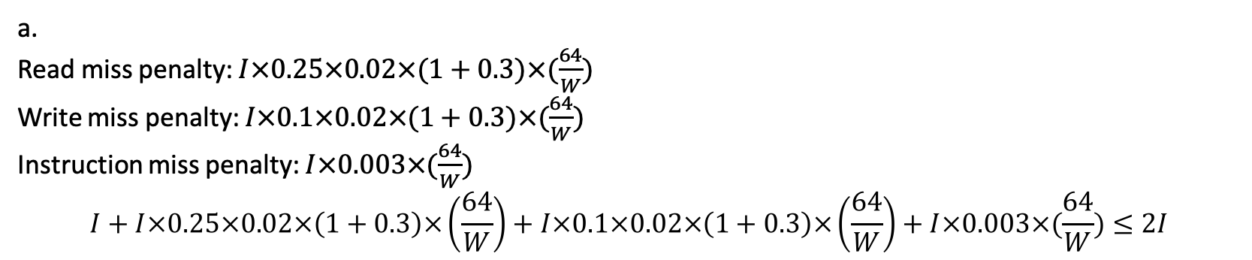
With the write back policy, the cache content may be changed and inconsistent with that in the main memory. Thus, upon a read miss, if the replaced block is “dirty”, it will first be written back to the main memory, and then the desired block will be brought into the cache. With write allocation, when a write miss occurs, the corresponding block will be brought to the cache, and then new data will be written into this block. The replaced block, if the dirty bit is set, will need to be written into the main memory first before the write block is brought into the cache. Suppose number of instruction is I, band width W, base CPI=1
a.
Read miss penalty: $I×0.25×0.02×(1+0.3)×(\frac{64}{W})$
Write miss penalty: $I×0.1×0.02×(1+0.3)×(\frac{64}{W})$
Instruction miss penalty: $I×0.003×(\frac{64}{W})$
$$I+I×0.25×0.02×\left(1+0.3\right)×\left(\frac{64}{W}\right)+I×0.1×0.02×\left(1+0.3\right)×\left(\frac{64}{W}\right)+I×0.003×(\frac{64}{W})≤2I$$

Slide 9
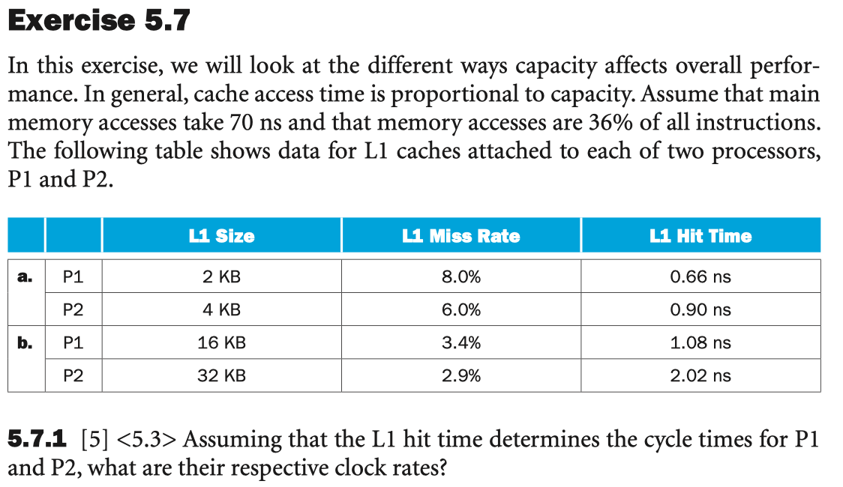
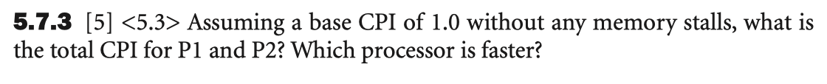
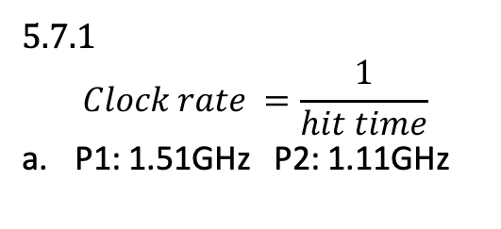
Exercise 5.7
5.7.1
$$Clock rate =\frac{1}{hit time}$$
P1: 1.51GHz P2: 1.11GHz

Slide 10
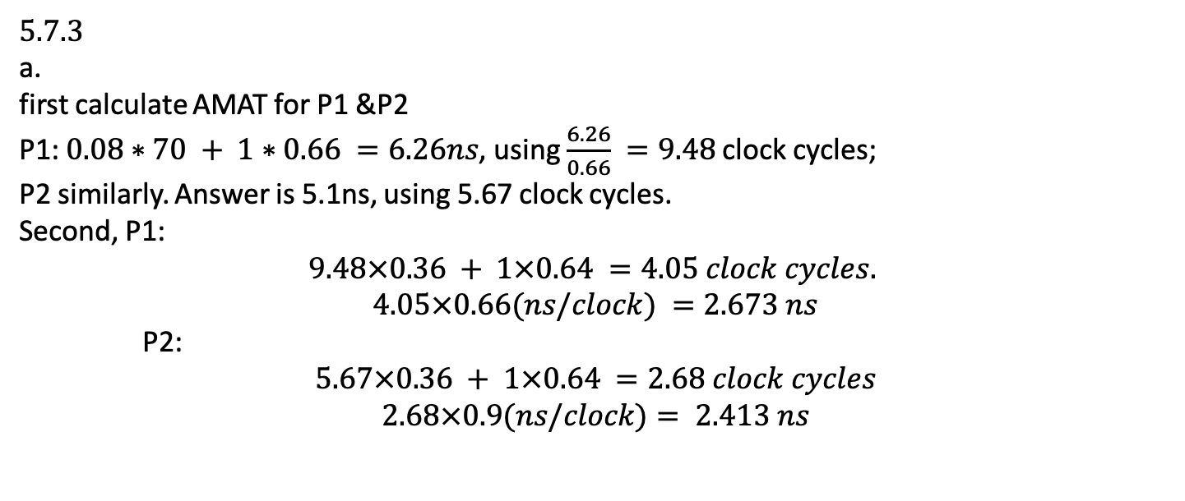
Exercise 5.7.3
5.7.3
first calculate AMAT for P1 &P2
P1: $0.08∗70 + 1∗0.66 =6.26ns$, using $\frac{6.26}{0.66} =9.48$clock cycles;
P2 similarly. Answer is 5.1ns, using 5.67 clock cycles.
Second, P1:
$$9.48×0.36 + 1×0.64 =4.05 clock cycles.$$
$$4.05×0.66(ns/clock) =2.673 ns$$
P2:
$$5.67×0.36 + 1×0.64 =2.68 clock cycles$$
$$2.68×0.9(ns/clock)= 2.413 ns$$

Slide 11
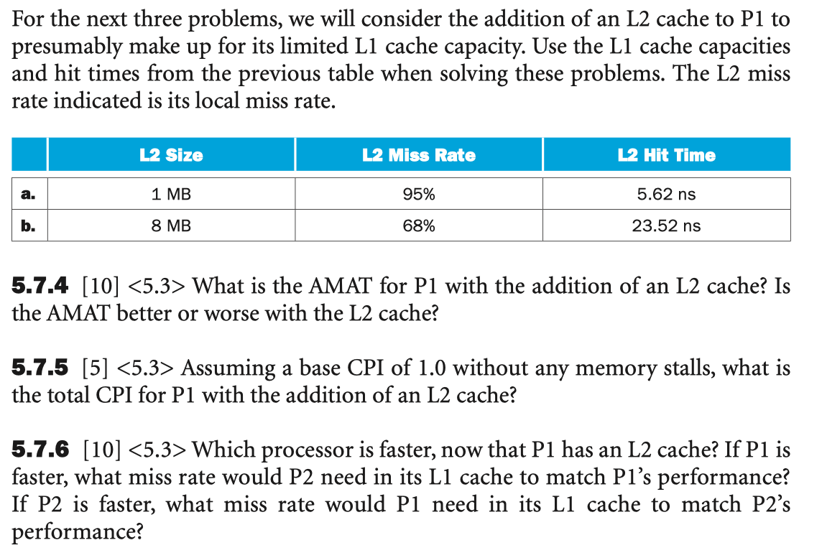
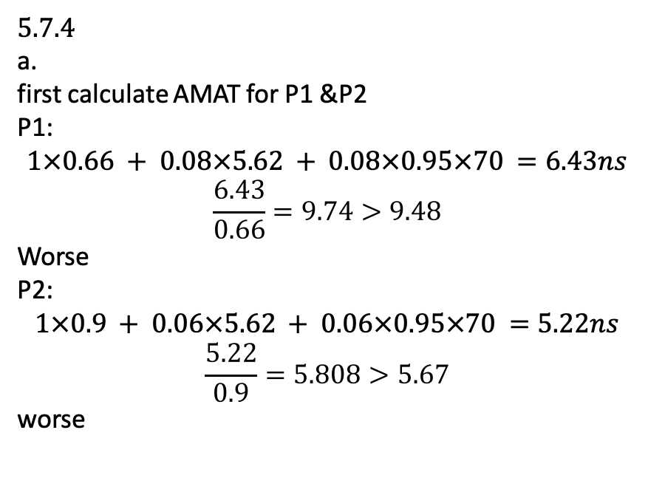
Exercise 5.7.4-5.7.6
5.7.4
first calculate AMAT for P1 &P2
P1:
$$1×0.66 + 0.08×5.62 + 0.08×0.95×70 =6.43ns$$
$$\frac{6.43}{0.66}=9.74>9.48$$
Worse
P2:
$$1×0.9 + 0.06×5.62 + 0.06×0.95×70 =5.22ns$$
$$\frac{5.22}{0.9}=5.808>5.67$$
worse

Slide 12

Exercise 5.7.4-5.7.6
5.7.5
P1:
$$9.74×0.36+1×0.64=4.15$$
P2:
$$5.808×0.36+1×0.64=2.73$$

Slide 13
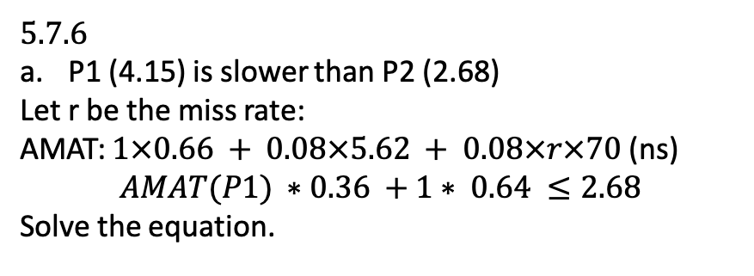
Exercise 5.7.4-5.7.6
5.7.6
P1 (4.15) is slower than P2 (2.68)
Let r be the miss rate:
AMAT: $1×0.66 + 0.08×5.62 + 0.08×r×70$(ns)
$$AMAT(P1) ∗0.36 +1∗ 0.64 ≤2.68$$
Solve the equation.

Slide 14
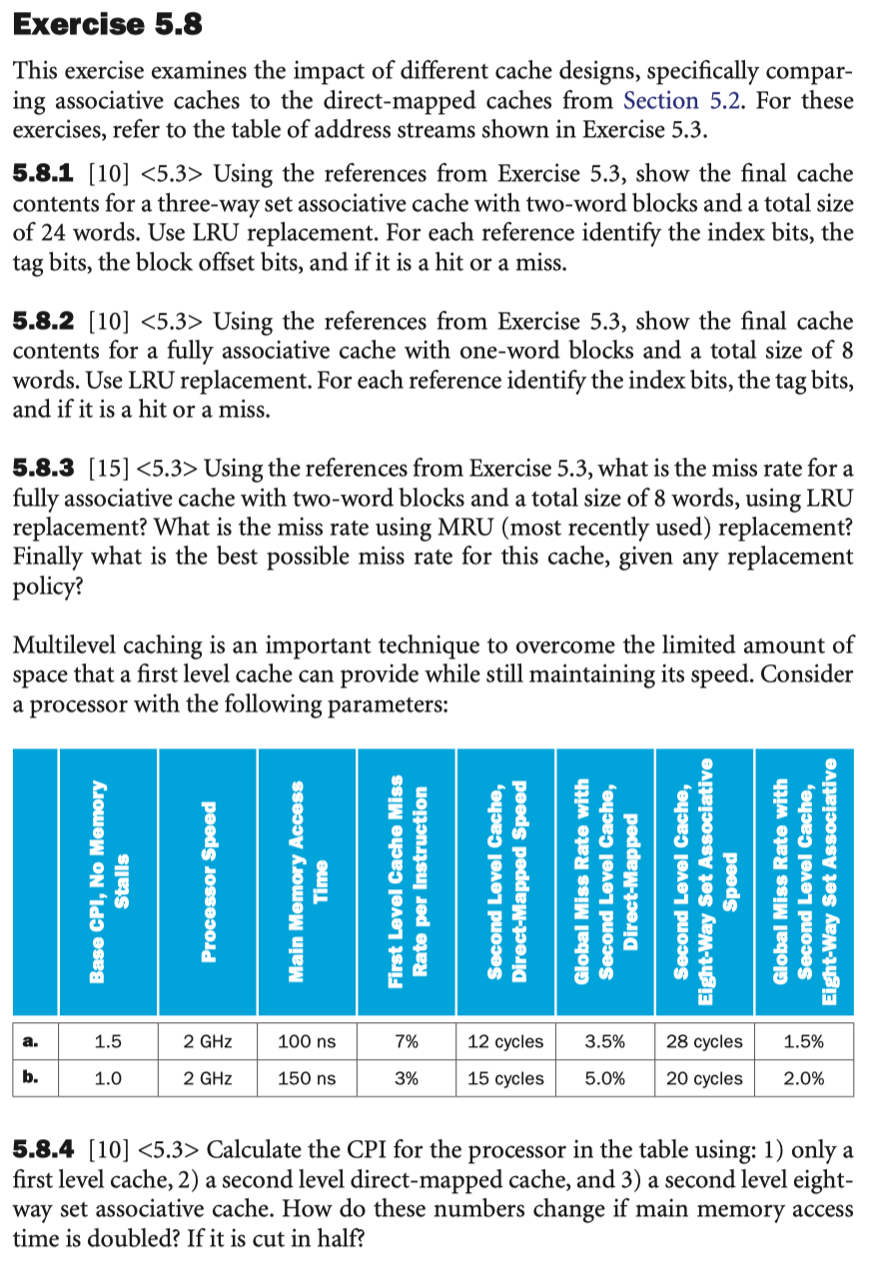
Exercise 5.8.1-5.8.3

Slide 15
 | Binary address | tag | index | h/m
3 | 11 | 0 | 01 | miss
180 | 10110100 | 10110 | 10 | miss
43 | 101011 | 101 | 01 | miss
2 | 10 | 0 | 01 | hit
191 | 10111111 | 10111 | 11 | miss
88 | 1011000 | 1011 | 00 | miss
190 | 10111110 | 10111 | 11 | hit
14 | 1110 | 1 | 11 | miss
181 | 10110101 | 10110 | 10 | hit
44 | 101100 | 101 | 10 | miss
186 | 10111010 | 10111 | 01 | miss
253 | 11111101 | 11111 | 10 | miss
Index
00 | 88 | 89
01 | 2 | 3 | 42 | 43 | 186 | 187
10 | 180 | 181 | 44 | 45 | 252 | 253
11 | 190 | 191 | 14 | 15
bits 7–3 tag, 2–1 index, 0 block offset
The block offset is the address of the desired data within the block.

Slide 16
 | Binary address | tag | index | h/m
3 | 11 | 11 | N/A | miss
180 | 10110100 | 10110100 | N/A | miss
43 | 101011 | 101011 | N/A | miss
2 | 10 | 10 | N/A | miss
191 | 10111111 | 10111111 | N/A | miss
88 | 1011000 | 1011000 | N/A | miss
190 | 10111110 | 10111110 | N/A | miss
14 | 1110 | 1110 | N/A | miss
181 | 10110101 | 10110101 | N/A | miss
44 | 101100 | 101100 | N/A | miss
186 | 10111010 | 10111010 | N/A | miss
253 | 11111101 | 11111101 | N/A | miss
3$→$181 | 180$→$44 | 43$→$186 | 2$→$253 | 191 | 88 | 190 | 14

Slide 17
 | Binary address | tag | index | h/m
3 | 11 | 11 | N/A | miss
180 | 10110100 | 10110100 | N/A | miss
43 | 101011 | 101011 | N/A | miss
2 | 10 | 10 | N/A | hit
191 | 10111111 | 10111111 | N/A | miss
88 | 1011000 | 1011000 | N/A | miss
190 | 10111110 | 10111110 | N/A | hit
14 | 1110 | 1110 | N/A | miss
181 | 10110101 | 10110101 | N/A | miss
44 | 101100 | 101100 | N/A | miss
186 | 10111010 | 10111010 | N/A | miss
253 | 11111101 | 11111101 | N/A | miss
LRU
2$→$14$→$186 | 3$→$15$→$187 | 180$→$88$→$180$→$252 | 181$→$89$→$181$→$253 | 42$→$14 | 43$→$15 | 190$→$44 | 191$→$45

Slide 18

 | Binary address | tag | index | h/m
3 | 11 | 11 | N/A | miss
180 | 10110100 | 10110100 | N/A | miss
43 | 101011 | 101011 | N/A | miss
2 | 10 | 10 | N/A | hit
191 | 10111111 | 10111111 | N/A | miss
88 | 1011000 | 1011000 | N/A | miss
190 | 10111110 | 10111110 | N/A | miss
14 | 1110 | 1110 | N/A | miss
181 | 10110101 | 10110101 | N/A | hit
44 | 101100 | 101100 | N/A | miss
186 | 10111010 | 10111010 | N/A | miss
253 | 11111101 | 11111101 | N/A | miss
MRU
The best miss rate is $\frac{10}{12}$
2 | 3 | 180$→$44$→$186$→$253 | 181$→$45$→$187$→$253 | 42 | 43 | 190$→$88$→$190$→$14 | 191$→$89$→$191$→$15

Slide 19
Exercise 5.8.4

Slide 20
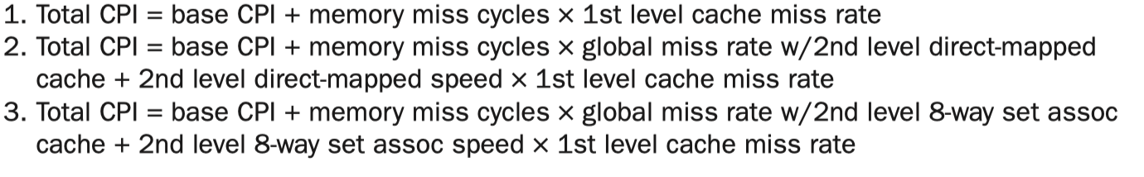
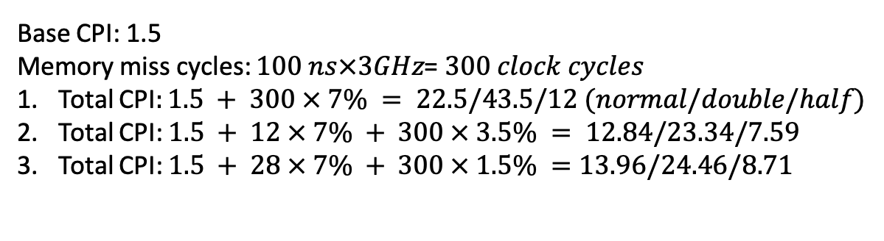
Base CPI: 1.5
Memory miss cycles: $100 ns×3GHz$= $300 clock cycles$
Total CPI$:1.5 + 300 × 7\% = 22.5/43.5/12 (normal/double/half)$
Total CPI: $1.5 + 12 × 7\% + 300 × 3.5\% = 12.84/23.34/7.59$
Total CPI: $1.5 + 28 × 7\% + 300 × 1.5\% =13.96/24.46/8.71$

