Slide 1





Baidu’s social responsibility as a technical company

Slide 2


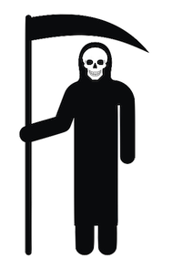
The death of Wei Zexi
Baidu Search
The Beijing Armed Police Corps Hospital
Wei Zexi
Notes:
第一部分，交代魏则西的死：
魏则西有XXX病，大医院说没救了，于是搜百度
Wei accepted the treatment from the Beijing Armed Police Corps because of the trust to the information from Baidu.
魏则西是由于去了百度上面的The Beijing Armed Police Corps hospital，医院说与外国合作的新方法有救。
the treatment, clinging to a promise made by his doctor that it “has an efficacy rate of 80–90%” and “could easily prolong my life for 20 years”.
然后被治死了。
after taking the treatment four times and spending more than 200 thousand RMB, Wei didn’t get any better. Finally, Wei passed away at home and before his death.
外国方法已经很久不用了，被证明无效。
引出下一张PPT，为什么去了莆田医院。

Slide 3


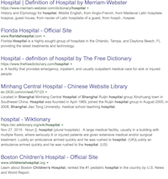

The relationship between Baidu and Putian hospital
Hospital
⭐️
The Beijing Armed Police Corps Hospital
Baidu revenues
Putian hospitals
12 billion RMB
The Beijing Armed Police Corps Hospital
total
26 billion RMB
Notes:
Baidu is China’s largest search engine and the largest Chinese searching engine in the world.
Enterprises can set their advertisements on Baidu and try to get a high rank on the searching list of Baidu by giving money to buy the service.
The Putian Medical Group, including the Beijing Armed Police Corps in Wei’s case, is also benefiting from Baidu promotion service.
Putian’s Communist Party chief stated that Putian hospitals may have contributed 12 billion RMB of the total of 26 billion RMB in ad revenues reported by Baidu that year.

