Slide 1
Preliminary Findings – Genre type of restaurant (air stores)
Air Genre Name | Numbers
Izakaya | 197
Cafe/Sweets | 181
Dining bar | 108
Italian/French | 102
Bar/Cocktail | 79
Japanese Food | 63
Other | 27
Yakiniku/Korean food | 23
Western food | 16
Okonomiyaki/Monja/Teppanyaki | 14
Creative cuisine | 13
Asian | 2
International cuisine | 2
Karaoke/Party | 2

Slide 2
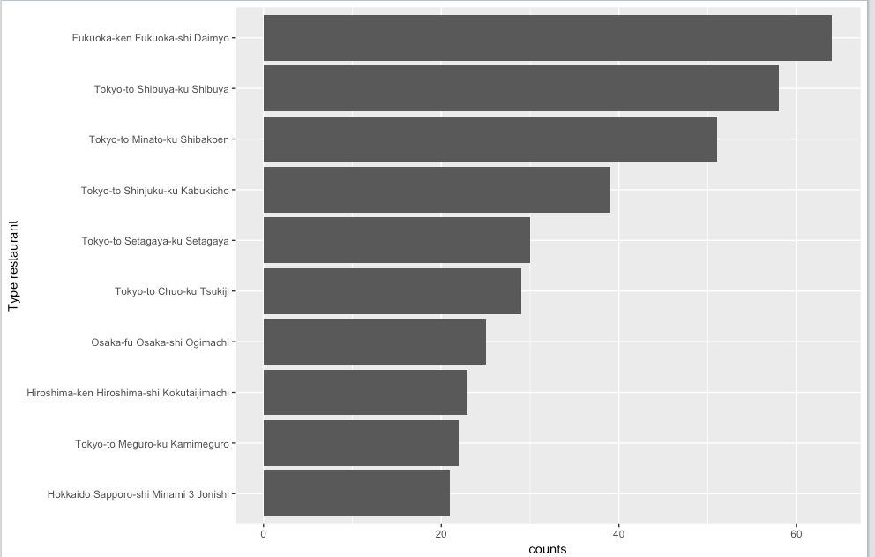
Preliminary Findings – Areas of air stores

Slide 3
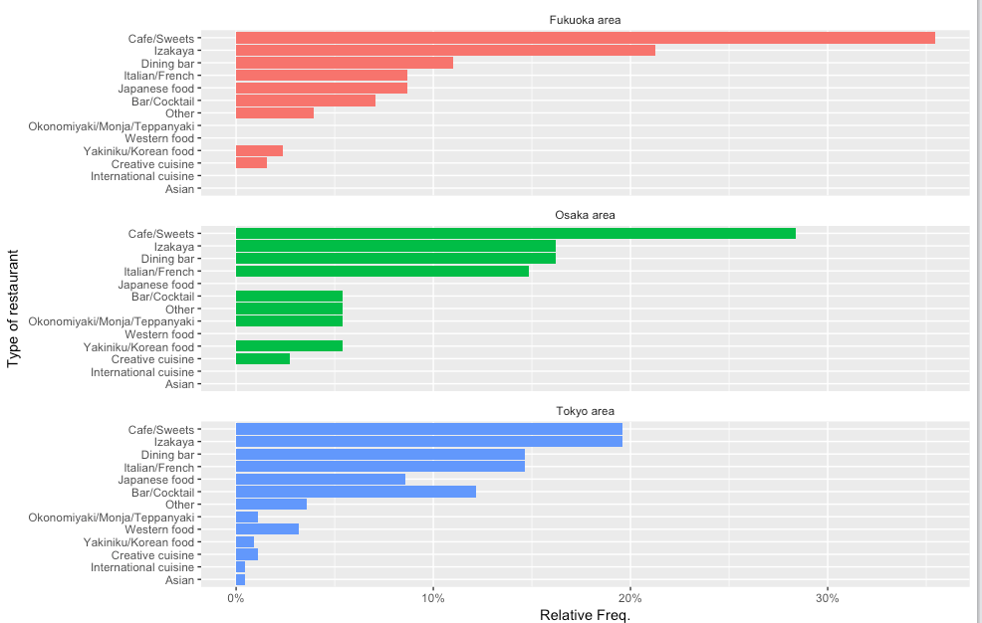
Preliminary Findings – Filter areas Tokyo, Fukuoka, Osaka and compare genre(air stores)

Slide 4
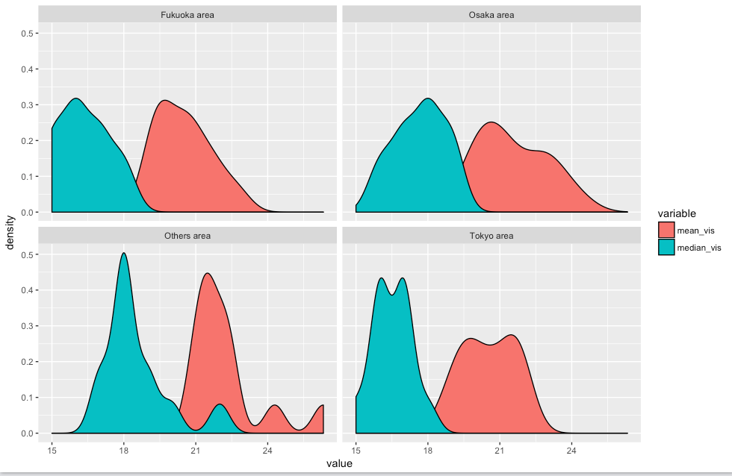
Preliminary Findings – Density map for visitors by month (air stores)

Slide 5
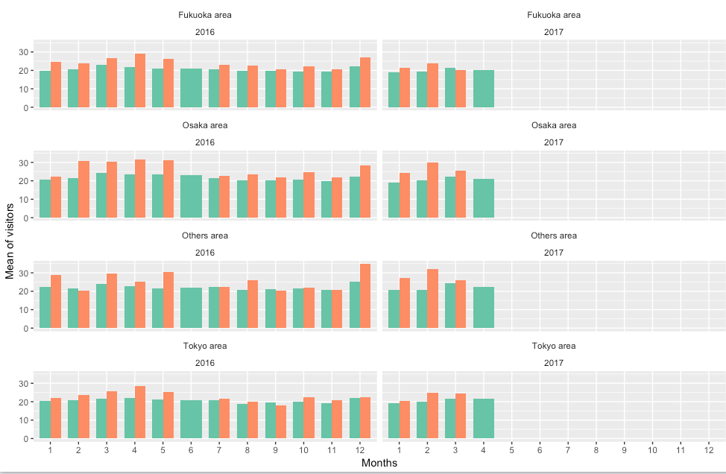
Preliminary Findings – Mean by area/month/year with mark holiday flag (air stores)

Slide 6
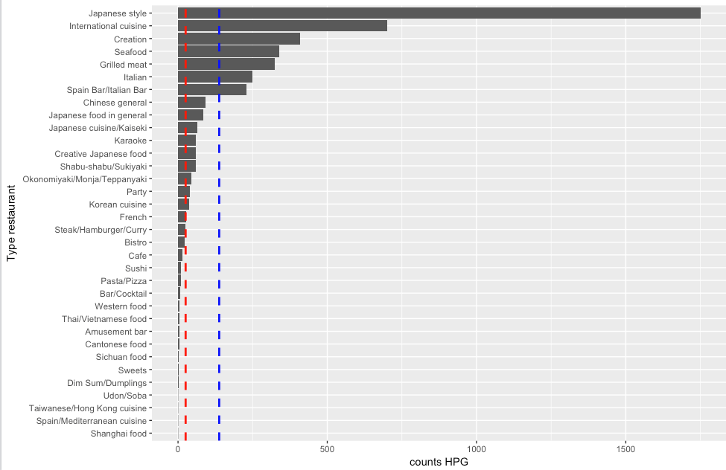
Preliminary Findings – Genre type of restaurant (hpg stores)

Slide 7
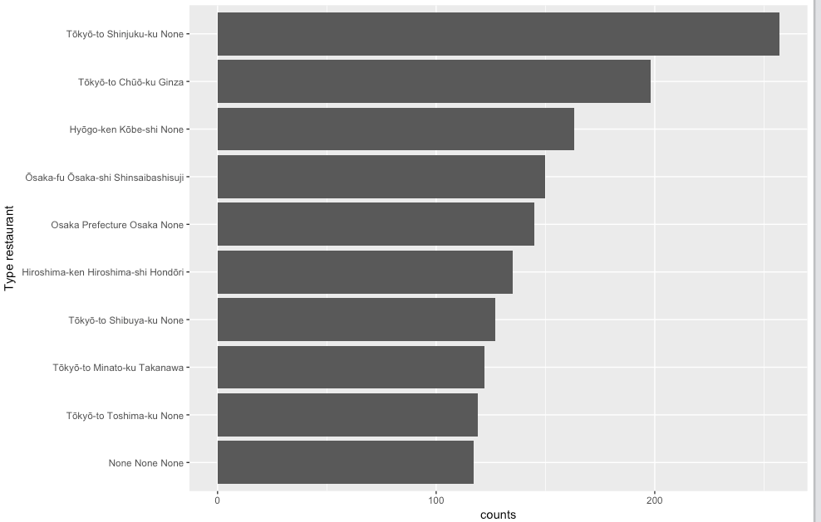
Preliminary Findings – Areas of hpg stores

Slide 8
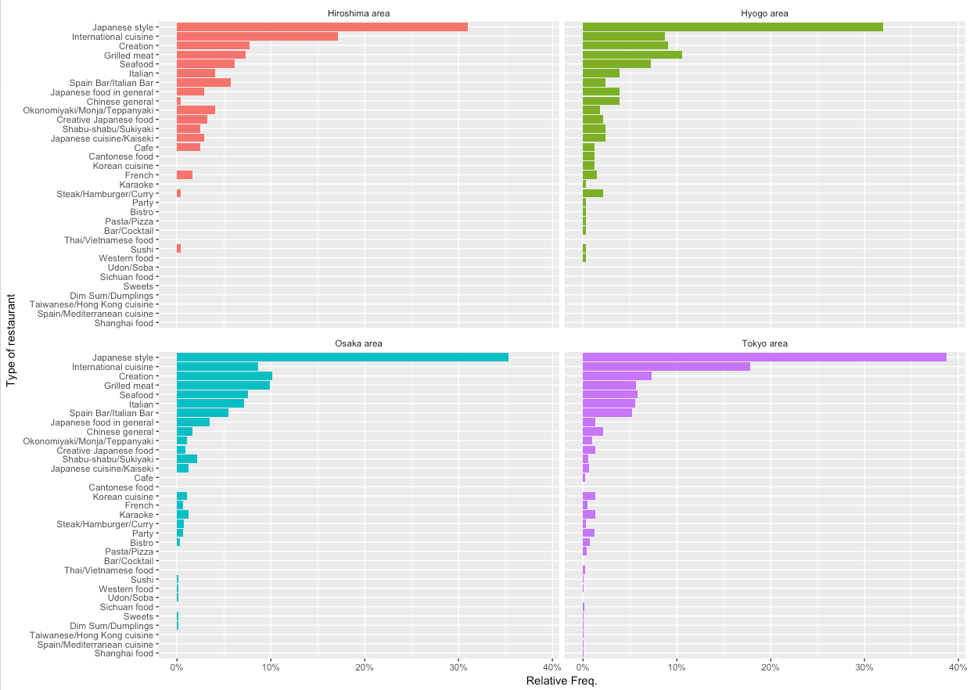
Preliminary Findings – Filter areas Tokyo, Hyogo, Osaka, Hiroshima and compare genre(hpg stores)

Slide 9
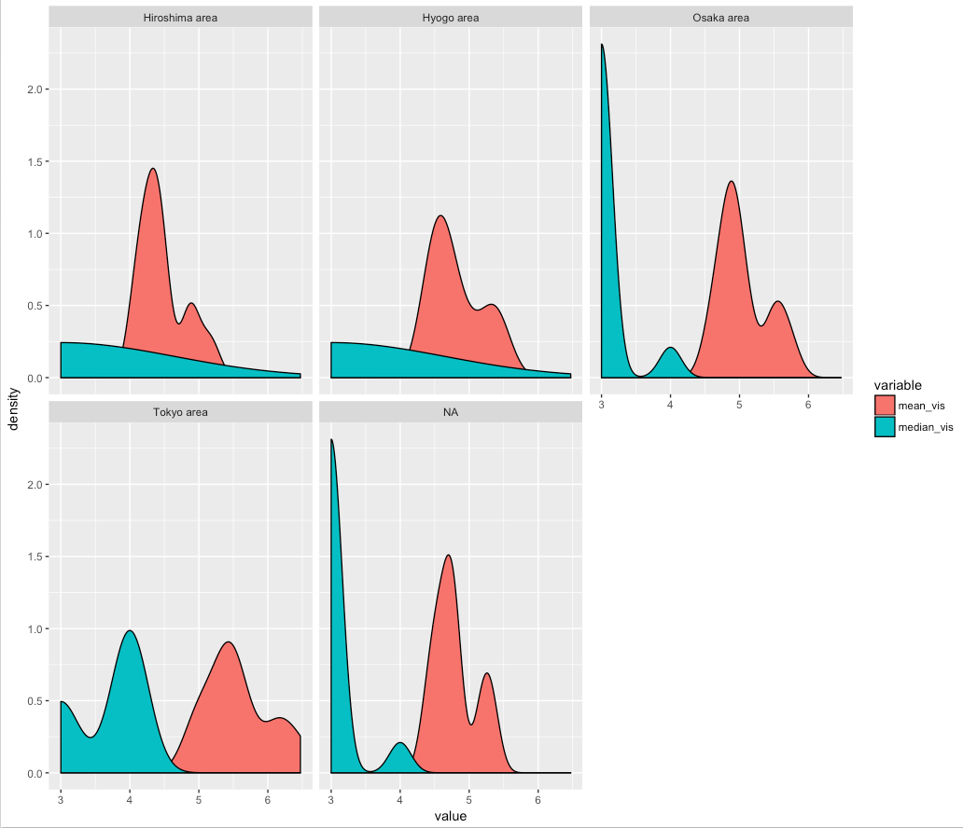
Preliminary Findings – Density map for visitors by month (hpg stores)

Slide 10
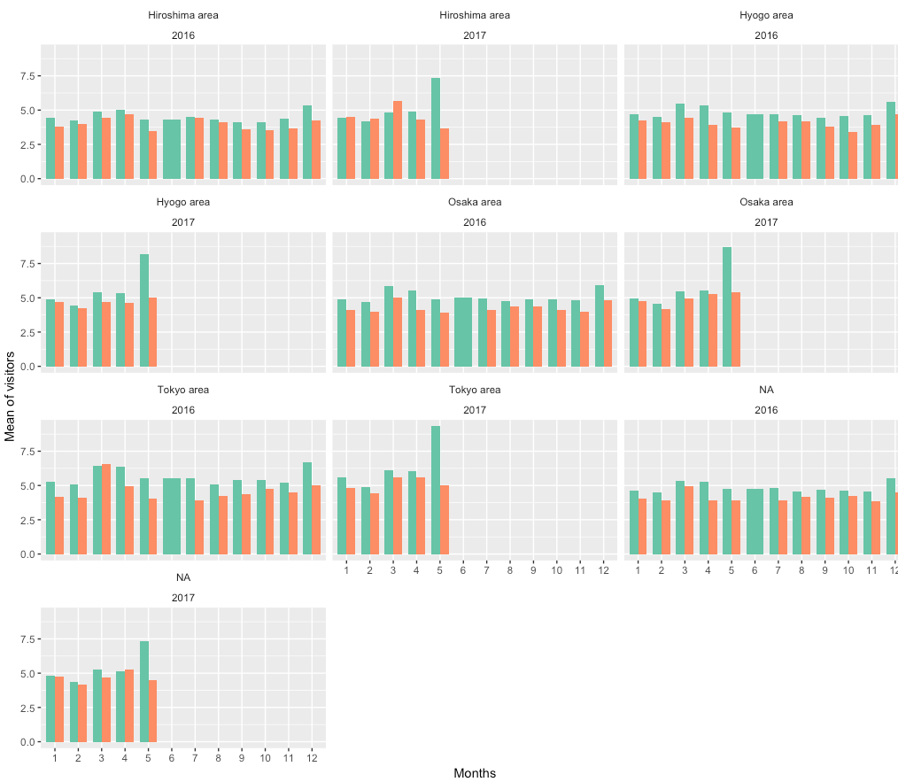
Preliminary Findings – Mean by area/month/year with mark holiday flag (hpg stores)

