Slide 1
EXPERIMENT VALIDATION
Experiment results close the loop from Python model to post-sim RTL.
4
5
SEQ_LEN
PATTERNS
Sparse attention core verification
16 / 32 / 64 / 128
full + four sparse modes
Python golden reference defines exact pair, MAC, checksum, and reduction values.
PASS
PASS
RTL pre-simulation reproduces software pair/MAC counts for every sequence block.
PRE-SIM
POST-SIM
Post-simulation keeps all checks passing after synthesized timing model.
all visible checks
all visible checks
Python
Presim
Synthesis
Postsim
golden counts
RTL behavior
gate netlist
timing-aware check
Source: docs/attention_compare_notes.md, RES/*.png
01

Slide 2
TEST SETUP
The workload fixes sequence length and pattern rules so reductions are predictable.
Pattern modes under test
Fixed parameters
full
all token pairs
seq_len
16, 32, 64, 128
window_size
4
sliding
4-token local block
dilation
2
dilated
every 2nd key in local block
global_index
0
sliding_global
local block + global token
feature_dim
4
butterfly
structured sparse connectivity
Verification rule: hardware pair count, estimated cycle count, MAC count, and final check must agree with software expectation.
Source: docs/attention_compare_notes.md, RES/*.png
02

Slide 3
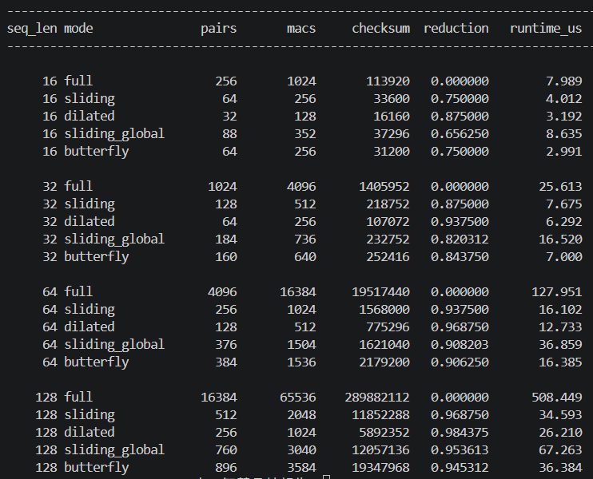
PYTHON GOLDEN
Python golden reference establishes exact pair and MAC counts for every mode.
65,536
The software run gives the expected table before any RTL comparison. It also includes a checksum column, so the demo is checking deterministic QK work rather than only counting loop iterations.
FULL MACS
seq_len=128 baseline
1,024
DILATED MACS
98.4375% reduction
Key readout: sparse modes reduce pair/MAC work while preserving a concrete score checksum for each tested sequence length.
3,040
GLOBAL MACS
95.3613% reduction
Source: RES/python.png; SW/attention_reference.py
03

Slide 4
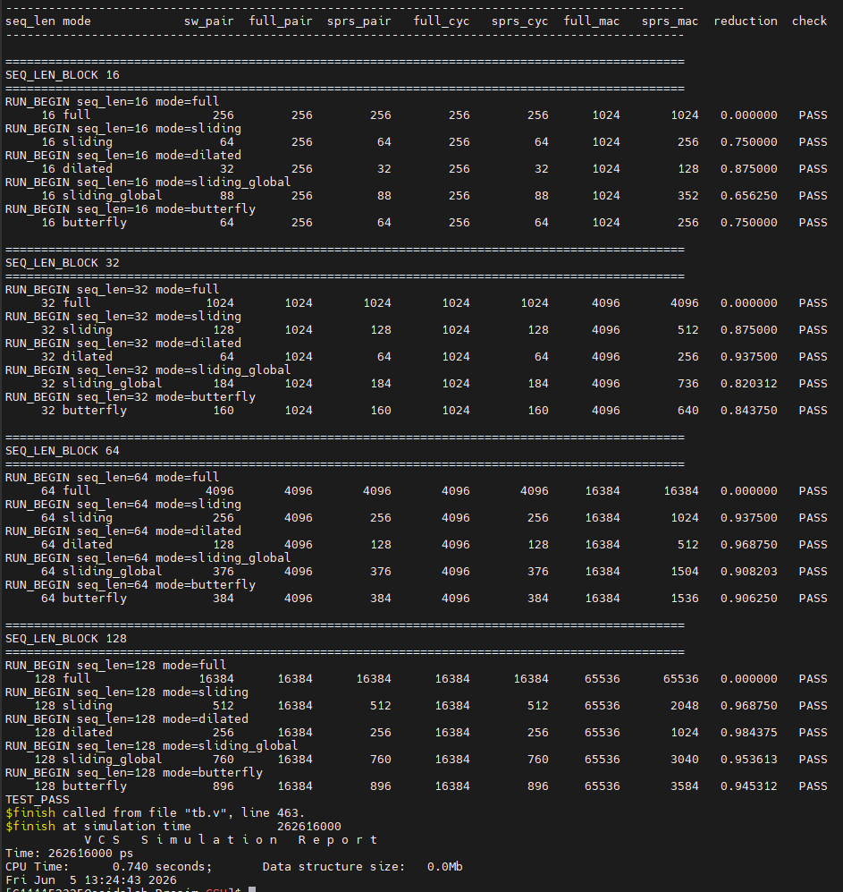
RTL PRE-SIMULATION
Pre-sim RTL matches software counts across every sequence block.
What the table proves
sw_pair, full_pair, and sprs_pair columns align for all visible runs.
full_cyc and sprs_cyc track the same pair-stream estimate.
full_mac and sprs_mac match the expected feature_dim=4 scaling.
Every visible row ends in PASS.
Pre-sim is the RTL behavior checkpoint before synthesis and timing annotation.
Source: RES/Presim.png; RTL/Presim/tb.v
04

Slide 5
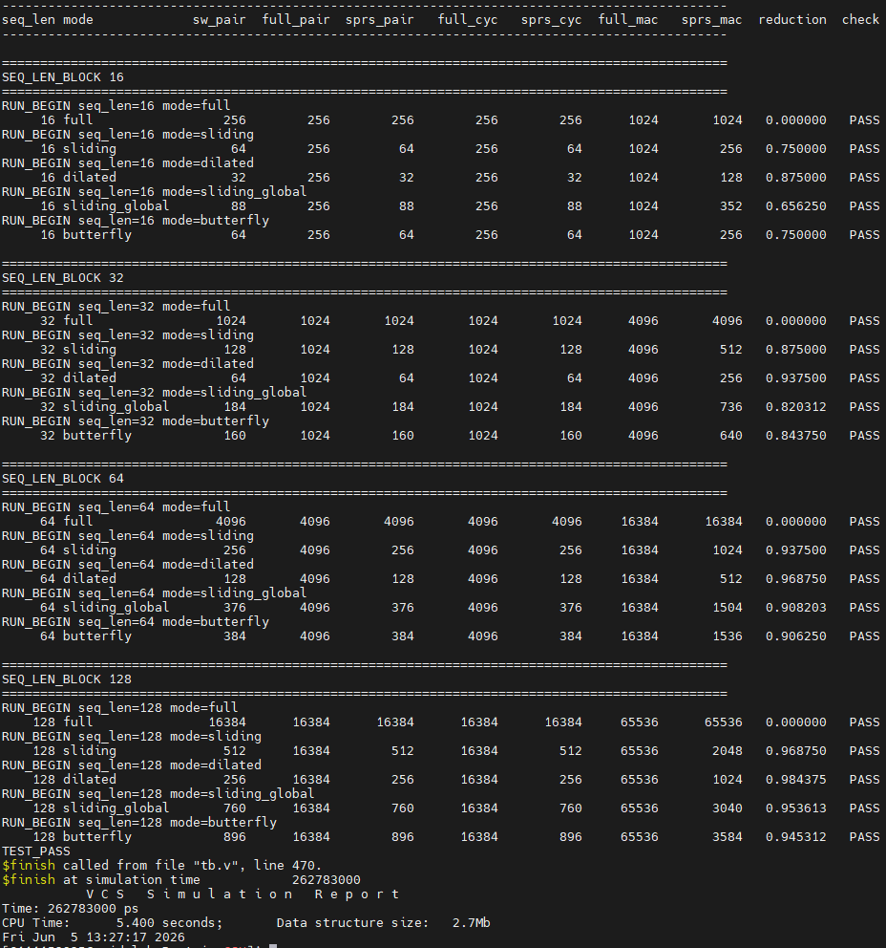
POST-SIMULATION
Post-sim preserves the same correctness after the synthesized timing model.
TEST PASS
postsim visible rows
Synthesis did not change the functional answer.
The same sparse pair/MAC reductions survive the post-sim run.
CPU time shown in the simulator report is a tool runtime, not hardware throughput.
Source: RES/Postsim.png; RTL/Postsim/tb.v
05

Slide 6
VALIDATION SUMMARY
At seq_len=128, sparse modes cut MAC work by 94.5%-98.4% while all checks pass.
MAC reduction vs full attention, seq_len=128
What is validated
sliding
96.88%
Software expected counts exist for all modes.
2,048 MACs
dilated
98.44%
Pre-sim RTL agrees with the golden reference.
1,024 MACs
sliding_global
95.36%
Post-sim output remains PASS.
3,040 MACs
butterfly
94.53%
Sparse pair-stream cycle estimate scales with valid pairs.
3,584 MACs
Conclusion: the experiment section can claim functional consistency across software, RTL pre-sim, and post-sim, with sparse attention delivering the expected MAC reduction.
Source: docs/attention_compare_notes.md, RES/*.png
06

