Slide 1
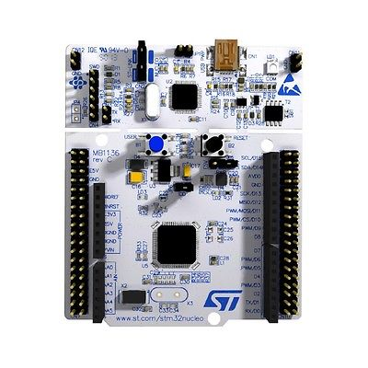
Microcontroller Circuit Nucleo STM32L476RG
A2,A3,A4-Voltmeter
A5-AM Mod

Slide 2


Voltage Divider Circuit
V_O1
R1
R2
V_XY
V_O2
R1
R2
V_YZ
V_O3
R1
R2
V_ZX

Slide 3
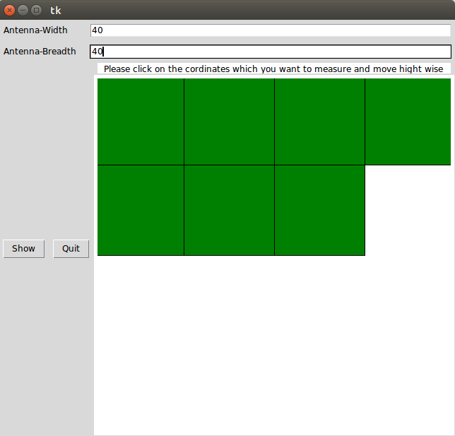
Graphical User Interface

Slide 4
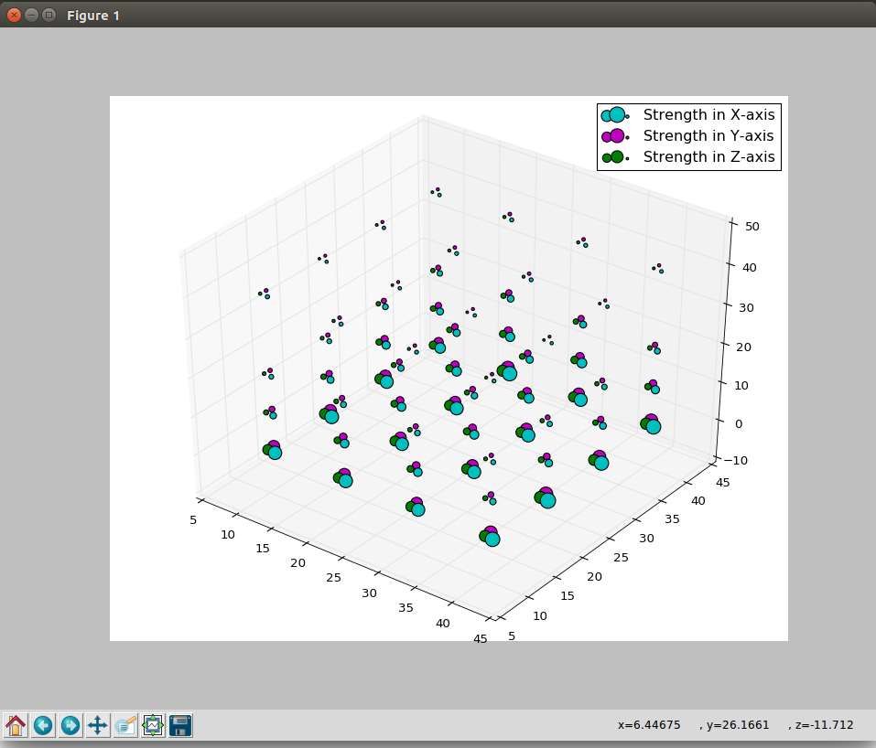
4-Dimensional Scattered Graph

Slide 5
Voltage Readings Received

