Slide 1
Pacman Game API Design
COMP504
Team Sleepy Day
Notes:
Hi everyone, we are sleepy day.

Slide 2
Overview
Team Members
Graphical User Interface Demo
Use Case Introduction
Pac-Man Game API
Highlights of Our Project
Notes:
Today’s presentation includes 5 parts. Let’s start with introduction of our team members.

Slide 3



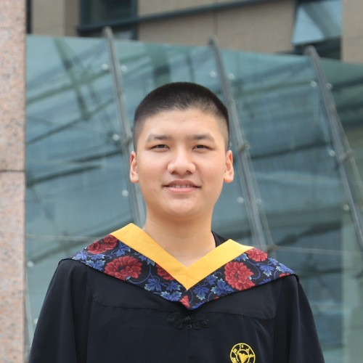


Team Introduction
Bingnan
Team Leader
Qi-ao
Tech Leader
Qian
Doc Leader
Jianxu
Backend Dev
Yusen
Frontend Dev
Jianjun
Frontend Dev
Li Chen
Developer
Notes:
We got six member in our group. I am the first one. the second one is Qi-ao, our tech leader, who was responsible for creating interface. Document lead is Qian, she established the API document and helped prepare presentation. Jianxu was in charge of back-end implementation, Yusen and Jianjun’s main job was constructing map and drawing other game objects in the front-end.

Slide 4
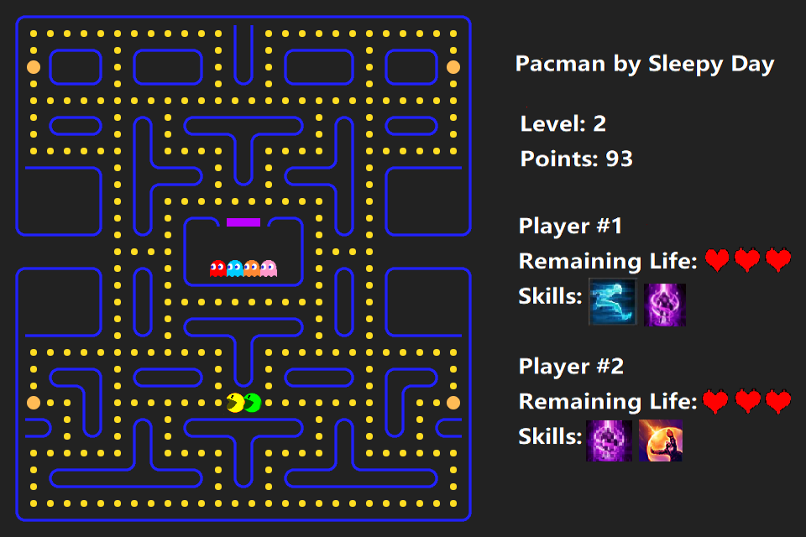
Graphical User Interface Demo
https://pacman-team-sleepyday.herokuapp.com
Notes:
We’ve achieve a pretty good graphical user interface, including moving and static objects. In our design, two players can control their own pacman independently and they will have remaining life and skills displayed in the right side. The goal of one or two players in our game is to eat all dots and enter next level. So, That’s it, a quick overview our project. Our tech leader will be the next to introduce some details. Please welcome.

Slide 5
Use case
Start Game
Initialize Level
Update
Terminate Game
Next Level
Notes:
The game itself can be divided into 4 parts:
game start
level initialization
update
game end

Slide 6
Use case
Start Game
Initialize Level
Update
Terminate Game
Next Level
Notes:
Now, we turn to first part
game start

Slide 7
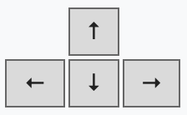
Start Game
Press to start game
Initialize one Pacman with 3 lives
Notes:
There are only a few things to do with game start.
User presses any arrow key to start game.
A Pacman initially has 3 lives.

Slide 8
Use case
Start Game
Initialize Level
Update
Terminate Game
Next Level
Notes:
Then, next step, level initialization ...

Slide 9
Initialize Level
Load current level information from stored files
Map of this level
Ghost number for each type
Initialize Pacman and Ghosts states
Location (place of birth)
Speed (without skills)
Types
Notes:
Load stored level information (map & ghost number per type)
For each level, Pacman and ghosts are set to their birth place by level map.

Slide 10
Use case
Start Game
Initialize Level
Update
Terminate Game
Next Level
Notes:
Here comes the most important part: update

Slide 11
Update (Pacman - Ghost)
Press to move Pacman
A Pacman can eat (collide with)
Dot --> gain 10 points
Fruit (randomly produced) --> gain 100 points
Energizer --> gain 50 points
& switch to Ghost-Retreat (GR) mode
Ghost (GR mode) --> first 200 points,
second 400 points, …
Ghost can eat (collide with) a Pacman -->
Notes:
User controls Pacman’s moving direction in the maze using arrow keys.
Eating:
Each time a Pacman eats a dot, the player will gain 10 points.
Each time a Pacman eats a fruit, the player will gain 100 points.
Each time a Pacman eats an energizer, the player will gain 50 points, and it will become invisible and capable of chasing the ghosts. Once it catches a ghost, the player will gain 200 points (it will double the next time); and the ghost will be reset to its birth place.
When the Pacman is caught by one ghost, it will be reset to its birth place and lose one life.

Slide 12
Use case
Start Game
Initialize Level
Update
Terminate Game
Pacman eats all dots in current level
Next Level
Notes:
When all the dots are eaten by the Pacman, the game will go to next level. The next level will have more ghosts or faster ghosts.

Slide 13
Use case
Start Game
Initialize Level
Update
Terminate Game
Next Level
Notes:
When the Pacman is caught by one ghost, it will be reset to its birth place and lose one life. And if all 3 lives lost, the game is over..

Slide 14

Terminate Game
A Pacman loses all its lives
Press button to restart the game
Notes:
If all 3 lives lost, the game is over.
Press restart button to restart the game.

Slide 15
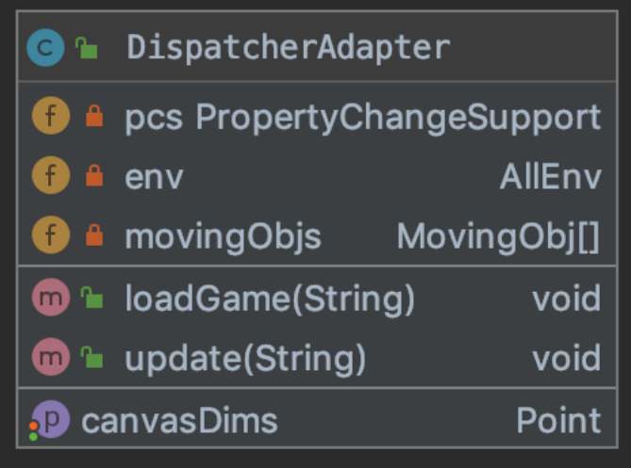
Game API
Create the game objects
Maintain the game process
Notes:
We use the DA to create the game objects like pacman and ghost and maintain the game process like in the update funtion, we will update the location of pacman and ghost and perform the change accordingly.

Slide 16
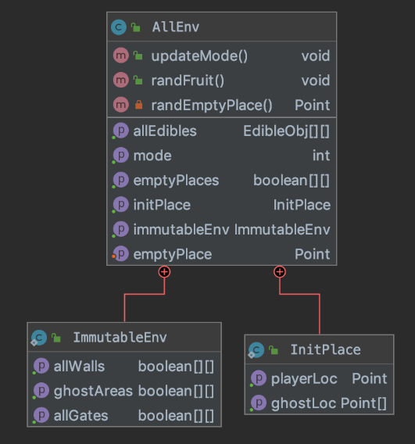
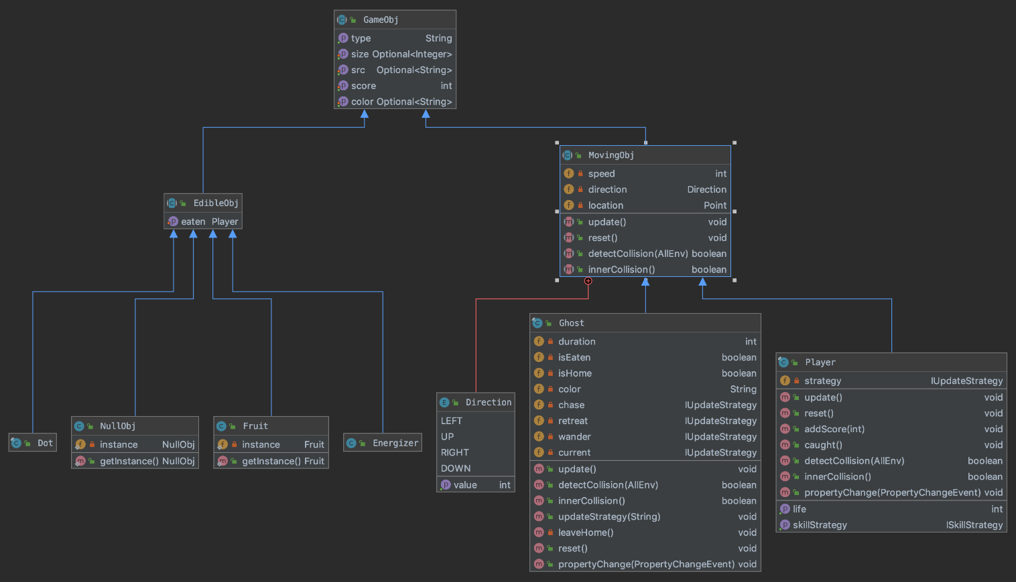
Game API
Static objects
Edible objects
Moving objects

Slide 17
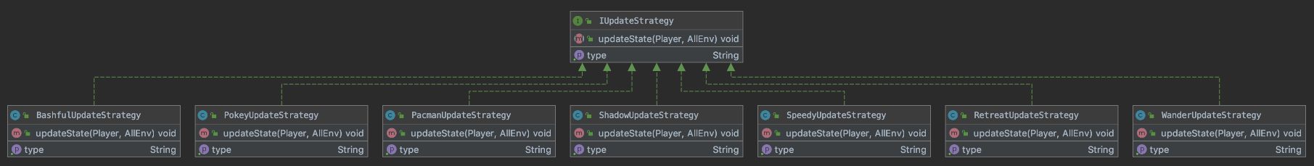
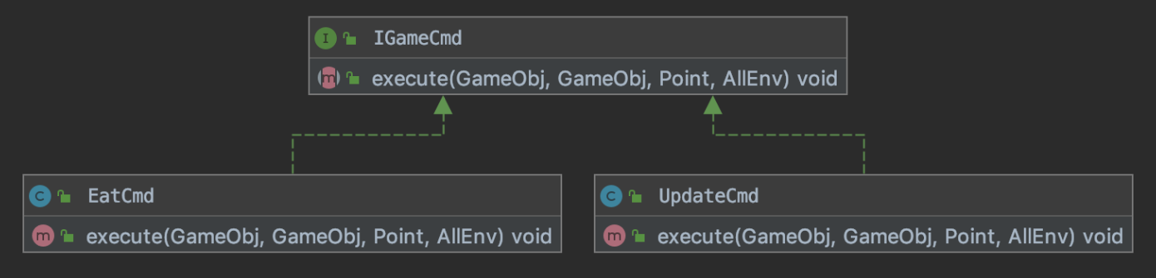
Game API
Strategies
Commands

Slide 18
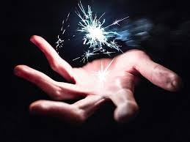
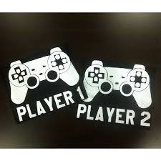
Highlights
Magic pacman mode
Double player mode

Slide 19






Pacman Skills
Acceleration
Invincible
Teleport

