Slide 1
Convolution
邸慧军
ajon@bit.edu.cn
计算机学院
智能信息技术北京市重点实验室
图像计算与感知智能研究所

Slide 2
Content
Definition
Understand the convolution
Signal and System
Signal Transforms
Calculation of convolution
Properties of convolution
Spatial Filtering and Convolution

Slide 3
Convolution
Continuous time signal
Discrete time signal
How to understand it?
How is the convolution derived?

Slide 4
Content
Definition
Understand the convolution
Signal and System
Basic Concept
Linear, Time-Invariant (LTI) System
Impulse-Response
Signal Transforms
Calculation of convolution
Properties of convolution
Spatial Filtering and Convolution

Slide 5

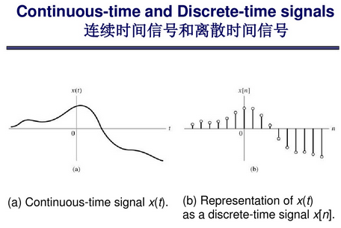
Signal and System
Signal

Slide 6
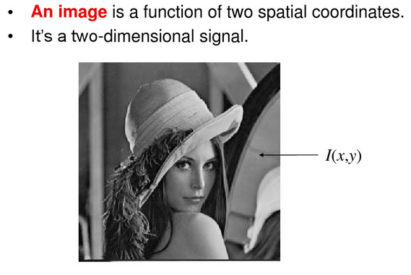
Signal and System

Slide 7
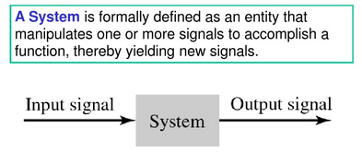
Signal and System
System
For example
Light signal
Camera
Image signal
Image signal
Image Filtering
Image signal

Slide 8
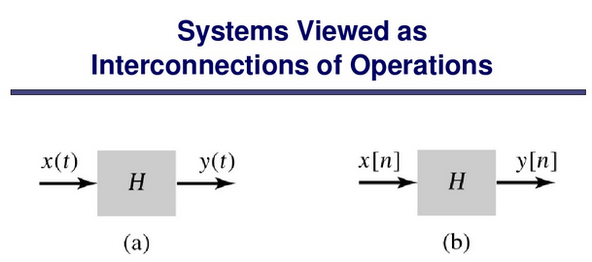
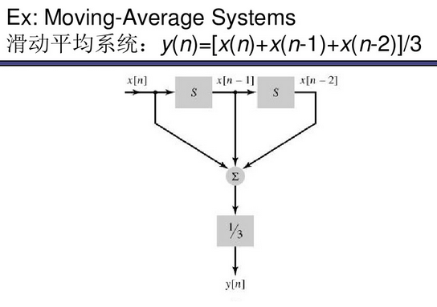

Slide 9
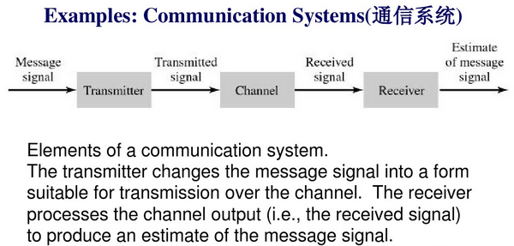

Slide 10
Content
Definition
Understand the convolution
Signal and System
Basic Concept
Linear, Time-Invariant (LTI) System
Impulse-Response
Signal Transforms
Calculation of convolution
Properties of convolution
Spatial Filtering and Convolution

Slide 11
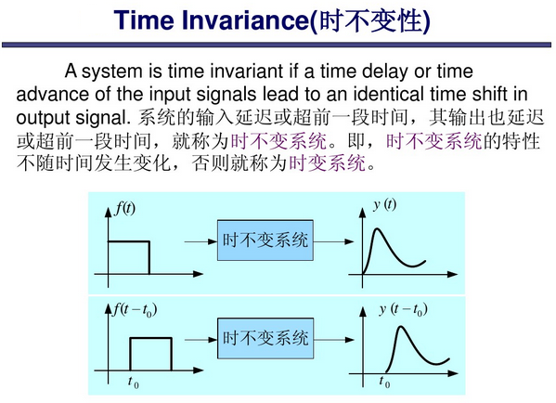

Slide 12
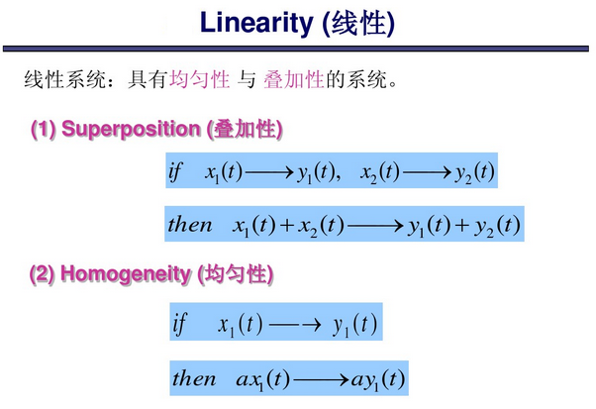

Slide 13
Content
Definition
Understand the convolution
Signal and System
Basic Concept
Linear, Time-Invariant (LTI) System
Impulse-Response
Signal Transforms
Calculation of convolution
Properties of convolution
Spatial Filtering and Convolution

Slide 14
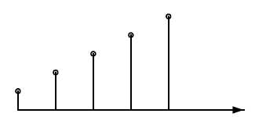
Let’s play a game
Ultraman fight Monsters
Suppose the attack effect is
For one unit hit (1 strength), the blood drop of the Monster in the following 5 seconds will be 1 2 3 4 5
Hit signal
Monster
Blood drop signal
Unit hit response h[n]
h[0~4] = {1,2,3,4,5}

Slide 15
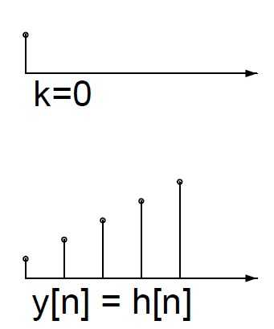
Let’s play a game
If hit the monster with 1 strength at 0-th second
Hit signal
Monster
Blood drop signal
Hit signal: x
Blood drop signal: y

Slide 16
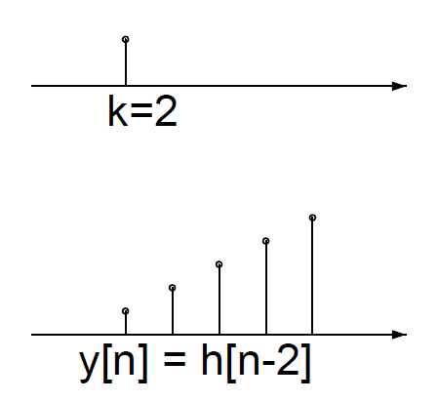
Let’s play a game
If hit the monster with 1 strength at 2-th second
Hit signal
Monster
Blood drop signal
Hit signal: x
Time-Invariant
Blood drop signal: y

Slide 17
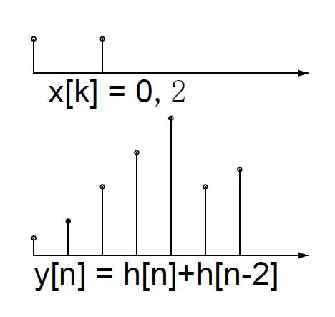
Let’s play a game
If hit the monster with 1 strength at 0-th and 2-th second
Hit signal
Monster
Blood drop signal
Hit signal: x
Linear
Blood drop signal: y

Slide 18
Let’s play a game
For a general hit x[k] (hit strength at k-th second)
Hit signal
Monster
Blood drop signal
y[7]=x[3] h[7-3]+x[4] h[7-4] +x[5] h[7-5] +x[6] h[7-6] +x[7] h[7-7]

Slide 19
Content
Definition
Understand the convolution
Signal and System
Basic Concept
Linear, Time-Invariant (LTI) System
Impulse-Response
Signal Transforms
Calculation of convolution
Properties of convolution
Spatial Filtering and Convolution

Slide 20
Ultraman fight Monsters
Suppose the attack effect is
For one unit hit (1 strength), the blood drop of the Monster in the following 5 seconds will be 1 2 3 4 5
Hit signal
Monster
Blood drop signal
Unit hit response h(n)

Slide 21
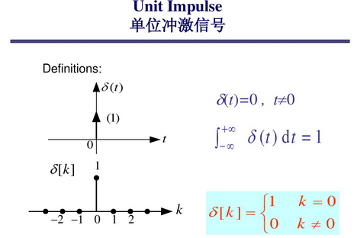

Slide 22
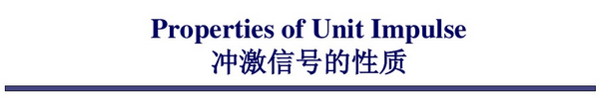
Selection
Signal Sampling
Signal Decomposition
A signal can be decomposed into a group of impulses

Slide 23
Ultraman fight Monsters
Suppose the attack effect is
For one unit hit (1 strength), the blood drop of the Monster in the following 5 seconds will be 1 2 3 4 5
For a general hit x[k] (hit strength at k-th second)
Hit signal
Monster
Blood drop signal
Unit hit response h(n)

Slide 24
Impulse Response
Impulse response
Given impulse response h of a system, for any input signal x, then output y will be
Unit Impulse δ(t)
System
Impulse Response h(t)
Input signal x(t)
output signal y(t)
Linear, Time-Invariant

Slide 25
Content
Definition
Understand the convolution
Signal and System
Signal Transforms (Power series)
Fourier Transforms, Z-Transform, Laplace Transform
Calculation of convolution
Properties of convolution
Spatial Filtering and Convolution

Slide 26
Signal Transforms
Frequency Decomposition of a signal
Fourier Transforms
Laplace Transform
Z-Transform
They are all about power series

Slide 27
Convolution Theorem
Input signal f
System
h
output signal g
Transform
Input F
System
H
output G

Slide 28
Content
Definition
Understand the convolution
Calculation of convolution
Properties of convolution
Spatial Filtering and Convolution

Slide 29
Three-Steps of Convolution
For any given n, how to obtain
Step 1: time reversal of either signal
e.g., h[k]→h[-k]
Step 2: shift h[-k] by n samples to obtain h[n-k]
Step 3: multiply f[k] and h[n-k] for each k and then take the summation over k
Note
You need to change variable n to get the whole sequence.

Slide 30
1D Linear Convolution
a set of impulse
f[n]=[1 2 3 4]
h[k]=[1 –1]
4
3
1
2
1
o
-1
o
origin

Slide 31
Step 1:Time Reversal
h[k]=[1 –1]
h[-k]=[–1 1]
1
1
o
o
-1
-1

Slide 32
Step 2: Shift
h[-k]
h[1-k]
h[2-k]
1
1
1
o
o
o
-1
-1
n=1
n=0
n=2
4
3
2
f[k]=[1 2 3 4]
1
o

Slide 33
Step3: Multiply-and-Add
g[0]=1
g[2]=1
g[1]=1
1
1
1
o
o
o
-1
-1
n=2
n=0
n=1
4
3
2
f[k]=[1 2 3 4]
1
o

Slide 34
Final Result
f[n]=[1 2 3 4]
h[n]=[1 –1]
g[n]=[1 1 1 1 -4]
If the lengths of two input signals are N₁ and N₂ respectively,
the length of the output signal will be N₁+N₂-1.

Slide 35
2D Linear Convolution
n
n
x(m,n)
h(m,n)
4 1
2 5 3
1
1 -1
m
m

Slide 36
Step 1:Time Reversal
h(m,n)
h(m,-n)
h(-m,-n)
n
1
1 -1
m
-1
1 1
-1 1
1 1

Slide 37
Step 2: Shift
l
h(1-k,1-l)
h(1-k,-l)
h(-k,-l)
-1 1
1 1
4 1
2 5 3
-1 1
1 1
-1 1
1 1
k
x(k,l)

Slide 38
Step3: Multiply-and-Add
l
y(1,1)=10
y(1,0)=3
y(0,0)=2
-1 1
1 1
4 1
2 5 3
-1 1
1 1
-1 1
1 1
k
x(k,l)

Slide 39
Content
Definition
Understand the convolution
Calculation of convolution
Properties of convolution
Spatial Filtering and Convolution

Slide 40
Properties of Convolution
Commutative
Associative
Distributive
Derivative
Convolution with impulse

Slide 41
Properties of Convolution
Cascade system

Slide 42
Content
Definition
Understand the convolution
Calculation of convolution
Properties of convolution
Spatial Filtering and Convolution

Slide 43


Spatial Filtering: Gaussian Smoothing

Slide 44
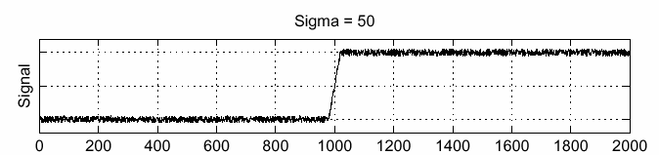
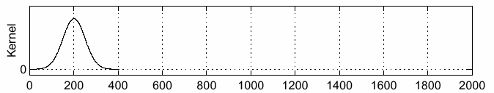
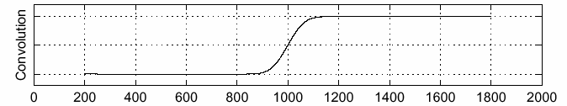
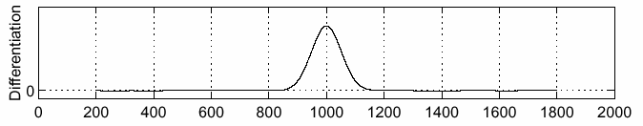
Spatial Filtering: Gradient
f
g
f * g
Source: S. Seitz

Slide 45
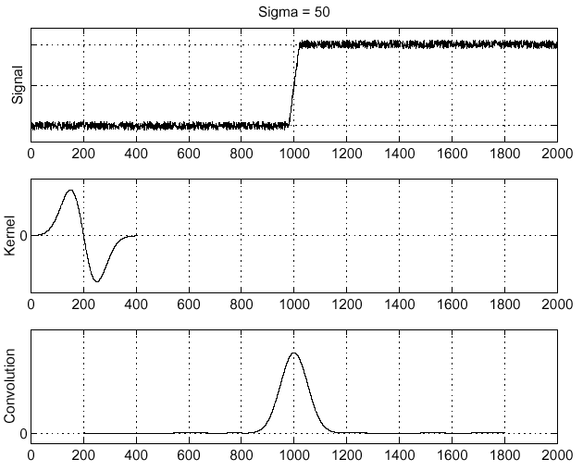
Derivative theorem of convolution
f
Source: S. Seitz

Slide 46
Cascade of convolution
f
g
f * g
g
D
g*D

Slide 47
End

