Slide 1
Arena Colles
https://jmars.mars.asu.edu/index.php?q=user/2713/edit
http://www.google.com/mars/

Slide 2

The End
Scientists detect a massive stream of comets heading towards the solar system
The comets heading towards Earth are extinction class...
However Mars is in the path of several smaller ice comets bearing enough water to revive the planet.

Slide 3
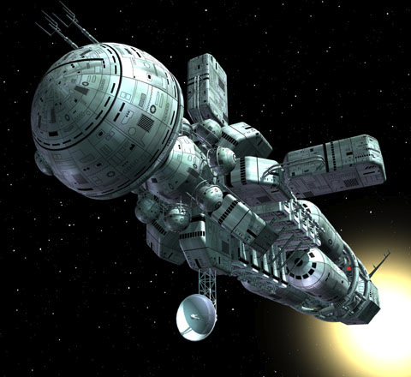
The Beginning
Several colony ships set off for a slow course to Mars.

Slide 4
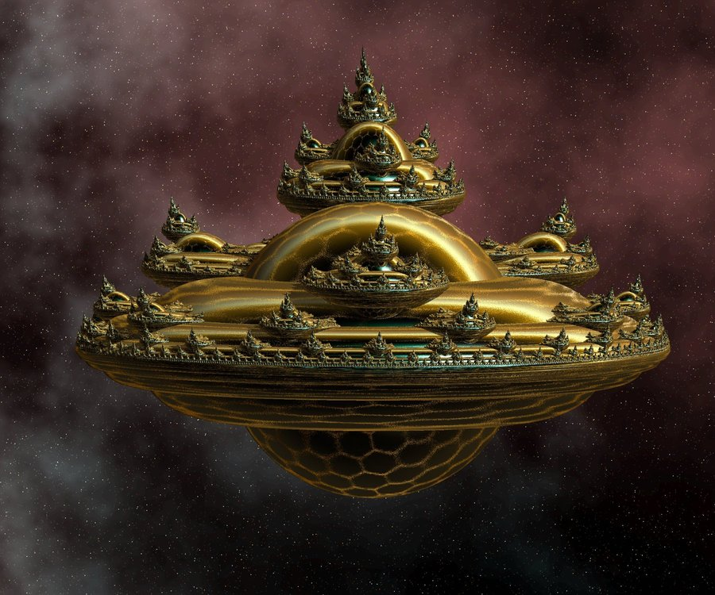
The Arks
In advance of the colonists, semi- automated Arks transport life from Earth onto a small region of Mars deemed optimal for colonization.

Slide 5
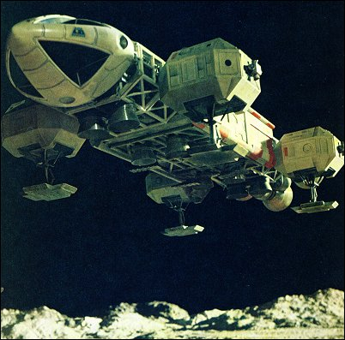
Your Mission
It is your responsibility to guide robots in fertilizing and preparing Mars for the large masses of humanity to live in.

Slide 6
Game Elements

