Slide 1
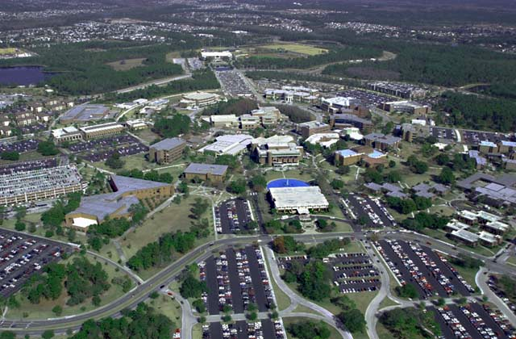
SODA: A Semantics-Aware Optimization Framework for Data-Intensive Applications Using Hybrid Program Analysis
Bingbing Rao, Zixia Liu, Hong Zhang, Siyang Lu, Liqiang Wang
University Of Central Florida

Slide 2
Outline
Background & Motivation
Introduce SODA
  Semantics-Aware Data Model
  Cache Management
  Operation Reordering
  Element Pruning
Experiment & Evaluation
Conclusion & Future work
Q & A

Slide 3
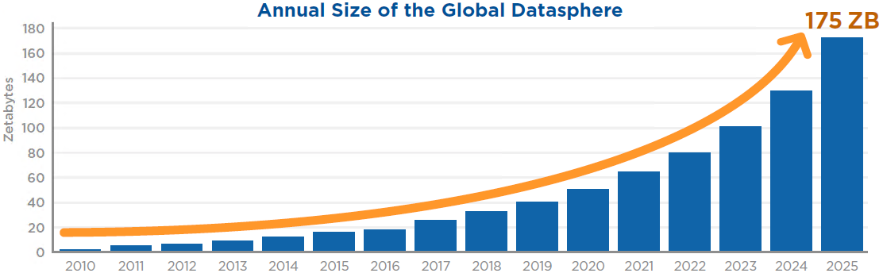
Data Is Still Big
The size of all new data will grow from 33 ZB in 2018 to 175 ZB by 2025.
80% of worldwide data will be unstructured by 2025
Source: Data Age 2025, IDC sponsored by Seagate (2018/11)
Notes:
https://www.seagate.com/files/www-content/our-story/trends/files/idc-seagate-dataage-whitepaper.pdf
https://solutionsreview.com/data-management/80-percent-of-your-data-will-be-unstructured-in-five-years/

Slide 4

Big Data Platforms

Slide 5
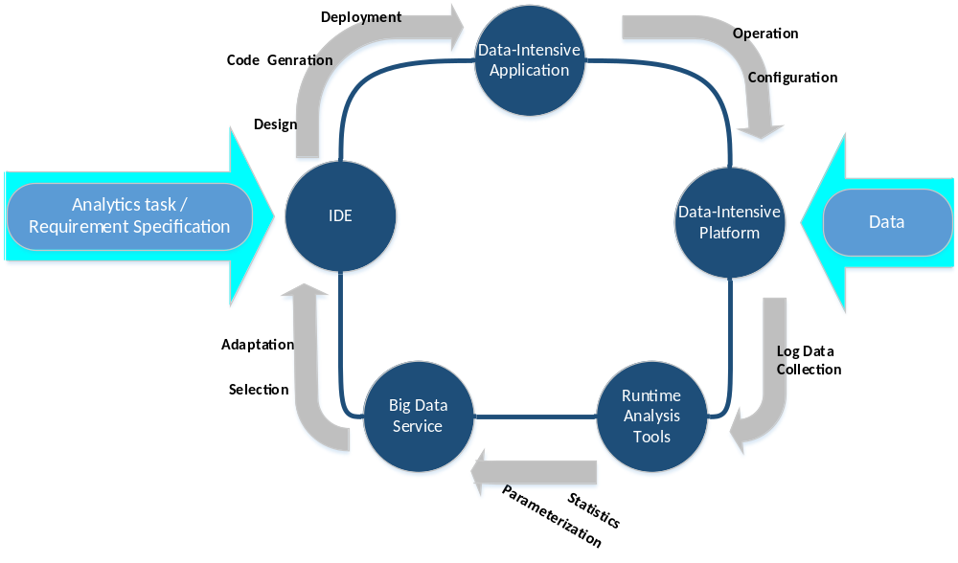
Apps Development & Challenges
Challenge 2: Limited knowledge about unstructured data
Challenge 1: Easy to enumerate different execution plans with different performance due to the freedom of programming model
Challenge 3: System usually treat user-defined function(UDF)s as black-boxes
Challenge 4: Performance is sensitive to runtime factors and case-dependent on coding and input data.
Notes:
http://www.infowaygroup.com/services/quality-assurance.html

Slide 6
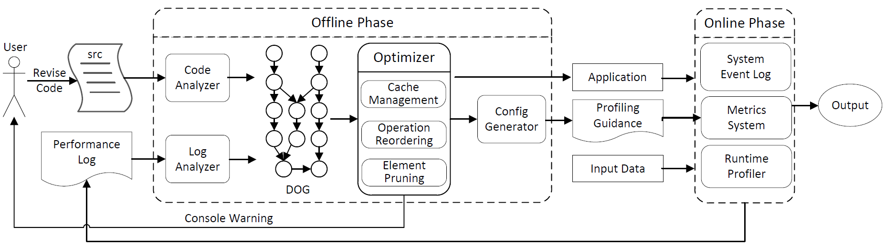
SODA Architecture
A two-stage framework, offline and online stages, to assist programmers to design and optimize data-intensive applications semi-automatically.
SODA: The full life cycle of semantics-aware optimization approach for Data-Intensive applications

Slide 7
Semantics-Aware Data Model
An abstract data model associated with semantic context regarding code, data and system to represent skeleton of an application and track evolution of dataset(s)
  Data Representation: Attribute-Based Data Abstraction
  Data Manipulation: Predefined Primitive Operations (Map, Filter, Group..)
  Application Representation: Data Operational Graph (DOG)
Optimization Strategies
  Cache Management (persist a data block in memory)
  Operation Reordering (Filter pushdown)
  Element Pruning (remove redundant attributes in an element)

Slide 8
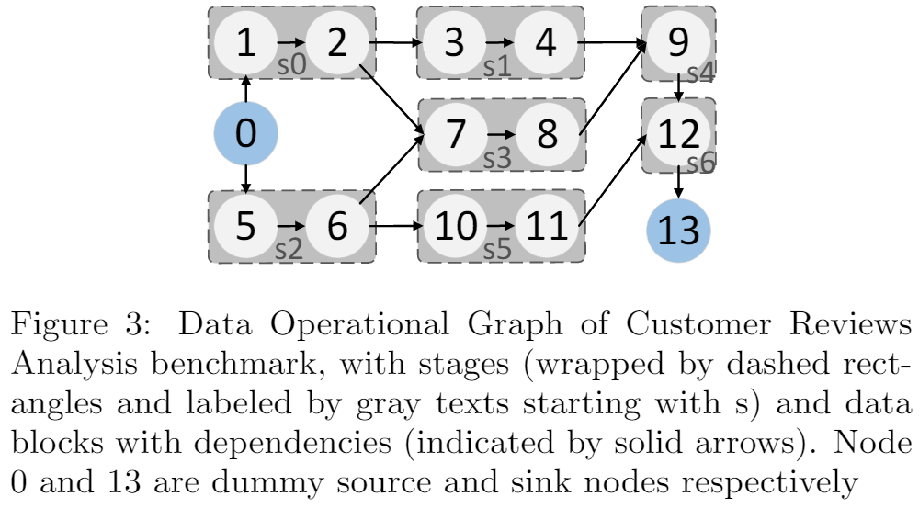
Cache Management
Without Cache, all stages are computed
from node 0 ( [0, 1, 2, 3, 4] → s1)
With Cache, a stage is computed from
the node (2) preserved in memory
([3, 4] → s1).
Cache Management is an optimization
that determines a cache management
policy on the stage level to reduce the computational cost (ie, execution time) of an application.
  LRU does not work well → Execution Distance (Static) → datasets persisted in memory
  A convex optimization problem (Dynamic) to approach a global optimal cache allocation W
    Dataset size matter memory capacity and perf behaviors.
    Executing order of stages matter perf behaviors
Notes:
least recently used
backpack problem

Slide 9
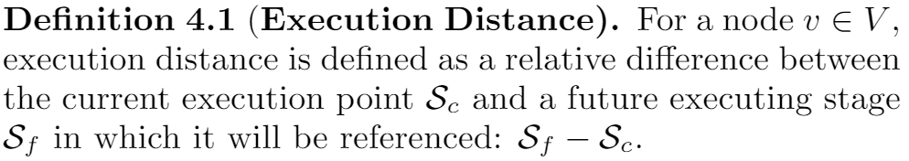
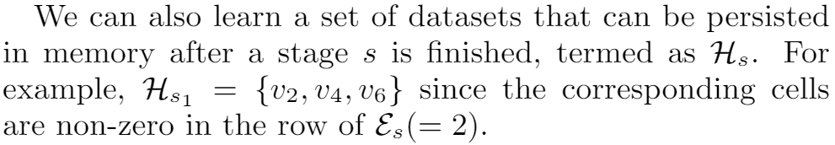
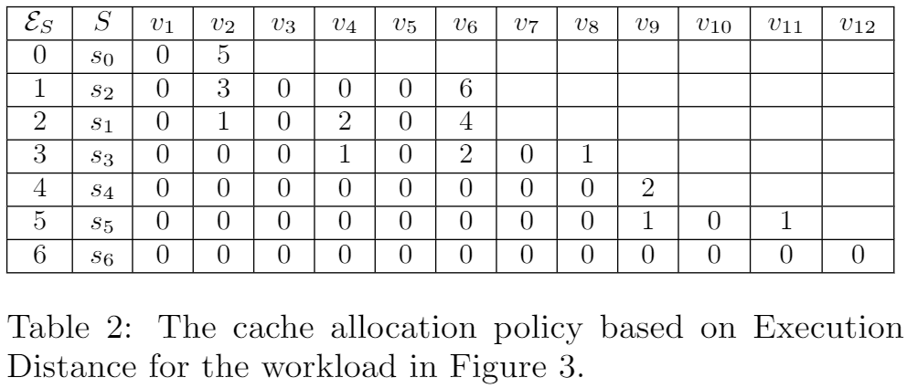
Execution Distance (Static)
A Global and Optimal Cache Allocation Policy W

Slide 10
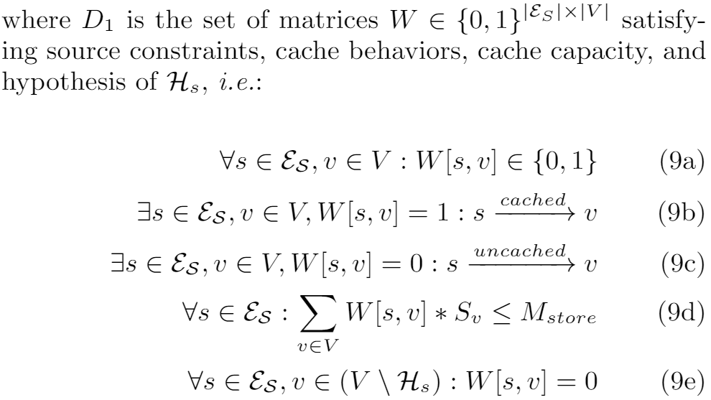
Global and Optimal Cache Allocation Policy W
Source Constraints (9a)
  A binary matrix
Cache Behaviors (9b, 9c)
  W[s,v] = 1, dataset v is cached after stage s
  W[s,v] = 0, dataset v is not persisted in
  memory after stage s
Cache Capacity (9d)
  Within execution of a stage s, the total size of all persisted datasets is less than the configurable size of storage memory of an executor.
Hypothesis of caching datasets (9e)
  Given an execution of a stage s, only considering to cache datasets that is possible to be used in future.

Slide 11
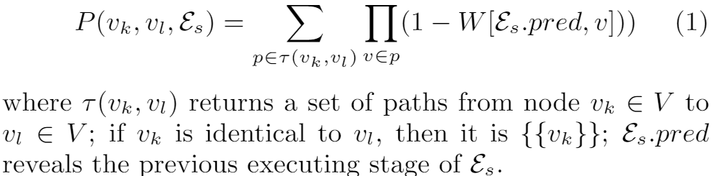
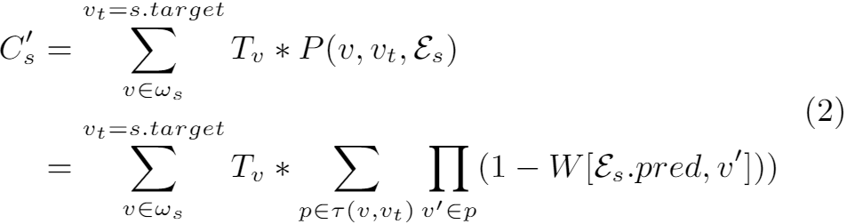
The expected computational cost of a stage
The number of recomputation times of a dataset v_k (because it is used again later but not cached) to generate v_l in an execution stage
The predicted (or expected) computational cost of a stage s can be regulated concisely under the global cache management policy W

Slide 12
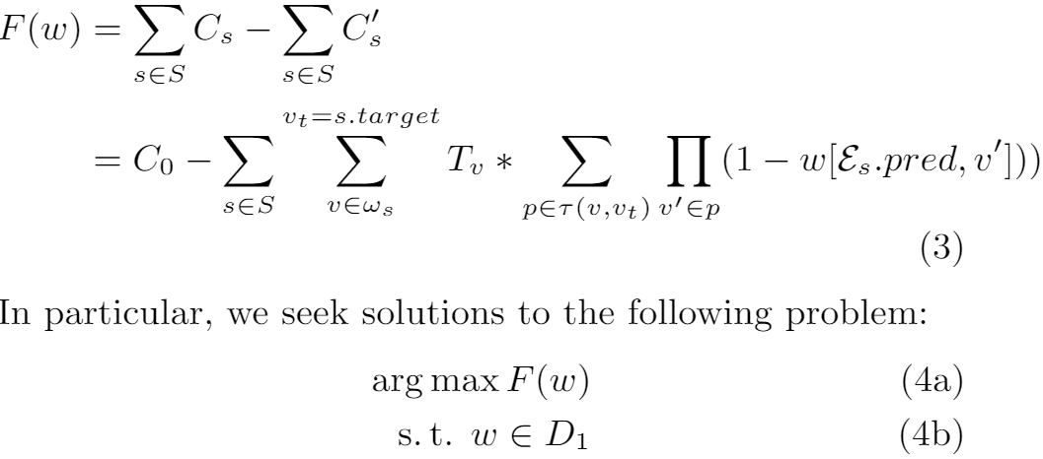
The maximizes caching gain F(w)

Slide 13
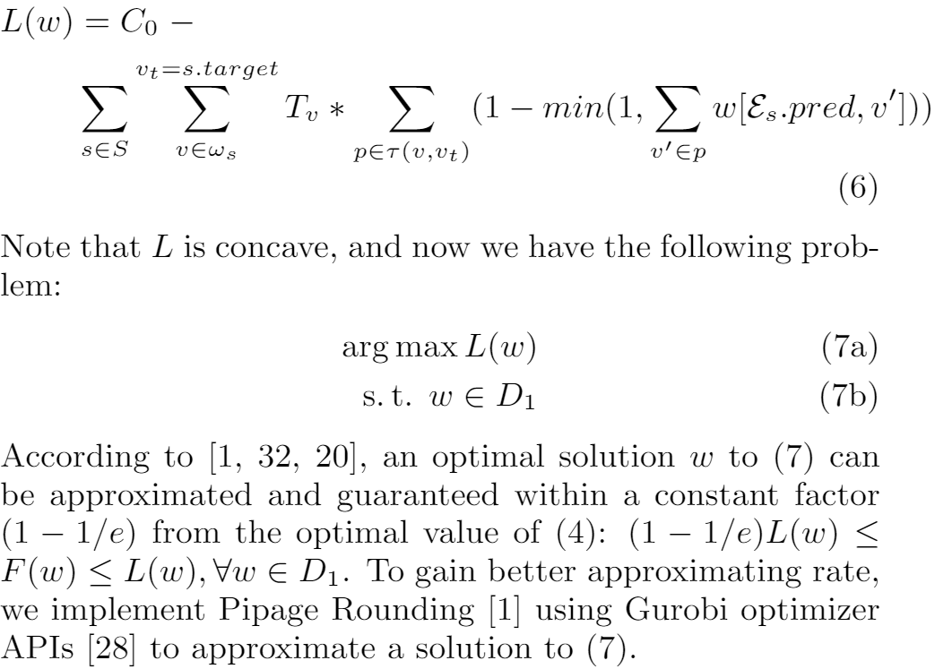
The relaxation Solution F(w) → L(w)

Slide 14
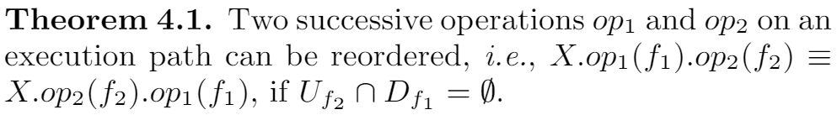
Operation Reordering
It is a two-step way to improve applications' performance by reordering operations along with data path (Filter Pushdown).
  Guaranteeing semantics identical (static)
  Evaluating performance improvement (dynamic)
    Two polynomial regression models are trained for op1 and op2 using profiling data of prior execution.
    Using these two models to predict and evaluate performance behavior of each operations on new input after reordering.

Slide 15
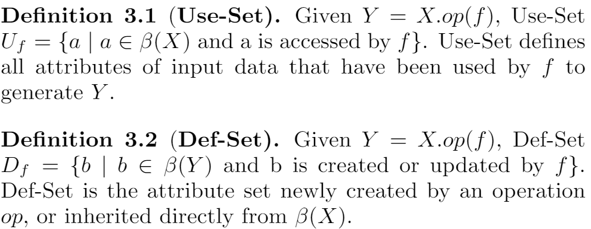
Use-Set and Def-Set of an Operation

Slide 16
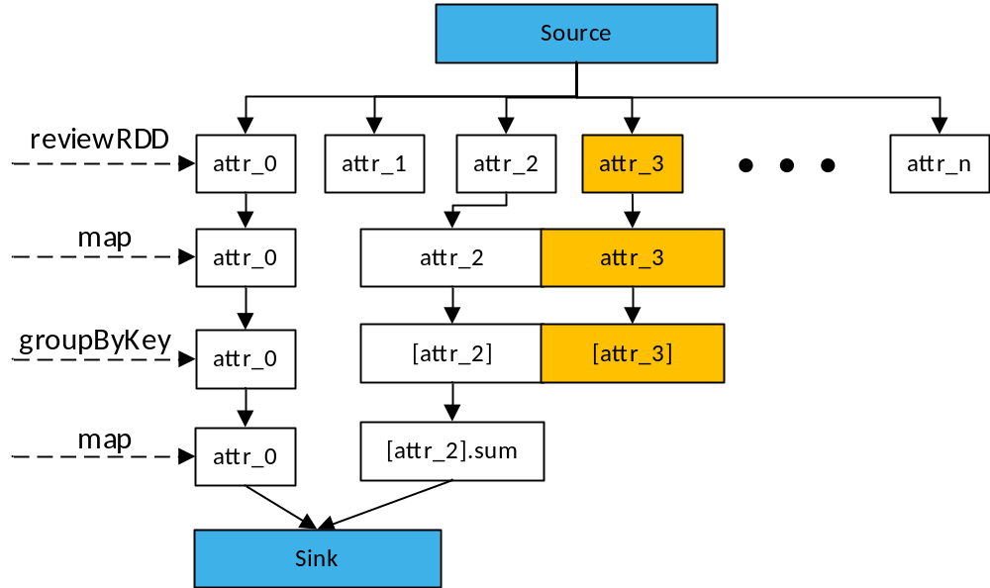
Element Pruning
It is a static optimization to eliminate unused attributes in an element by analyzing data dependency in the attribute level among operations.
  Analyzing attribute dependency
  between the input and output
  dataset of an operation and its UDF
  Building a directed data dependency
  graph (DDG) to represent the whole
  data flow of the application
  Removing nodes that does not make
  contributions to output of the application

Slide 17
Experiment and Evaluation
Four real-world applications are adopted as benchmarks from Github to evaluate accuracy and effectiveness of SODA on a 9-node cluster of Apache Spark (v3.0.0)
  System Log Analysis (SLA)
  Customer Reviews Analysis (CRA)
  Social Network Analysis (SNA)
  Pre-Processing Job (PPJ)
Evaluation
  Effectiveness Assessment
  Performance Behavior
  System Overhead

Slide 18
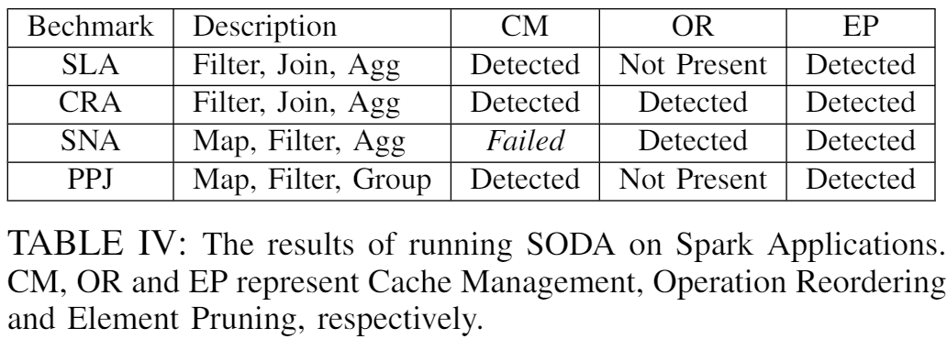
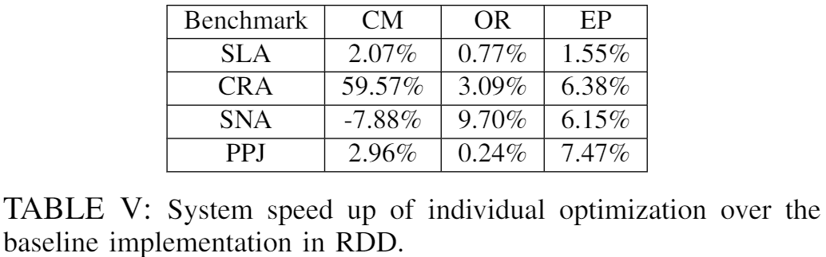
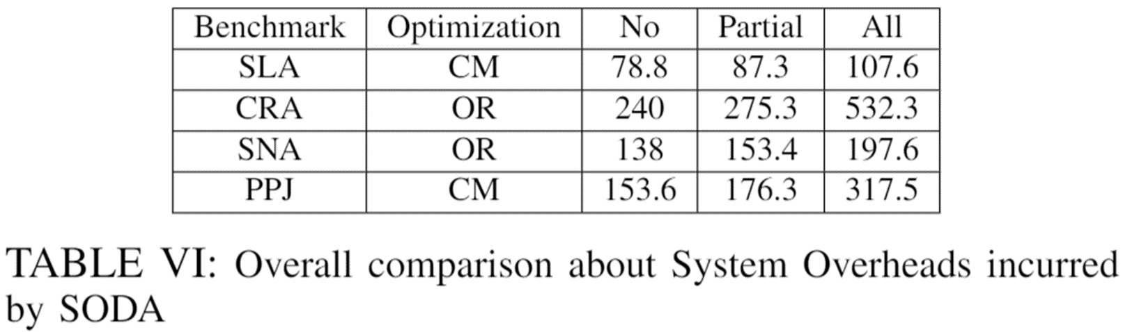
Results: Effectiveness Assessment & Overhead

Slide 19
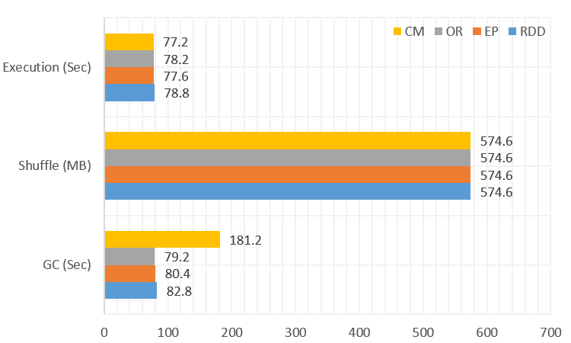
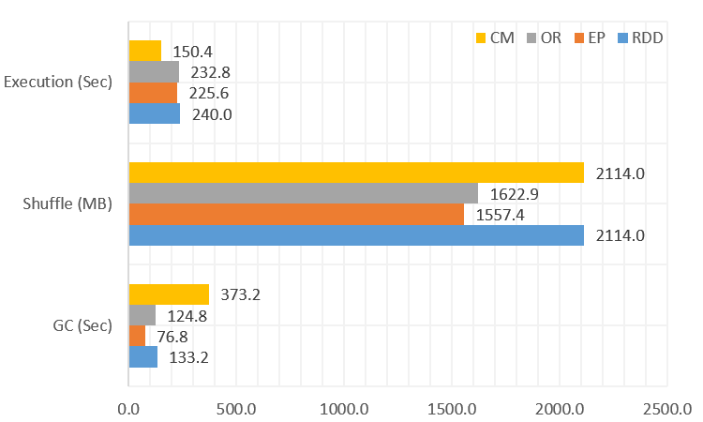
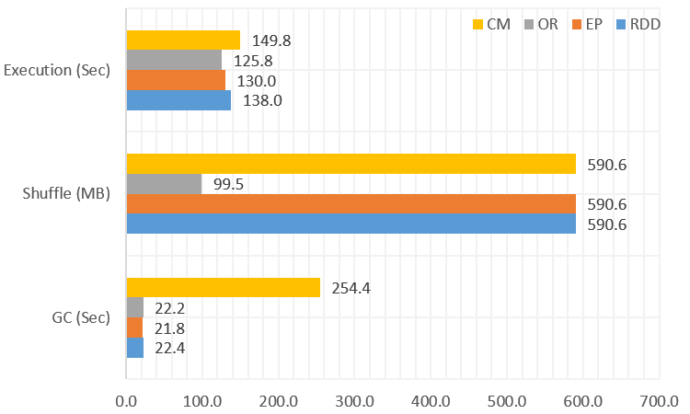
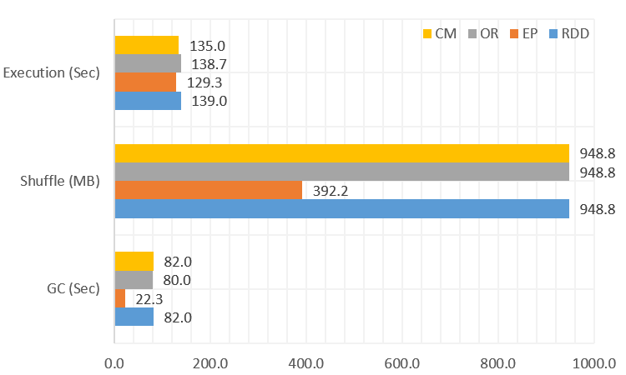
Results: Performance Behavior
a) SLA
b) CRA
c) SLA
d) CRA

Slide 20
Conclusion & Future work
Conclusion
  SODA: A two-stages of semantic-aware optimization approach to help programmers develop an application: Offline and Online Stage.
  The experimental results show that SODA gains a better performance than the baseline.
Future work
  Introduce statistics algorithm (sampling) to collect more data properties during runtime.
  Dig into code to fix out the performance issues regarding JVM.

Slide 21
Thanks
Q&A

