Slide 1

Dynamic Trend Detection in U.S. Border Security Social-Media Networks
Wingyan Chung, BingBing Rao, and Liqiang Wang
University of Central Florida
Acknowledgments: Funding support by NSF CAREER (grant #1622292) and by Intel Corporation (grant #23568271).

Slide 2
Outline
Introduction
Related Work
Temporal Models for Dynamic Trend Detection in SM Networks
Model Evaluation
Experimental Findings and Implications
Conclusion

Slide 3
Introduction
Detecting temporal trends in large networks has strategic importance in many domains
Intelligence agencies examine organized networks of cyber-criminals to detect activity trends over time.
E-commerce marketers study customer networks to detect changes in consumer preferences and habits.
Border security agents analyze network relationships to identify illegal activities.
A common feature of these domains is the dynamic nature of the data obtained in their social networks
Social media has emerged as an important source of intelligence, and is identified as one of three major elements in “the enemy’s battle terrain” (Marble et al. 2015)

Slide 4
Research Needs
As computational power increases, graph analytics is increasingly used to facilitate complex calculation of graph metrics. However, research on dynamic trend detection in social networks is relatively scarce.
This research addresses the needs to accurately predict user activities in large-scale social networks.
We developed a new dynamic network prediction model that characterizes user interactions as they form relationships over time in networks.
Implemented the model in a distributed computing environment
Conducted experiments using SM data on U.S. border security discussion
SM community consists of 210,921 human agents who posted 533,246 messages and formed 453,552 links among agents.
Evaluated the model against a benchmark model

Slide 5
Related Work
Social media analytics
Sentiment analysis and emotion extraction are important tools for understanding large amounts of social media data.
Network analysis involves centrality computation, influence identification, and community structure analysis, among others.
Relevant work includes contagion in SM networks and influence propagation
Temporal Network Dynamics
Influence is modeled as conditional dependence between entity’s current state and previous state based on Markovian assumption (Pan et al. 2012)
Dynamic network metrics were developed: emergence, persistence (Wei & Carley 2015)
Technologies for Graph analytics and social network analysis

Slide 6
Temporal Models for Dynamic Trend Detection in SM Networks
Model 1: Exponential Aggregation Model (EAM) (Wei & Carley, 2015)
Use a single exponential smoothing formula to predict A(t+1) given A(1), A(2), …, A(t)
Baseline model
Model 2: Network Interaction Model with Random Link Formation (NIM)
Creates a simulated network of human agents based on the most recent known network configuration
Simulates randomness of agent interaction
Three Steps
Initiation of network
Simulation of network configuration
Predicting activities of agents

Slide 7
Steps in Network Interaction Model
Initiation
Simulation of Network for time (t+1)
Derive the network density using single exponential smoothing
Add or delete agents based on a random interaction process
Predict activities of agents at time (t+1) using Betweenness Centrality
See supplementary slide for details

Slide 8
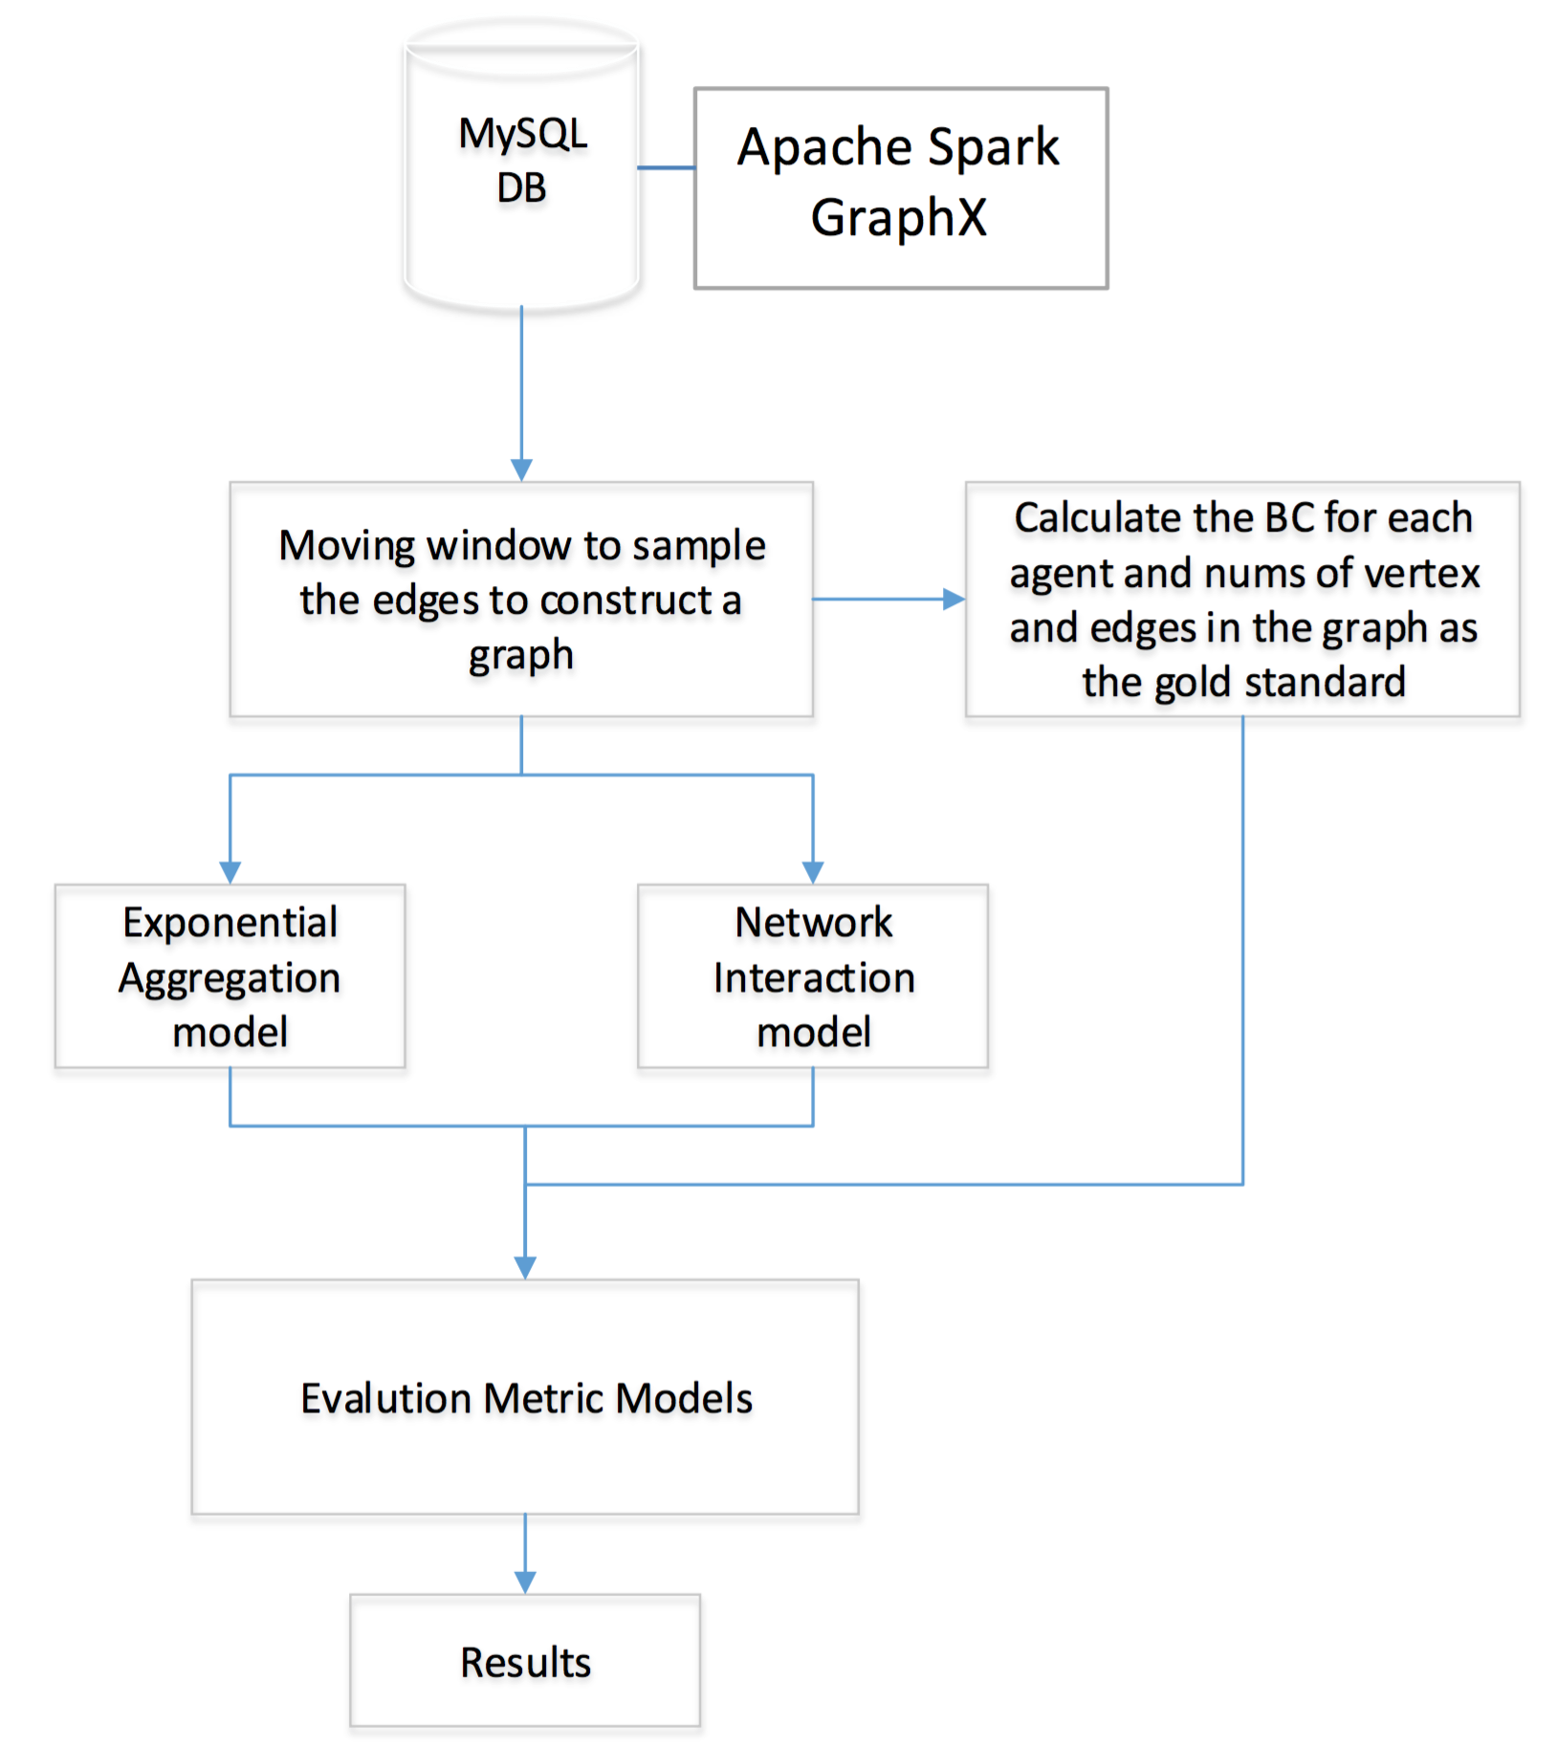
Experimental Procedure
Data
The community consists of 210,921 human agents who posted 533,246 messages and formed 453,552 links among agents.
Data collected from Twitter during May-August of 2013 (average 4,773 tweets per day) using queries formulated by reviewing relevant literature.
Apache Spark
Model implementation
Used to predict agent activities at time (t+1)

Slide 9
Model Evaluation
EAM and NIM were validated using a social-media community focused on U.S. border and immigration security
A node in the network represents a user; a link represents an interaction between two users. An interaction can be re-tweet, modified-tweet, or targeted-tweet.
The BC score was used as the “gold standard” to evaluate our predictive models’ performance.
Evaluation Metrics
Root Mean Square Error (RMSE)
Symmetric Mean Absolute Percentage Error
Logarithmic Median Absolute Percentage Error

Slide 10
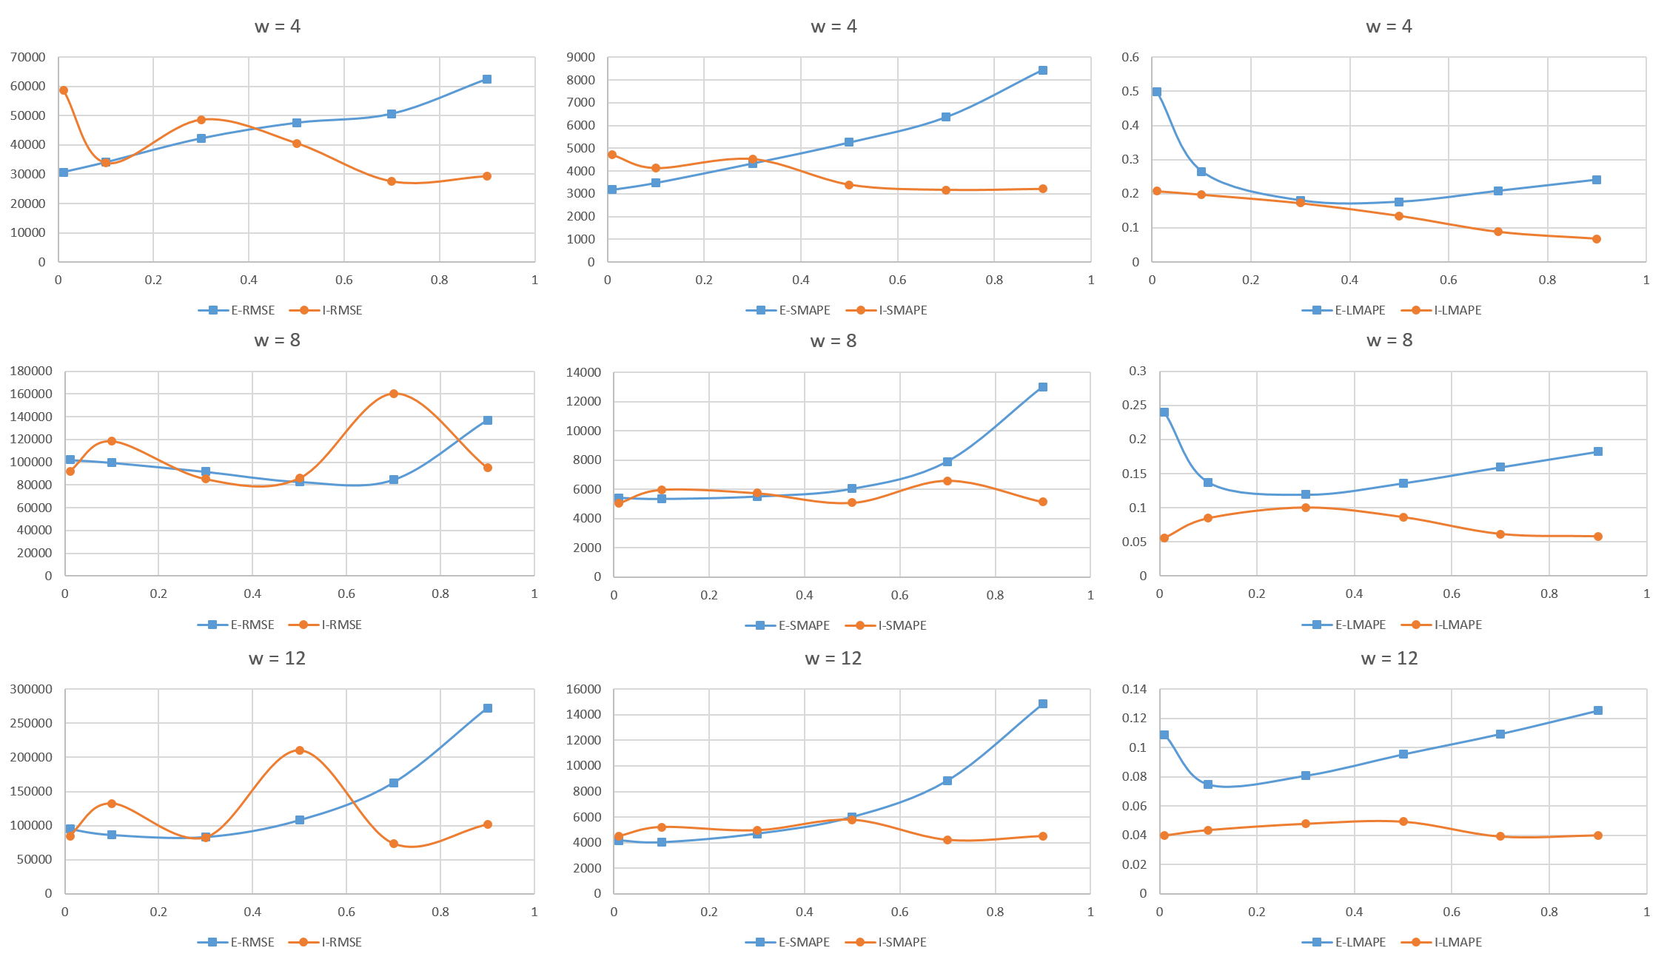
Experimental Findings (1): Predicting agent activities on 8/10/2013
w=4
w=8
w=12

Slide 11
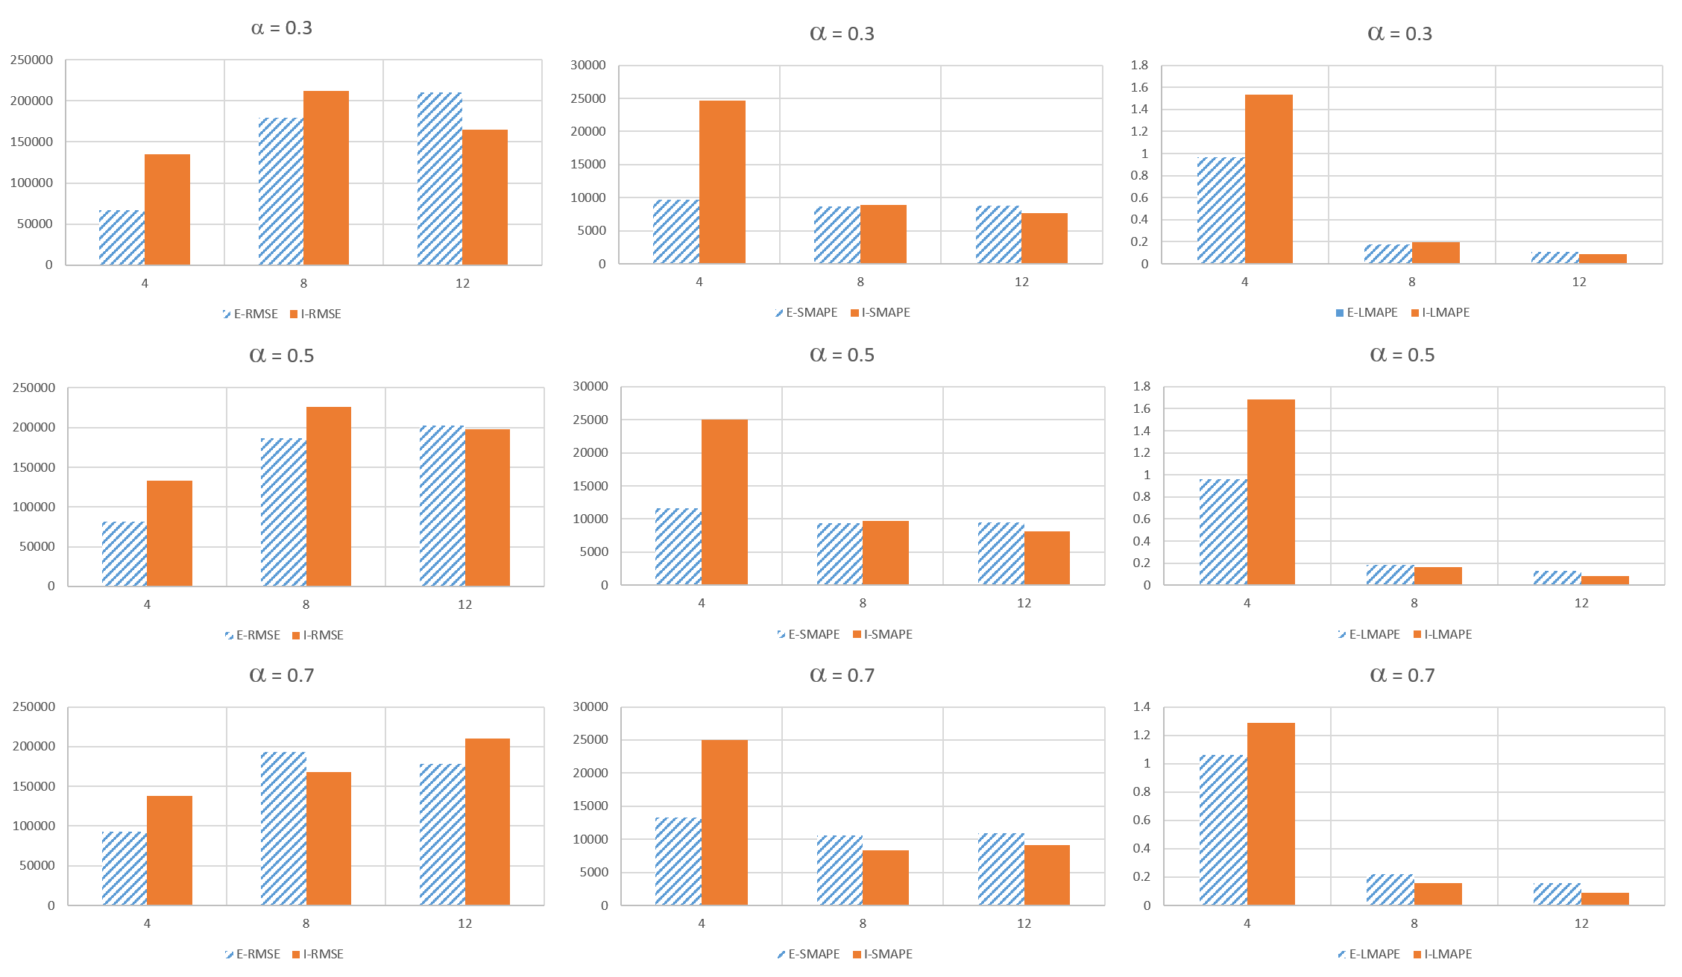
Experimental Findings (2) : Predicting agent activities on 8/13/2013
𝛼=.3
𝛼=.5
𝛼=.7

Slide 12
Discussion
Accuracy of NIM (red lines with round dots) increases generally as α increases from 0 to 1. In contrast, the accuracy of EAM (blue lines with square dots) decreases generally as α increases.
NIM outperformed EAM for all window sizes and α values
NIM outperformed EAM based on SMAPE (when α > 0.5) and based on RMSE (when α > 0.6) for all window sizes.
Accuracies of both models improve as the window size increases.
NIM (columns with red solid fill) outperformed EAM (columns with blue slanted line fill) in 12 of the 18 comparisons for w = 8 and w = 12 (especially when α ≥ 0.5). In contrast, EAM achieved higher accuracies when w = 4 for all values of α.

Slide 13
Implications
NIM’s superior predictive accuracy can be attributed to its flexibility in modeling link formation and its realistic prediction of future network configuration.
EAM follows a predefined exponential function to predict network activities, resulting in less accurate prediction when more recent data are considered.
The accurate predictions of network density and link formation by NIM translate to a superior forecast of temporal network activities due to both macroscopic and microscopic assessment of future trends.
Larger window sizes tend to favor NIM significantly.
LMAPE described network activity trends and distribution the best because its logarithmic function and geometric mean denominator both served to gauge predictive accuracy in an unbiased manner.

Slide 14
Conclusion
We developed and validated a dynamic network activity model to characterize temporal trends in a large social-media network of interactive human agents.
Two models were implemented and compared: EAM and NIM.
NIM achieved higher predictive accuracy than EAM when emphasis is placed on recent trends (i.e., high α). NIM also has generally less fluctuation in predictive accuracy than EAM across different temporal span of networks.
Logarithmic Median Absolute Percentage Error (LMAPE) was found to provide more intuitive measurement than existing metrics.
The research should provide new approaches and system artifacts for dynamic trend detection in SM networks, reporting new findings of network trend detection, and providing new technical approaches to process large graph-based data.

Slide 15

Thank you!
http://cyber.ist.ucf.edu/
Wingyan Chung, Ph.D.
Email: wchung@ucf.edu; Tel.: (407) 882-1435

