Slide 1
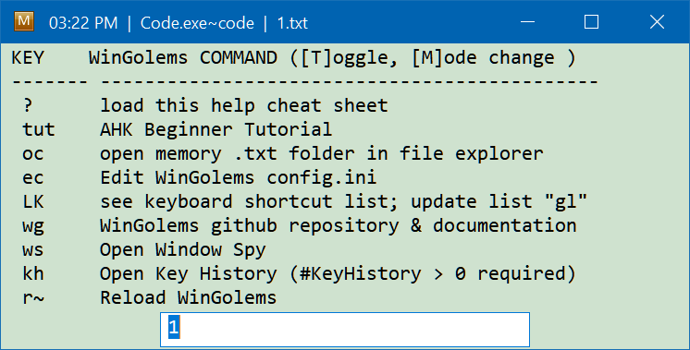
Target application.exe + Active command suffix
Currently loaded mem_cache .txt file
Input box accepts
Command keys
Uppercase 1st letter initiated functions

