Slide 1

Moneylog
Bing Bai
Li Yu
Lei Wang

Slide 2
Github link
https://github.com/binguniverseca/MoneyLog

Slide 3
Task distribution
Database design and connection - Yu Li
CRUD operations and testing – Bing Bai
Interface design – Lei Wang
coding - Bing Bai ，Lei Wang，Li Yu
Presentation – Yu Li

Slide 4



Database connection
SQL Serve Management
Visual Studio

Slide 5
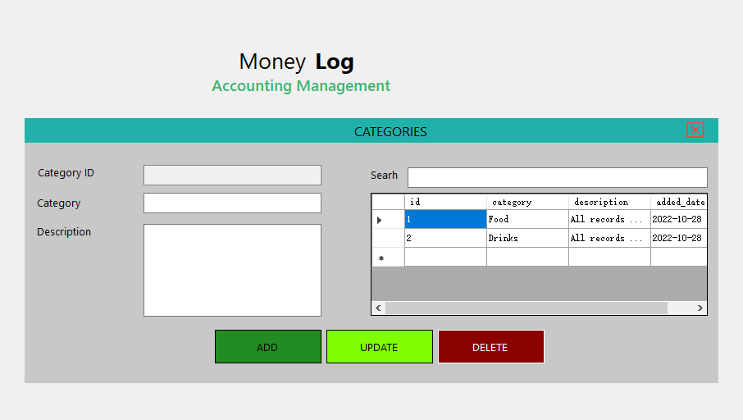
Crud operations

Slide 6
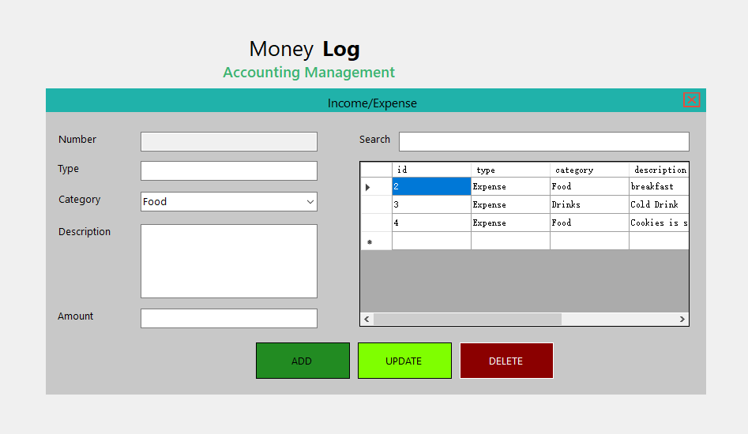
Crud operations

Slide 7
functionalities

Slide 8
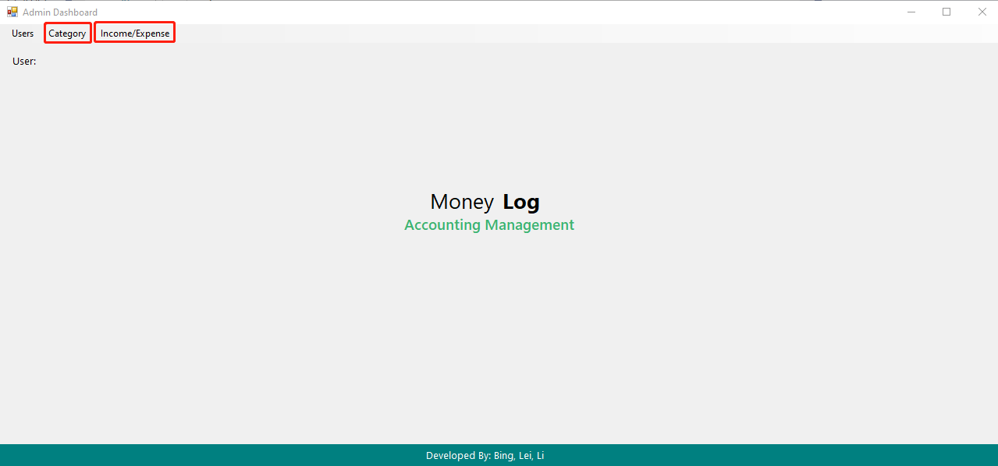
Project logic

Slide 9
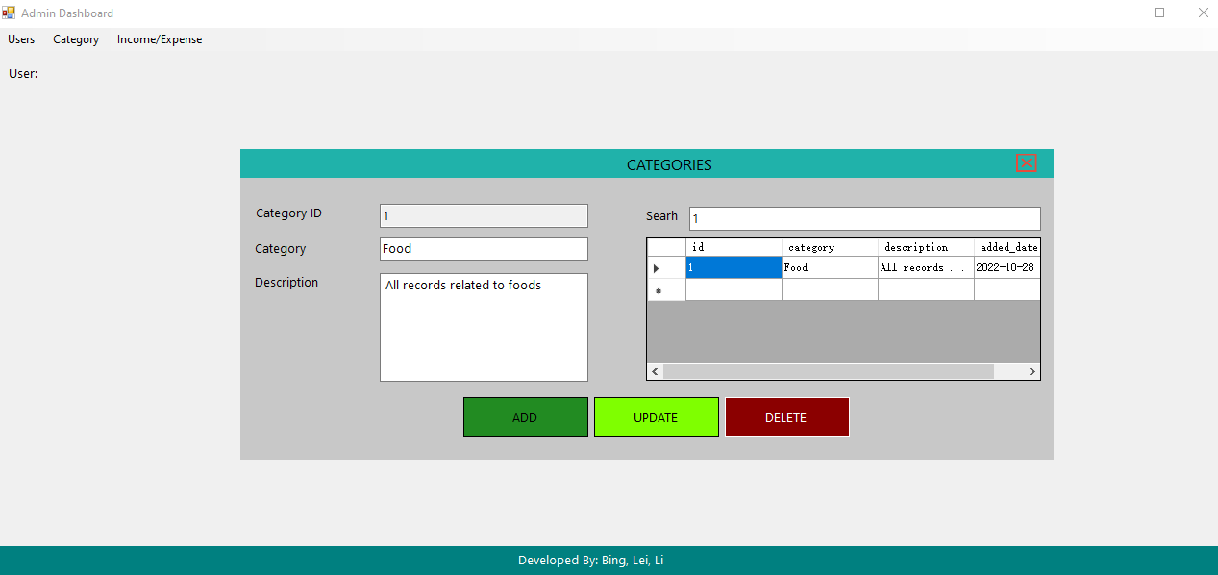
Project logic

Slide 10
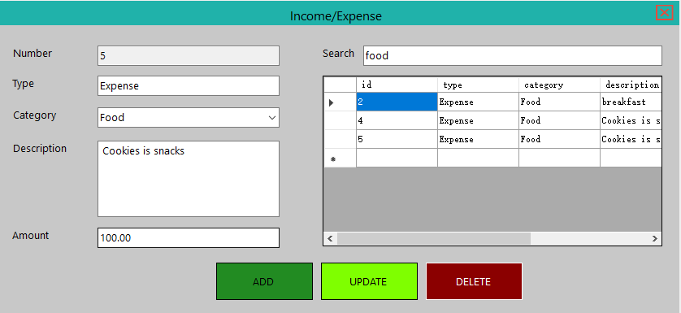
Project logic

Slide 11
Thank you

