Slide 1

Scientific Survey Auto Creation
Supervisor: Dr. Chao Wu
Bingwei Chen

Slide 2
Overview
Motivation
Introduction of the project
Design and Implementation of the Application
Demo of the Application
Evaluation

Slide 3
Motivation

Slide 4
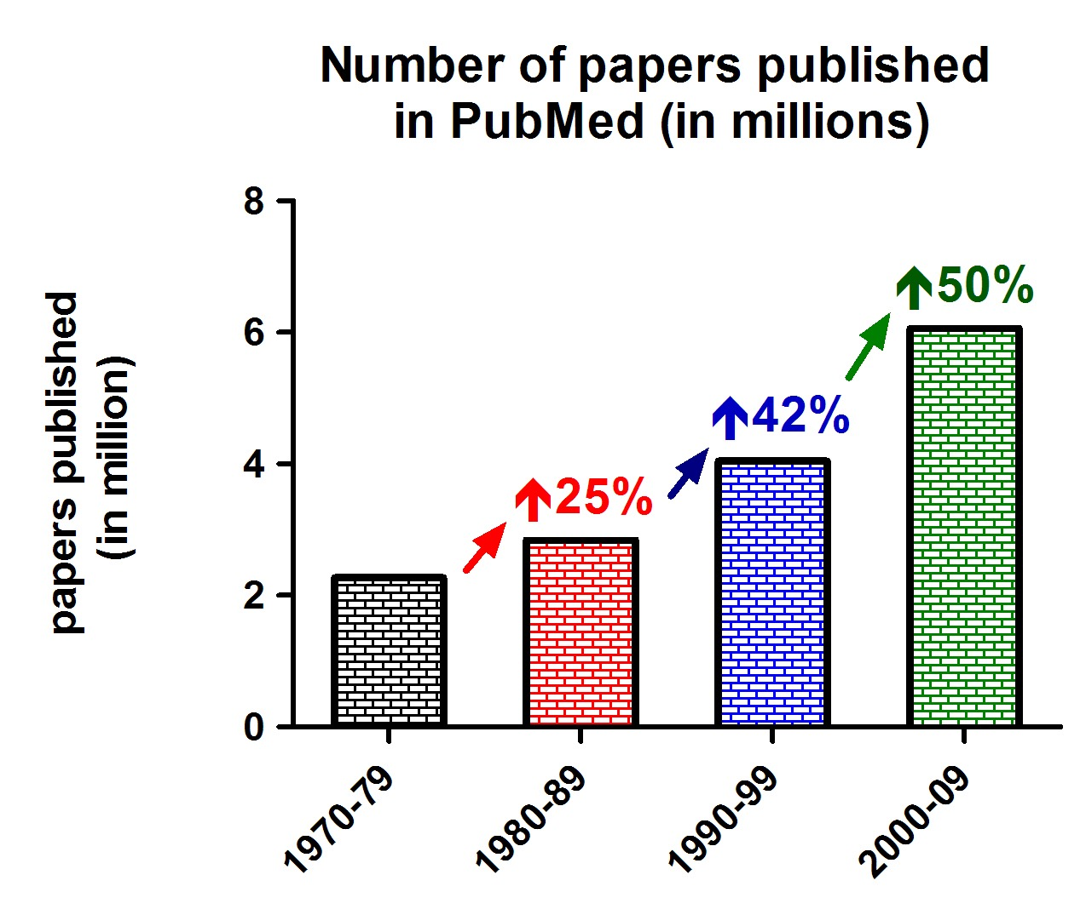
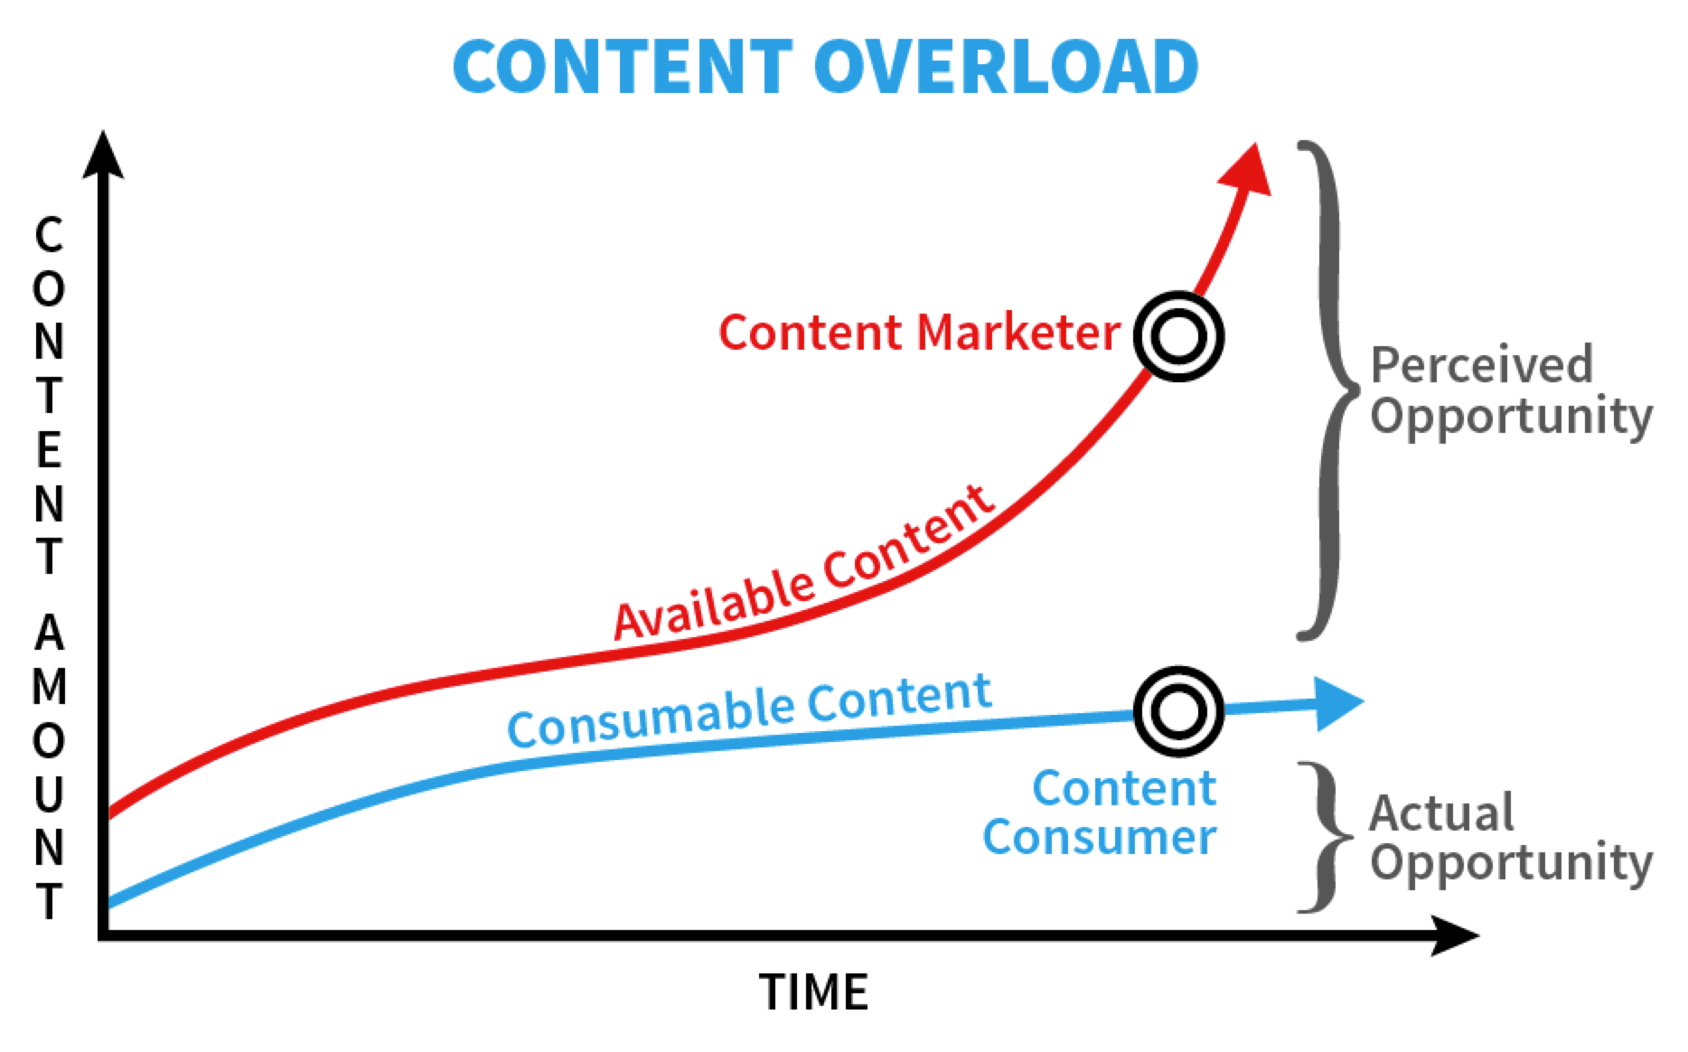
Information overload
In 2016, the total number of academic publication in IEEE Xplore is 4,011,868.
Even for topic “neural network”, it still shows 122,805 results.

Slide 5
Semantic Similarity
Paper get highest score when it mentions the search query most frequently
Results do not include citation relation
Results cannot show the evolution of the topic
Results are not grouped by sub topic

Slide 6
Introduction

Slide 7
Objectivities
Search System
return valid articles
Storyline Generation System
use valid articles to construct storyline
Web application
visualize the storyline graph

Slide 8
Background
Document Retrieval: theory of find relevant documents
Solr: an open source search platform
React: a Javascript library for building user interfaces
D3.js: a JavaScript library for producing dynamic, interactive data visualizations in web browsers.
Spark framework: A micro framework for creating web applications

Slide 9
Application

Slide 10
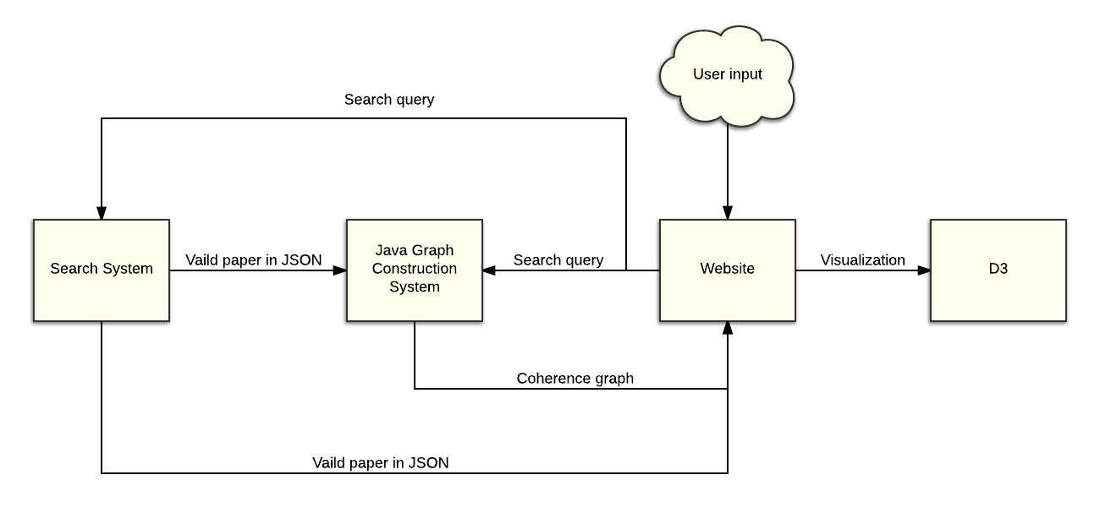
Overview of the application

Slide 11
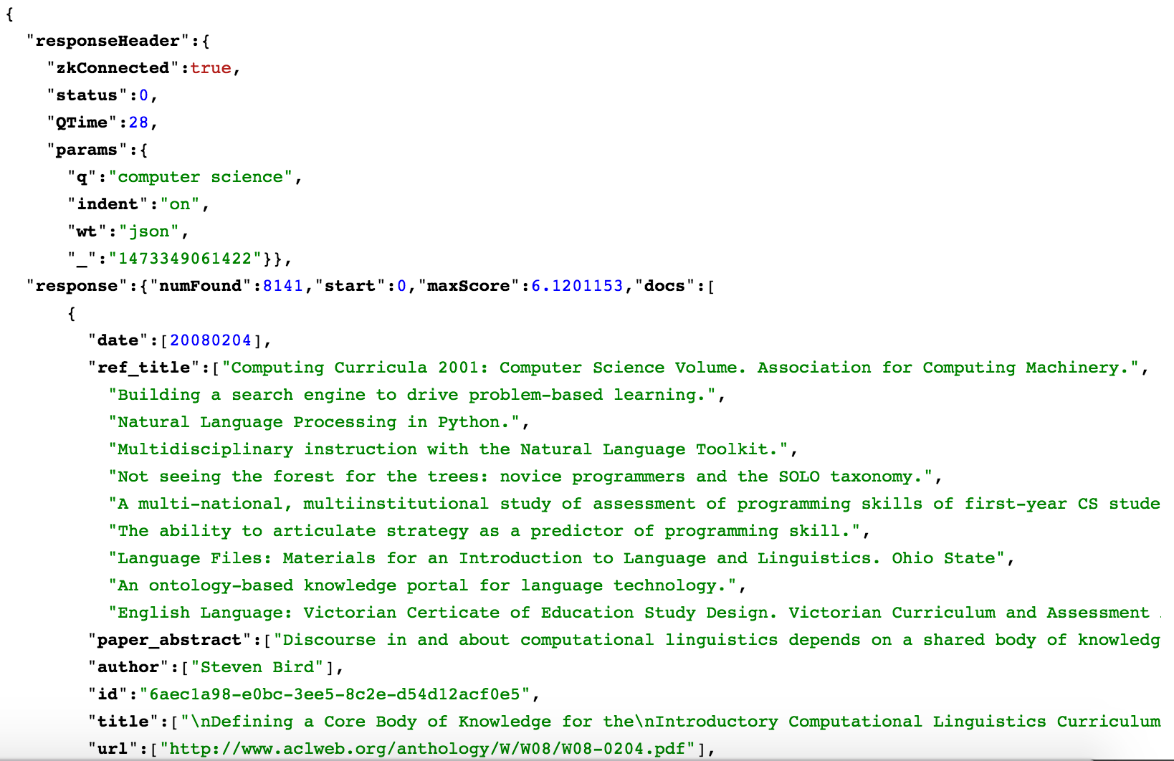
Search System
Pre-processing
ACL Anthology
ParsCit
XML to JSON
Construct Solr
Define schema
Indexed by POST tool
Jetty server CORS

Slide 12
Java Graph Construction System
Collect valid paper from Search System
Create graph
Construct citation graph
Construct coherence graph
Concurrency mode

Slide 13
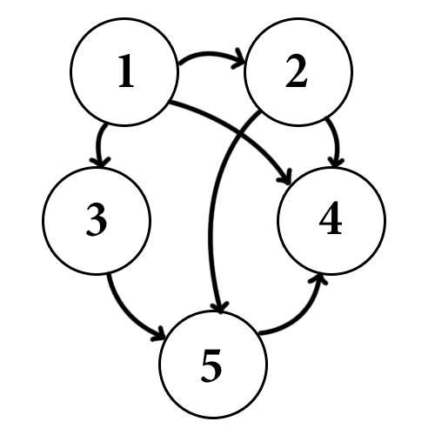
Graph in Java
Vertex:
Store object of the paper
Store edges of this vertex
Edge:
Store weigh of the edge
Store the label of the edge

Slide 14
Citation Graph
Citation label edges
Same author label edges
Same ancestor label edges

Slide 15
Coherence Graph
Divide and conquer
Get valid pairs
Generate extension

Slide 16
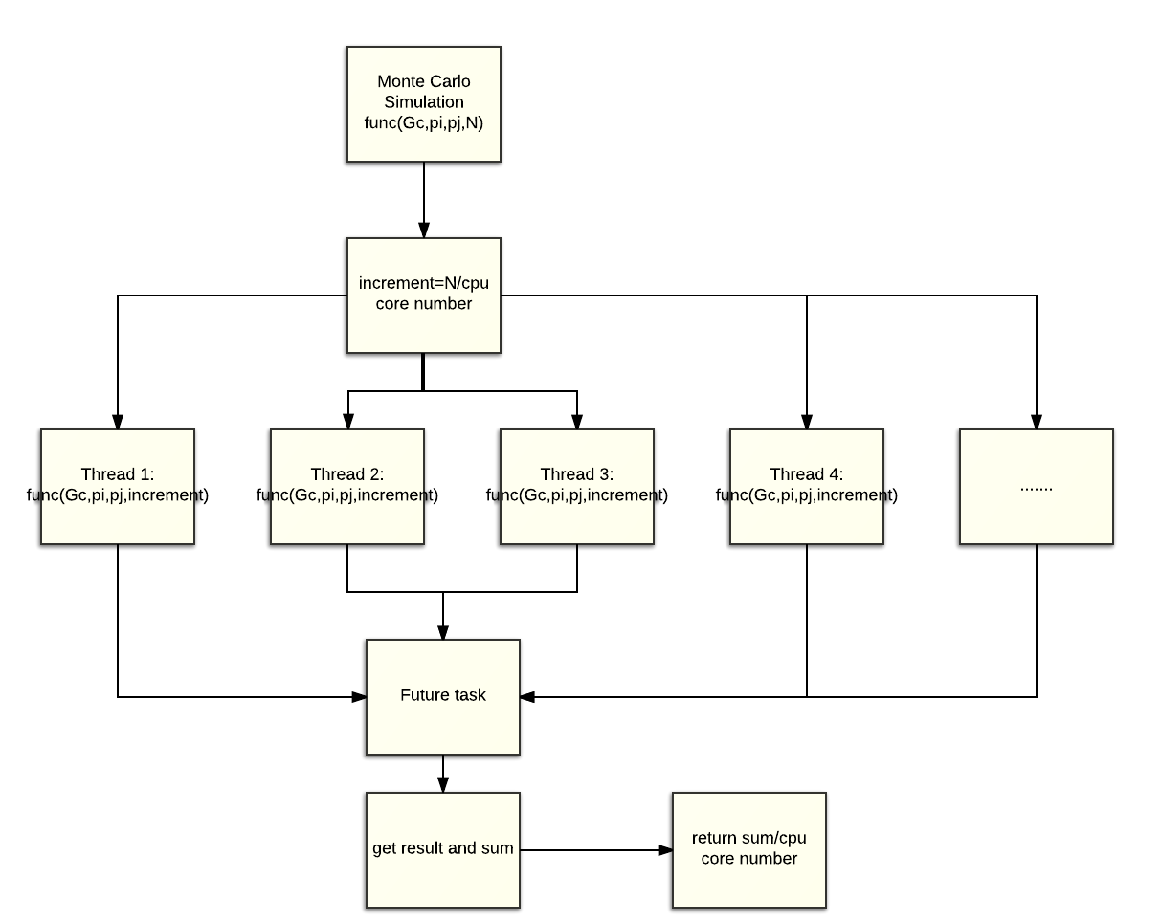
Concurrency
Java.util.concurrency package
distribute works to several threads
collect the result of each thread
sum the result

Slide 17
Web Application
Search
Collect search query from users
Use HTTP Request to get valid paper from Search system
Show papers in table
Graph
Collect graph parameters
Get storyline graph from Java Graph Construction system
Visualized by D3.js

Slide 18
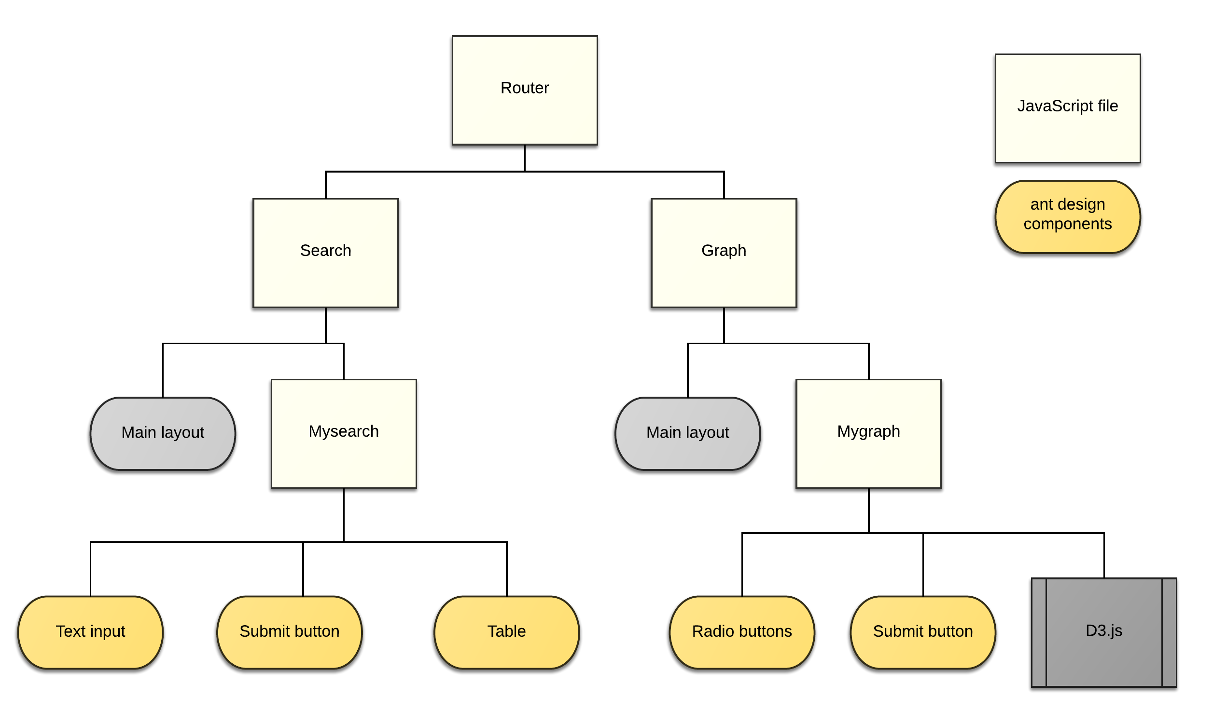
Web Application

Slide 19
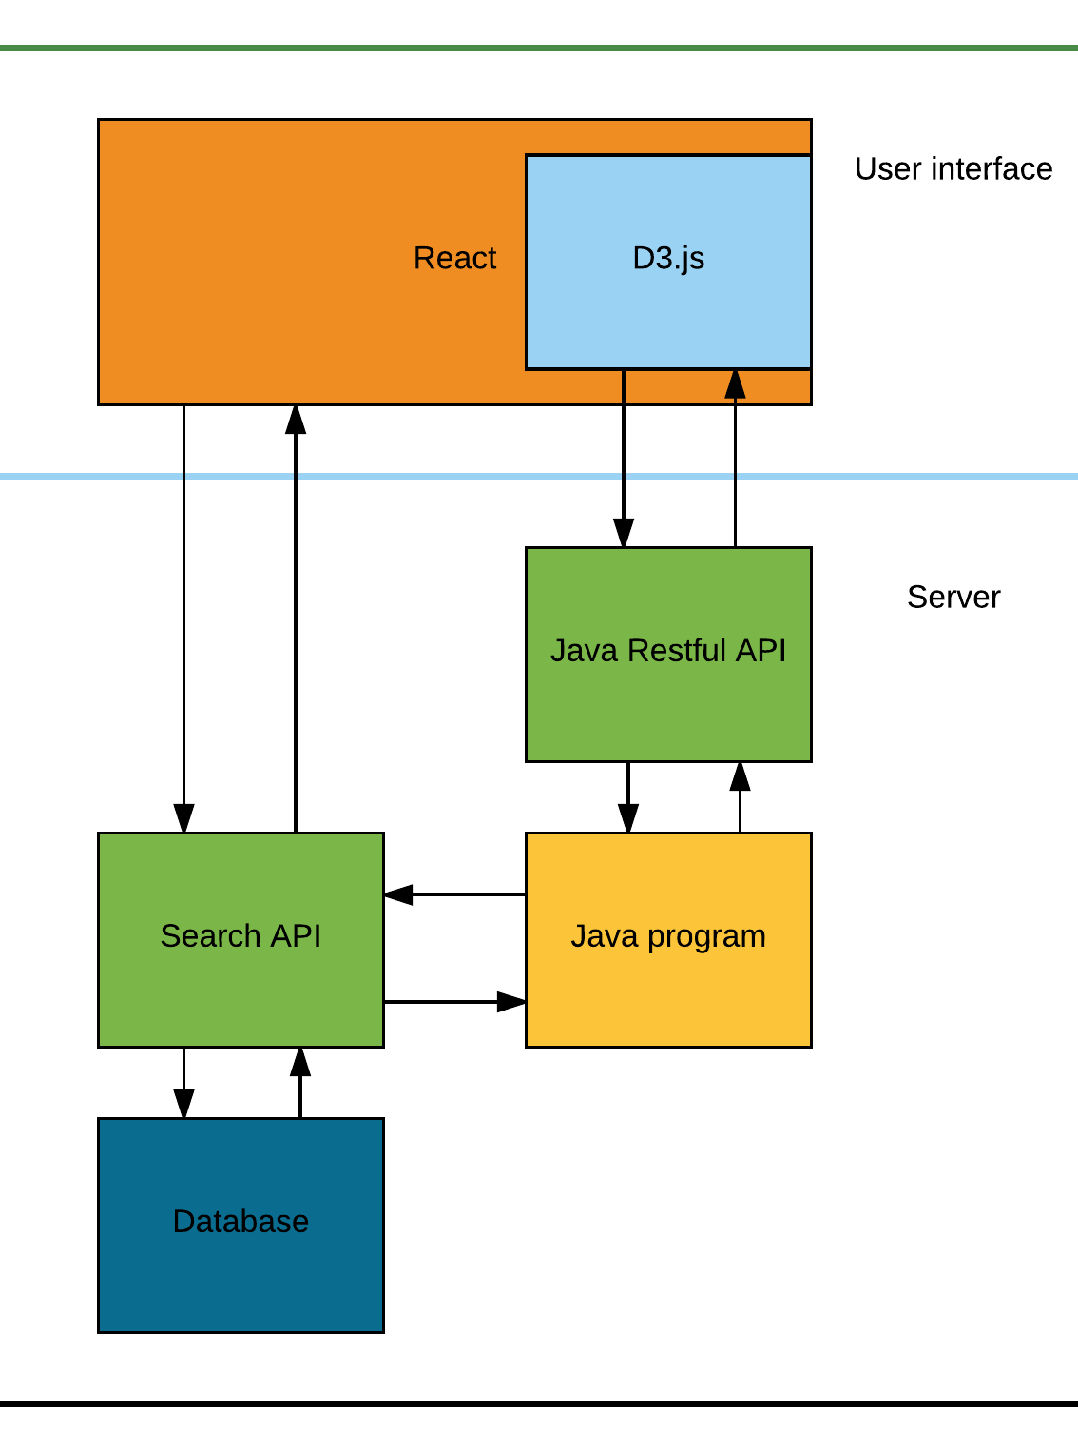
Application Architecture
React for front end
D3.js embed on React
Spark framework for Java Restful API
Solr search platform to provide search API

Slide 20
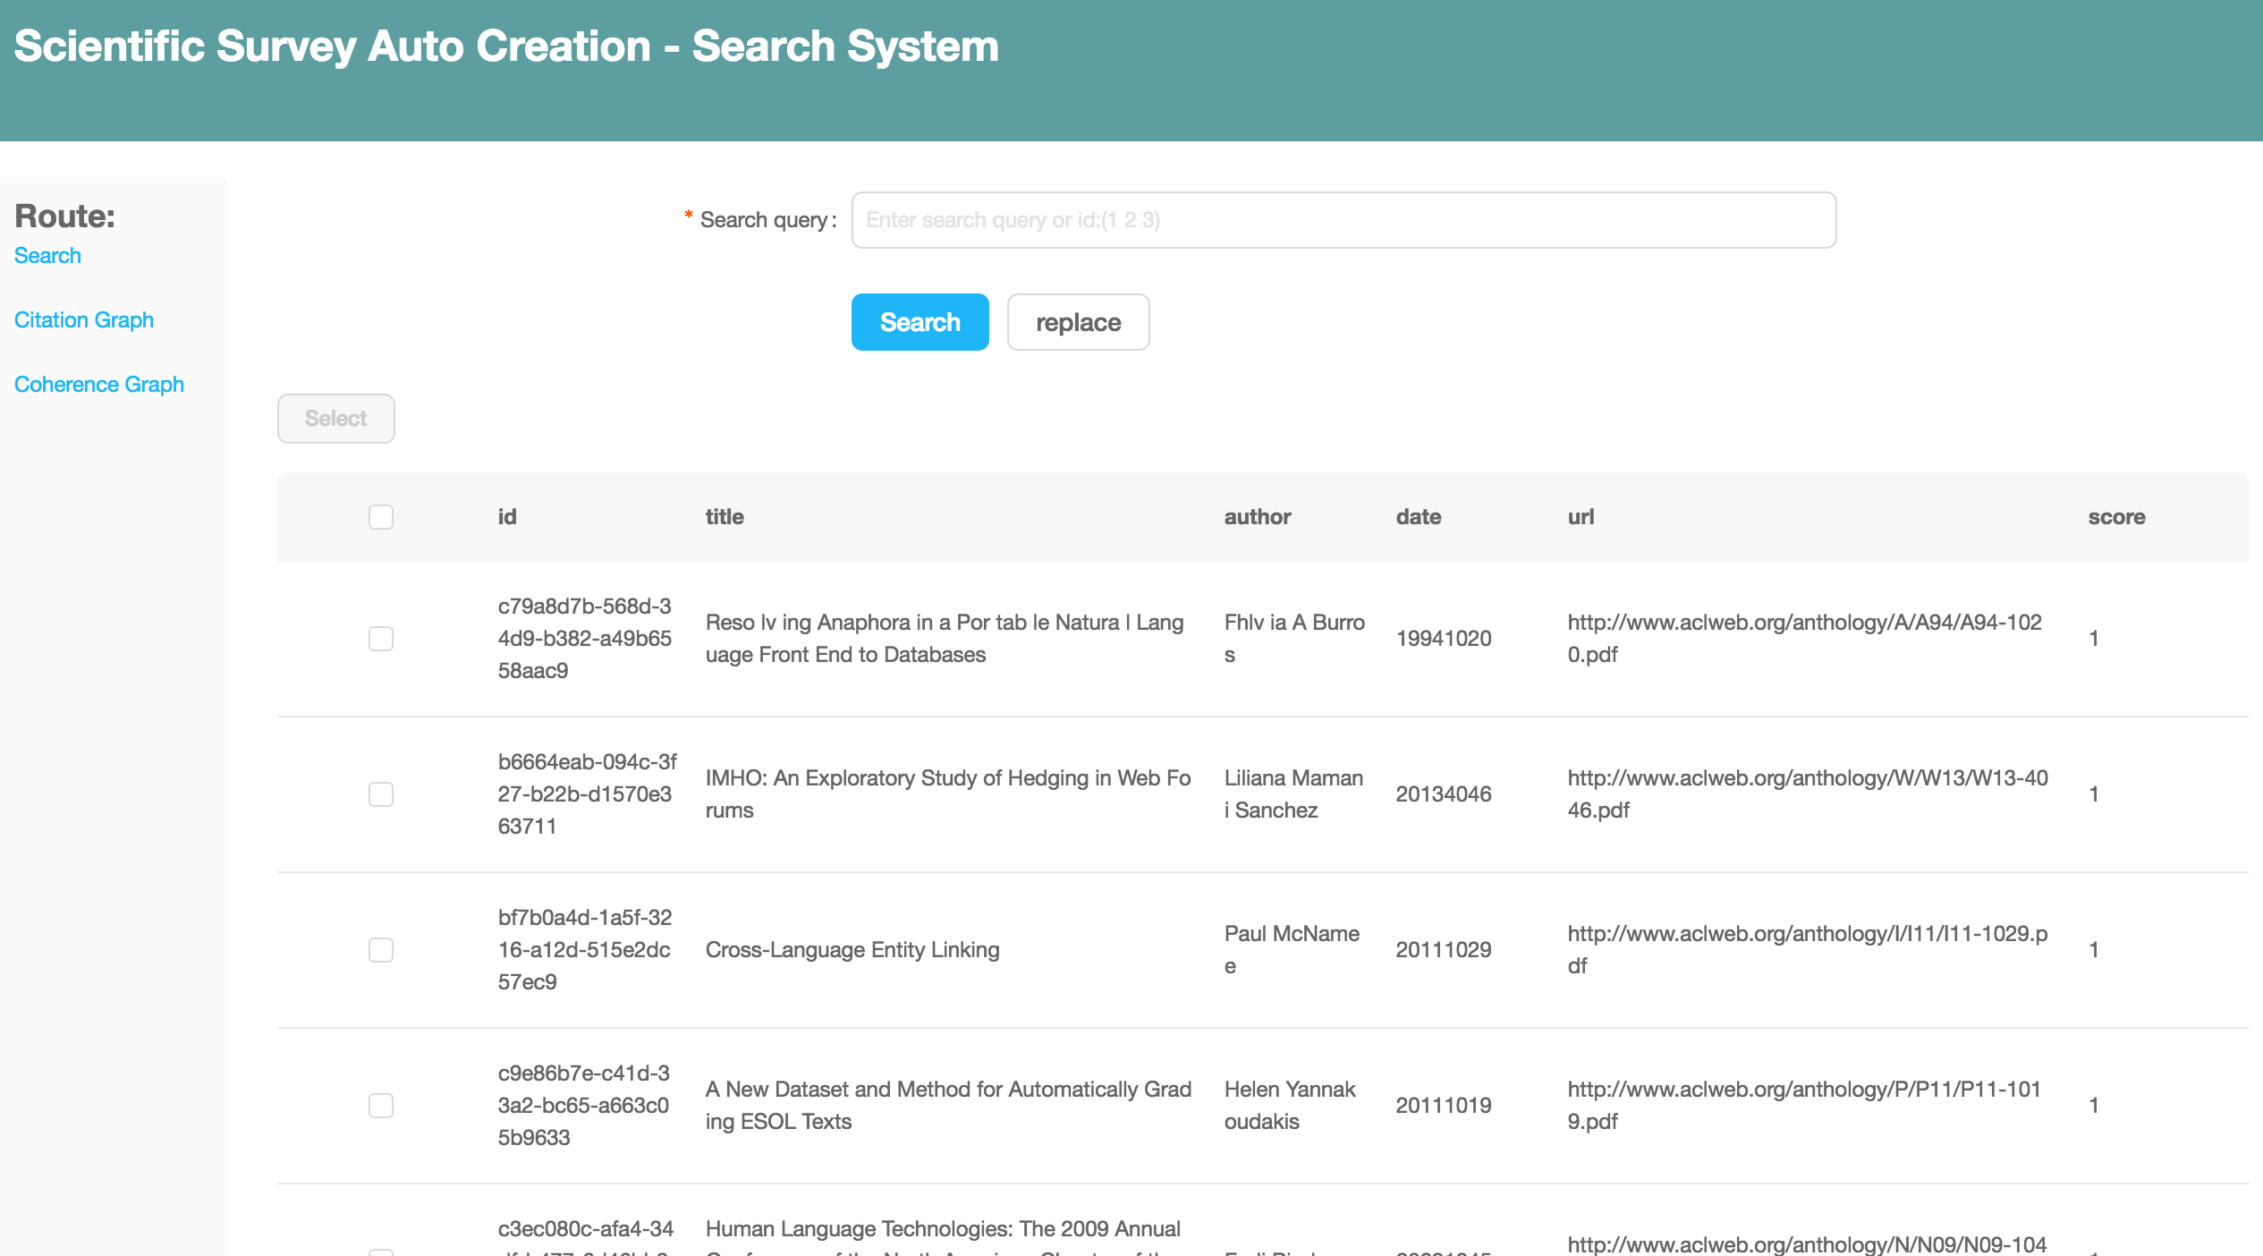
Demo
http://146.169.47.62:8989/

Slide 21
Evaluation
Result
Speed of the Application
Limitation
Future work

Slide 22
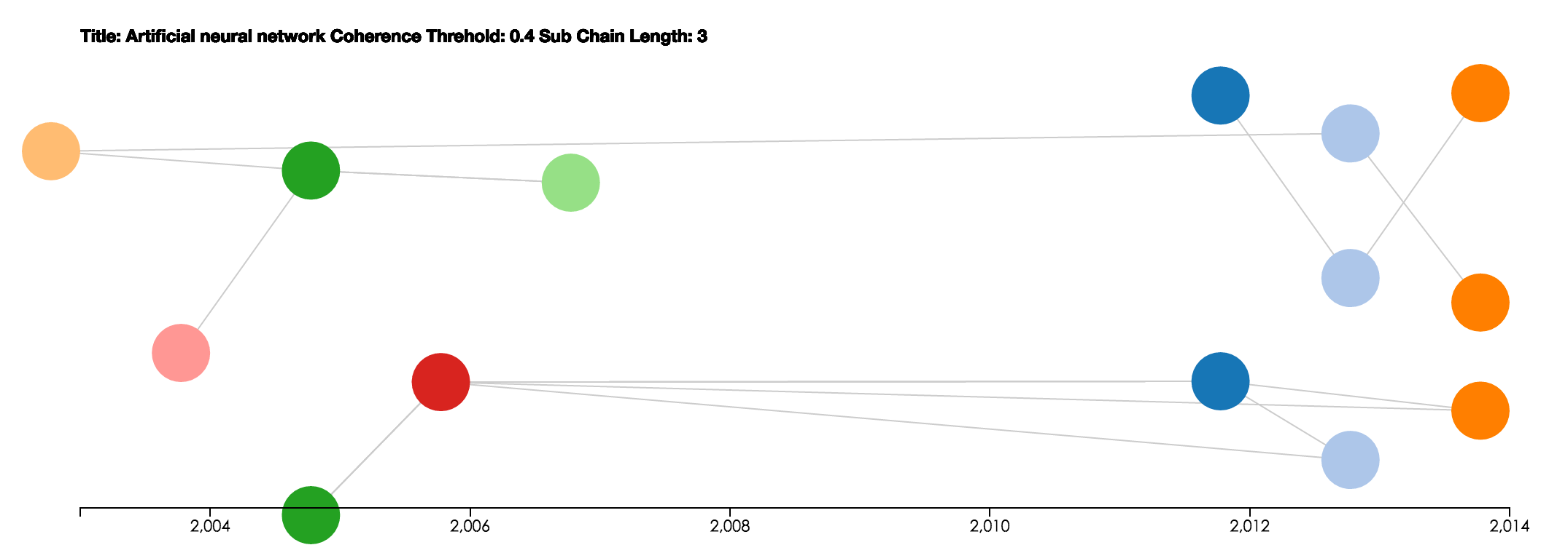
An example of result

Slide 23
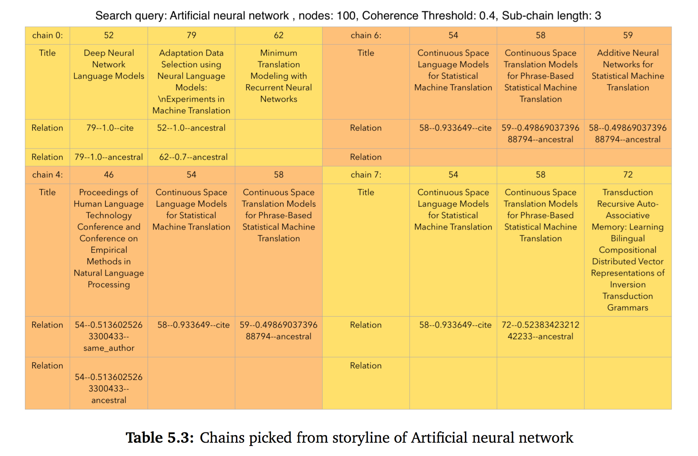
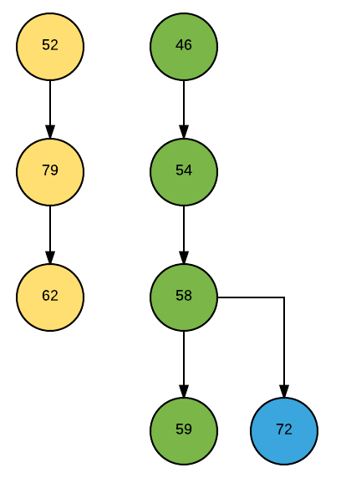
An example of result

Slide 24
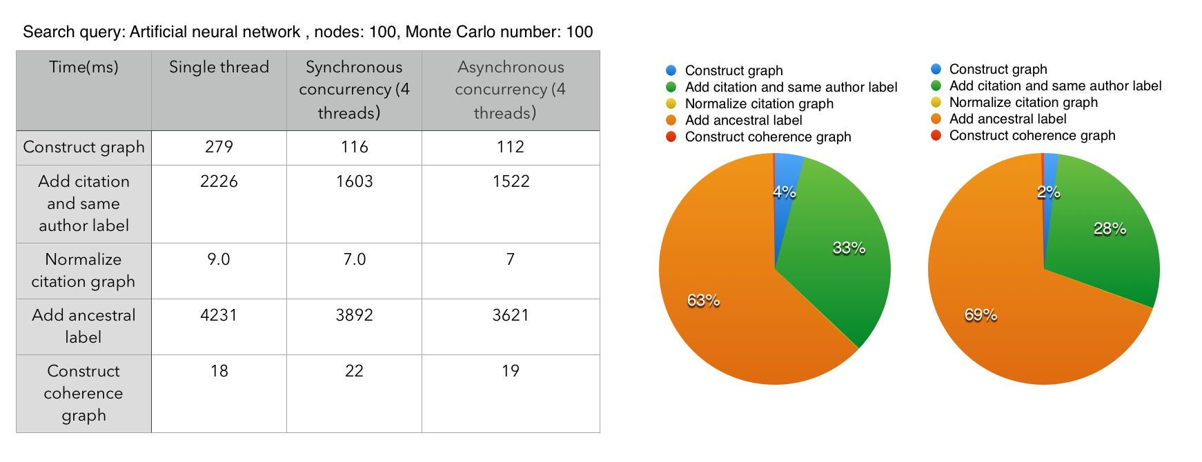
Speed of the Application
The application cost most time on graph construction.
Users will wait several seconds when 100 nodes are used.

Slide 25
Limitation
Too much parameters of graph adjusted by users
Speed of construction graph is slow

Slide 26
Future work
Use distribute system to speed up
Adjust parameters of graph automatically

