Slide 1
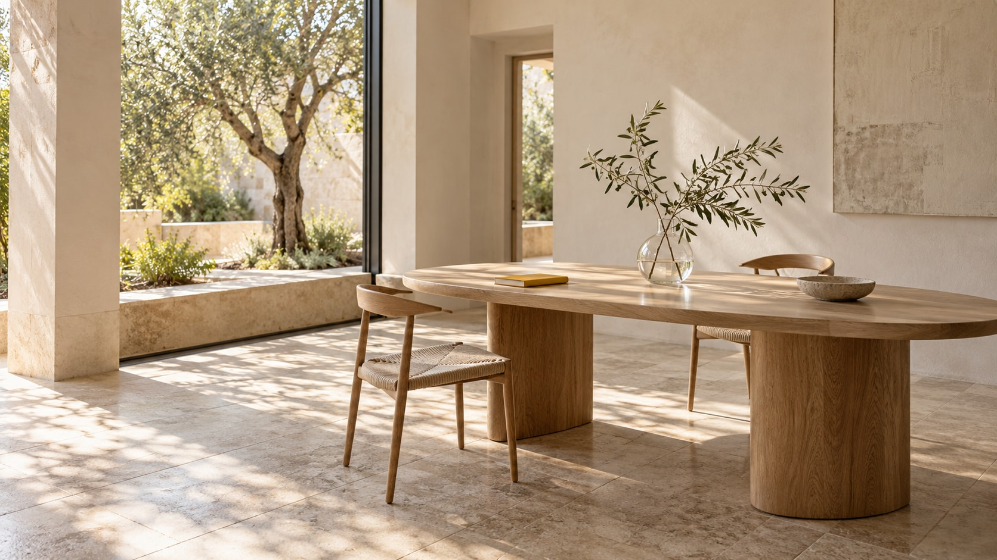
ATELIER NORTH
ATELIER
NORTH
Workspaces and cultural buildings
Daylight. Tactile materials. Clear space.
Fictional studio and illustrative data. AI-generated imagery.
01

Slide 2
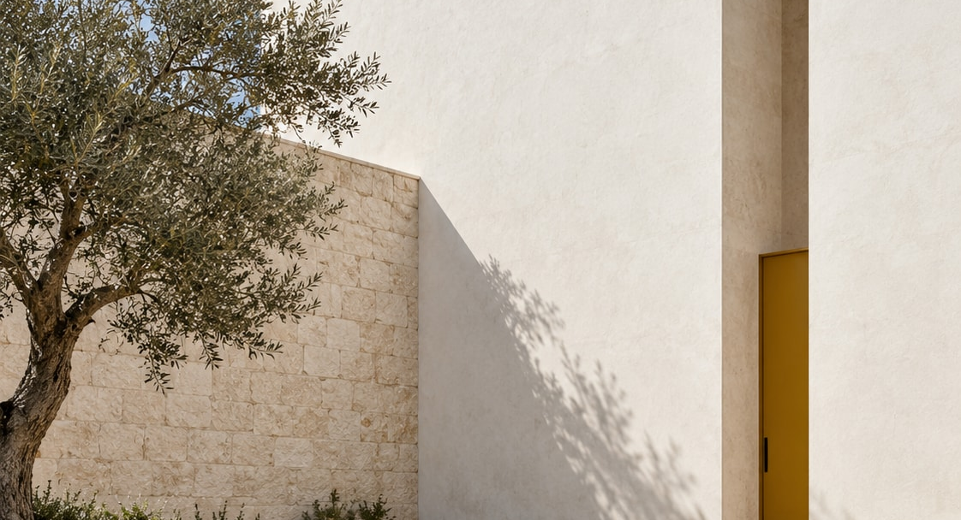
ATELIER NORTH
The pavilion concept
01
A narrow yellow entrance
02
Pale limestone
2
3
03
Olive tree
1
Fictional concept. Images express design direction, not a completed building.
02

Slide 3
ATELIER NORTH
12 workplaces in a 24-project portfolio
24 projects
Demonstration portfolio only.
These counts are not
business results.
Fictional studio and illustrative data. AI-generated imagery.
03

Slide 4
ATELIER NORTH
Discover to deliver
01
02
03
04
Discover
Design
Develop
Deliver
Clarify the brief.
Test spatial ideas.
Resolve materials and
details.
Support the agreed
handover.
No project duration or fee is specified.
04

Slide 5
ATELIER NORTH
Daylight and material
warmth
We design calm workspaces and
small cultural buildings through
careful use of daylight, tactile
materials and a clear floor plan.
Fictional studio and illustrative data. AI-generated imagery.
05

