Slide 1
Review Meeting 4
Build your own Radar System, Project Course
Group 7:
Bingxue Xu
Nikita Dubrovskyi
Rafael Rodrigues
Stefano Crescenza
Tuesday, 30/09/2025

Slide 2
Week Achievements
SAR image generation: Time Domain Correlation.
SAR image generation: Range Migration Algorithm (RMA).
SAR image generation using real targets: Range Migration Algorithm (RMA).
SAR image measurement: acquisition of the SAR image using the three available trihedral corner reflectors as targets.

Slide 3
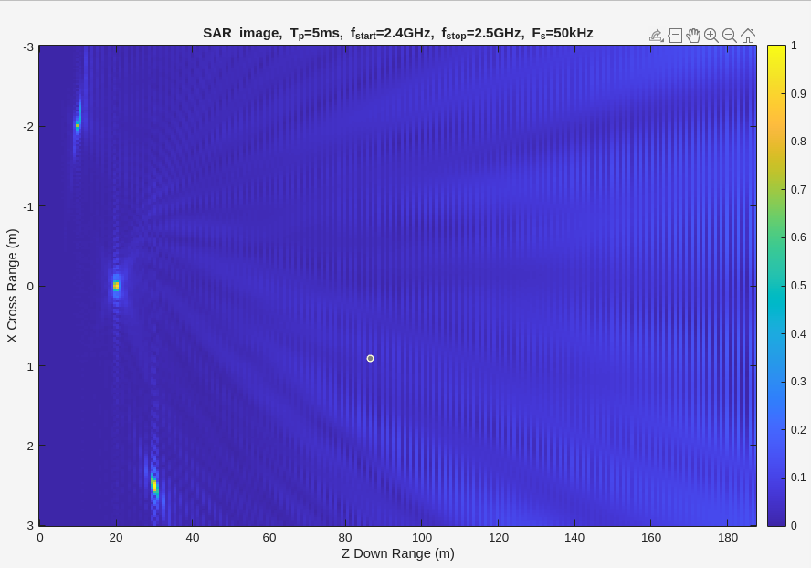
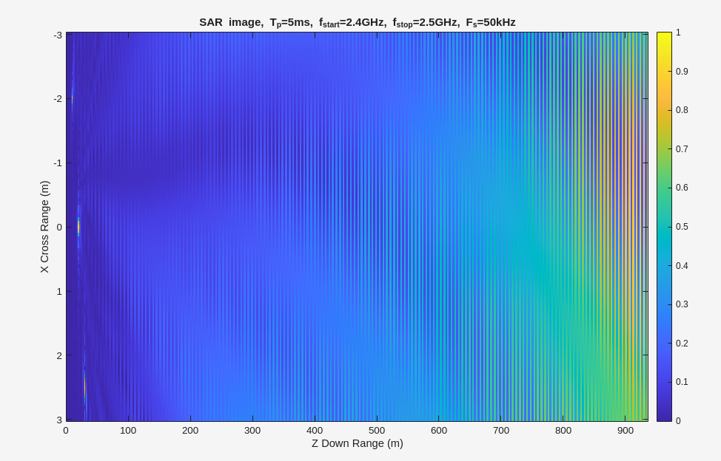
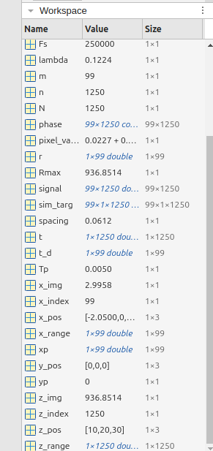
1. Time Domain Correlation (Sub-group 1):
a. Increase 𝐹𝐹𝑠𝑠 to 250 kHz. How long does it take to generate the image? Why?
Elapsed time is 6.016496 seconds.
Elapsed time is 221.283552 seconds.
overall complexity: Runtime ∝ O(m×n×M×N) -> 25× increase
Increasing Fs 5×→ increases the 5 of time samples N per chirp → increases the signal resolution in time/range. → increases runtime 25×, theoretically

Slide 4
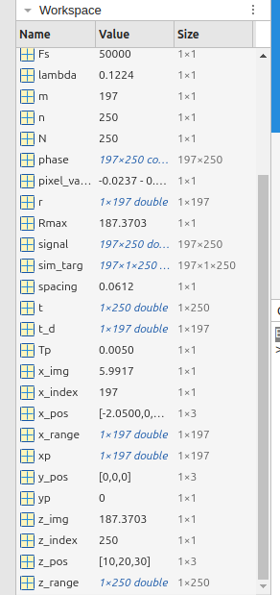
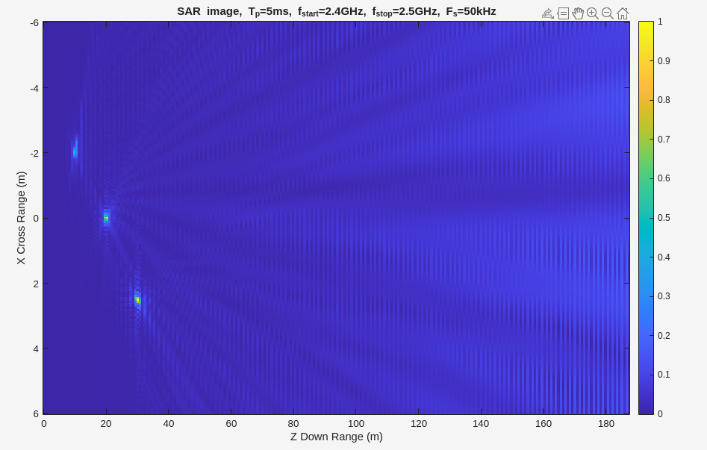
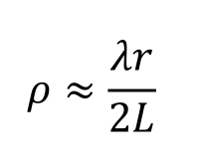
1. Time Domain Correlation (Sub-group 1):
b. Reduce 𝐹𝐹𝑠𝑠 back to 50 kHz and increase the rail length going to xp = -6000E- 3:spacing:6000E-3. How long does it take to generate the image? Why? What happens to the cross-range resolution?
Elapsed time is 6.016496 seconds.
Elapsed time is 29.546504 seconds.
overall complexity: Runtime ∝ O(m×n×M×N), total iterations in the loop increase by 4×, theoretically
M doubles (more radar positions),
m doubles (more pixels to compute),
increasing L 2×→ 2× better cross-range resolution.

Slide 5
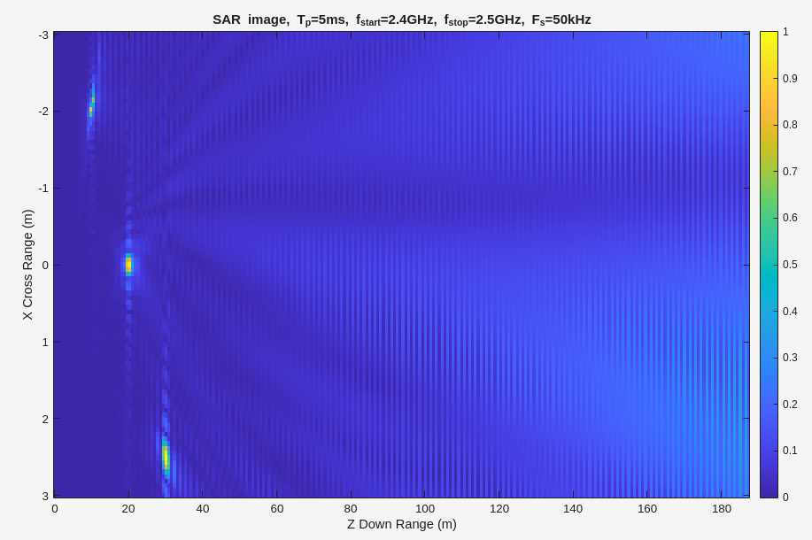
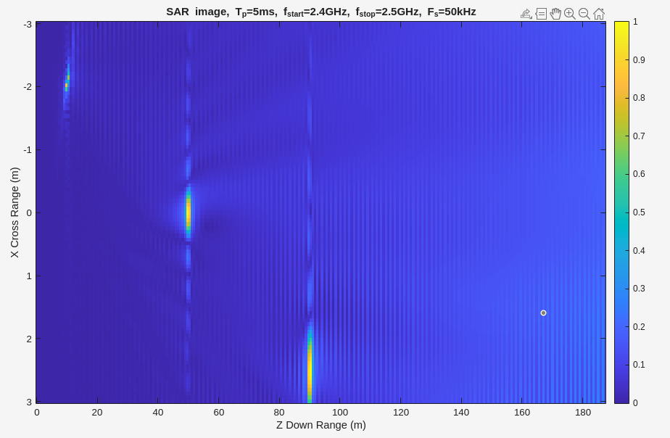
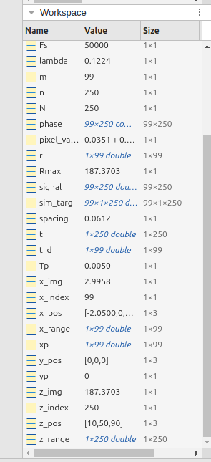
1. Time Domain Correlation (Sub-group 1):
c. Reduce the rail length back to xp = -3000E-3:spacing:3000E-3 and increase the position of the second target to 50 meter and the third target to 90 meter. Comment on the cross-range resolution of each target?
Elapsed time is 6.016496 seconds.
Elapsed time is 6.360319 seconds.
Target range (Z) Cross-Range Resolution (Δx)
When increasing the range of the targets, the cross-range resolution degrades proportionally with the target distance.
10 m ~ 10.2 cm
50 m ~ 51.0 cm
90 m ~ 91.8 cm

Slide 6
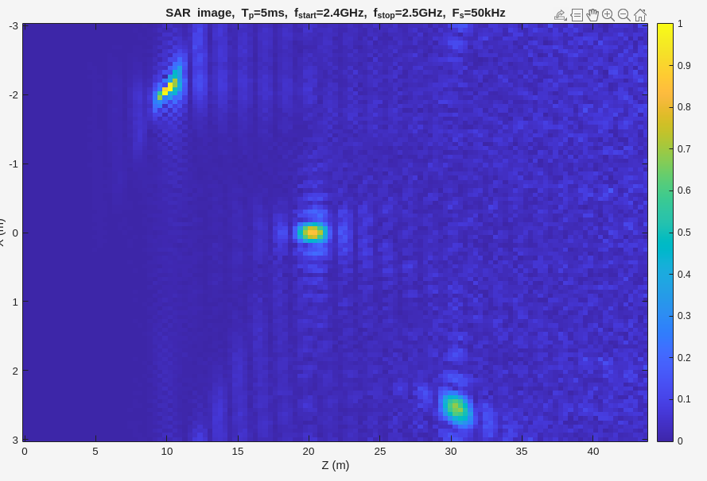
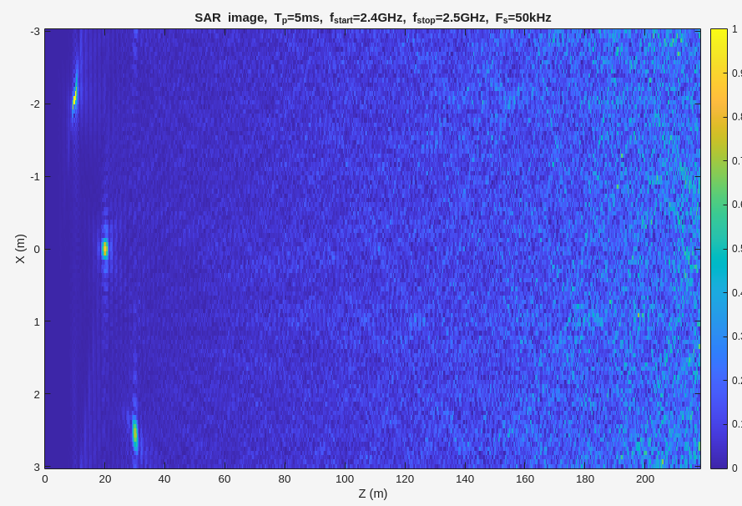
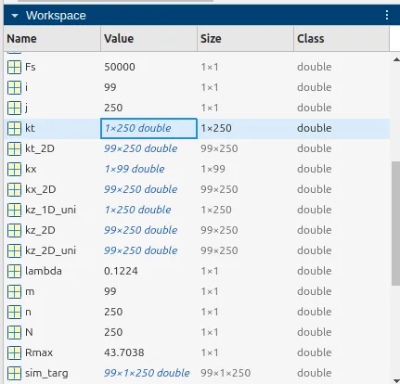
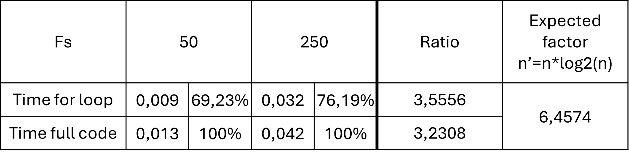
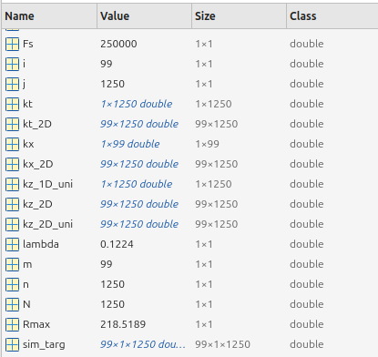
2. Range Migration Algorithm (RMA) (Sub-group 2):
a. Increase 𝐹𝐹𝑠𝑠 to 250 kHz. How long does it take to generate the image? Why?
Elapsed time is 0.107914 seconds.
Elapsed time is 0.082016 seconds.
Overall complexity: Runtime ∝ fft+interpolation + ifft+ plot
within interpolation for loop, N increases 5 ×, runtime should increase 5 ×, theoretically, most of runtime is spent on plot
fft and ifft runtime stay the same with different m and n
MATLAB’s fft() uses optimized algorithms that iterate recursively, but it is highly vectorized and compiled in C

Slide 7
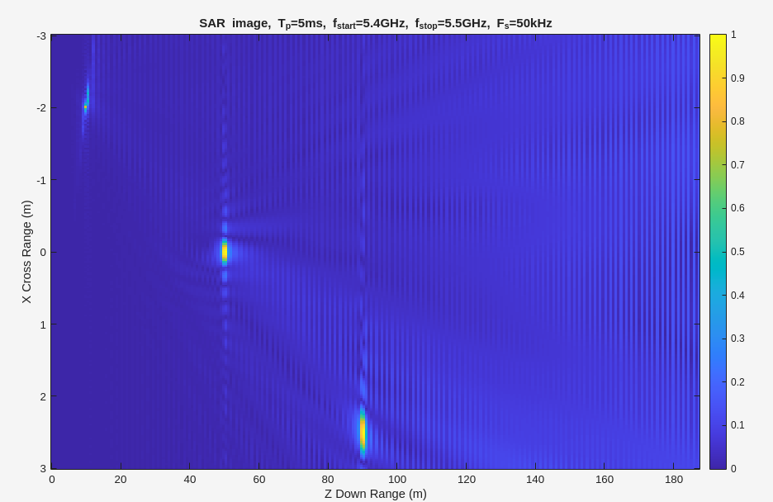
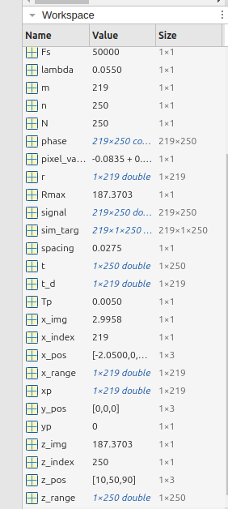

1. Time Domain Correlation (Sub-group 1):
d. Keep the target position as in the previous steps and change f = 5.4 − 5.5 𝐺Hz. How long does it take to generate the image? Why? What happens to the maximum range?
Elapsed time is 6.360319 seconds.
Elapsed time is 34.152778 seconds.
overall complexity: Runtime ∝ O(m×n×M×N), -> 4.5× increase
whenλ becomes ~half (i.e. you double the frequency from 2.45 GHz → 5.45 GHz), m changes from 99→219, both m and M ~double.
The maximum range does not change when you increase the center frequency from 2.45 GHz → 5.45 GHz, because the bandwidth, sampling frequency, and chirp duration all remain the same.

Slide 8
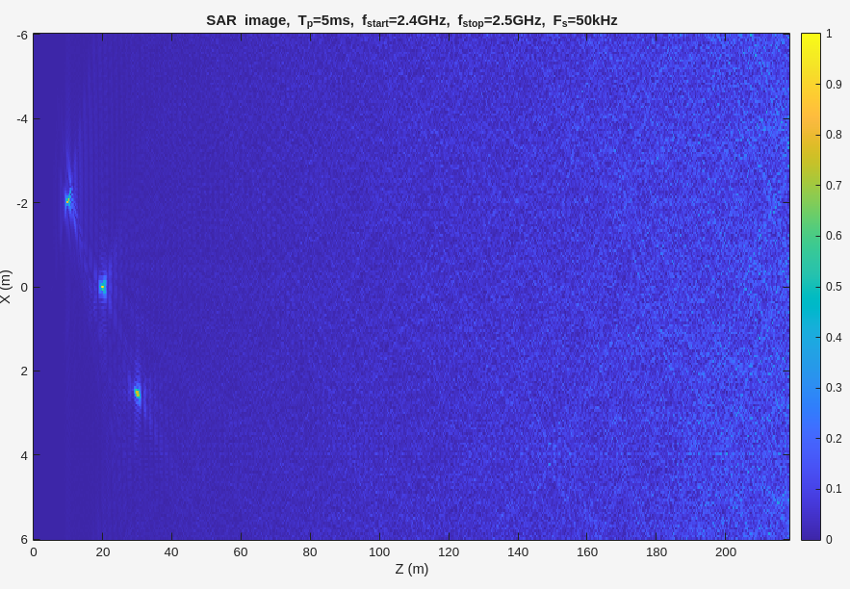
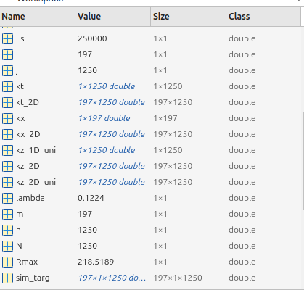
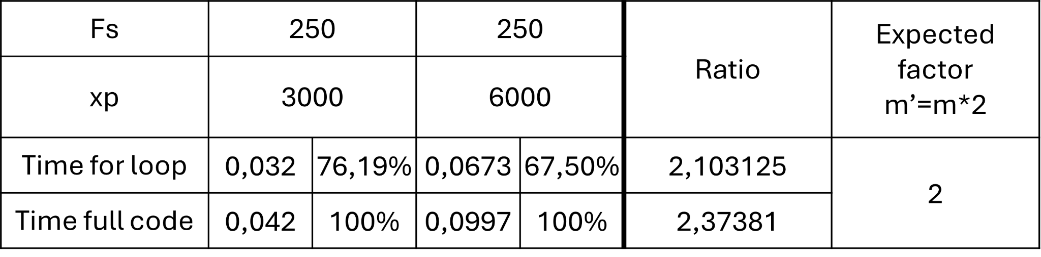
2. Range Migration Algorithm (RMA) (Sub-group 2):
b. Keep 𝐹𝐹𝑠𝑠 at 250 kHz and increase the rail length going from xp = -6000E-3:spacing:6000E-3. How long does it take to generate the image? Why? what happens to the cross-range resolution?
Elapsed time is 0.122072 seconds.
theoretically, doubling the rail length (from 6 m to 12 m) approximately doubles the image generation time. This is because all signal processing steps scale linearly with the number of radar positions (m), and doubling xp range doubles m. But in real run they are almost the same
Cross-range resolution improves (gets finer) with increased rail length. According to the fomula ince L increases, ρ\rhoρ decreases. Which means better separate nearby targets in the cross-range direction (X).

Slide 9
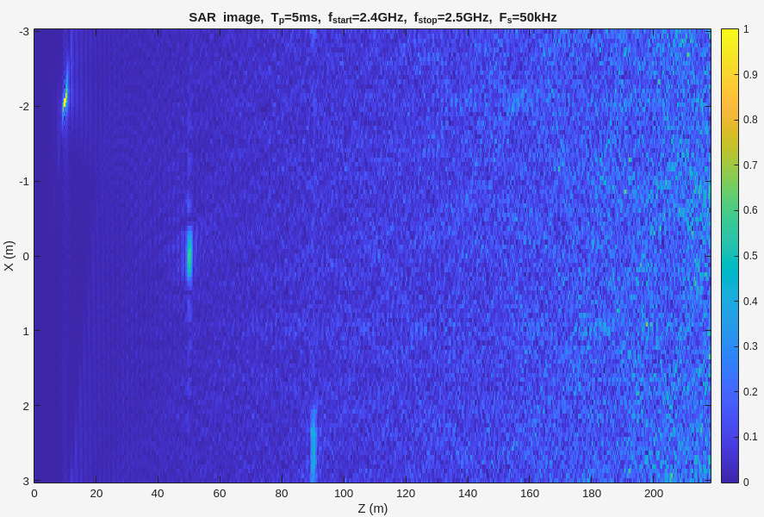
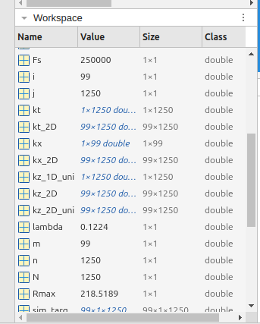
2. Range Migration Algorithm (RMA) (Sub-group 2):
c. Reduce the rail length back to xp = -3000E-3:spacing:3000E-3 and increase the position of the second target to 50 meter and the third target to 90 meter. Comment on the cross-range resolution of each target?
Elapsed time is 0.066368 seconds.
Cross-range resolution gets worse (larger) as distance increases.
Target 1 (z = 10 m) appears sharpest in cross-range,(~10.2 cm)
Target 2 (z = 50 m) appears more blurred laterally, (~51 cm).
Target 3 (z = 90 m) is even less distinguishable in the X-direction, (~91.8 cm).

Slide 10
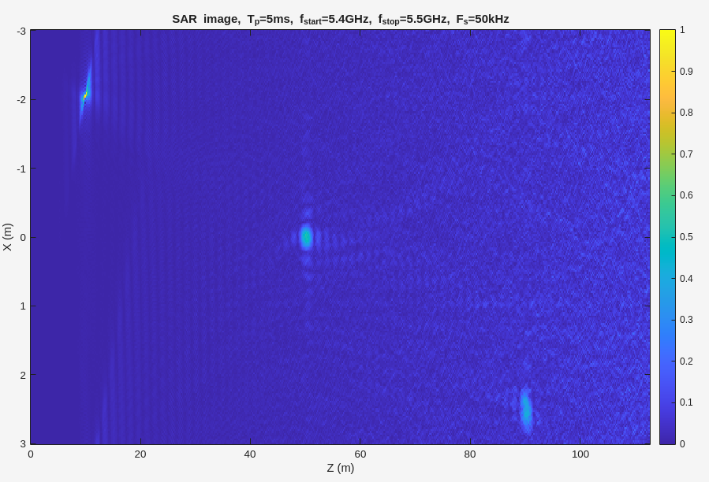

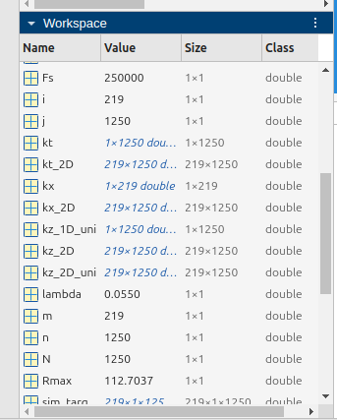
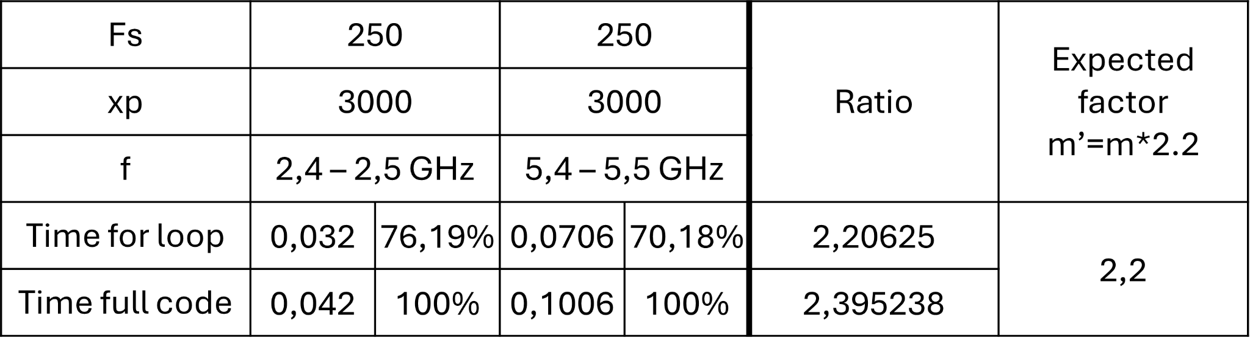
2. Range Migration Algorithm (RMA) (Sub-group 2):
d. Keep the target position as in the previous steps and change f = 5.4 −5.5 𝐺Hz. How long does it take to generate the image? What happens to the cross-range resolution? What happens to the maximum range?
Elapsed time is 0.097124 seconds.
The image takes about twice as long to generate due to increased spatial sampling (more radar positions with shorter wavelength).
λ≈0.122m → 0.056m
m = 99 → 219, So more radar positions = more rows to process more rows to process
Cross-range resolution improves because of the shorter wavelength. Targets appear narrower and more separated in X.
maximum range is determined by bandwidth and N, not center frequency — so it stays constant.

Slide 11
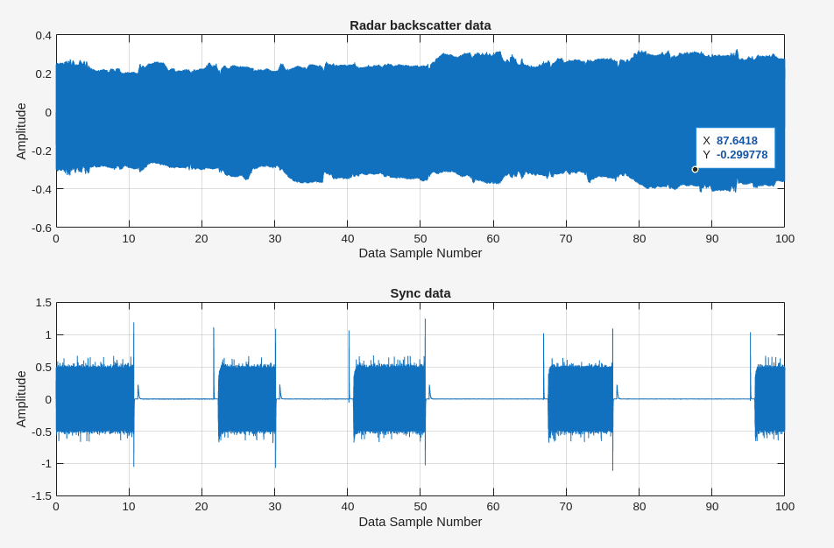
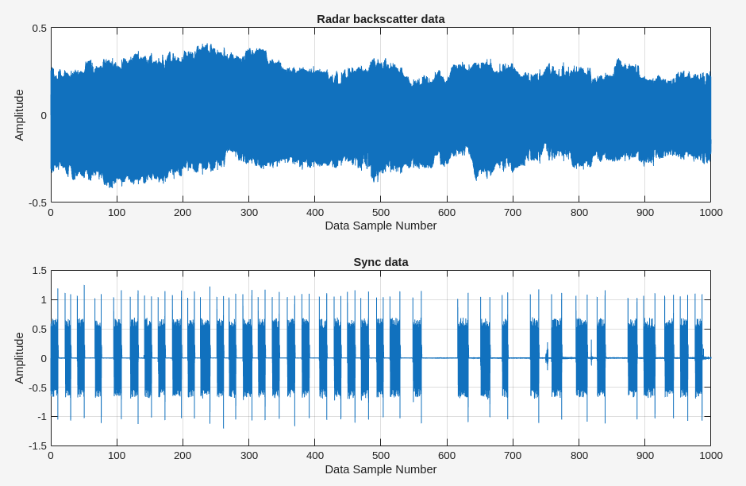
3. Range Migration Algorithm (RMA) (Sub-group 2):
a. Plot the entire data and the sync signal.
Nrp = round(0.5 * Fs); % 500 ms * Fs samples per rail position
radar_matrix(valid_rows,:) = radar_data(rail_start_indices(i) + Nrp : rail_start_indices(i) + 2*Nrp - 1)'; % leave a guard band Nrp

Slide 12
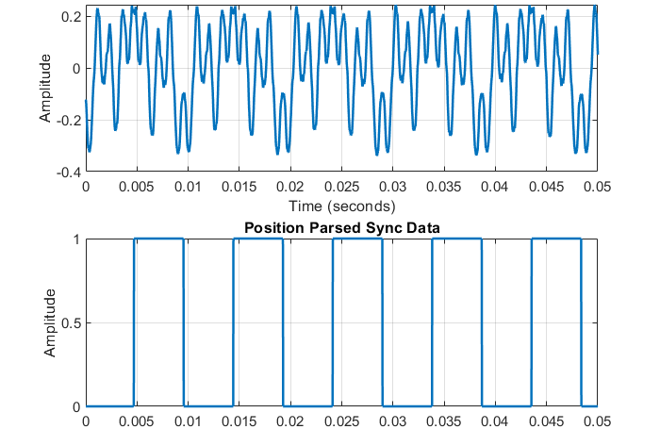
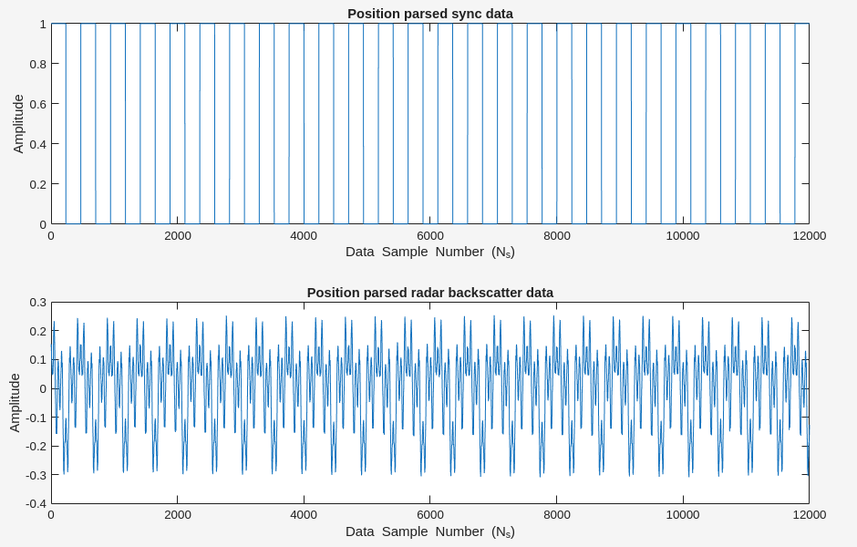
3. Range Migration Algorithm (RMA) (Sub-group 2):
b. Show that the data is parsed correctly by plotting the parsed (according to the
position of the radar on the rail) backscatter data together with the parsed sync
data. (Lec.5, slide 56).

Slide 13
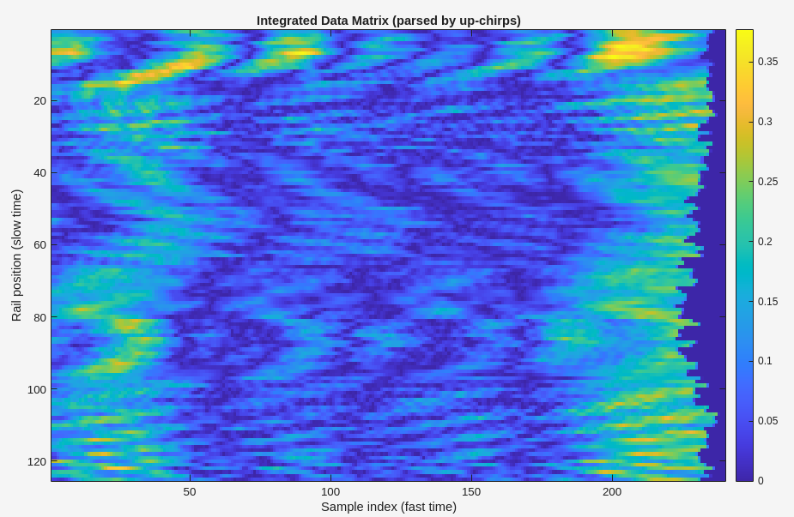
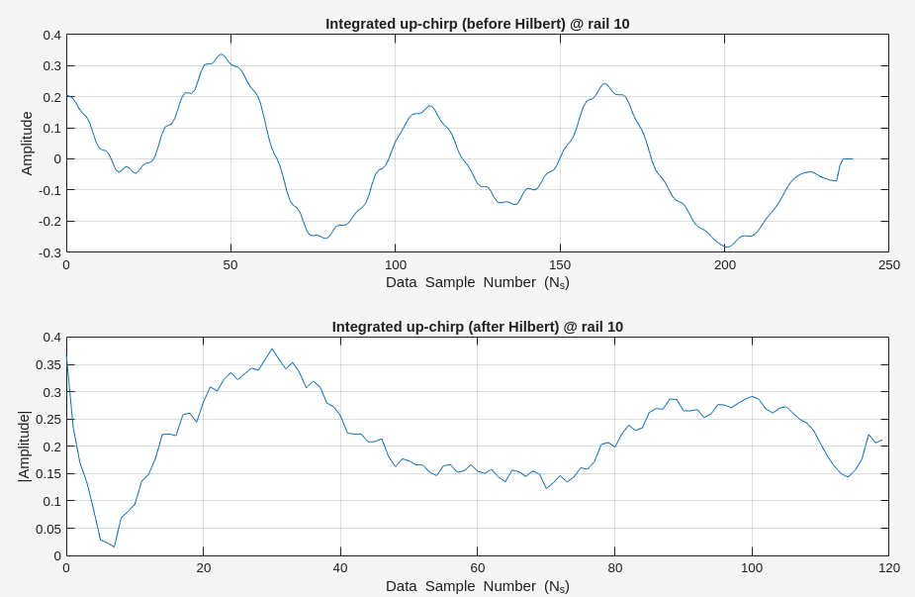
3. Range Migration Algorithm (RMA) (Sub-group 2):
c. Plot the integrated data to show that the data is parsed correctly according to
the up-chirp. (Lec. 5, as shown in the lower right figure on slide 57).

Slide 14
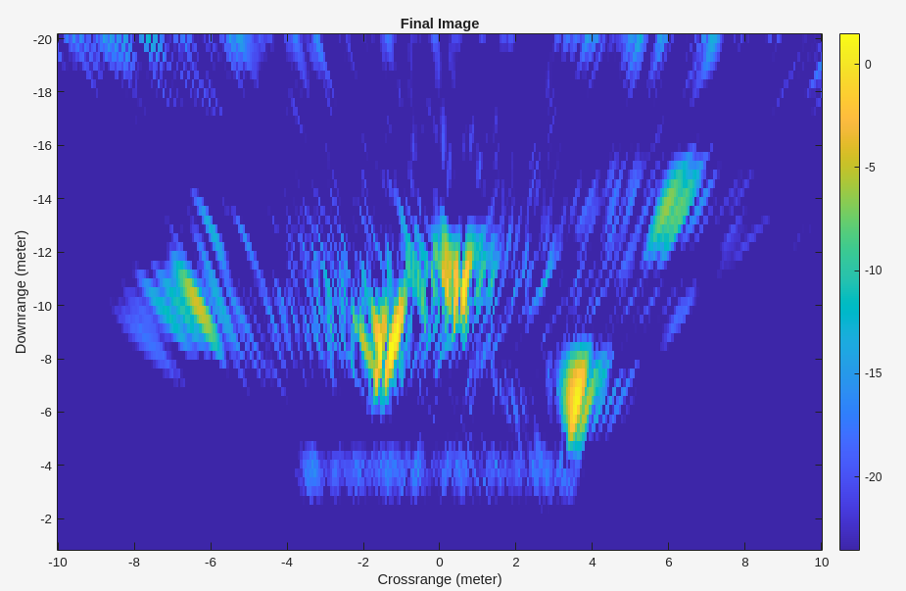
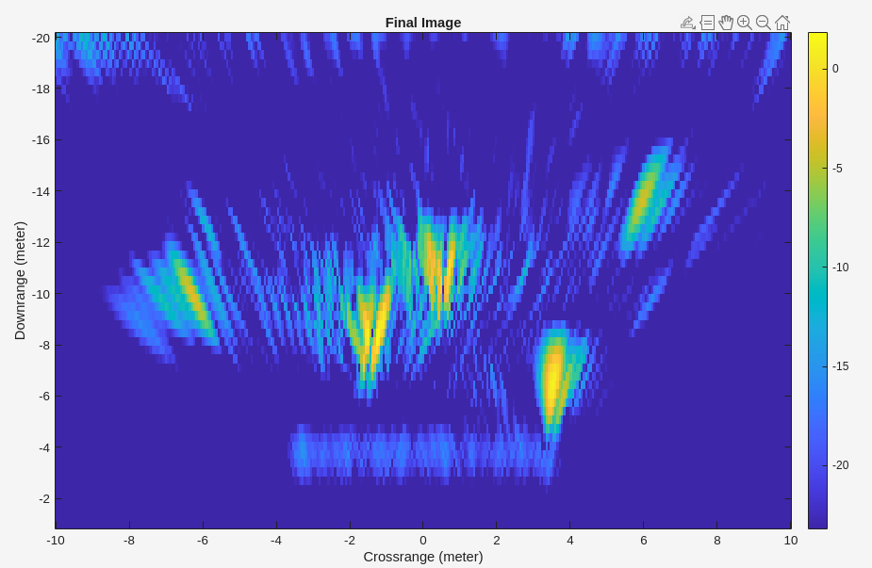
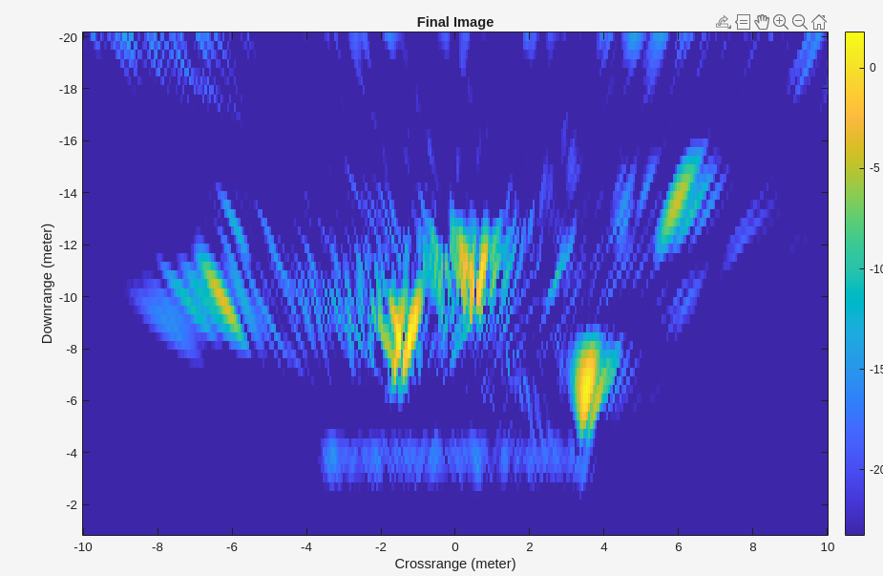
3. Range Migration Algorithm (RMA) (Sub-group 2):
d. Show the effect of variation in scan time Trp (amount of time spent in one
position on the rail) on the resolution or SNR of the final image. Increase and
decrease Trp to illustrate.
Trp = 0.1;
Trp = 0.5; % 500 ms
Trp = 1.0;

Slide 15

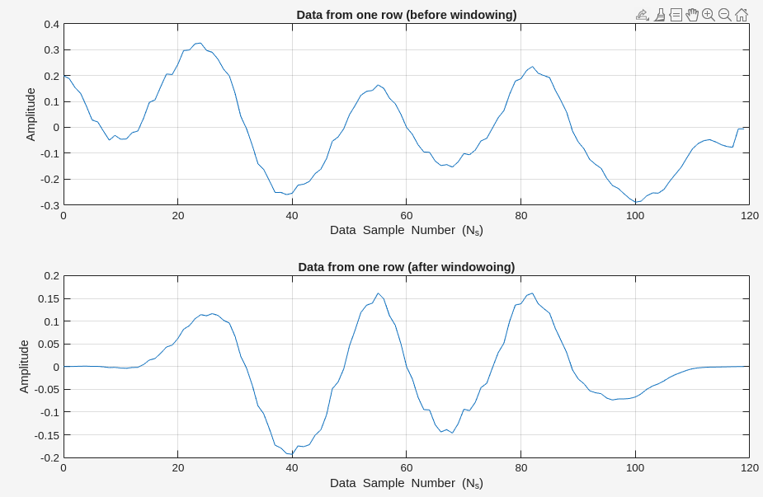
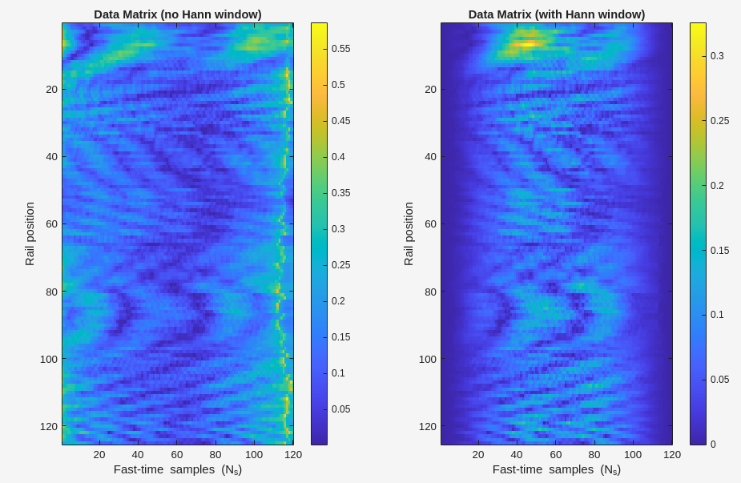
3. Range Migration Algorithm (RMA) (Sub-group 2):
e. Show results with and without using the Hann window.

Slide 16
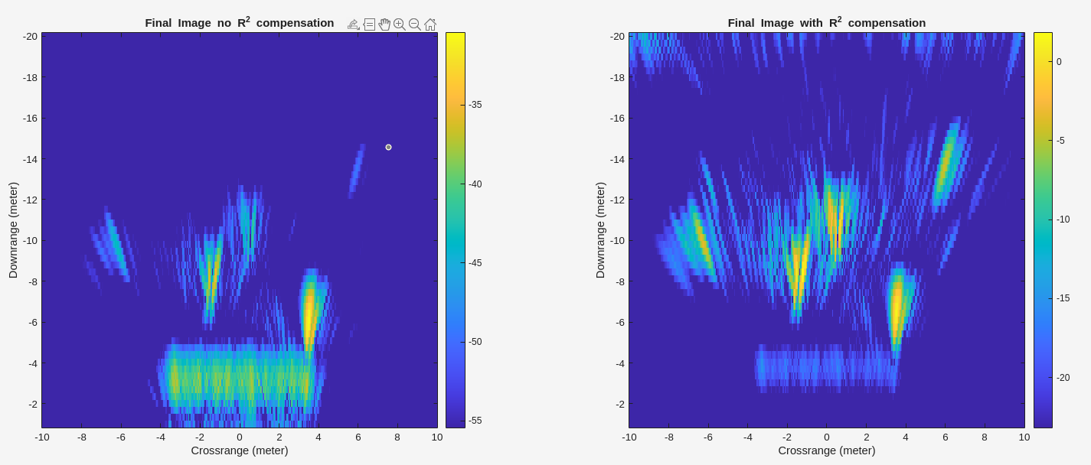
3. Range Migration Algorithm (RMA) (Sub-group 2):
f.Show results with and without multiplication of the down range data with the
square of the down range vector. (this is on the last slide of the algorithm)
Notes:
When you form the SAR image using Range Migration Algorithm (RMA), the raw backscatter amplitudes along the down-range (fast time) dimension are not naturally corrected for spreading loss.
A radar wave spreads out spherically.
Signal power received from a target decays as 1/R² (two-way propagation: one 1/R1/R1/R going out, another 1/R1/R1/R coming back).
To compensate, before migration, you multiply each range bin by the square of its down-range vector (R2R^2R2)
This equalizes energy across ranges and makes reflectors at larger distances appear with the same intensity as nearby ones.

Slide 17
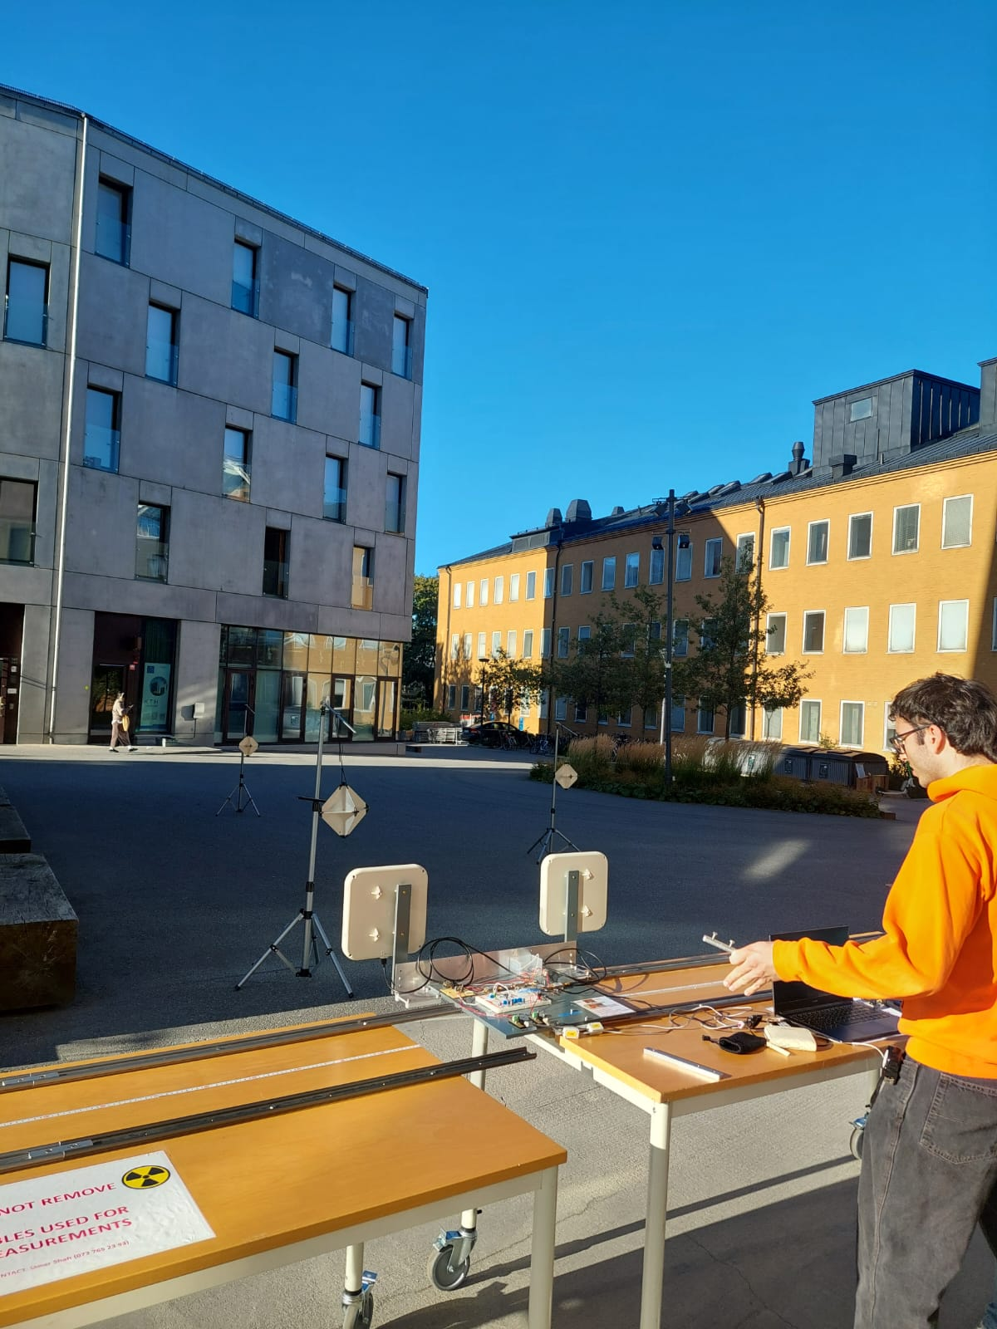
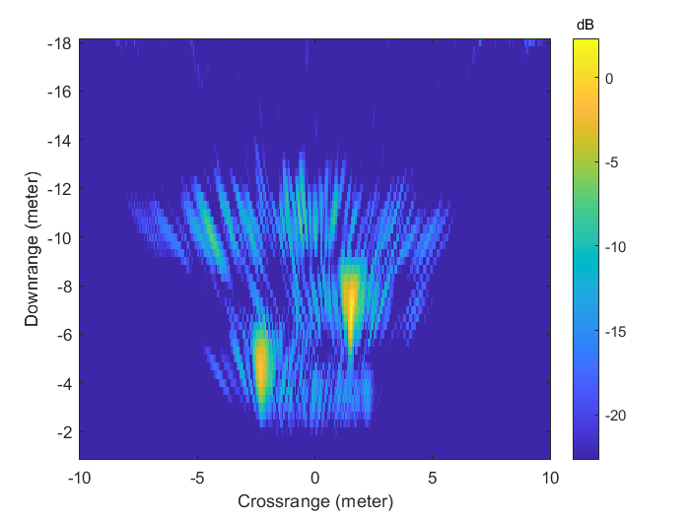
4. Range Migration Algorithm (RMA) (Sub-group 2):
SAR image measurement

Slide 18
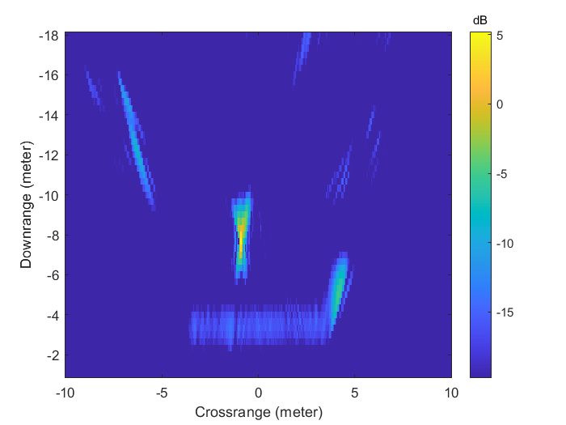
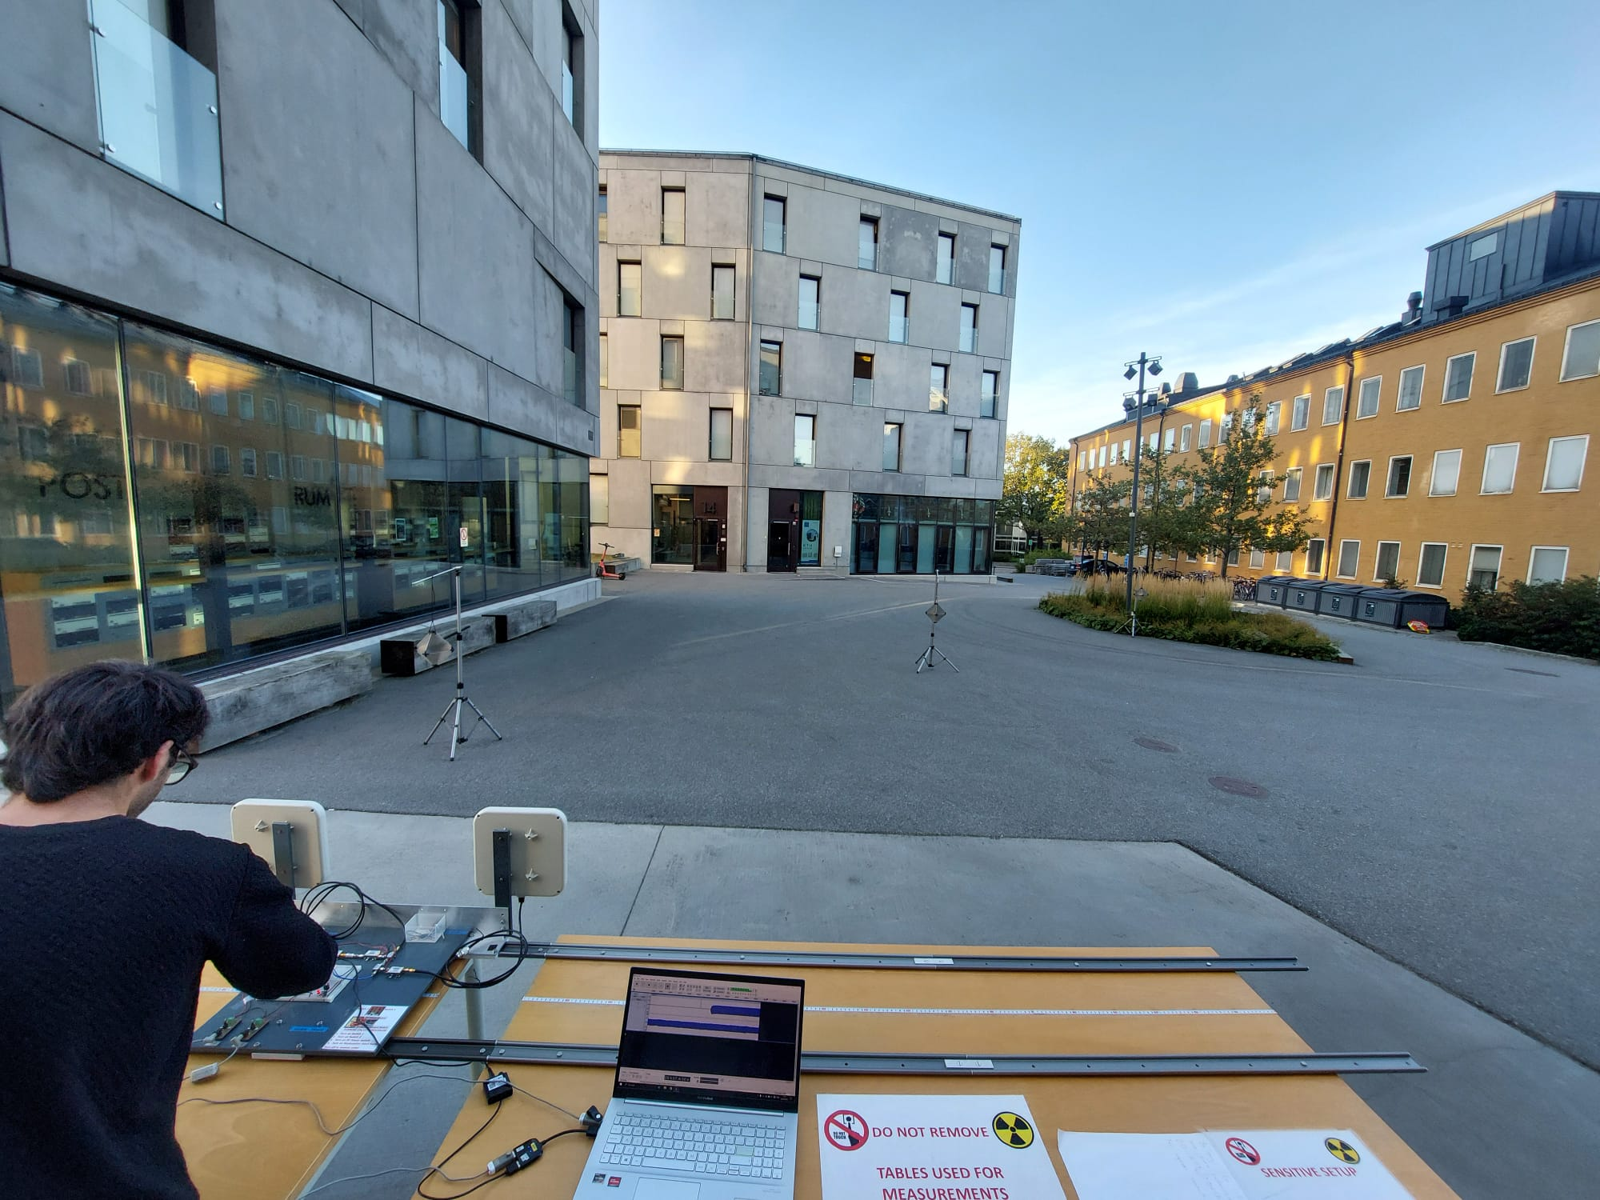
4. Range Migration Algorithm (RMA) (Sub-group 2):
SAR image measurement

Slide 19
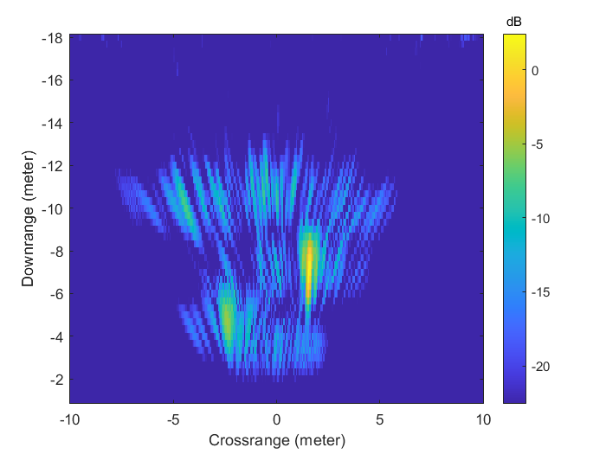
4. Range Migration Algorithm (RMA) (Sub-group 2):
a. Show the difference in azimuth resolution by using a shorter and longer rail length.

Slide 20
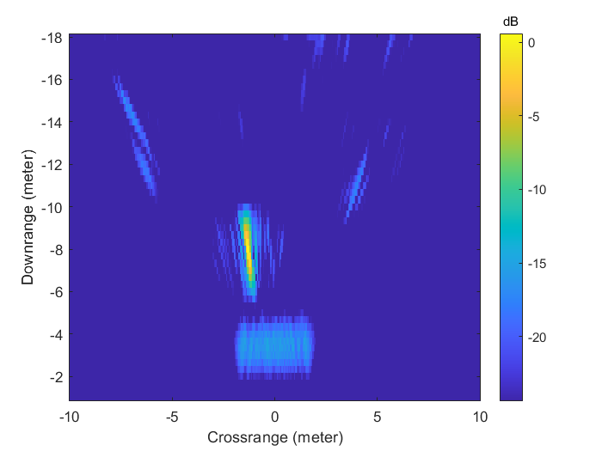
4. Range Migration Algorithm (RMA) (Sub-group 2):
a. Show the difference in azimuth resolution by using a shorter and longer rail length.

Slide 21
Plan for Next Week (Sub-groups 1 and 2)
Velocity measurements with CW for single and multiple targets
Velocity measurements with Low-IF CW for single and multiple targets
Velocity direction detection with CW using IQ demodulation in SDR
Velocity direction detection with Low-IF CW using IQ demodulation in SDR

