Slide 1
Review Meeting 5
Build your own Radar System, Project Course
Group 7:
Bingxue Xu
Nikita Dubrovskyi
Rafael Rodrigues
Stefano Crescenza
Tuesday, 07/10/2025

Slide 2
Week Achievements: SDR Radar
Velocity Measurements in CW mode without Power Amplifier.
a. Single Target
b. Multiple Targets
Velocity Measurements in Low-IF CW mode without Power Amplifier.
a. Single Target
b. Multiple Targets

Slide 3
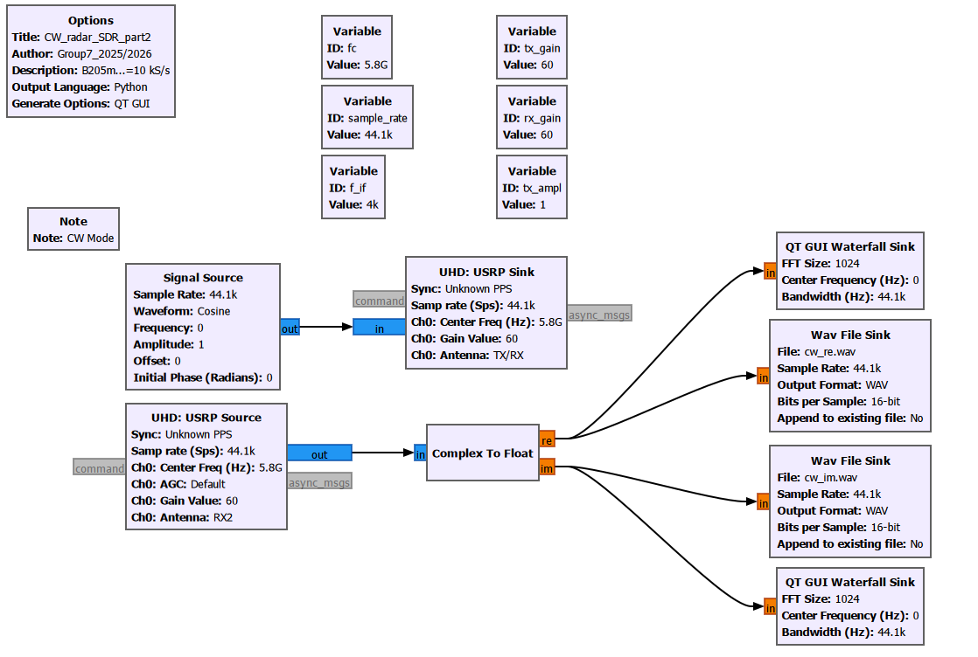
Velocity Measurements in CW mode without Power Amplifier. (Sub-group 2)
GNU Radio schematic

Slide 4
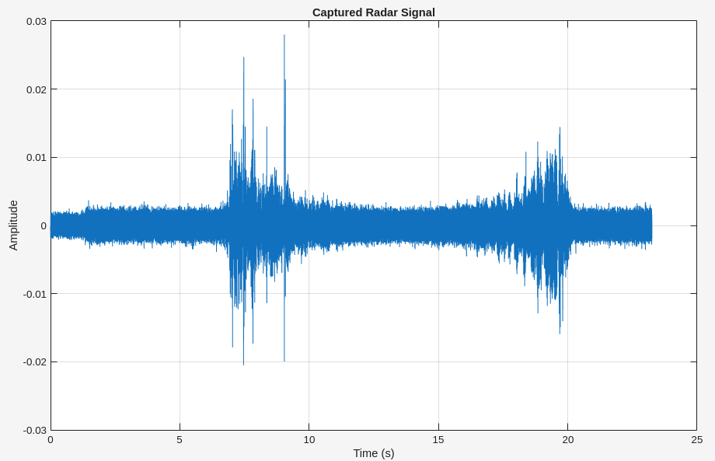
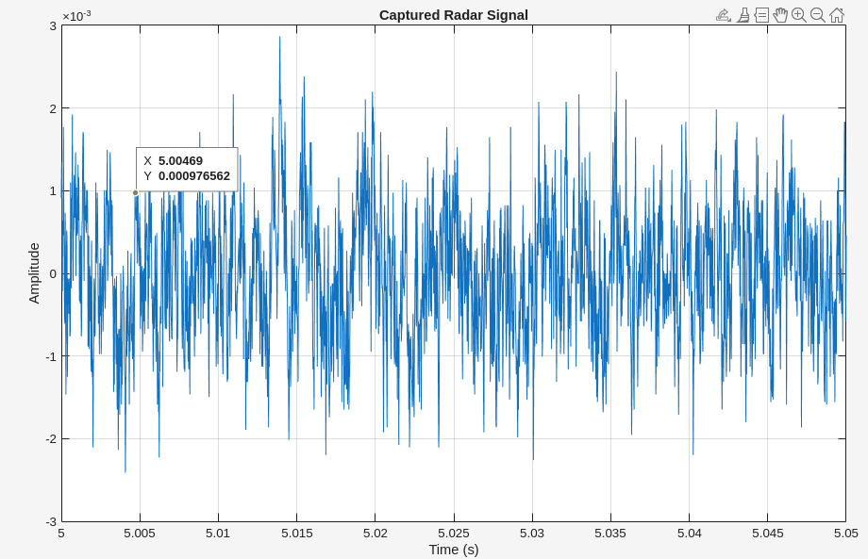
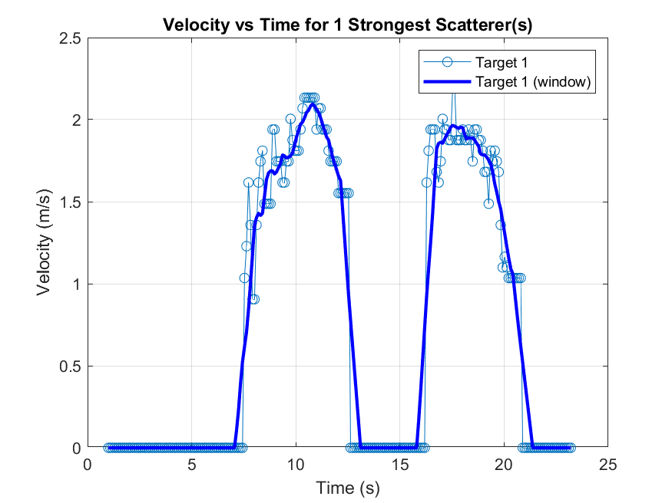
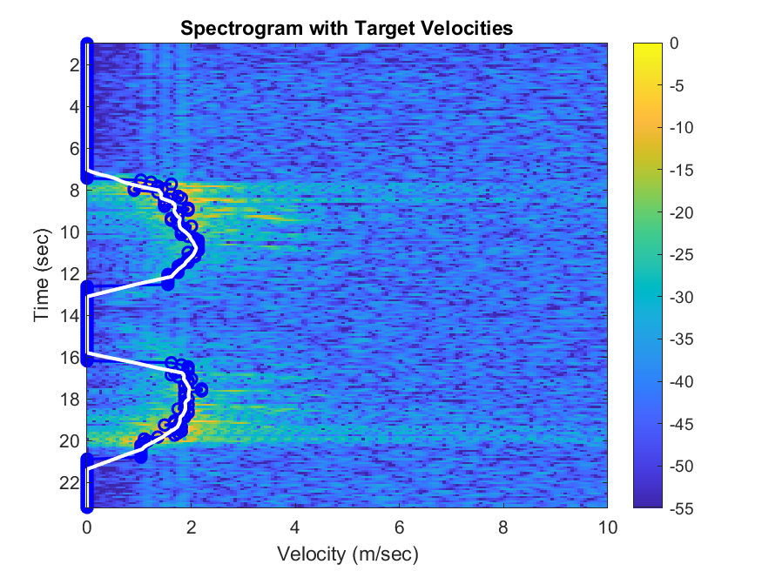
Velocity Measurements in CW mode without Power Amplifier. (Sub-group 2)
a. Velocity Measurements of a single target. Signal processing using your Matlab code
for the COTS radar: show captured data plot, velocity vs time plot (hint: take the
strongest scatterer), velocity vs time spectrogram, GNU Radio schematic

Slide 5
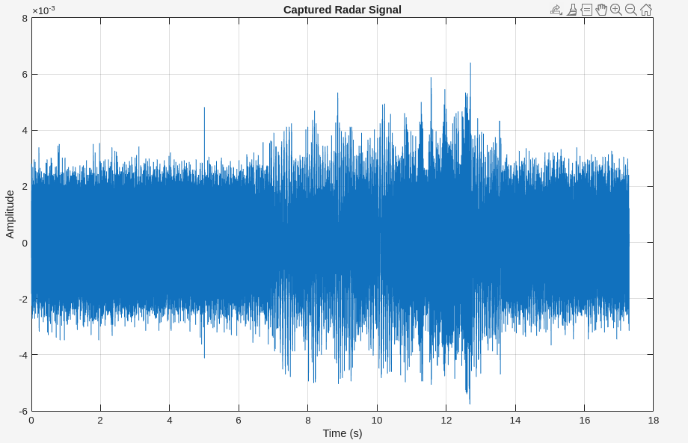
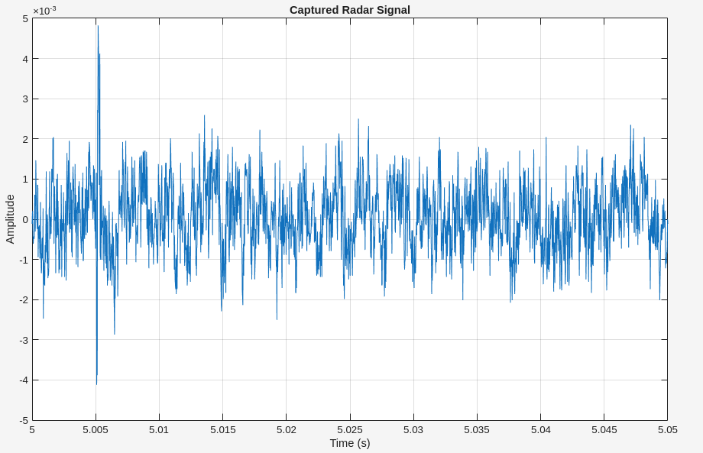
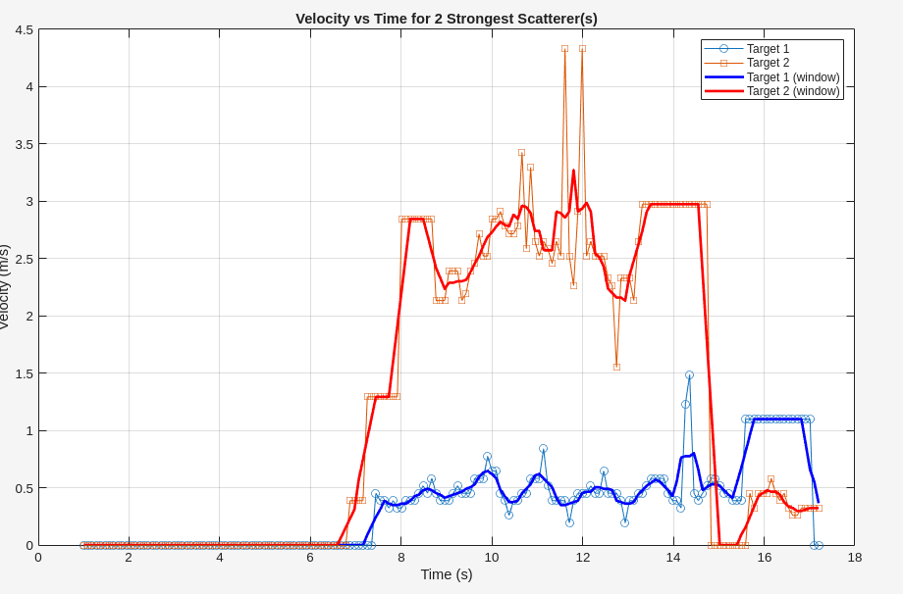
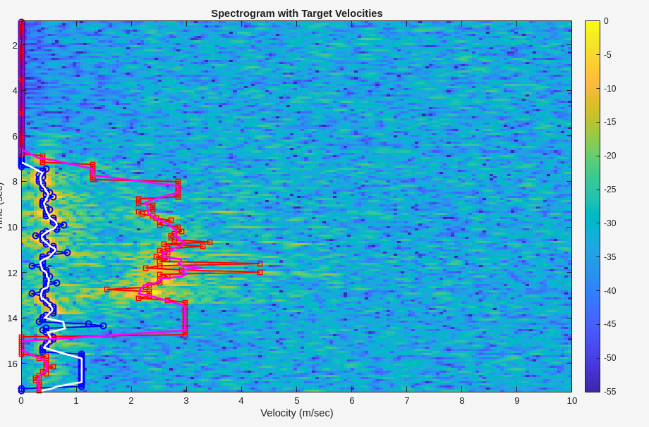
Velocity Measurements in CW mode without Power Amplifier. (Sub-group 2)
b. Velocity Measurements of multiple targets. Signal processing using your Matlab code
for the COTS radar: show captured data plot, velocity vs time plot, velocity vs time
spectrogram, GNU Radio schematic

Slide 6
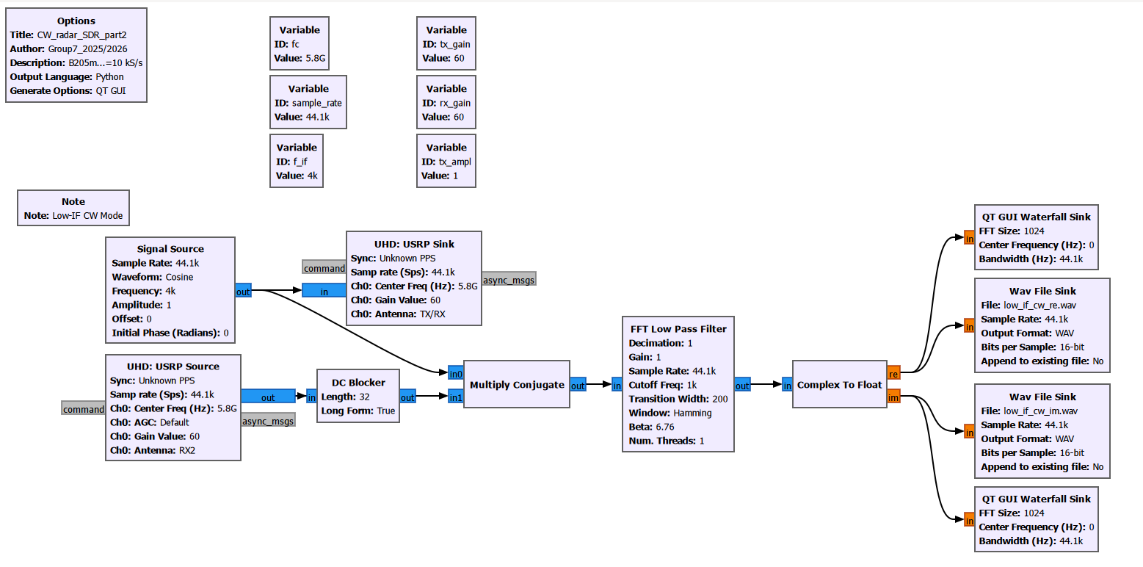
Velocity Measurements in Low-IF CW mode without Power Amplifier. (Sub-group 1)
GNU Radio schematic

Slide 7
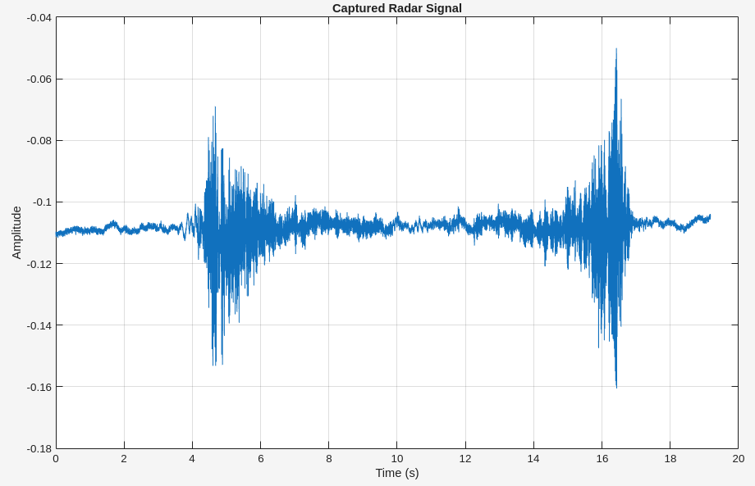
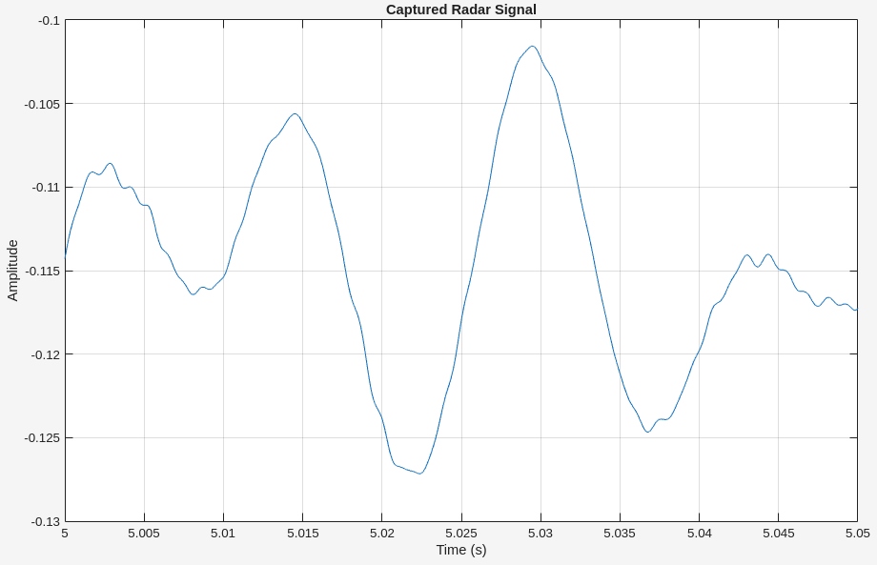
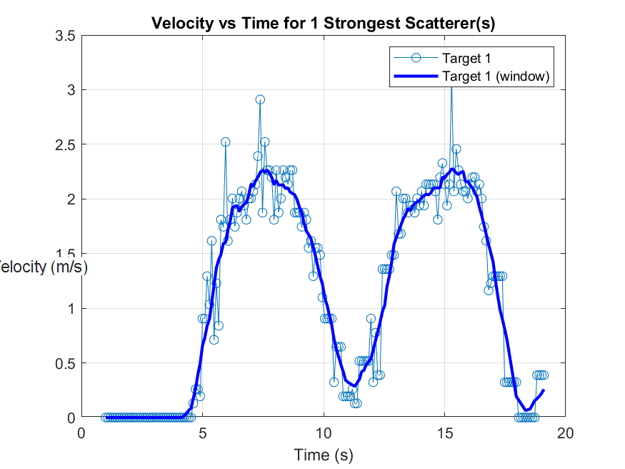
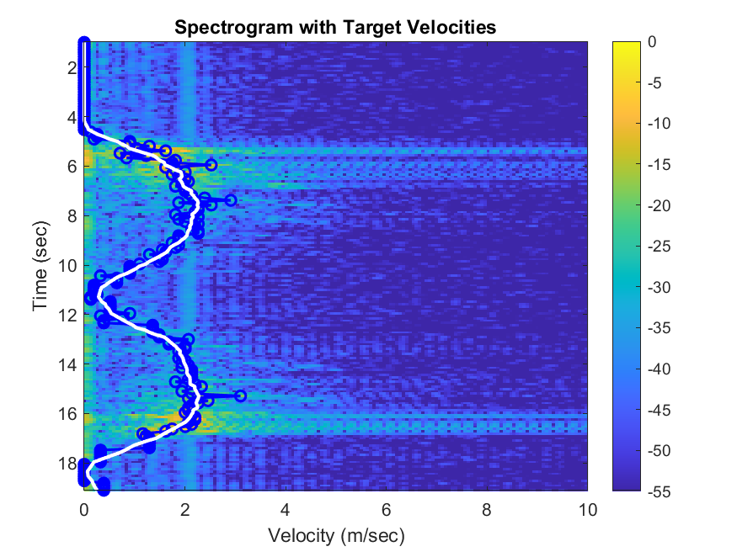
2. Velocity Measurements in Low-IF CW mode without Power Amplifier. (Sub-group 1)
a. Velocity Measurements of a single target. Signal processing using your Matlab code
for the COTS radar: show captured data plot, velocity vs time plot (hint: take the
strongest scatterer), velocity vs time spectrogram, GNU Radio schematic
Notes:
In CW mode: target Doppler overlaps with hardware DC noise → poor detection for slow targets.
In Low-IF CW mode:
You “park” the Doppler away from DC (where hardware artifacts live)
DC offset is removed safely.
Then you bring Doppler back down digitally, which is cleaner and controlled.
End result: better SNR, especially for slow targets, less baseline noise.

Slide 8
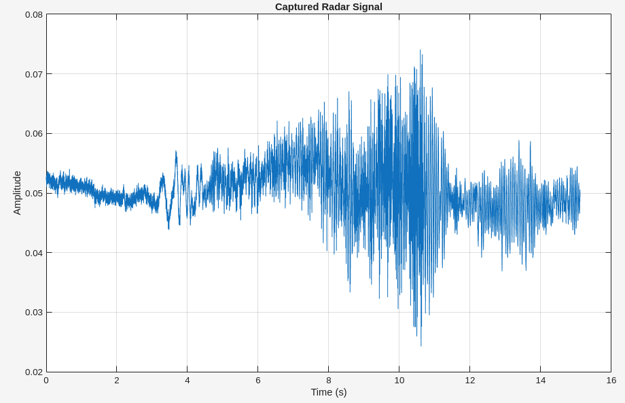
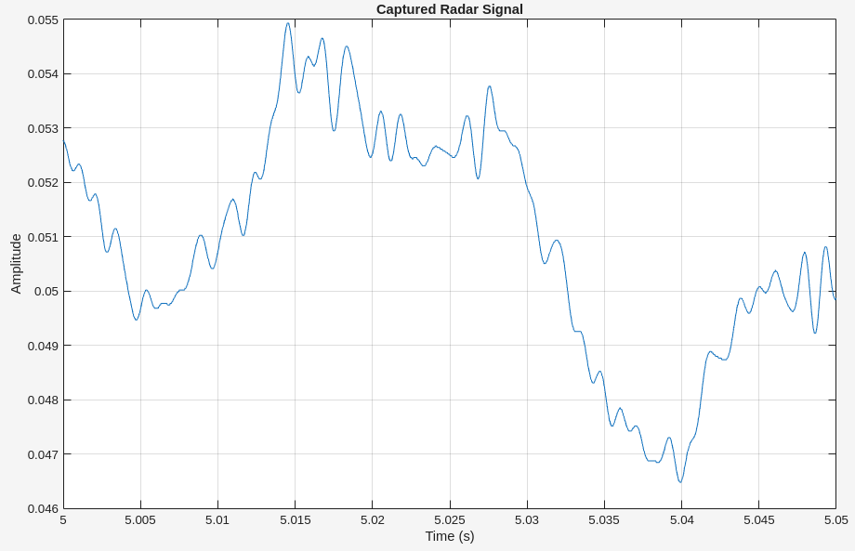
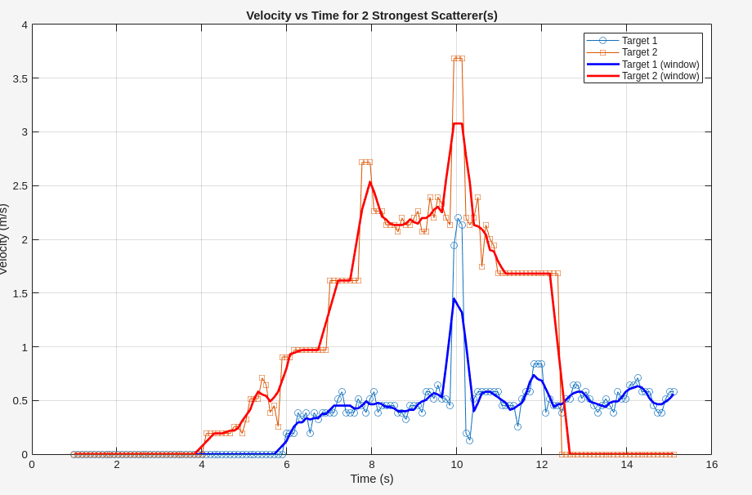
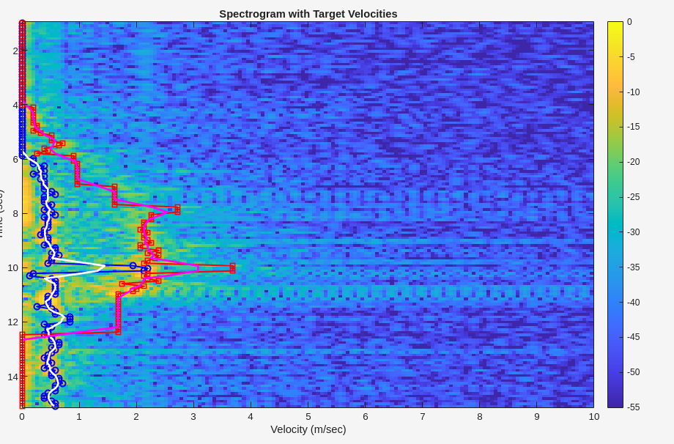
2. Velocity Measurements in Low-IF CW mode without Power Amplifier. (Sub-group 1)
b. Velocity Measurements of multiple targets. Signal processing using your Matlab code
for the COTS radar: show captured data plot, velocity vs time plot, velocity vs time
spectrogram, GNU Radio schematic
Notes:
Using Low-IF CW mode improves results compared to CW because the Doppler signal is shifted away from the DC offset region where hardware imperfections dominate. After digital demodulation and filtering, the recovered Doppler spectrum has a cleaner baseline, higher SNR, and much better visibility of slow-moving targets.

Slide 9
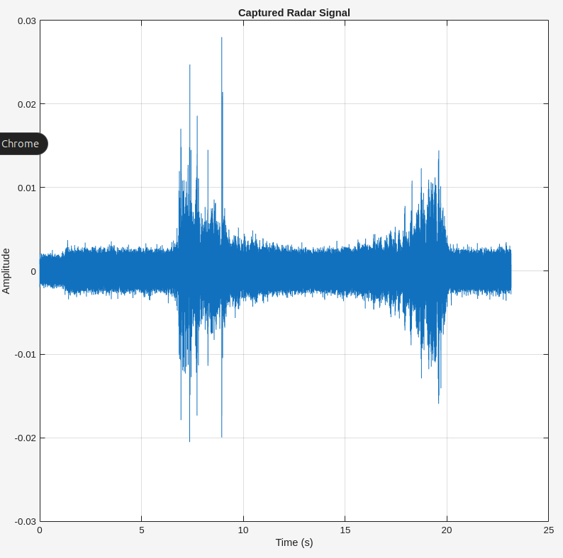
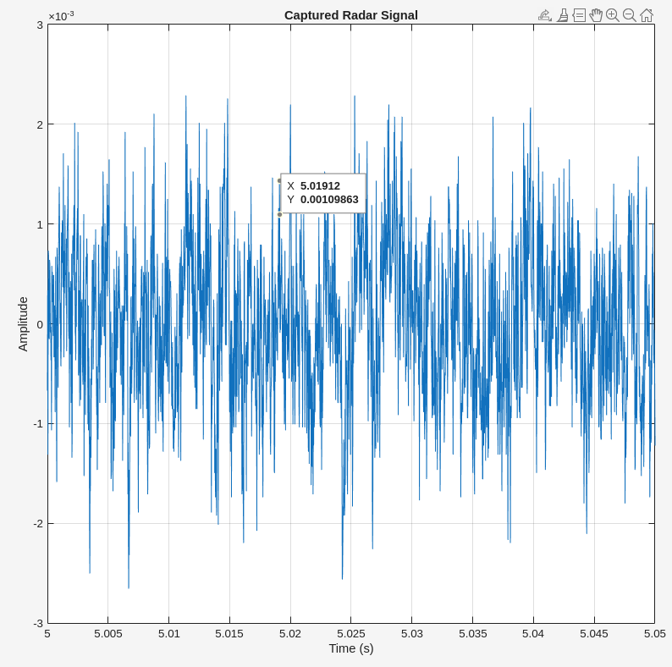
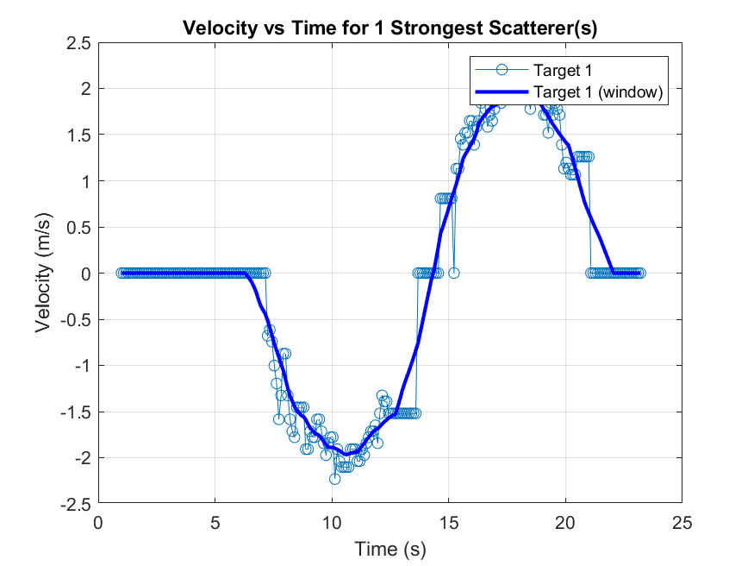
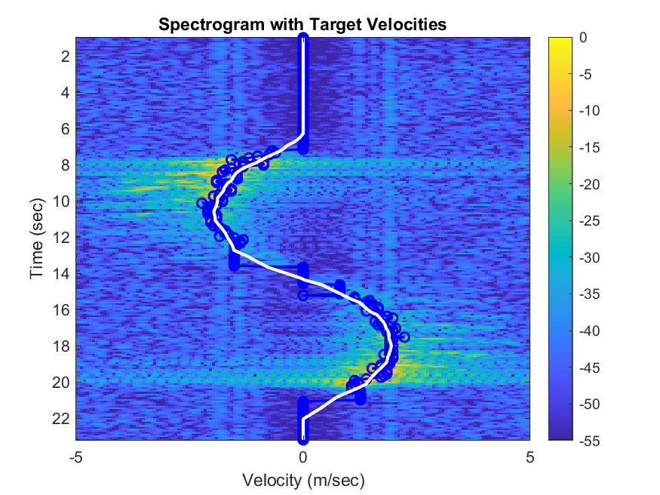
3. Velocity direction detection for a single and multiple targets in the CW mode using IQ
demodulation in SDR without Power Amplifier. (Sub-group 1)
a. Velocity direction measurements of a single target. Signal processing using your Matlab
code for the COTS part: show captured data plot, velocity vs time plot (hint: take the
strongest scatterer), velocity vs time spectrogram, GNU Radio schematic

Slide 10
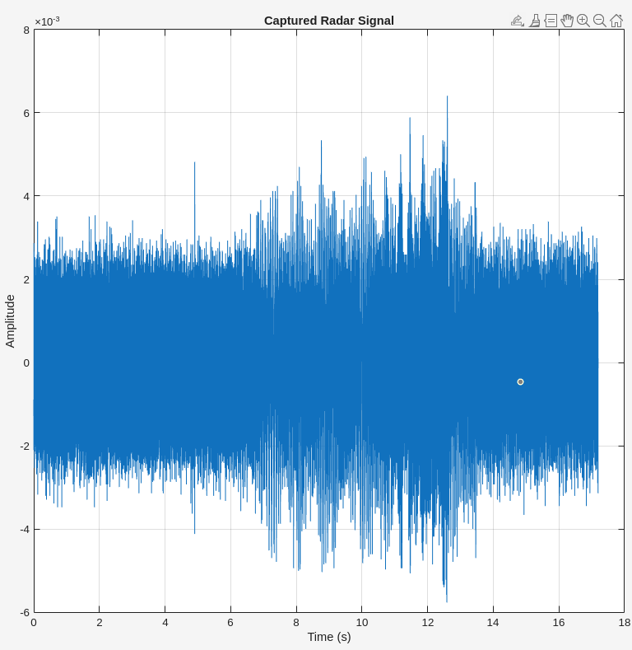
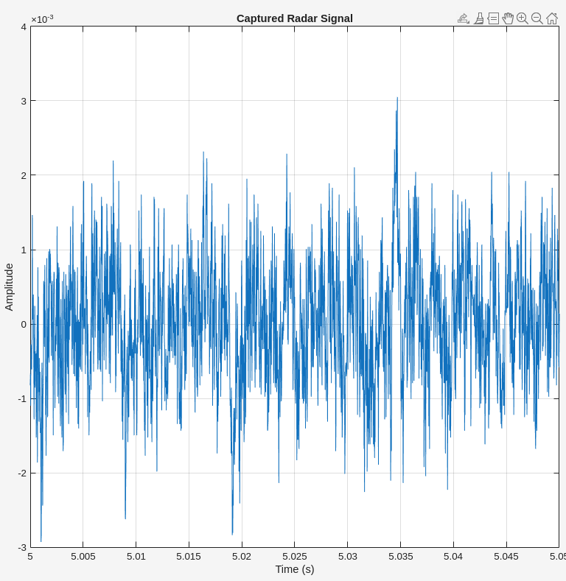
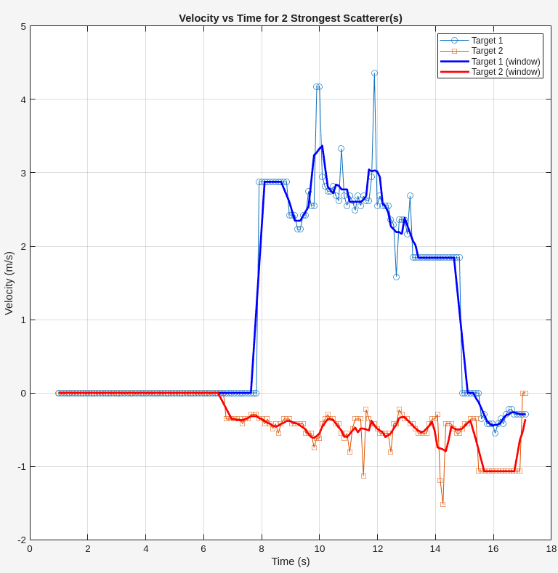
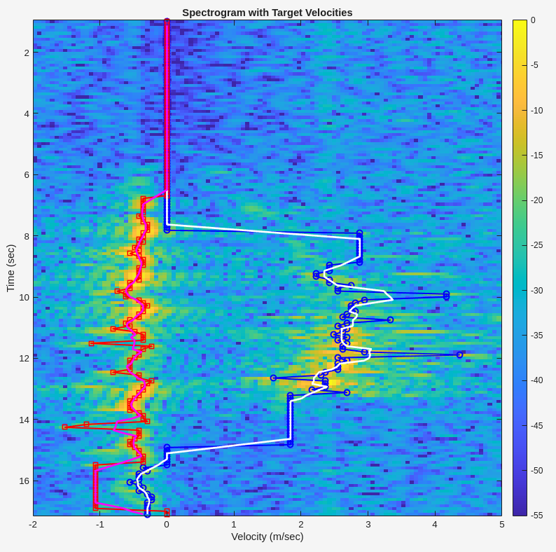
3. Velocity direction detection for a single and multiple targets in the CW mode using IQ
demodulation in SDR without Power Amplifier. (Sub-group 1)
b. Velocity direction measurements of multiple targets. Signal processing using your Matlab
code for the COTS part: show captured data plot, velocity vs time plot, velocity vs time
spectrogram, GNU Radio schematic

Slide 11
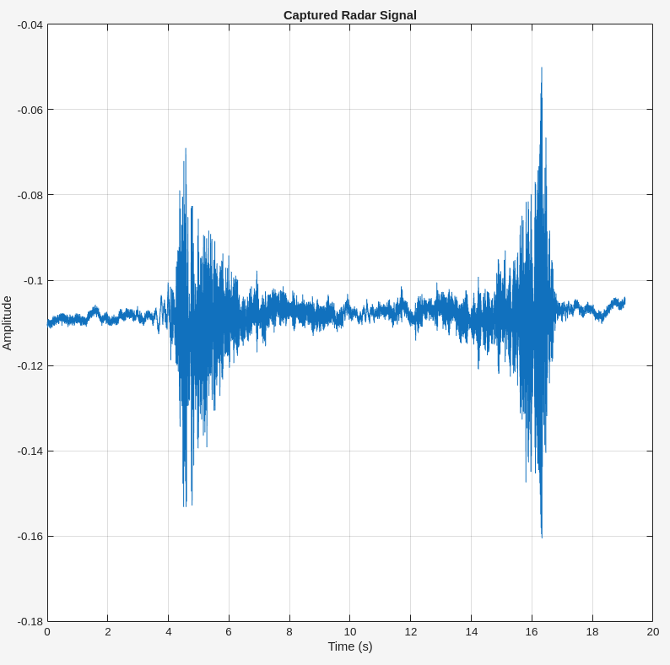
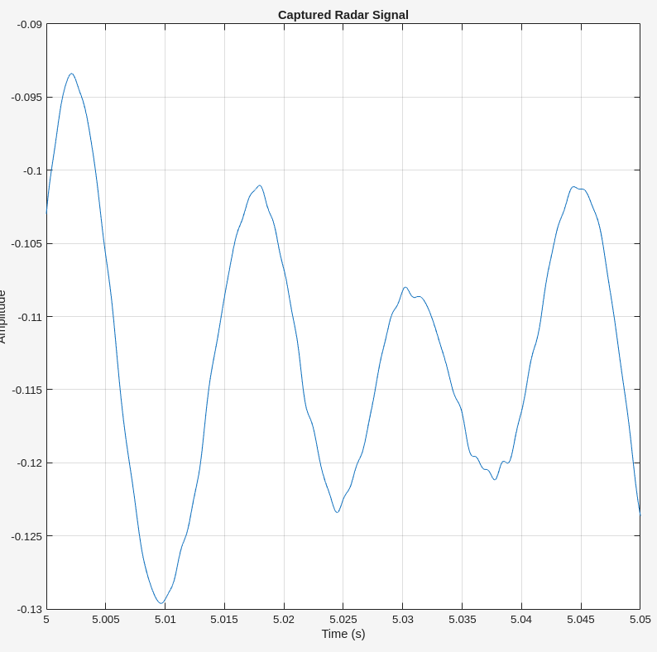
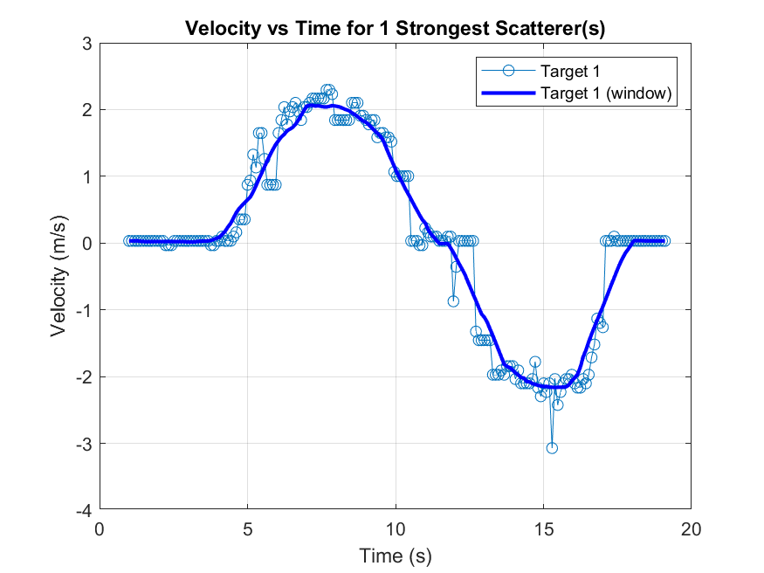
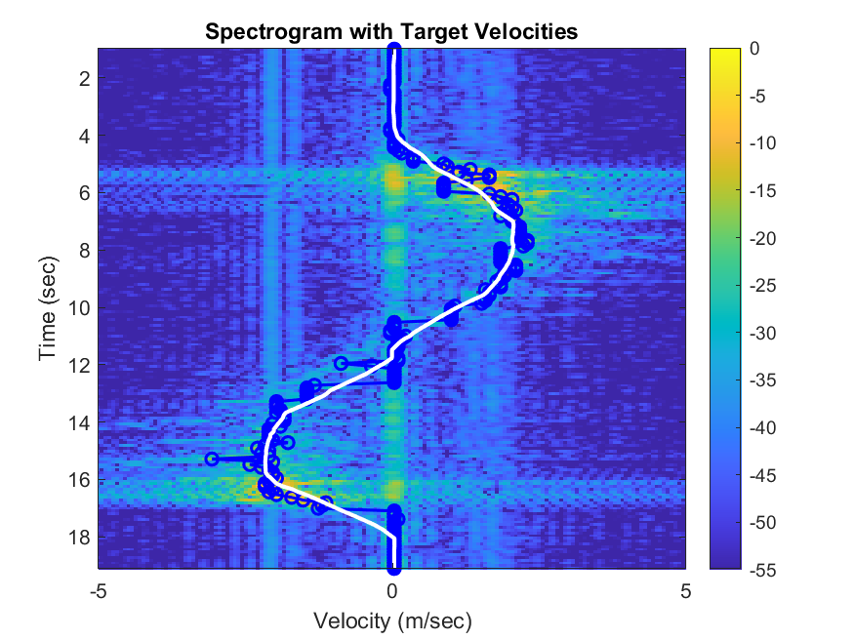
4. Velocity direction detection for a single and multiple targets in the Low-IF CW mode
using IQ demodulation in SDR without Power Amplifier. (Sub-group 2)
a. Velocity direction measurements of a single target. Signal processing using your Matlab
code for the COTS part: show captured data plot, velocity vs time plot (hint: take the
strongest scatterer), velocity vs time spectrogram, GNU Radio schematic

Slide 12
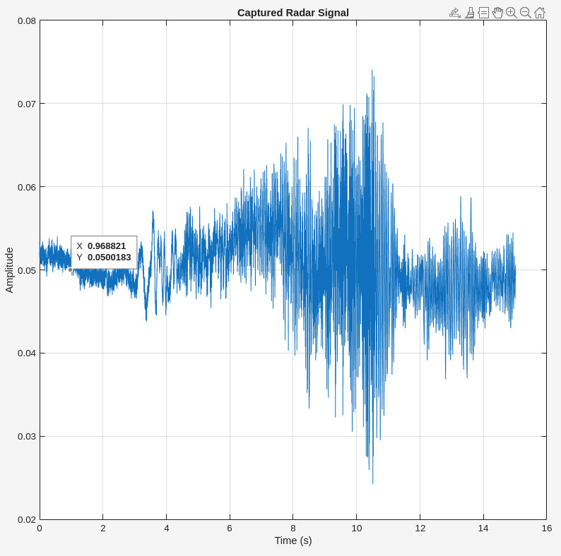
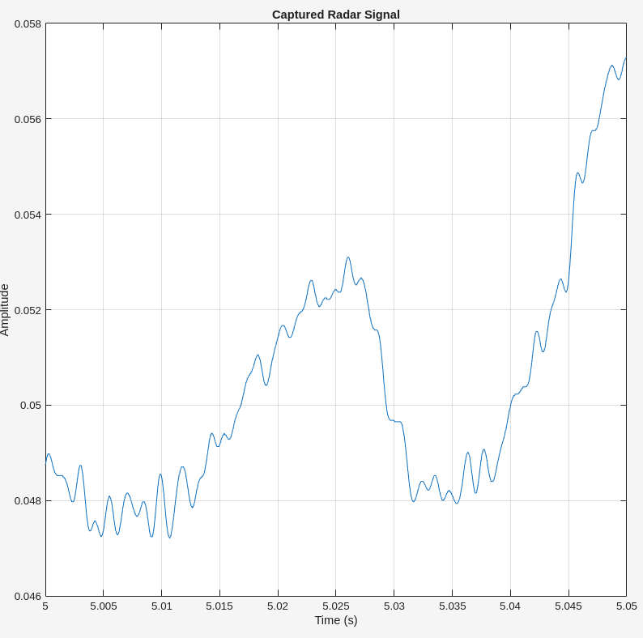
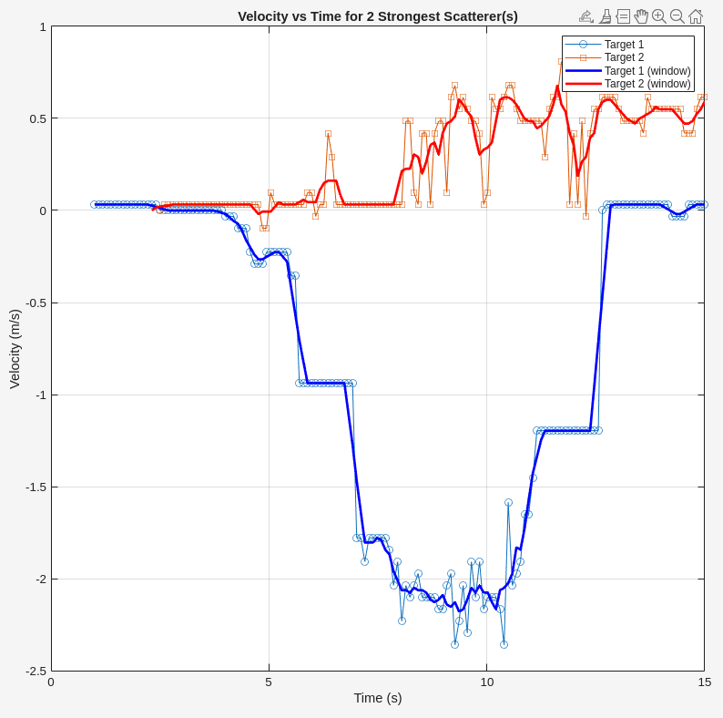
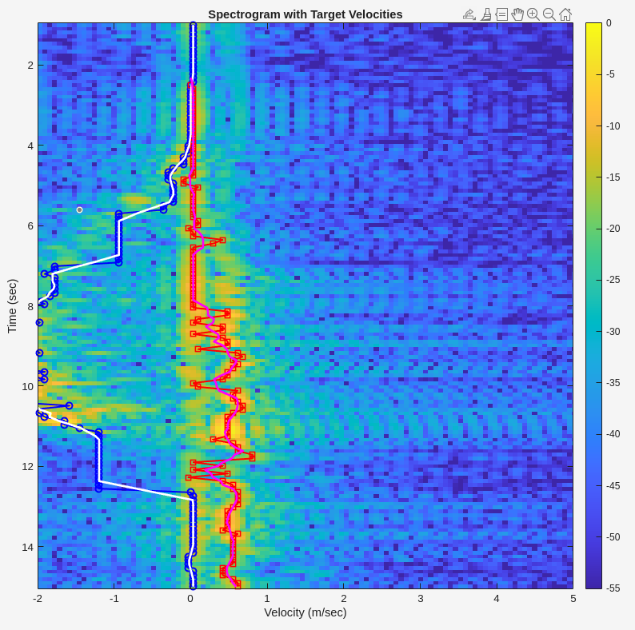
4. Velocity direction detection for a single and multiple targets in the Low-IF CW mode
using IQ demodulation in SDR without Power Amplifier. (Sub-group 2)
b. Velocity direction measurements of multiple targets. Signal processing using your Matlab
code for the COTS part: show captured data plot, velocity vs time plot, velocity vs time
spectrogram, GNU Radio schematic

Slide 13
Plan for Next Week (Sub-groups 1 and 2)
1. Measure velocity with the provided Power Amplifier connected to the Tx output of the SDR.
2. Compare the result obtained form the previous task to the case when there is no power amplifier at the output of the Tx stage of the SDR.
3. Monitor the breathing pattern of an individual using Low-IF CW mode.
4. Monitor the breathing pattern of an individual using CW mode.
5. Range Measurement in SFCW Mode

