Slide 1
Review Meeting 2
Build your own Radar System, Project Course
Group 7:
Bingxue Xu
Nikita Dubrovskyi
Rafael Rodrigues
Stefano Crescenza
Tuesday, 16/09/2025

Slide 2
Week Achievements
Circuit Build & Validation – complete baseband circuit and confirm signals.
Measurement & Analysis – characterize signals and filters, verify performance.
System Demonstration – prepare first CW test video.

Slide 3
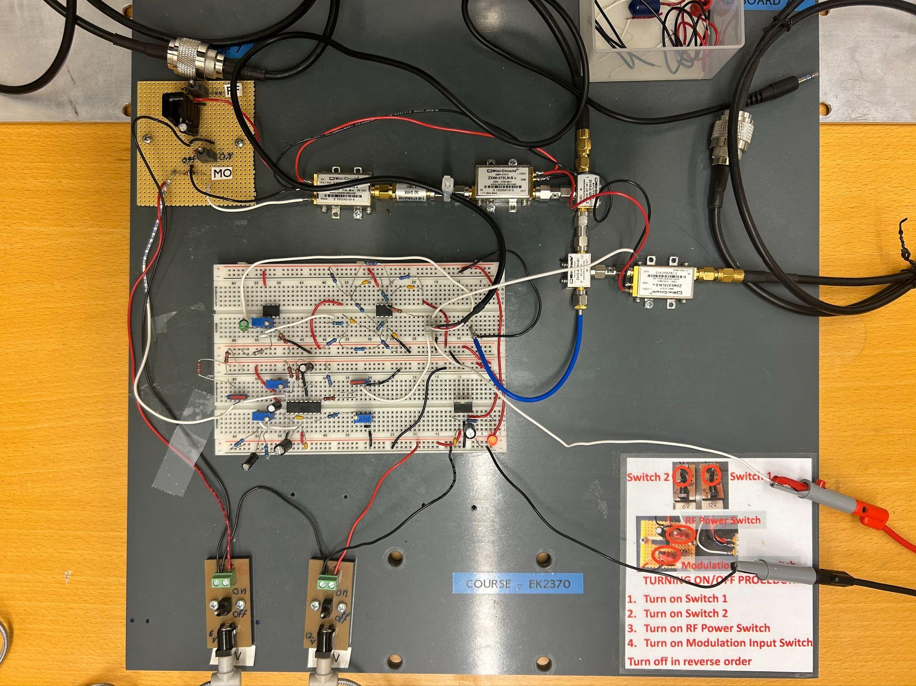
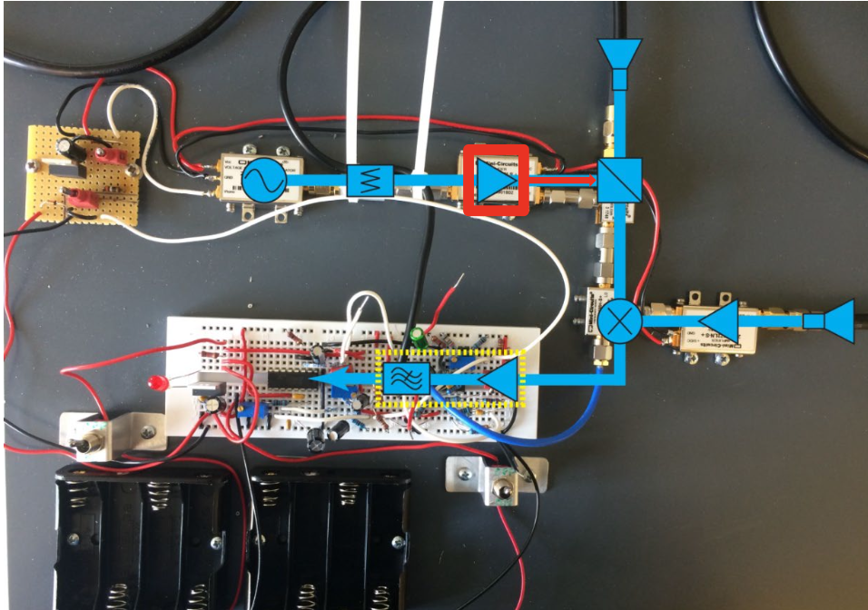
a. Show the image of the breadboard identifying the different circuit parts (modulator, video amplifier, filter, voltage regulator, etc) and the resistive trimmers.

Slide 4
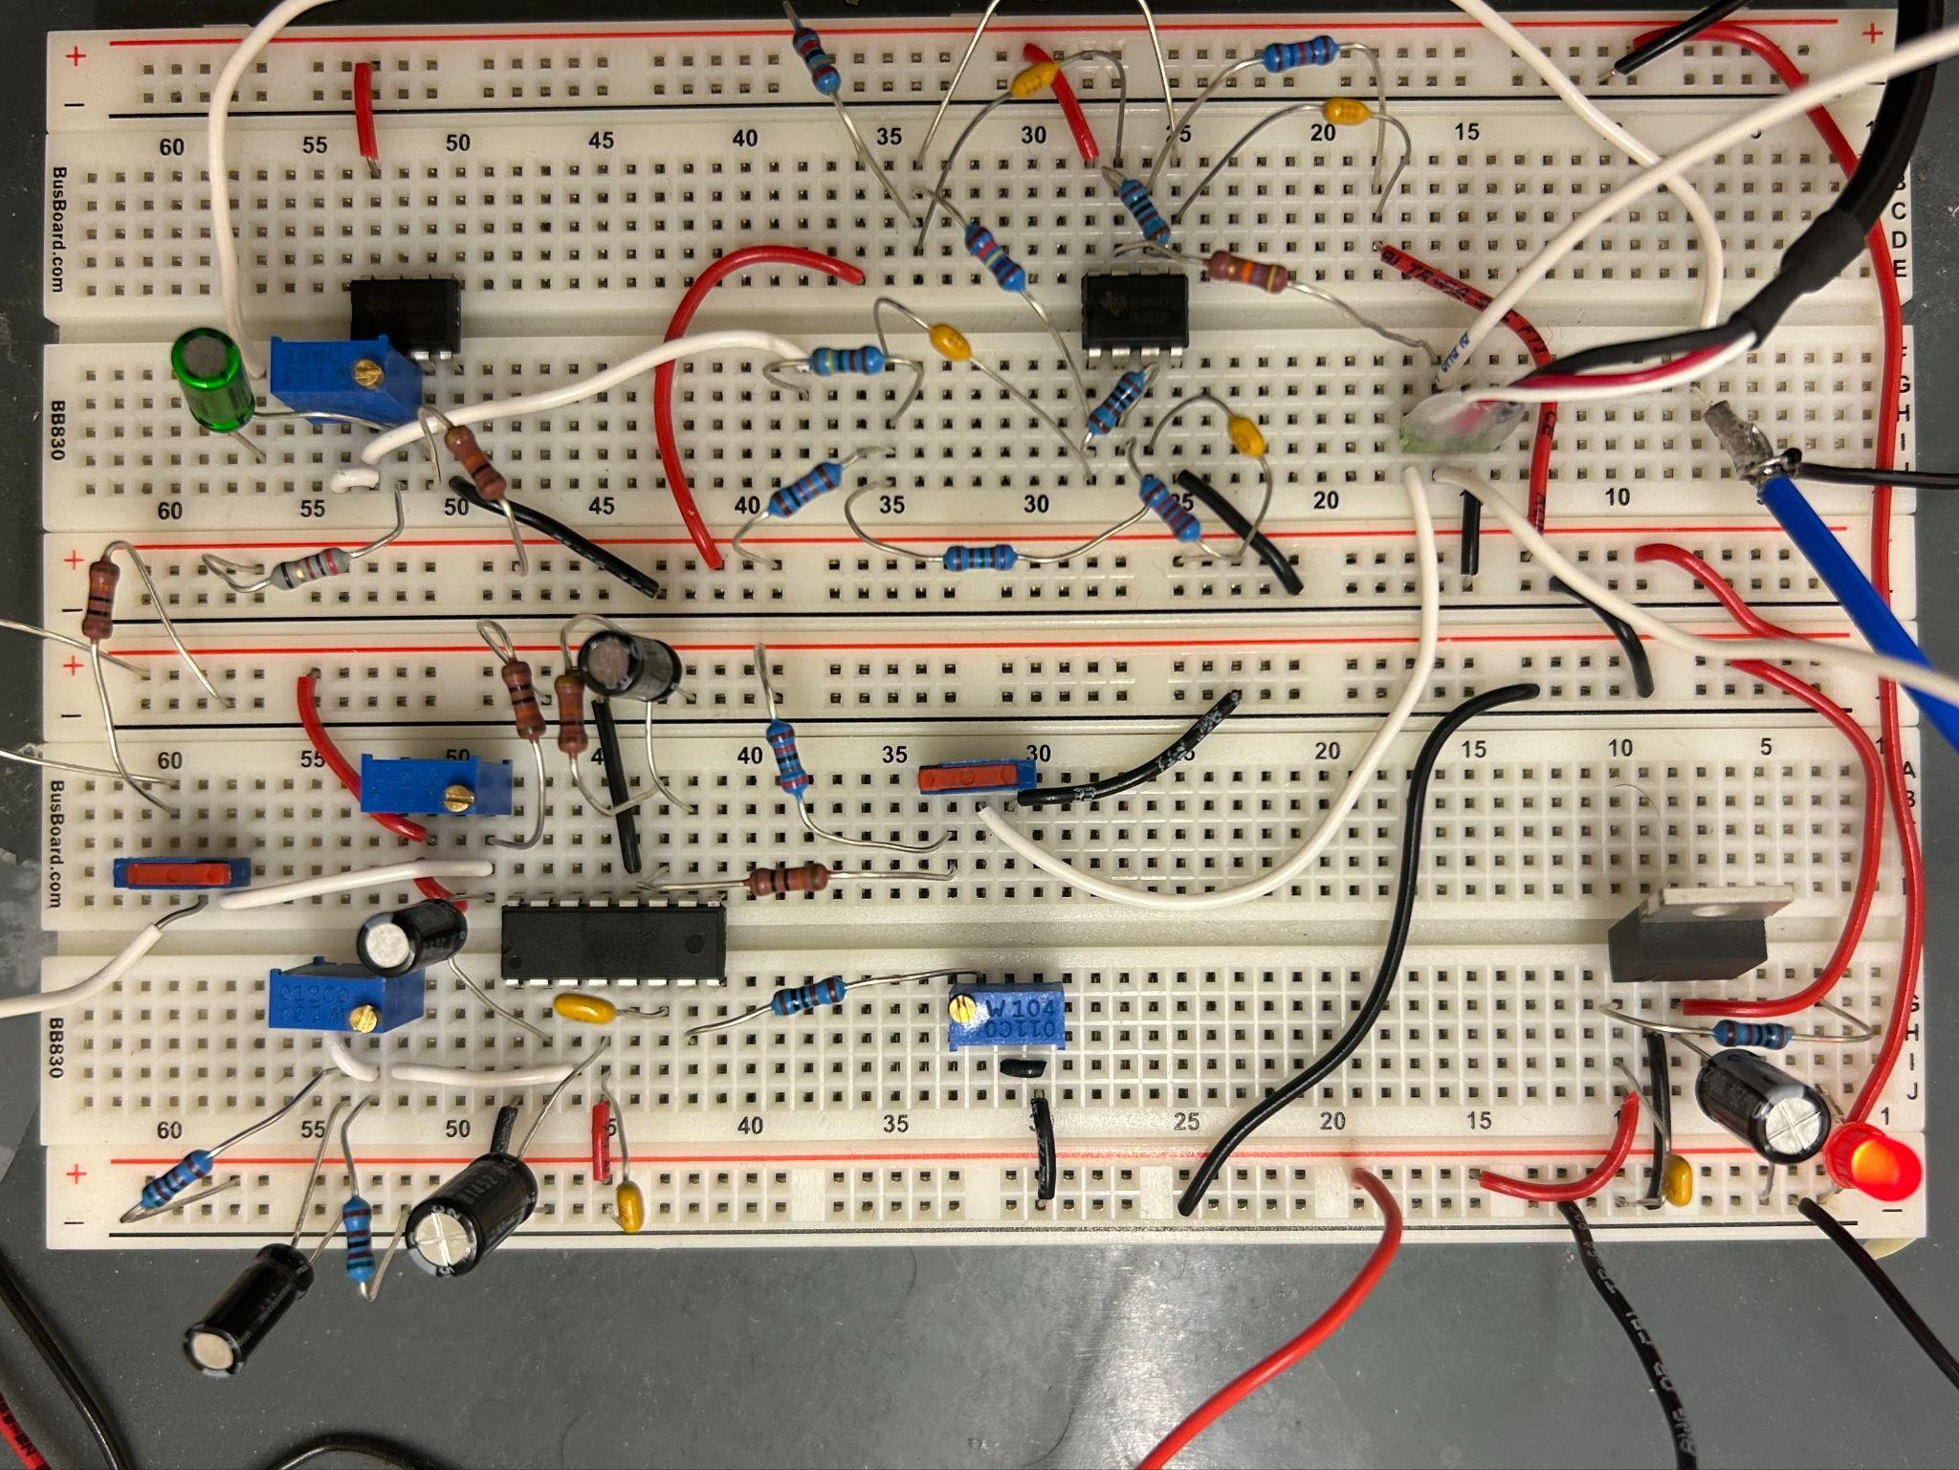
a. Show the image of the breadboard identifying the different circuit parts (modulator, video amplifier, filter, voltage regulator, etc) and the resistive trimmers.
Resistive Trimmer
Video Amplifier
Gain Resistive Trimmer
Pin2, set DC Offset
FM Modulator
Voltage Regulator
Pin3, set Ramp Magnitude
Pin7, set Chirp Rate

Slide 5
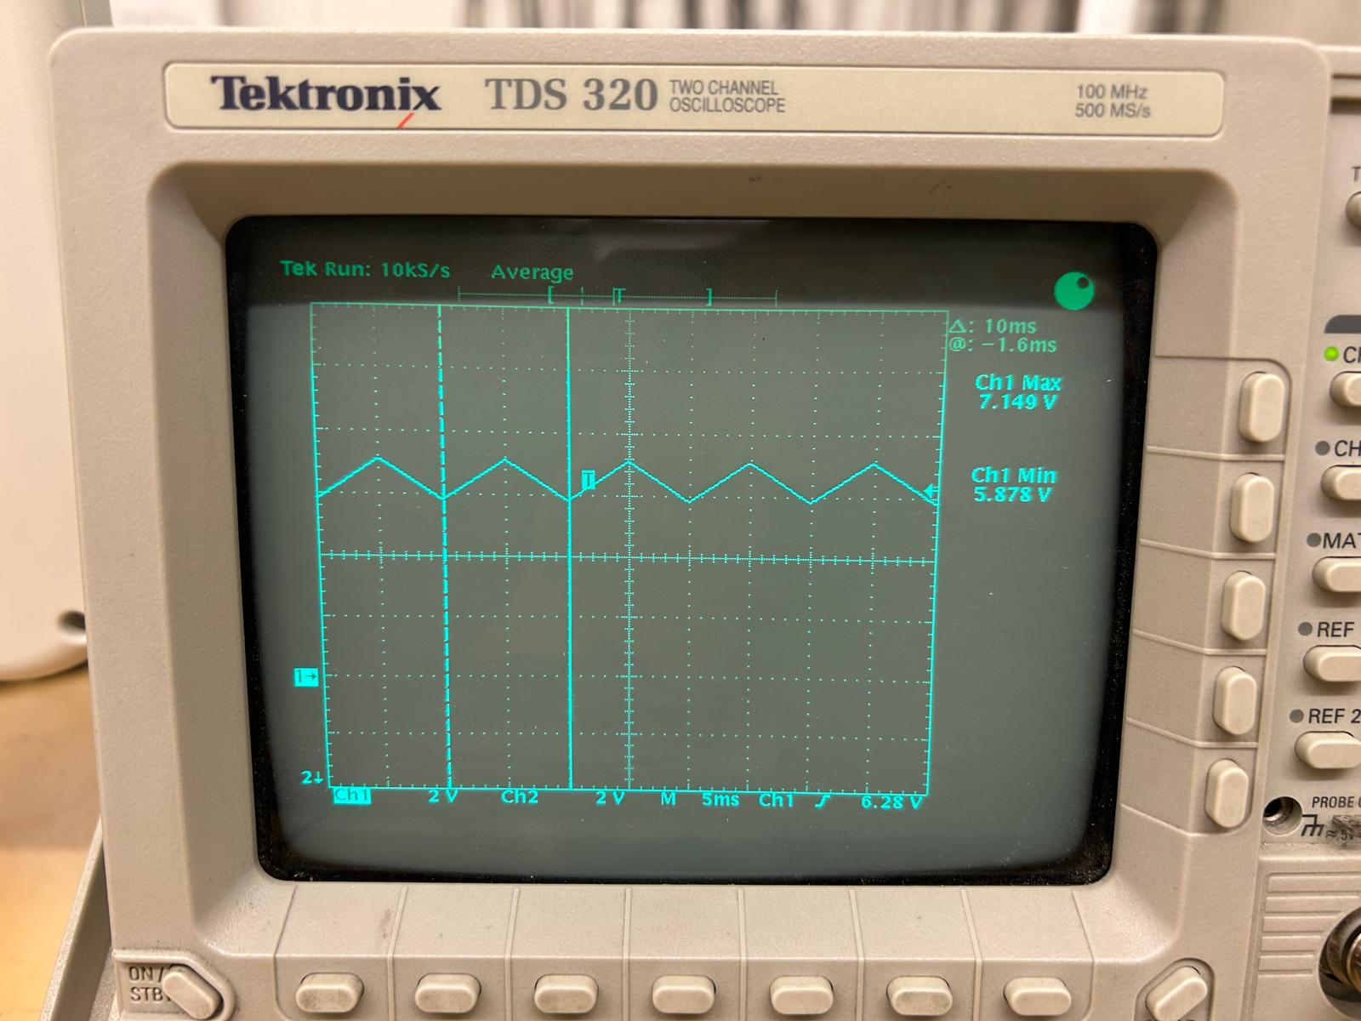
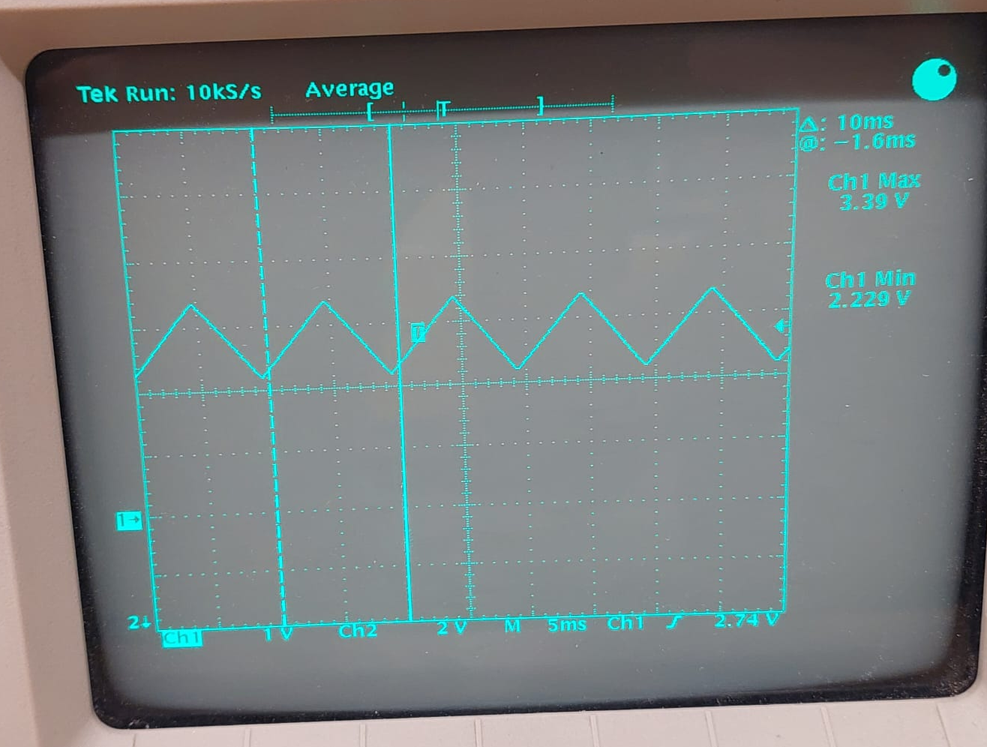
b. Show the adjusted Vtune triangle signal (i.e., Vpp = 2.2 to 3.4 V and up+down chirp period = 10 ms and the square sync signal.
Vtune triangle signal

Slide 6
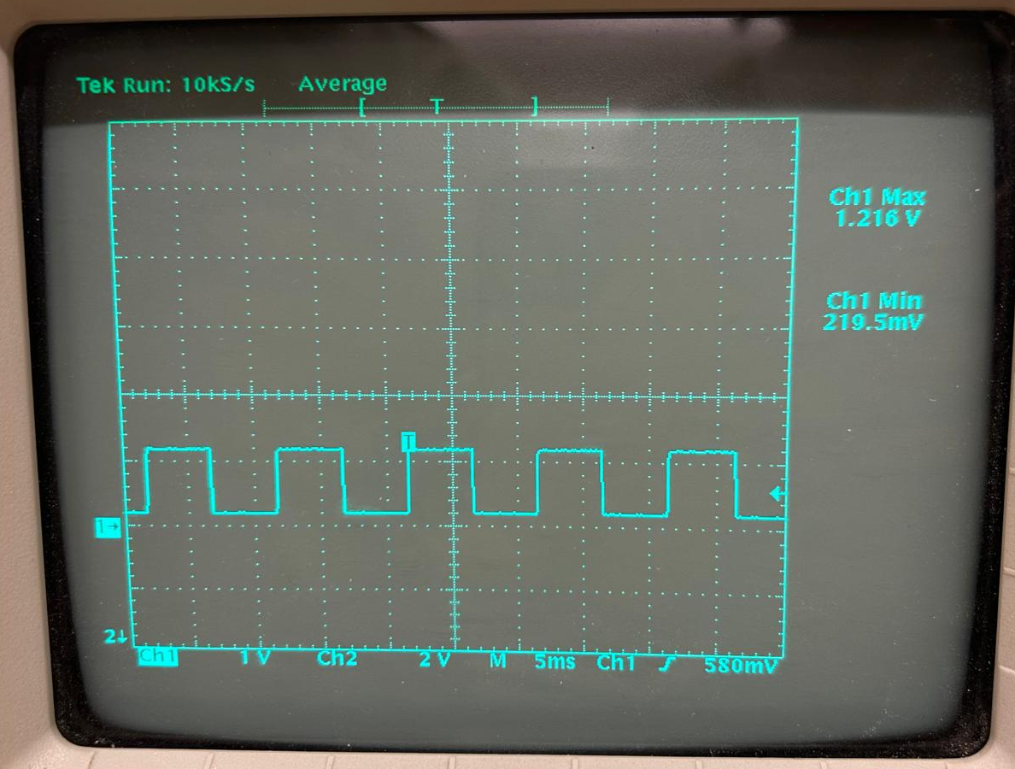
b. Show the adjusted Vtune triangle signal (i.e., Vpp = 2.2 to 3.4 V and up+down chirp period = 10 ms and the square sync signal.
Sync signal

Slide 7
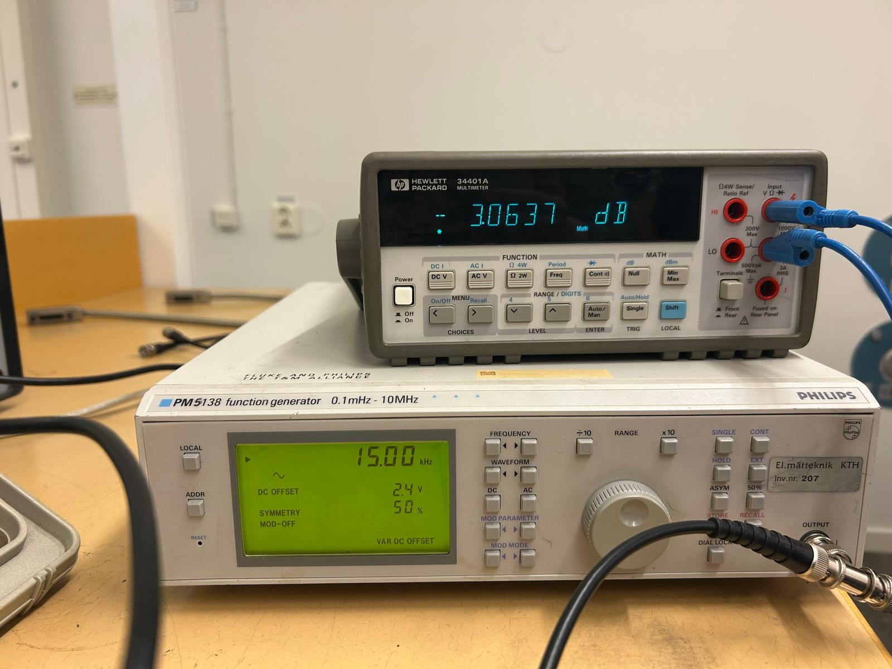
3 dB roll off of the active filter using a multimeter
After 47 kΩ resistor
c. Plot the 3 dB roll off of the active filter using a multimeter

Slide 8
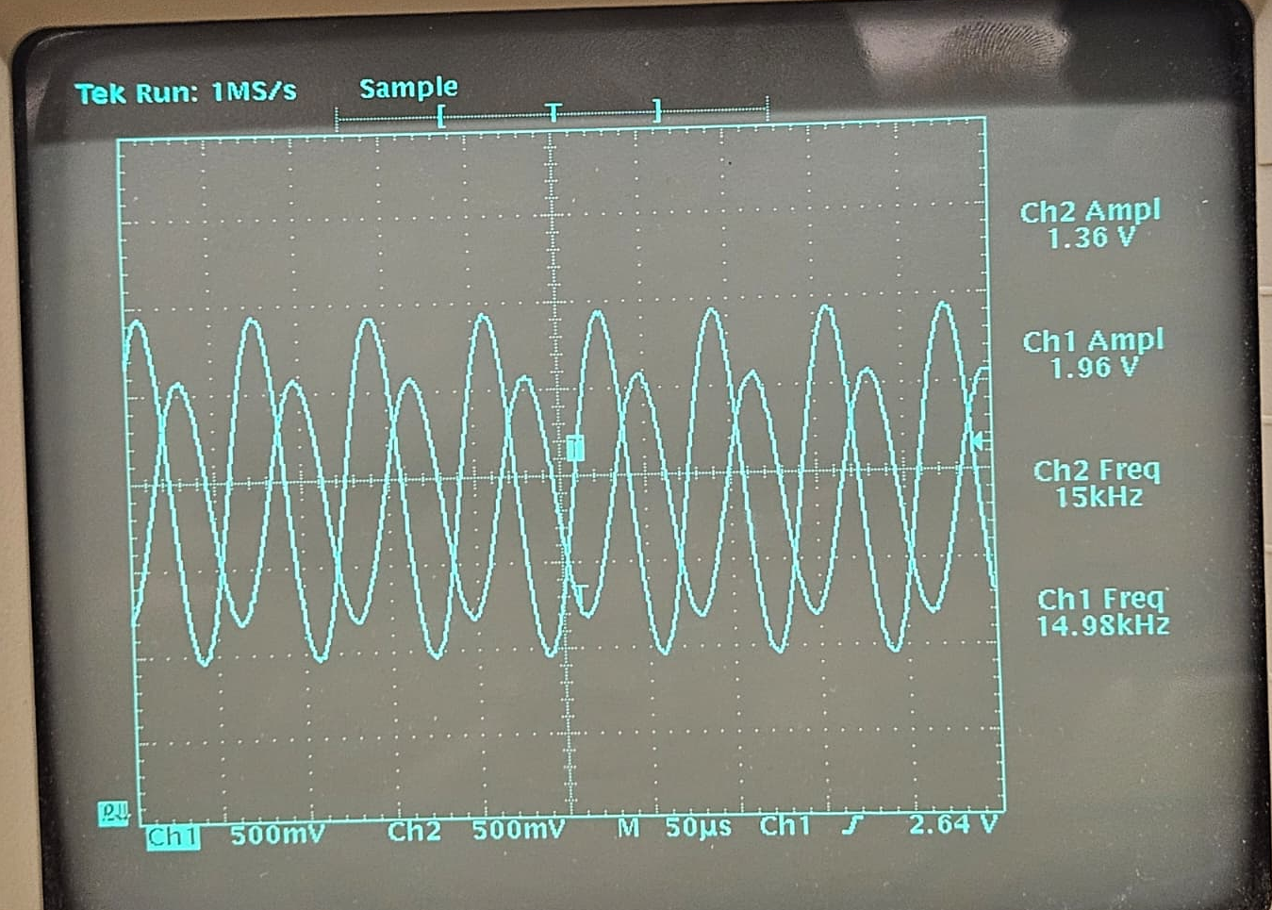
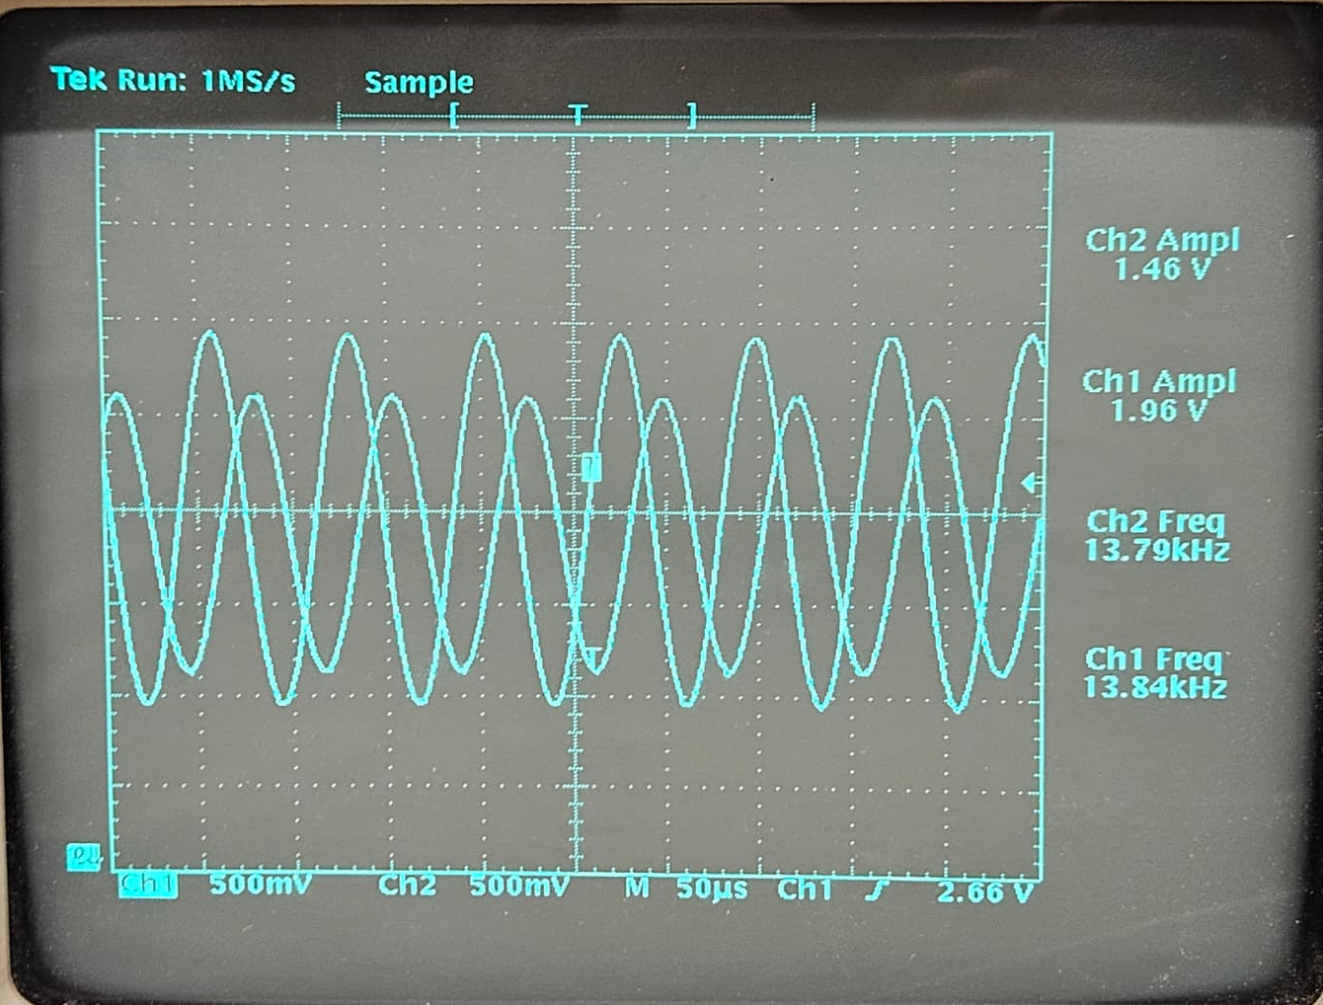
3 dB roll off of the active filter using an oscilloscope
Before 47 kΩ resistor
After 47 kΩ resistor
c. Plot the 3 dB roll off of the active filter using an oscilloscope. Compare the plots. For the oscilloscope, measure before and after the 47 kΩ resistor. Why is there a difference in the results?

Slide 9
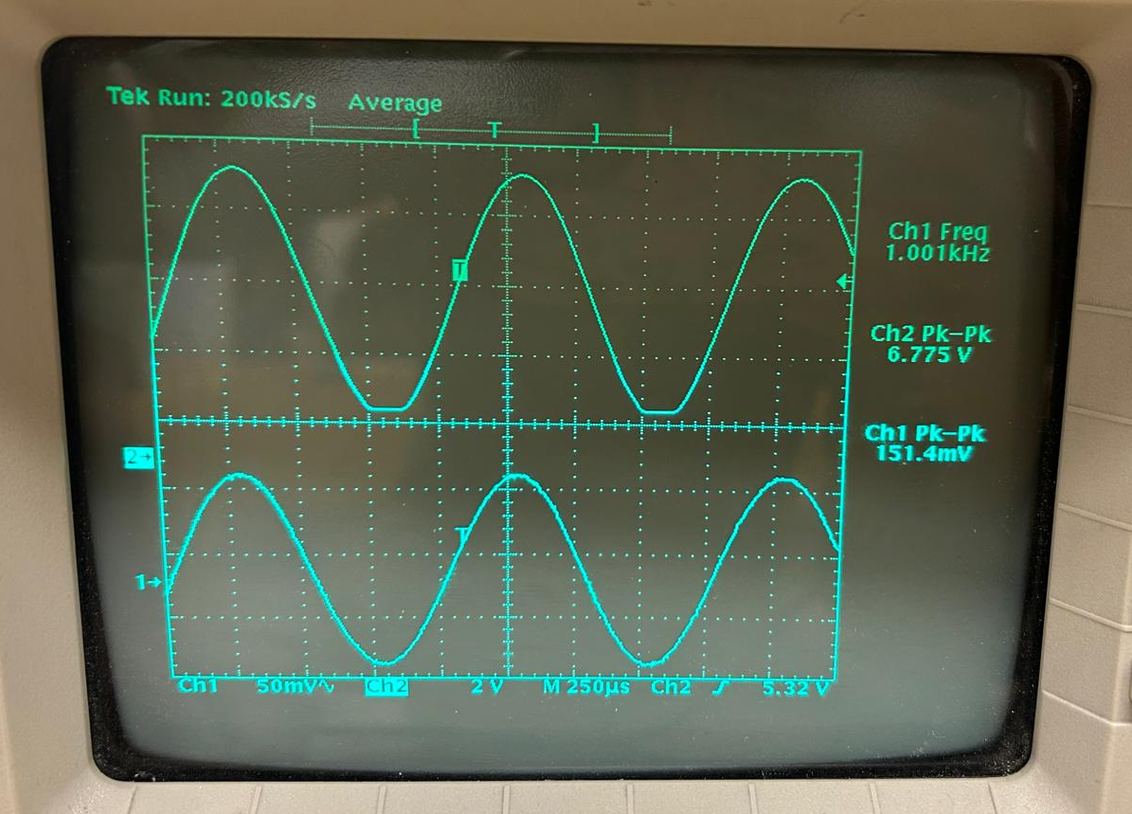
Gain stage - clipping
d. Show with an oscilloscope that lipping occurs when the gain is set too high. Set the gain to a value where there is no clipping.

Slide 10

First Test in CW mode

Slide 11
Plan for Next Week (Sub-groups 1 and 2)
Velocity Measurements in CW mode. (Sub-group 2)
Range Measurements in FMCW mode. (Sub-group 1):
Range-Doppler Measurements in FMCW mode. (Sub-group 1 and 2 together)
Real-time Measurements.
Extract velocity from range using two-point finite difference method and compare it to range-doppler measurements.
FMCW Mode: Simultaneous range and velocity estimation by only processing the up and down chirp for a single target.

Slide 12
Plan for Next Week (Sub-groups 1 and 2)
Sub-group1:
Write the MATLAB code for Time Domain Correlation, generating a SAR image using simulated point targets.
SAR image measurement. Acquisition of the SAR image using the three available trihedral corner reflectors as targets
Sub-group2:
Write the MATLAB code for the Range Migration Algorithm (RMA), generating a SAR image using simulated point targets.
Write the MATLAB code for the Range Migration Algorithm (RMA), generating a SAR image using real targets.

