Slide 1
Review Meeting 6
Build your own Radar System, Project Course
Group 7:
Bingxue Xu
Nikita Dubrovskyi
Rafael Rodrigues
Stefano Crescenza
Tuesday, 14/10/2025

Slide 2
Week Achievements: SDR Radar
Measure velocity with Power Amplifier.
Measure velocity without Power Amplifier.
Monitor the breathing pattern of an individual using Low-IF CW mode
Monitor the breathing pattern of an individual using CW mode
Range Measurement in SFCW Mode

Slide 3
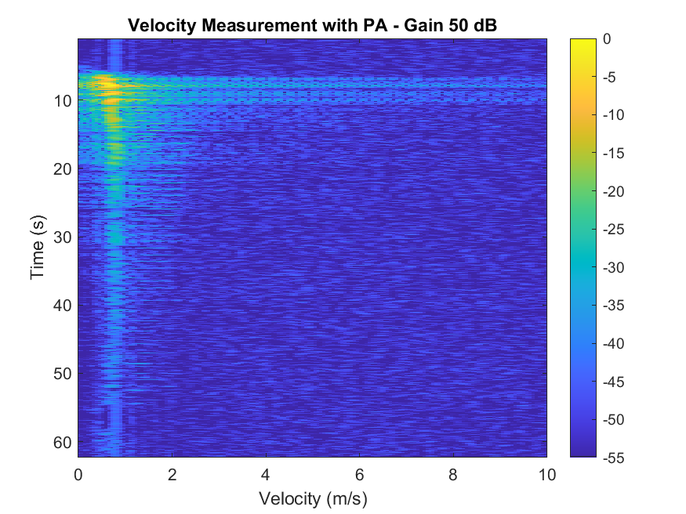
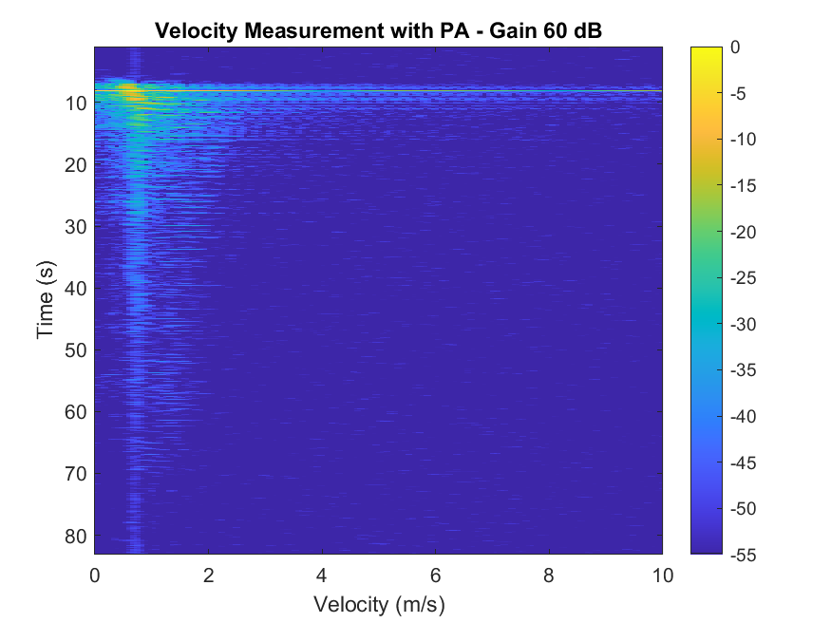
1. Measure velocity with Power Amplifier

Slide 4
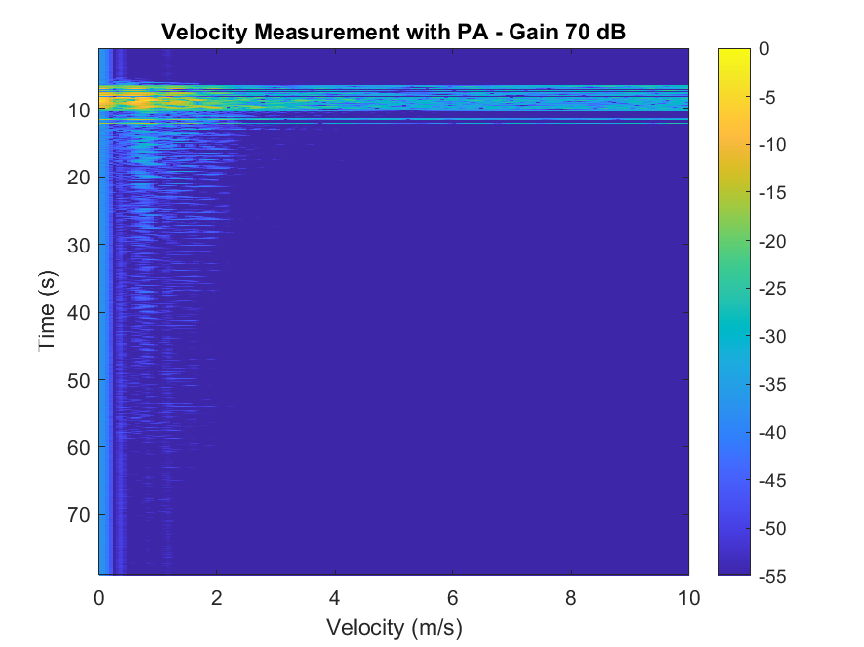
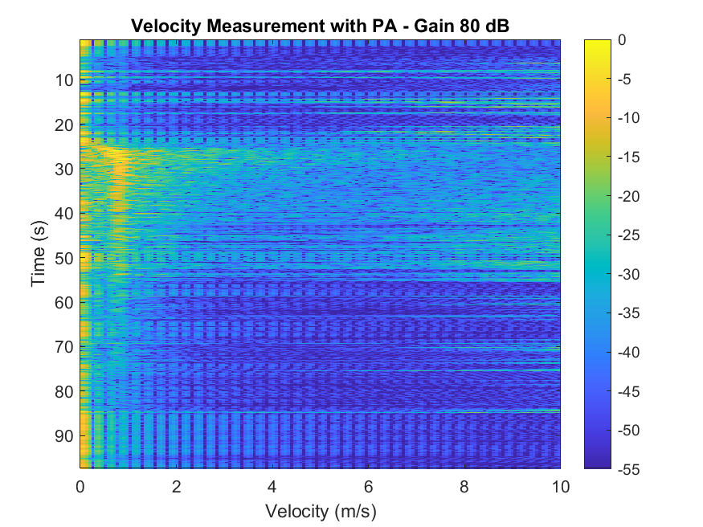
1. Measure velocity with Power Amplifier

Slide 5
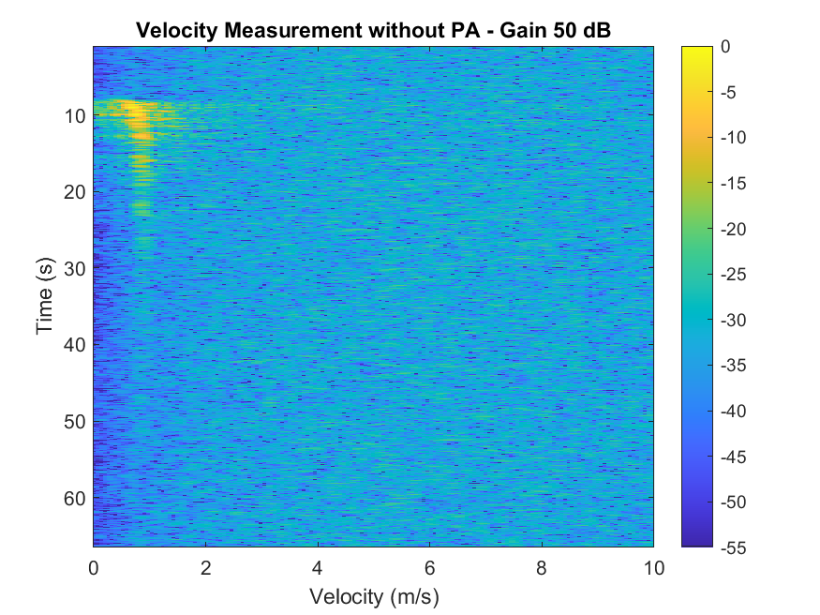
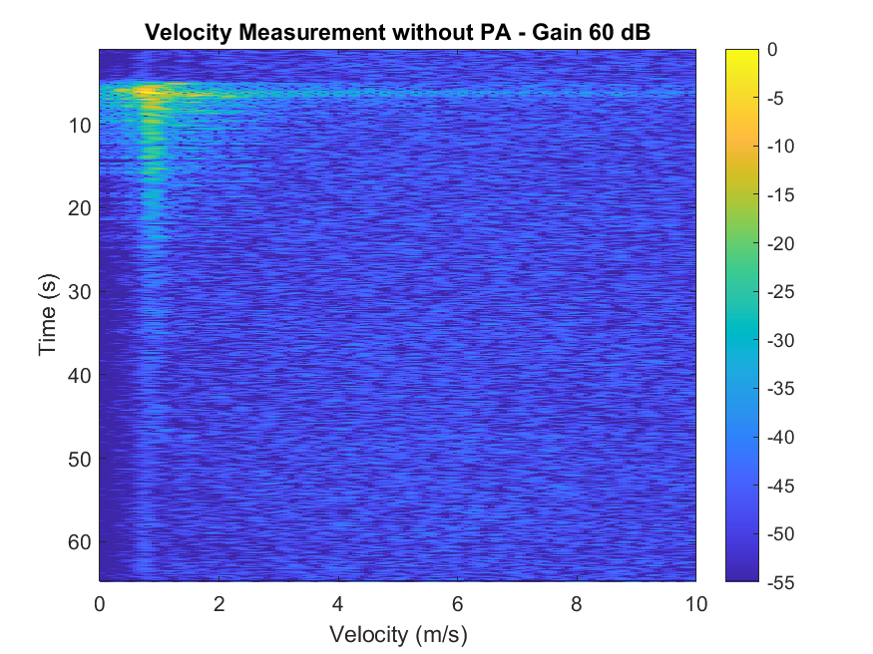
2. Measure velocity without Power Amplifier

Slide 6
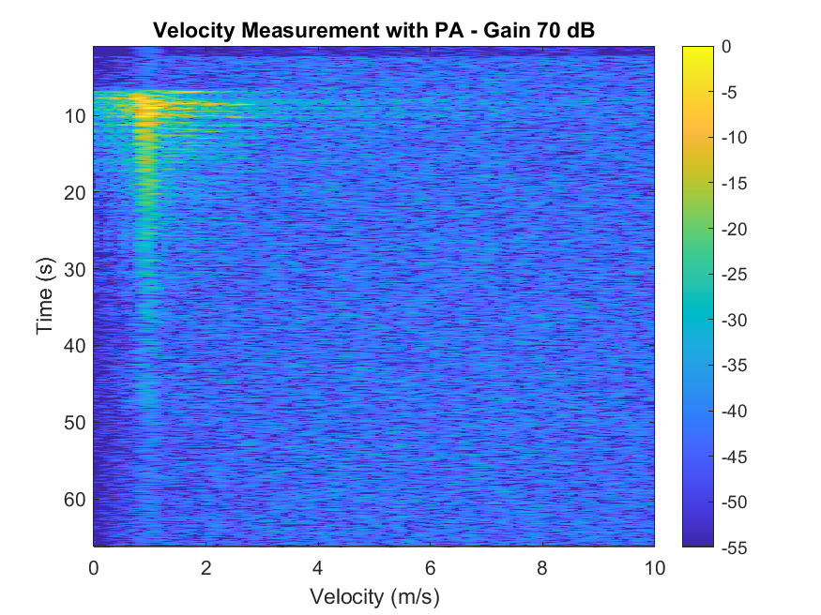
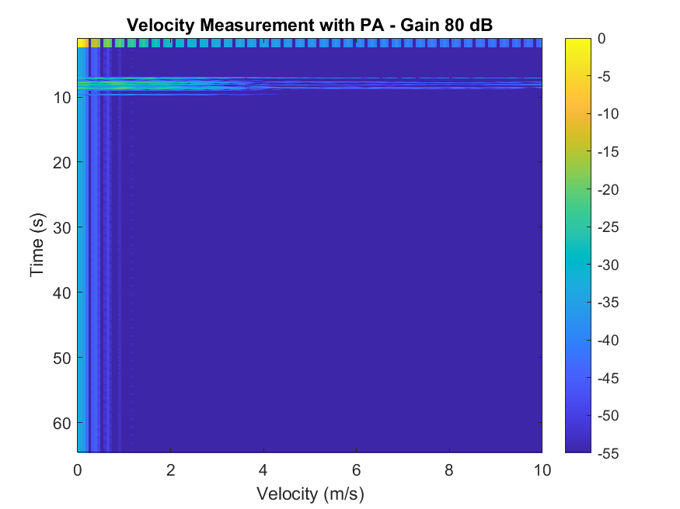
2. Measure velocity without Power Amplifier

Slide 7
Comparison CW with PA vs without PA

Slide 8
Comparison CW with PA vs without PA

Slide 9
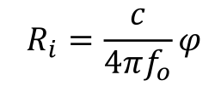
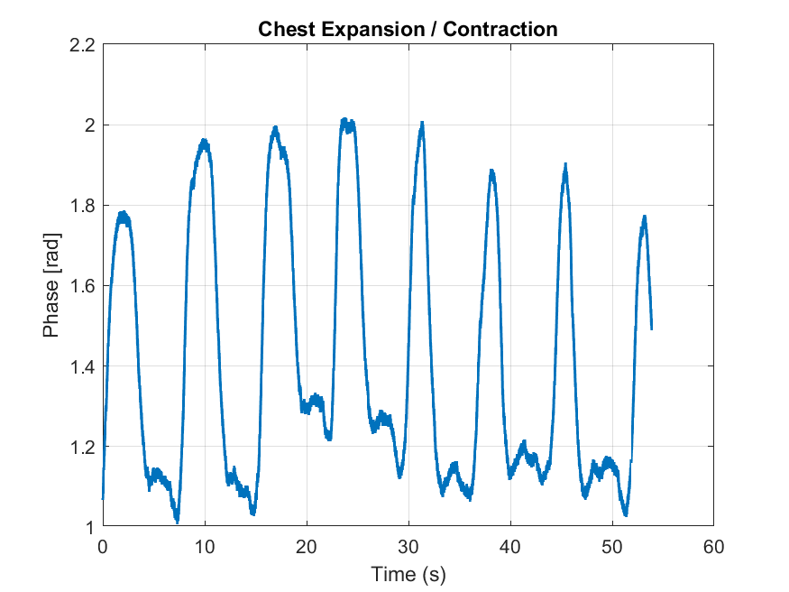
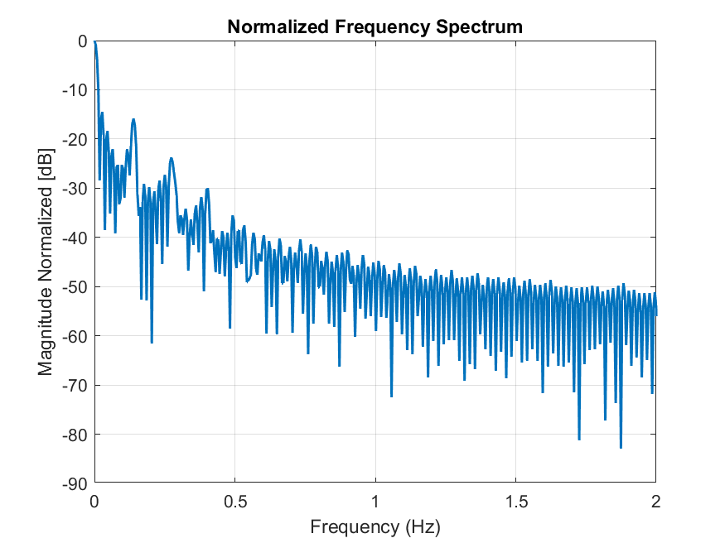
3. Monitor the breathing pattern of an individual using Low-IF CW mode. The
variation in the range due to breathing must be plotted as plotted in the lecture.
Perform the DFT on the data and observe whether you can identify the heart
rate. (hint: use the static phase term to calculate the range).
Notes:
The Low-Intermediate-Frequency (Low-IF) approach intentionally shifts the signal away from DC.

Slide 10
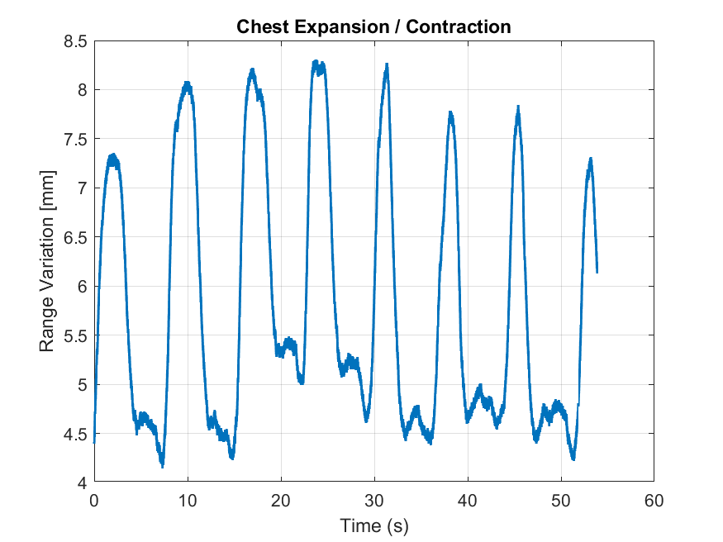
3. Monitor the breathing pattern of an individual using Low-IF CW mode. The
variation in the range due to breathing must be plotted as plotted in the lecture.
Perform the DFT on the data and observe whether you can identify the heart
rate. (hint: use the static phase term to calculate the range).
Breathing Rate: 8.35 breaths per minute
Heart Rate*: 33.40 beats per minute
(*) considering the Respiratory Sinus Arrhythmia (RSA) phenomenon with an average standard 1:4 ratio
Notes:
The Low-Intermediate-Frequency (Low-IF) approach intentionally shifts the signal away from DC.

Slide 11
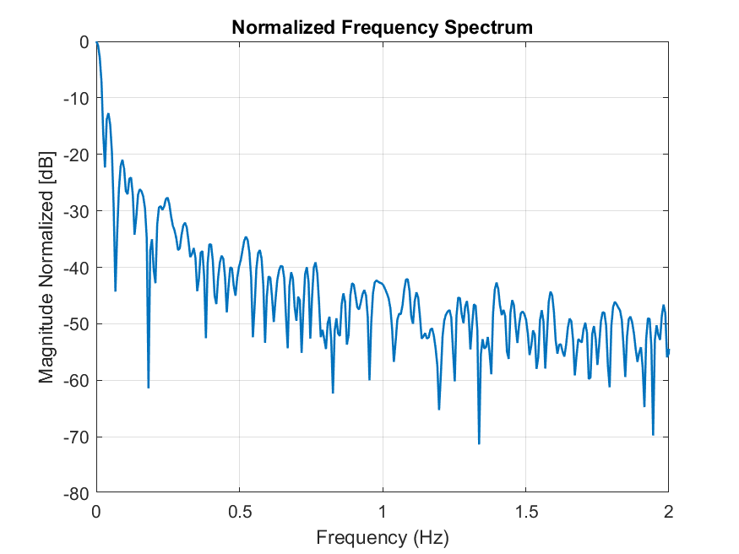
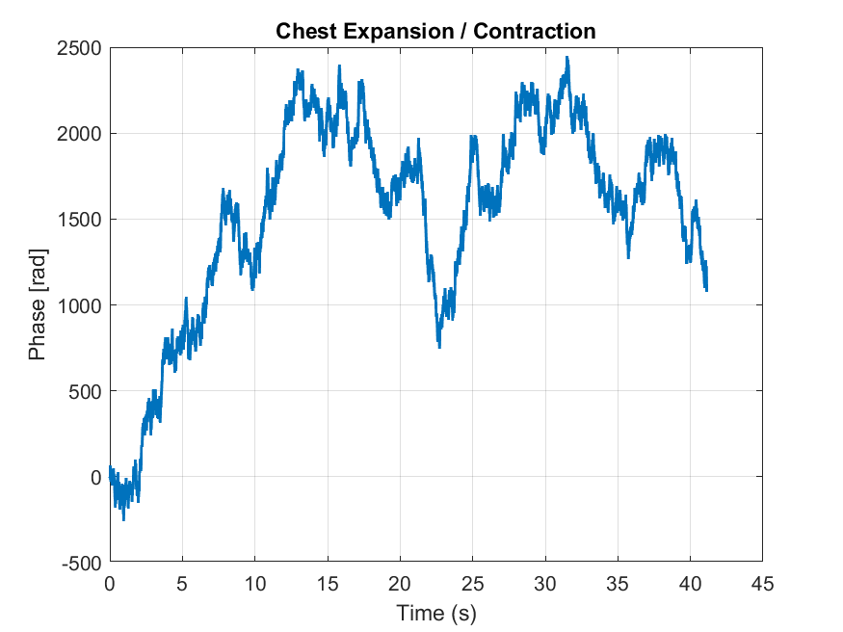
4. Monitor the breathing pattern of an individual using CW mode.
a. Do you see any reasonable data?
b. If not, give a reason as to why the breathing pattern is not observed in this
mode?
Notes:
the breathing motion signal is buried in flicker noise and DC offsets.

Slide 12
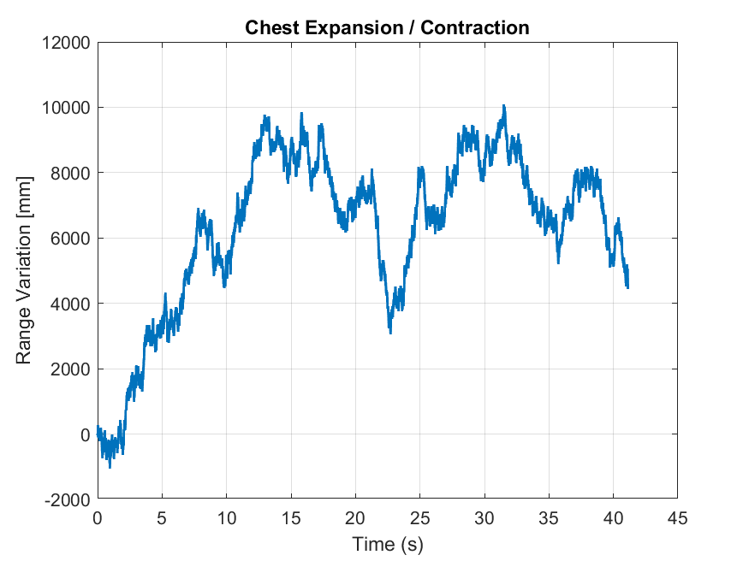
4. Monitor the breathing pattern of an individual using CW mode.
a. Do you see any reasonable data?
b. If not, give a reason as to why the breathing pattern is not observed in this
mode?
Breathing Rate: 5.47 breaths per minute
Heart Rate*: 21.88 beats per minute
(*) considering the Respiratory Sinus Arrhythmia (RSA) phenomenon with an average standard 1:4 ratio
Notes:
the breathing motion signal is buried in flicker noise and DC offsets.

Slide 13
5. Range Measurement in SFCW Mode - System Constraints
RF Capabilities:
70 MHz to 6 GHz frequency range
affected parameters: f0, df, Nf
Up to 56 MHz bandwidth (instantaneous BW)
affected parameters: df
Synchronization:
10 MHz clock reference or PPS time reference
affected parameters: Ts and the whole system
Conversion Performance and Clocks:
ADC Sample Rate (Max.): 61.44 MS/s
Frequency Accuracy: ±2.0 ppm
affected parameters: the whole system

Slide 14
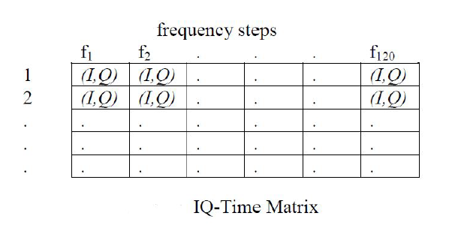
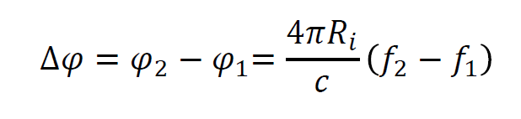
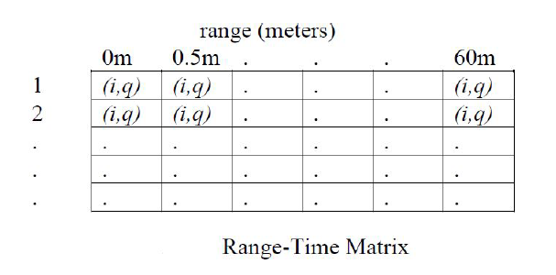
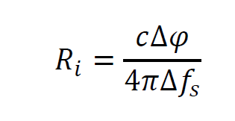
5. Range Measurement in SFCW Mode - Processing Approach
System
Nf=2 steps
Ts=200 ms
df=50 MHz
Nf=4 steps
Ts=200 ms
df=50 MHz
f0max = 5,85 GHz <= 6 GHz
f0max = 6 GHz <= 6 GHz
1D FFT on the
matrix rows
N-step generalization
via least squares

Slide 15
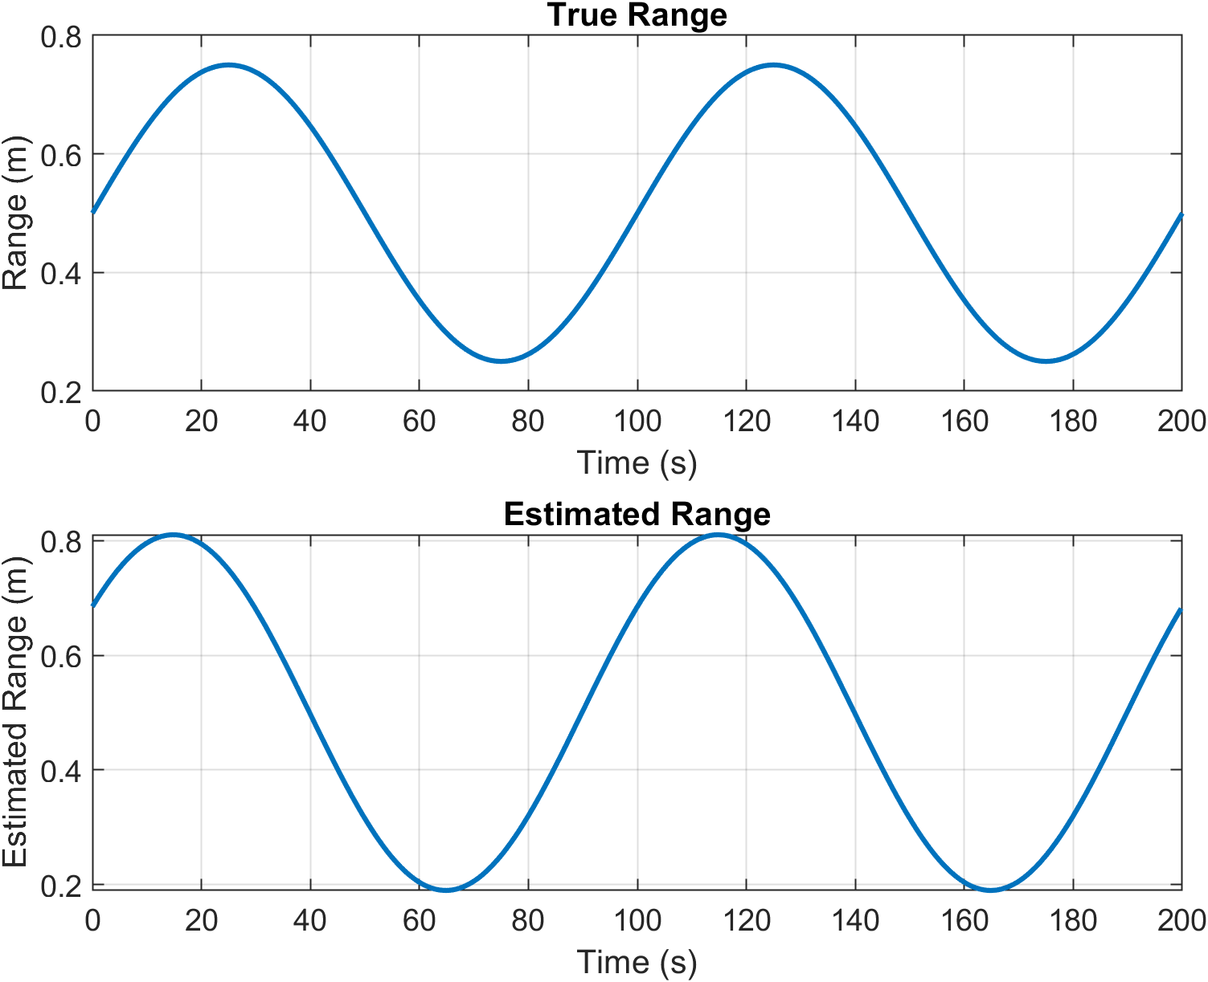
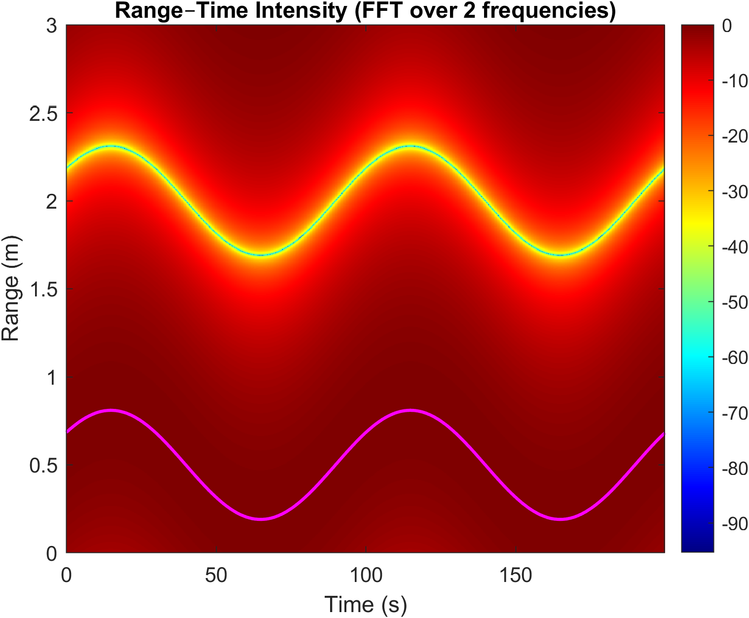
5. Range Measurement in SFCW Mode - Simulations: Nf=2 steps, df=50 MHz

Slide 16
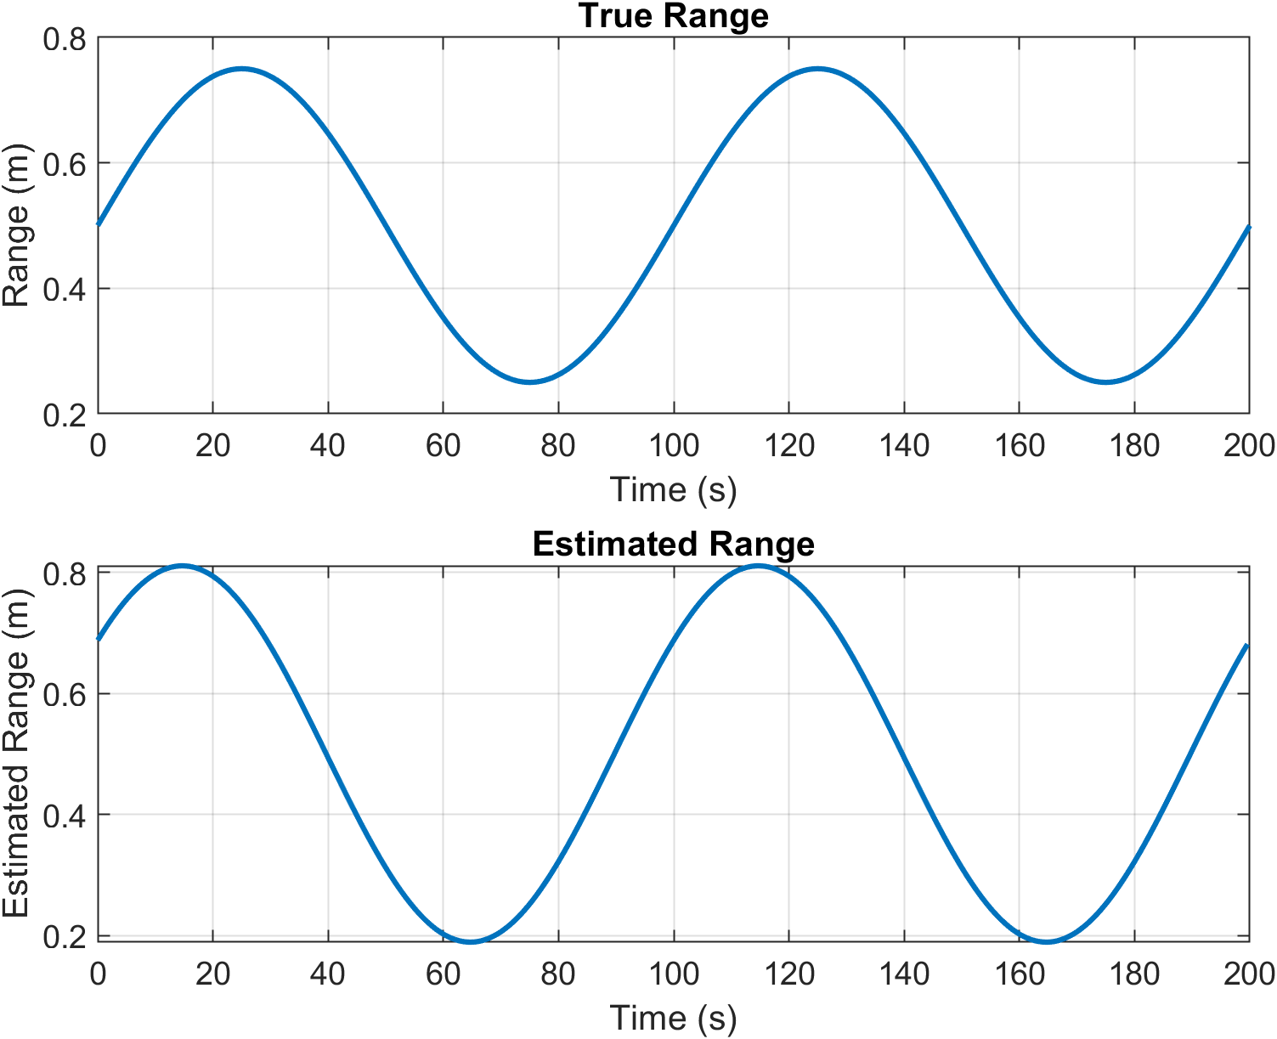
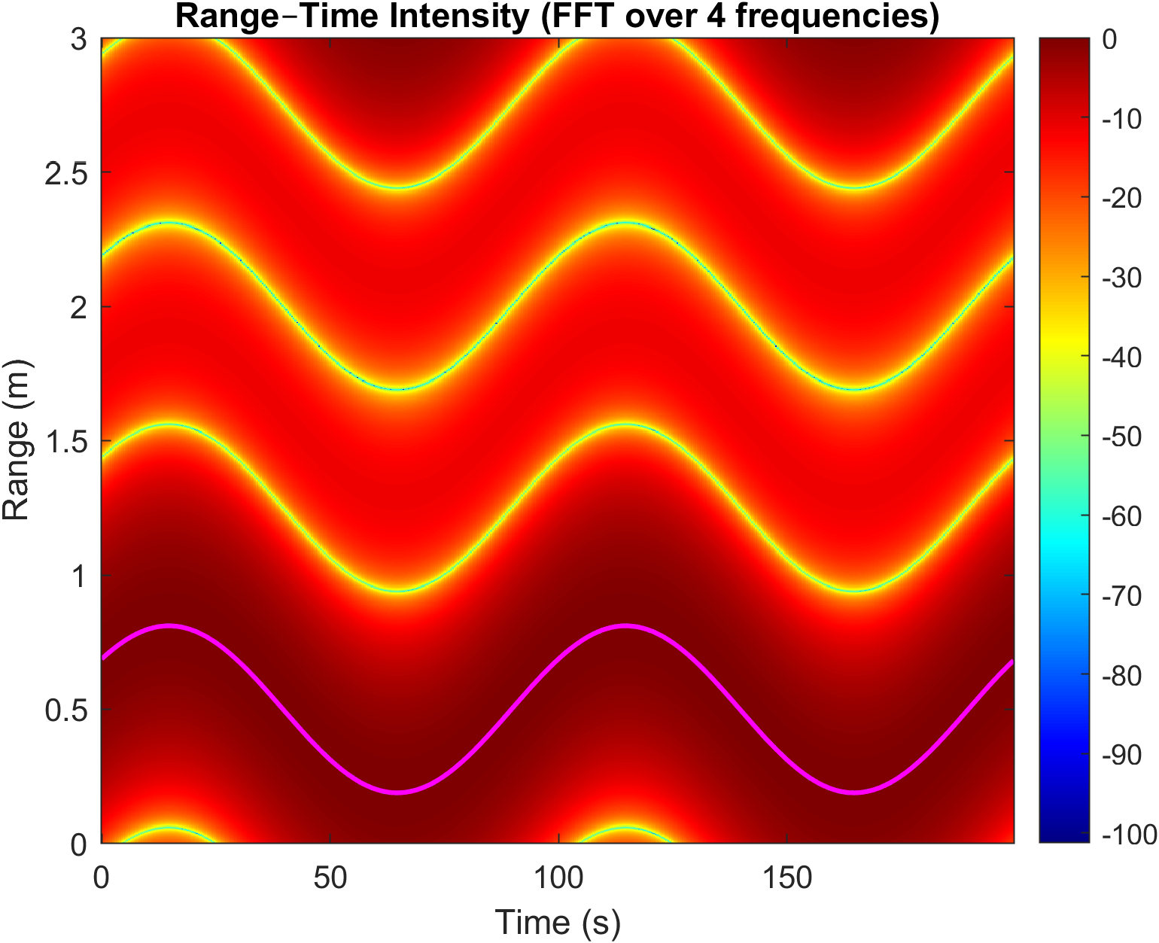
5. Range Measurement in SFCW Mode - Simulations: Nf=4 steps, df=50 MHz

Slide 17
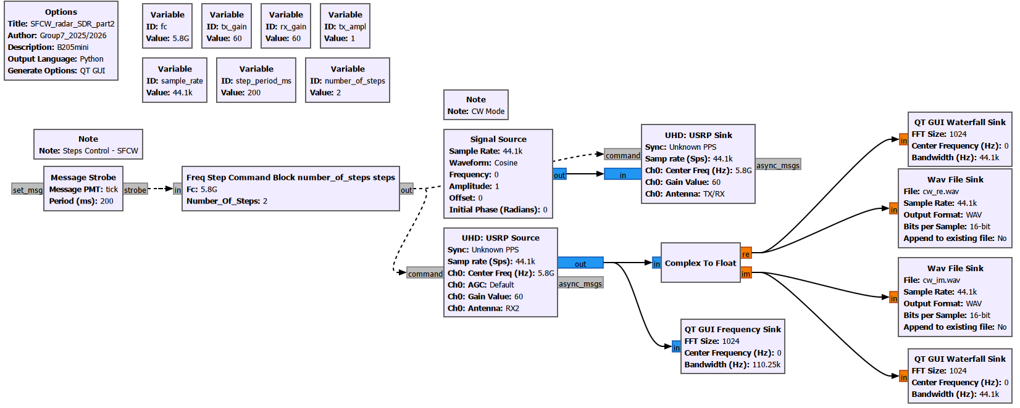
5. Range Measurement in SFCW Mode - Real Measurements: GNU RADIO
def handle_msg(self, msg):
freq = self.fc + self.current_step * self.step
cmd = pmt.make_dict()
cmd = pmt.dict_add(cmd, pmt.intern("freq"), pmt.from_double(freq))
self.message_port_pub(pmt.intern("out"), cmd)
self.current_step = (self.current_step + 1) % self.num_steps

Slide 18
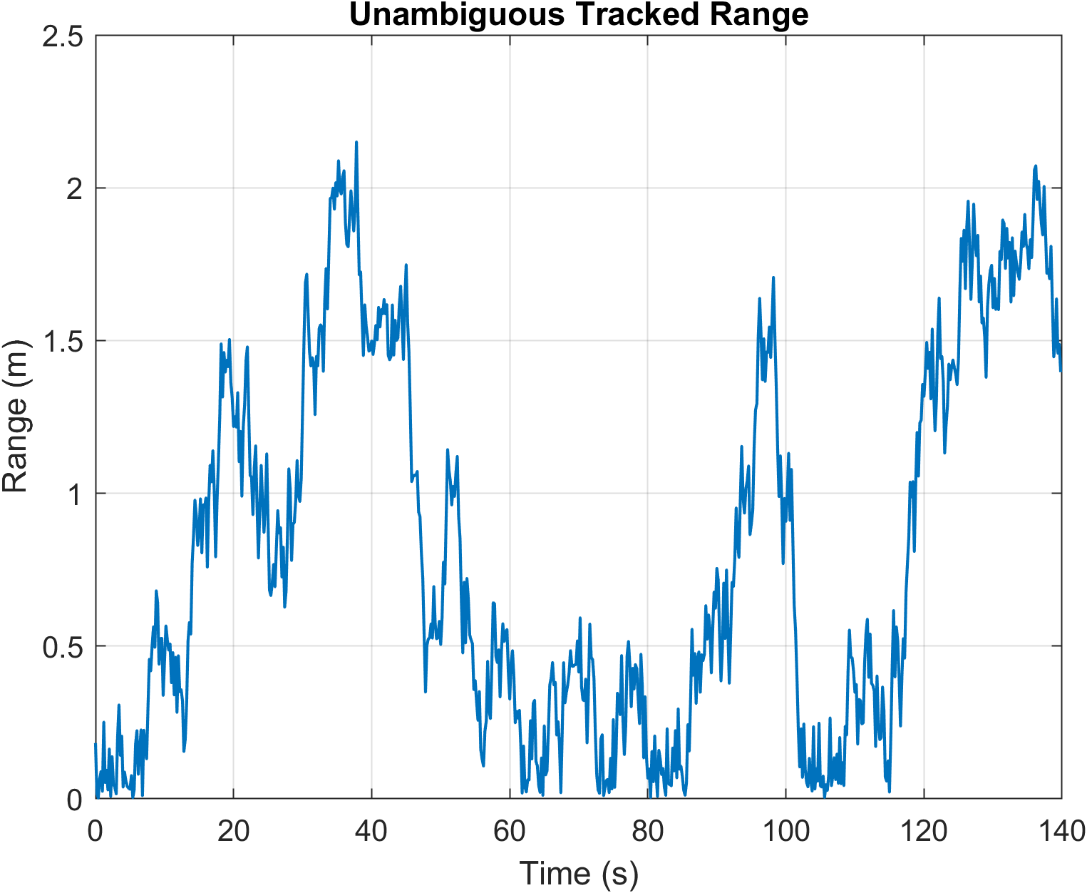
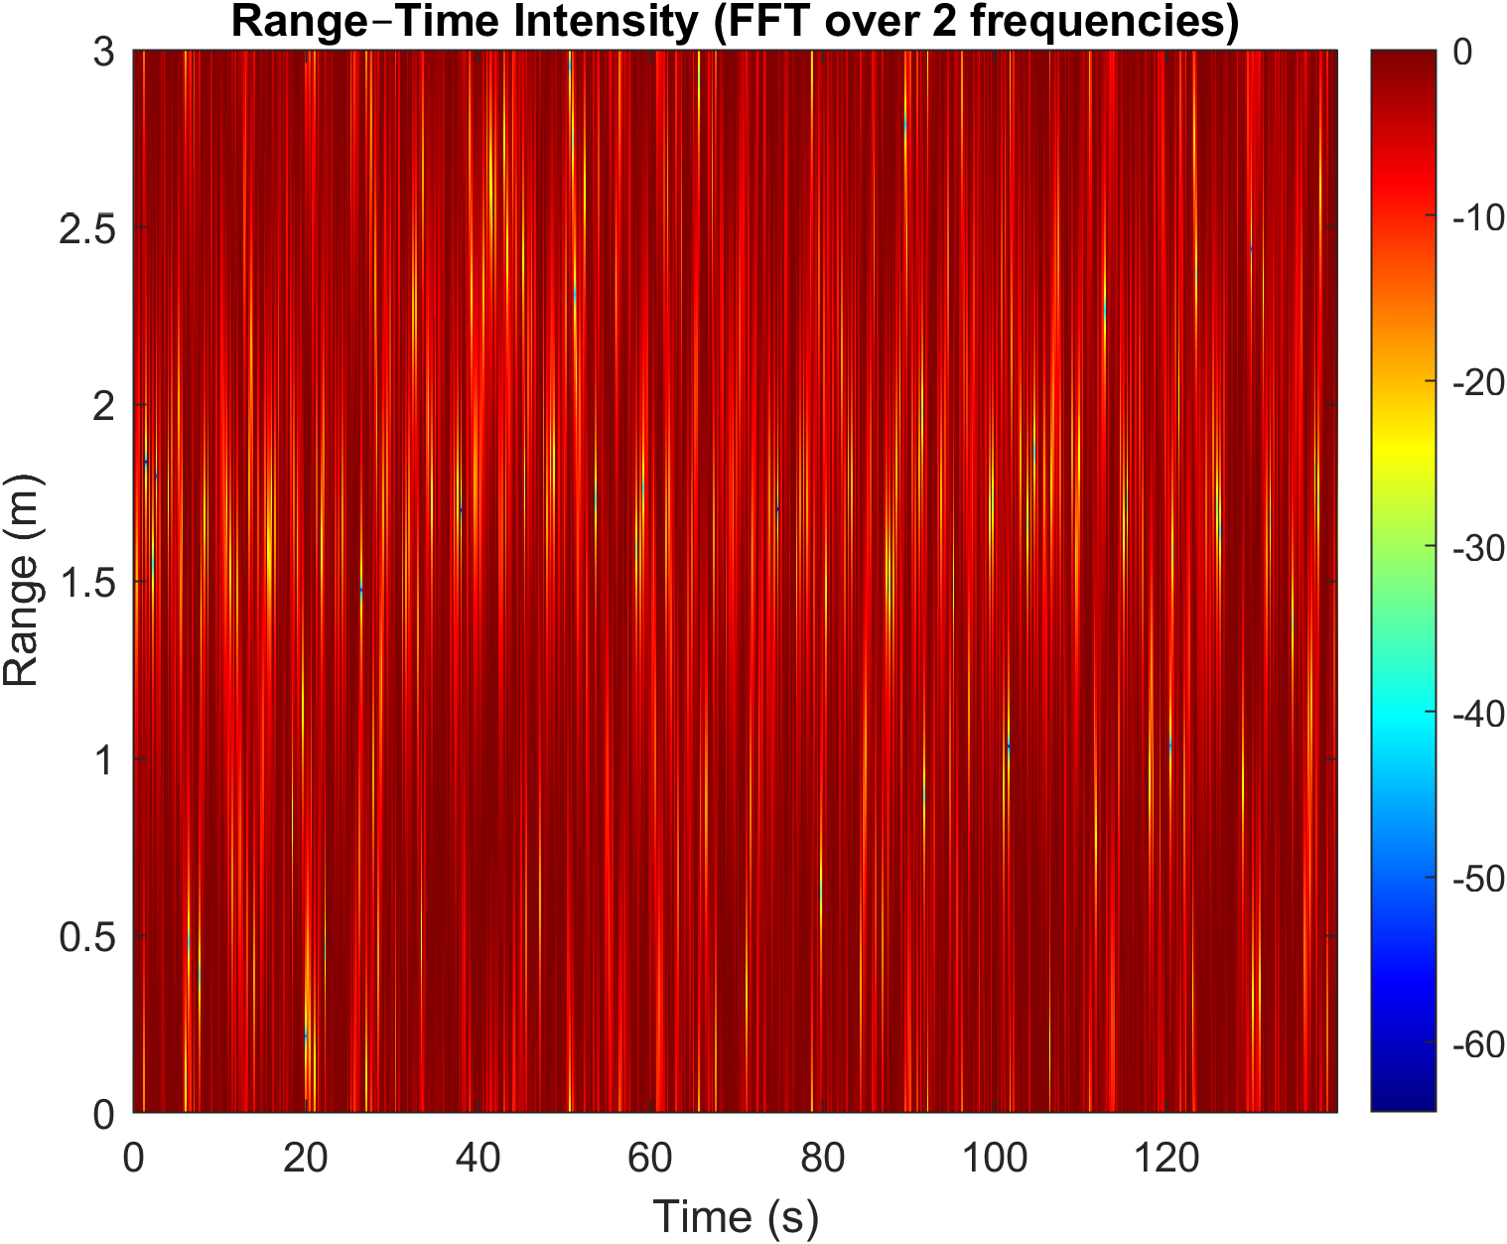
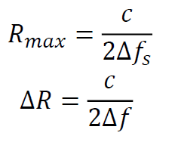
5. Range Measurement in SFCW Mode - Real Measurements: Nf=2, df=50MHz
Rmax = 3 meters
Rresolution = 1.5 meters

Slide 19
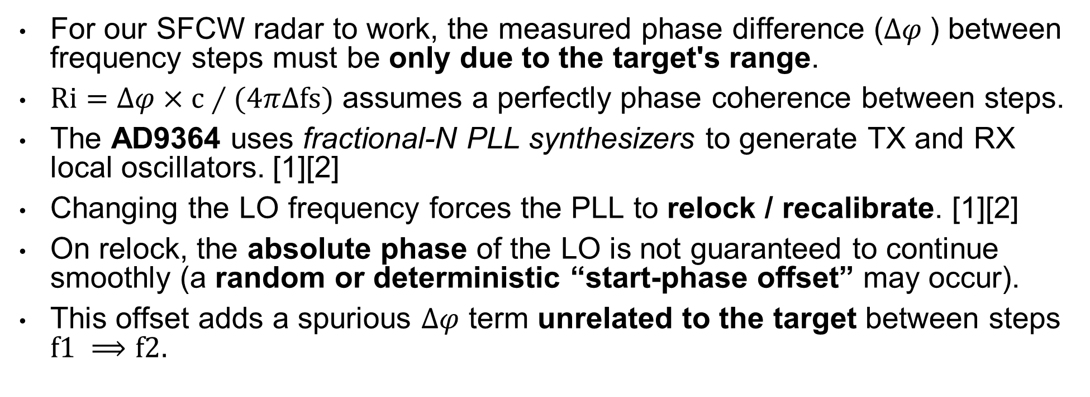
5. SFCW Mode - Problem: phase coherence and timing
PLL (Phase Locked Loop) Retune and Start Phase Offset in AD9364
For our SFCW radar to work, the measured phase difference ($∆φ$) between frequency steps must be only due to the target's range.
$Ri=∆φ×c∕(4π∆fs)$ assumes a perfectly phase coherence between steps.
The AD9364 uses fractional-N PLL synthesizers to generate TX and RX local oscillators. [1][2]
Changing the LO frequency forces the PLL to relock / recalibrate. [1][2]
On relock, the absolute phase of the LO is not guaranteed to continue smoothly (a random or deterministic “start-phase offset” may occur).
This offset adds a spurious $∆φ$ term unrelated to the target between steps $f1 ⟹f2.$
$${\text{Δ}φ}_{measured}(t)={\text{Δ}φ}_{target}(t)+{\text{Δ}φ}_{PLL offset}(t)$$
[1] https://www.analog.com/media/en/technical-documentation/data-sheets/ad9364.pdf [2] https://www.analog.com/media/cn/technical-documentation/user-guides/ad9364_reference_manual_ug-673.pdf

Slide 20
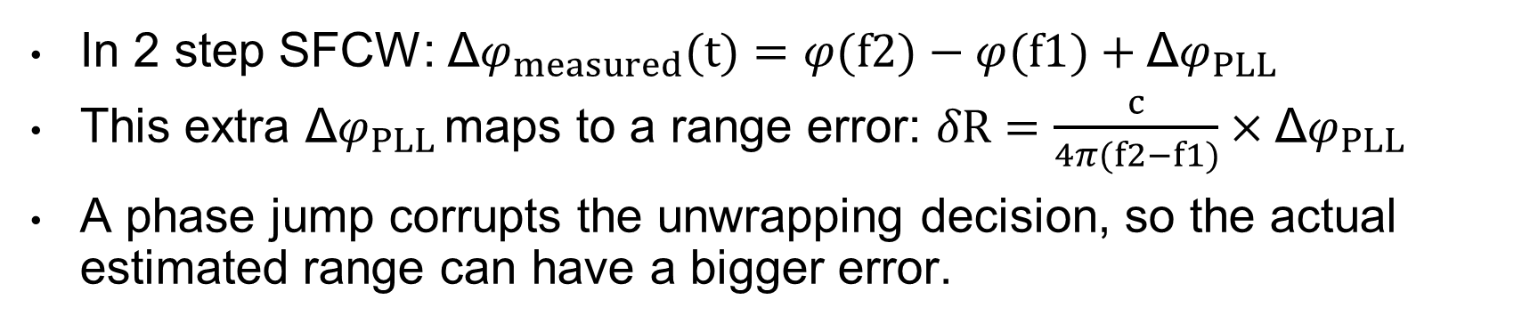
5. SFCW Mode - Problem: phase coherence and timing
Impact of Phase Jump on SFCW Range Estimation
set_center_freq(5.80e9)
acquire
set_center_freq(5.85e9)
acquire
…
In 2 step SFCW: ${\text{Δ}φ}_{measured}(t)=φ(f2)−φ(f1)+{\text{Δ}φ}_{PLL }$
This extra ${\text{Δ}φ}_{PLL }$maps to a range error: $δR=\frac{c}{4π(f2−f1)}×{\text{Δ}φ}_{PLL }$
A phase jump corrupts the unwrapping decision, so the actual estimated range can have a bigger error.
$${\text{Δ}φ}_{measured}(t)={\text{Δ}φ}_{target}(t)+{\text{Δ}φ}_{PLL offset}(t)$$

Slide 21
5. SFCW Mode - Possible (limited) Solution ???
If feasible, we could modify GNU radio to avoid set_center_freq() and instead apply a frequency shift in other way (within the max instantaneous BW).
This prevents the AD9364 PLL from re-locking, maintaining phase coherence.
Possibly, setting a center frequency e.g. 9,825 GHz and using some type of “Digital LO offset”, manually mixing the signal in software (<=BW) and applying it through a shift (±25MHz) within Signal Source.
However… for a minimum useful range, e.g. 3 m, we need almost full inst. BW (df=50 MHz ≈ 56 MHz). So, we are limited with 2 steps.
It has also implications in how we receive the signal.

Slide 22
Plan for Next Week (Sub-groups 1 and 2)
Report
Question regarding parameter data (S11, S21, S12, and S22) of amplifiers
Final Presentation

