Slide 1
Review Meeting 3
Build your own Radar System, Project Course
Group 7:
Bingxue Xu
Nikita Dubrovskyi
Rafael Rodrigues
Stefano Crescenza
Tuesday, 23/09/2025

Slide 2
Week Achievements
1. Velocity Measurements in CW mode: single and multiple targets
2. Range Measurements in FMCW mode: single and multiple targets
3. Range-Doppler Measurements in FMCW mode
4. Real-time Measurements: CW and FMCW mode [Extra Task]
FMCW Radar Tasks: [Extra Task]
5. Extract velocity from range using two-point finite difference method and compare it to range-doppler measurements
6. FMCW Mode: Simultaneous range and velocity estimation by only processing the up and down chirp for a single target

Slide 3
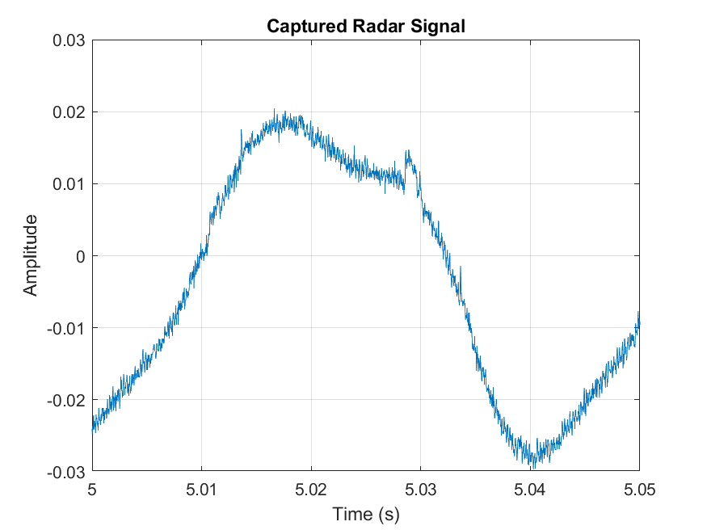
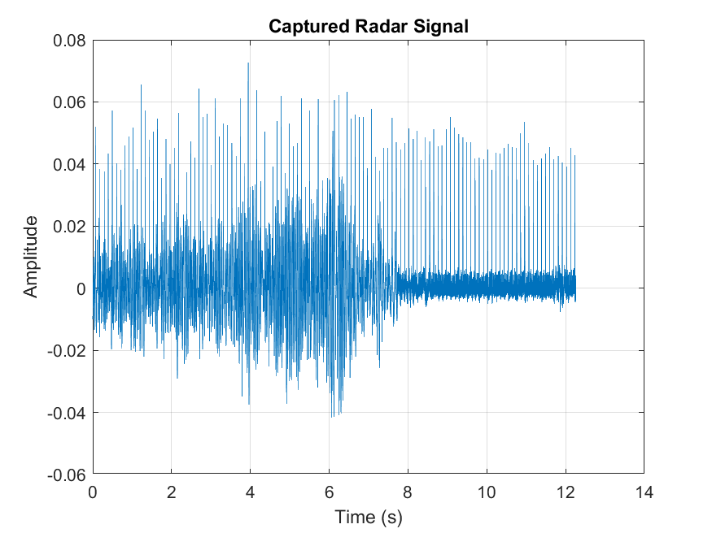
2. Velocity Measurements in CW mode. (Sub-group 2):
Velocity Measurements of a single target: captured data plot

Slide 4
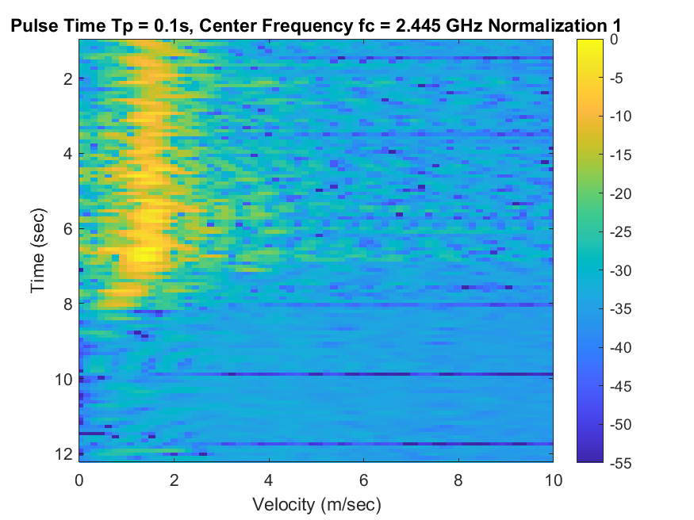
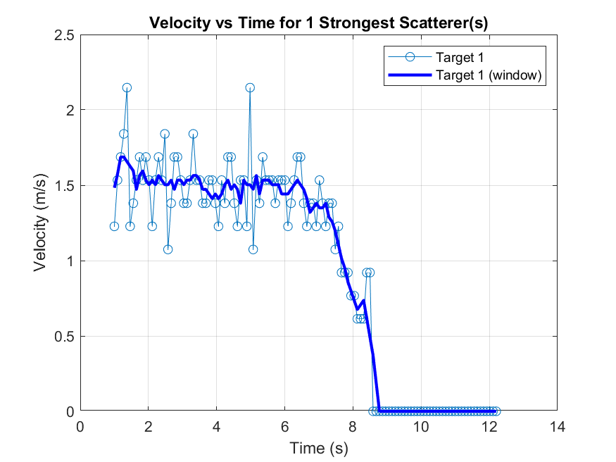
2. Velocity Measurements in CW mode. (Sub-group 2):
Velocity Measurements of a single target: velocity vs time spectrogram, velocity vs time plot

Slide 5
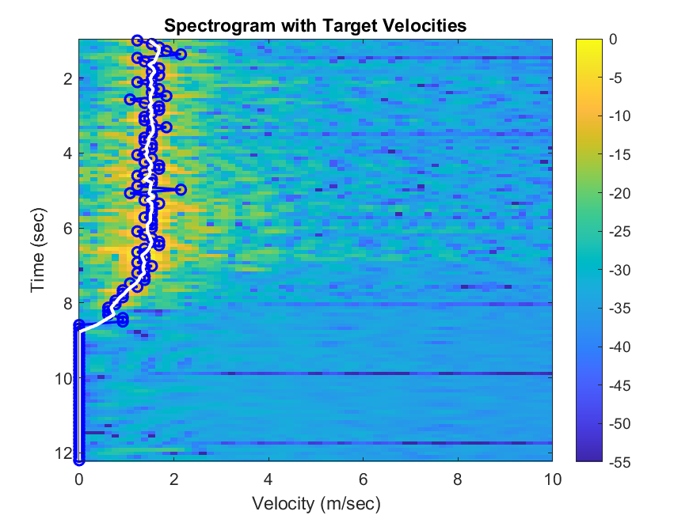
2. Velocity Measurements in CW mode. (Sub-group 2):
Velocity Measurements of a single target: velocity vs time spectrogram, velocity vs time plot

Slide 6
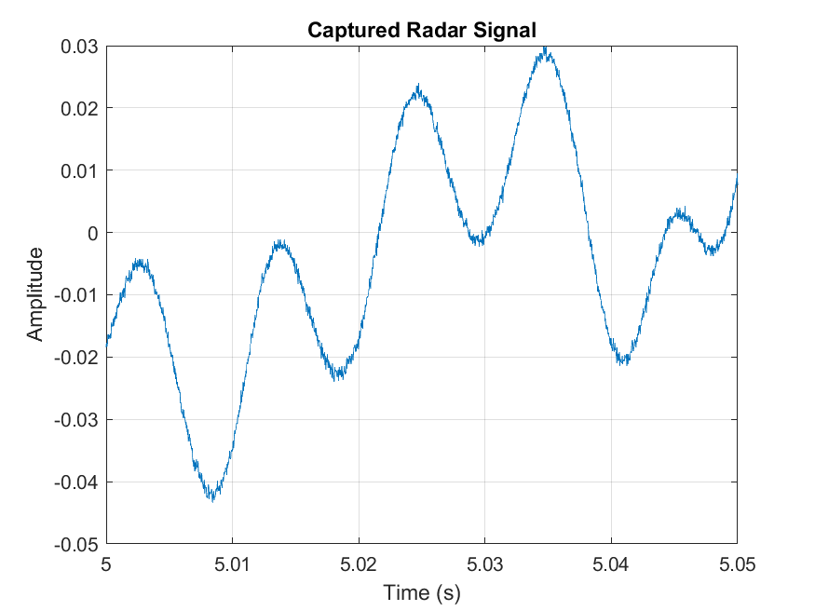
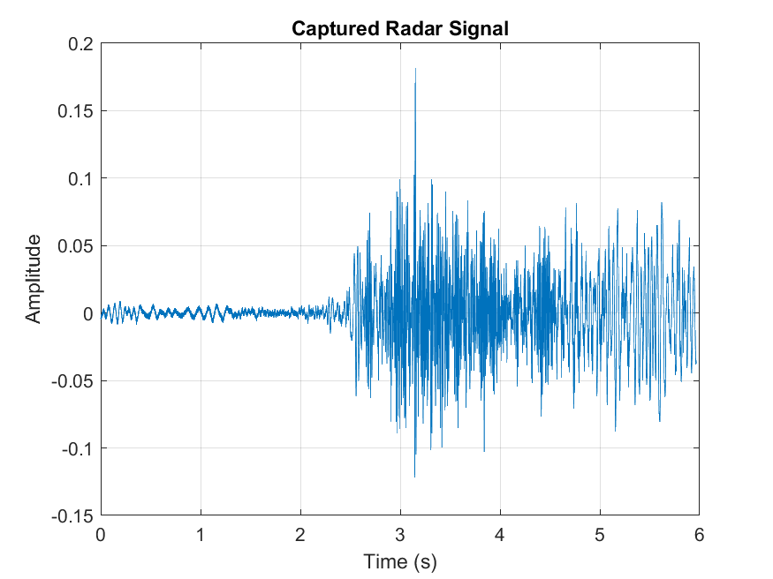
2. Velocity Measurements in CW mode. (Sub-group 2):
Velocity Measurements of multiple targets: captured data plot

Slide 7
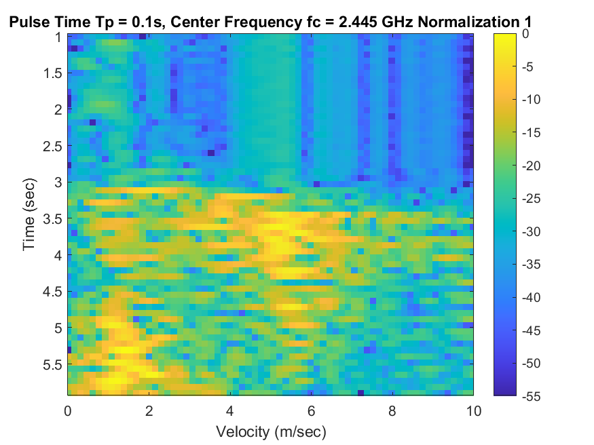
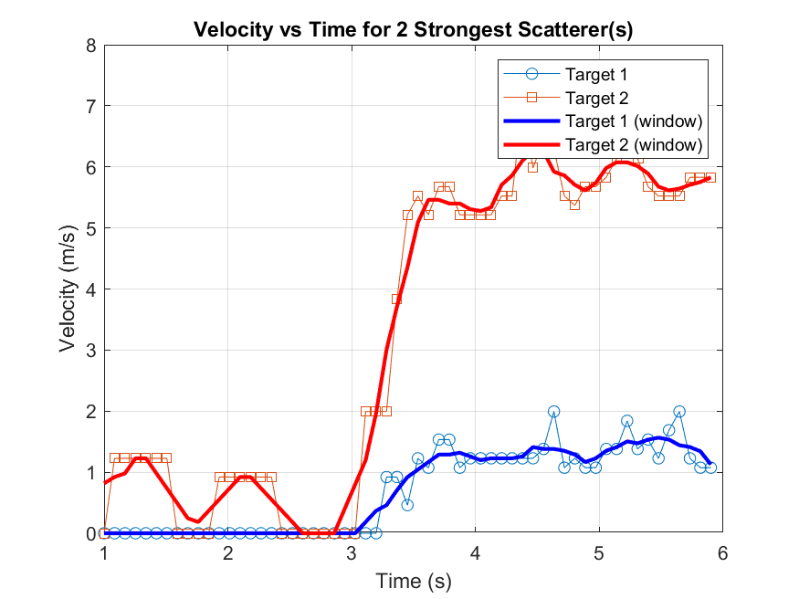
2. Velocity Measurements in CW mode. (Sub-group 2):
Velocity Measurements of multiple targets: velocity vs time spectrogram, velocity vs time plot

Slide 8
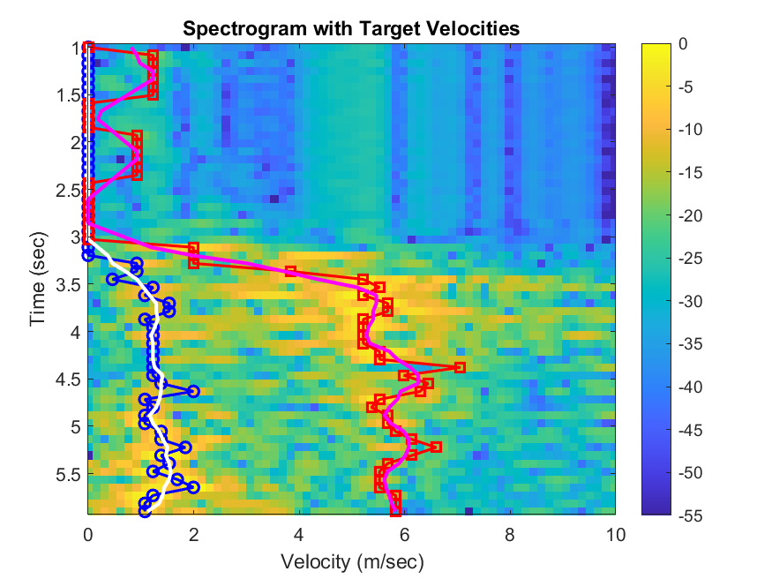
2. Velocity Measurements in CW mode. (Sub-group 2):
Velocity Measurements of multiple targets: velocity vs time spectrogram, velocity vs time plot

Slide 9
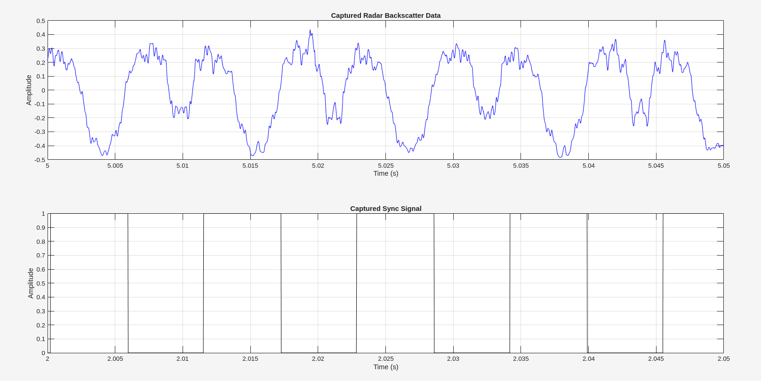
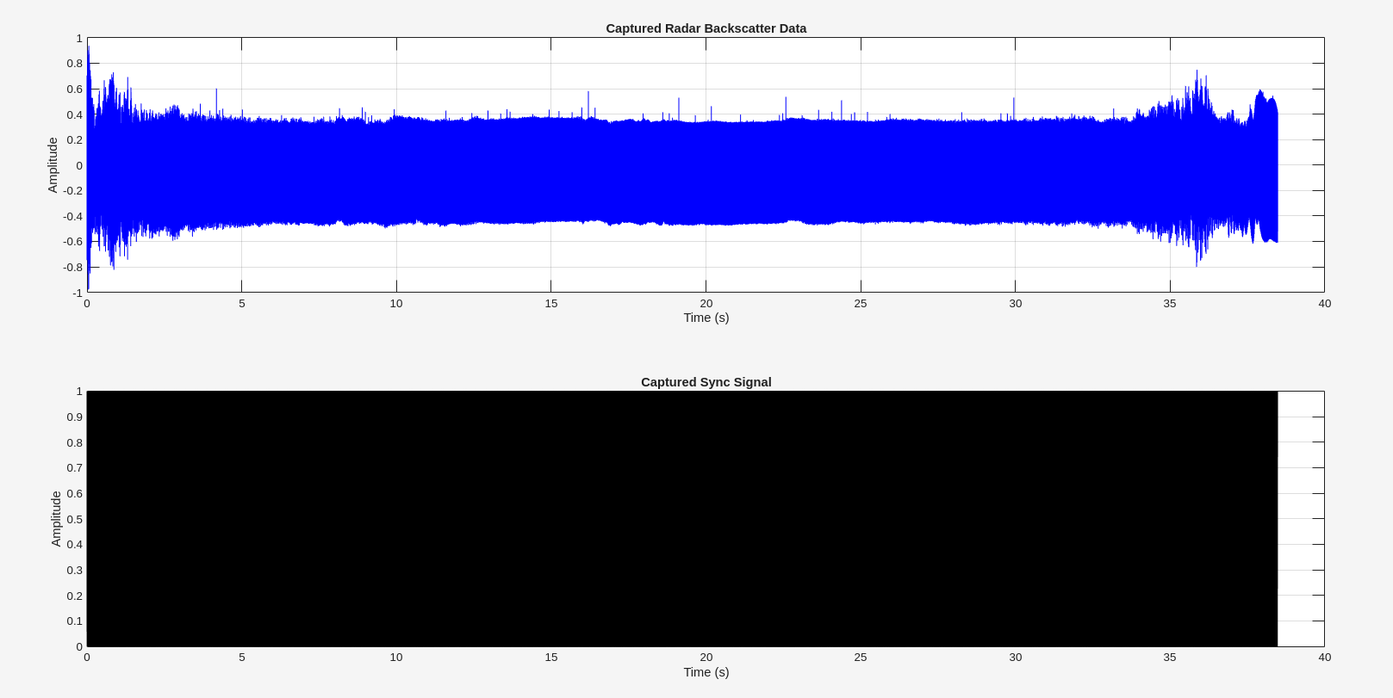
2. Range Measurements in FMCW mode. (Sub-group 1):
Range measurements of multiple targets: show captured data plot, captured sync plot (also
show zoom in)

Slide 10
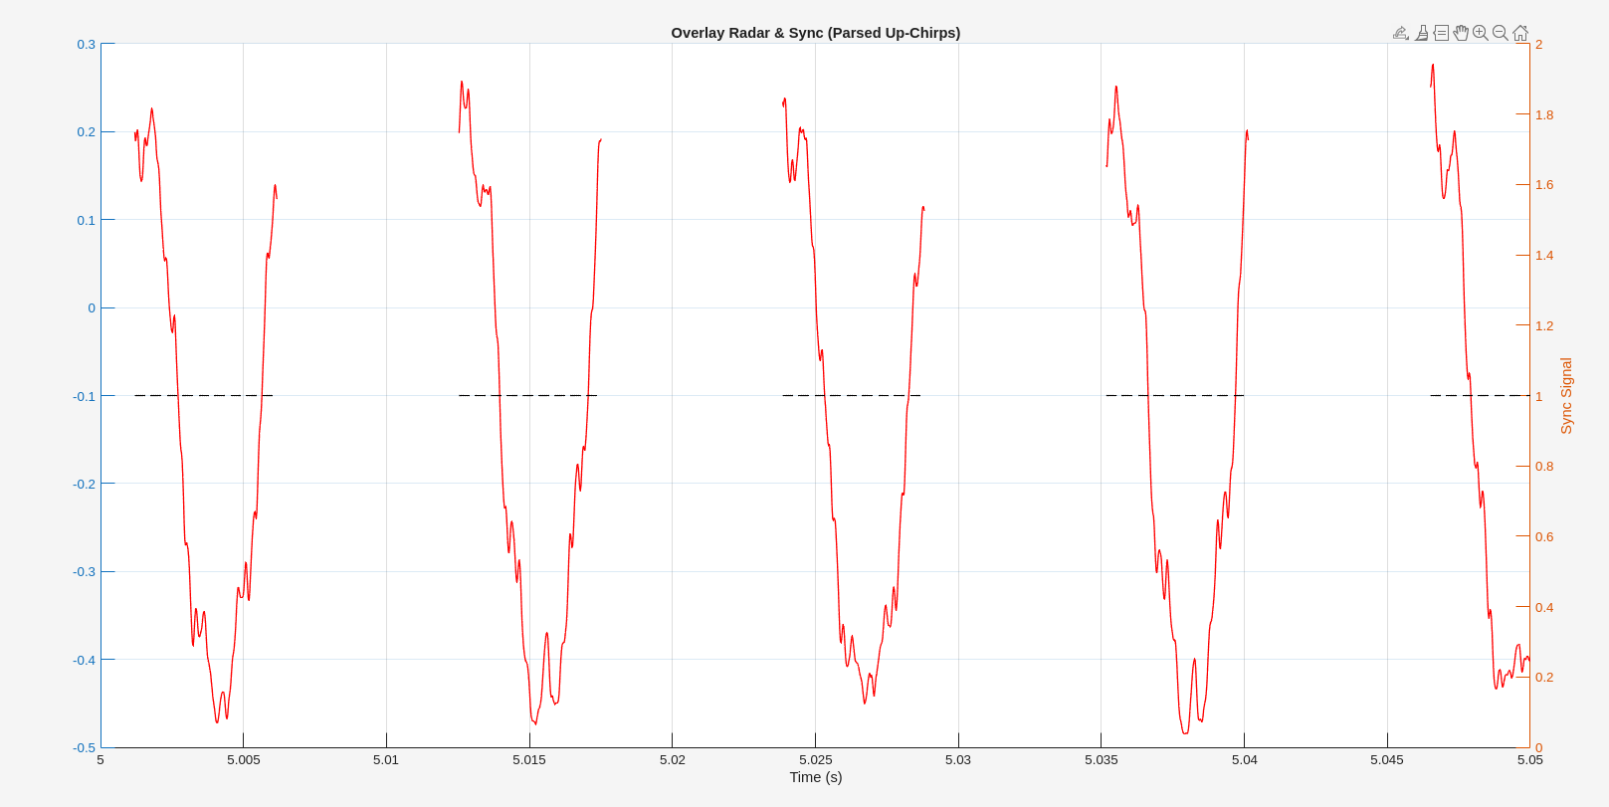
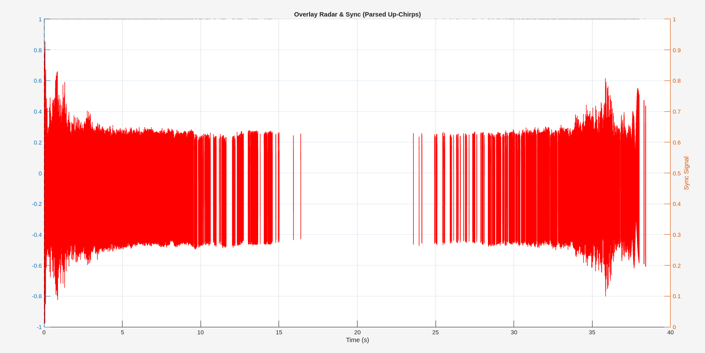
2. Range Measurements in FMCW mode. (Sub-group 1):
captured parsed up-chirp data overlayed over the sync plot (also show zoom
in)

Slide 11
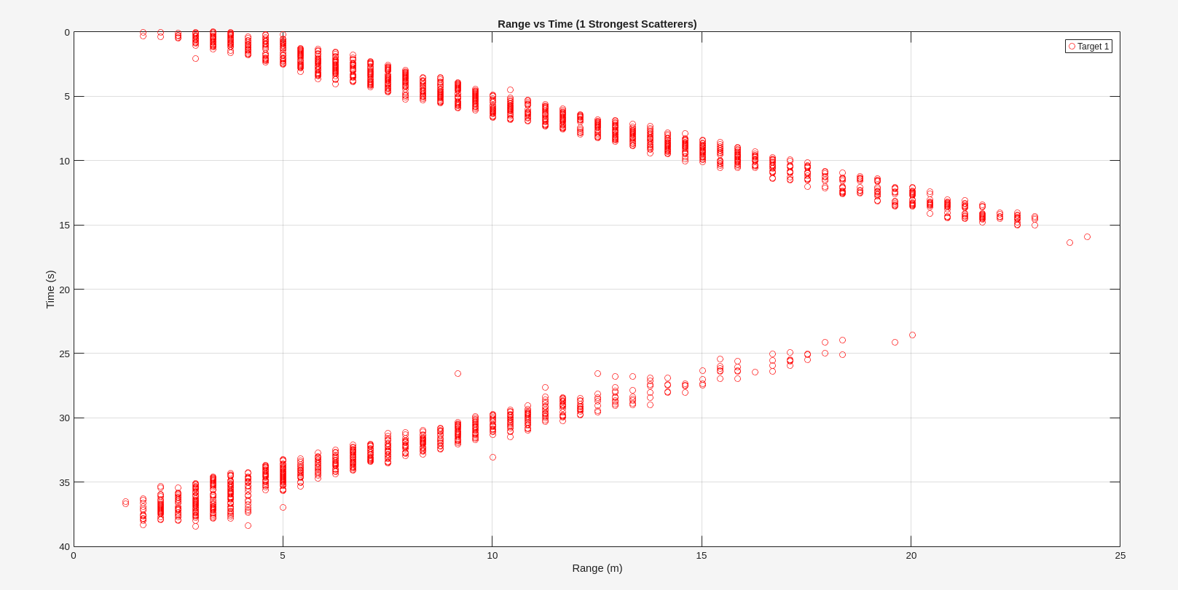
2. Range Measurements in FMCW mode. (Sub-group 1):
range vs time plot (hint: take the two strongest scratterers for two targets, multiple
local maximas is used by [pks, locs] = findpeaks(row, 'MinPeakDistance', min_sep_bin);)

Slide 12
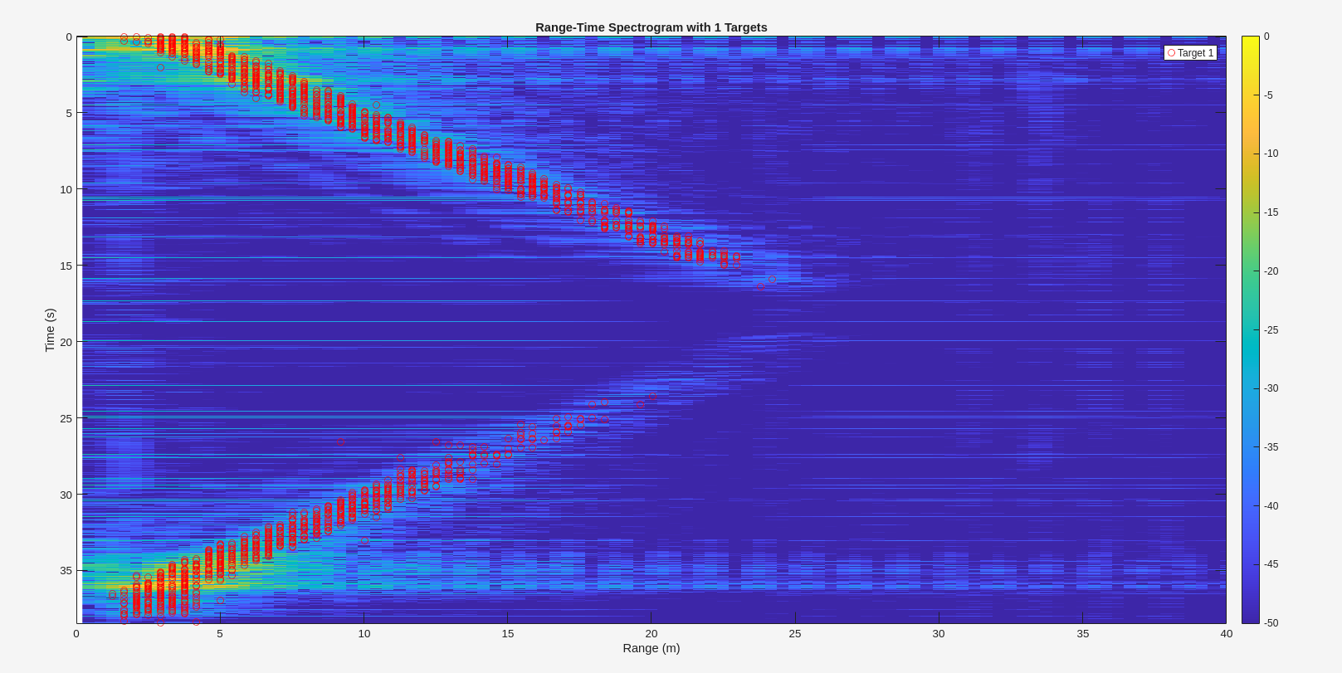
2. Range Measurements in FMCW mode. (Sub-group 1): Single target
range vs time spectrogram

Slide 13
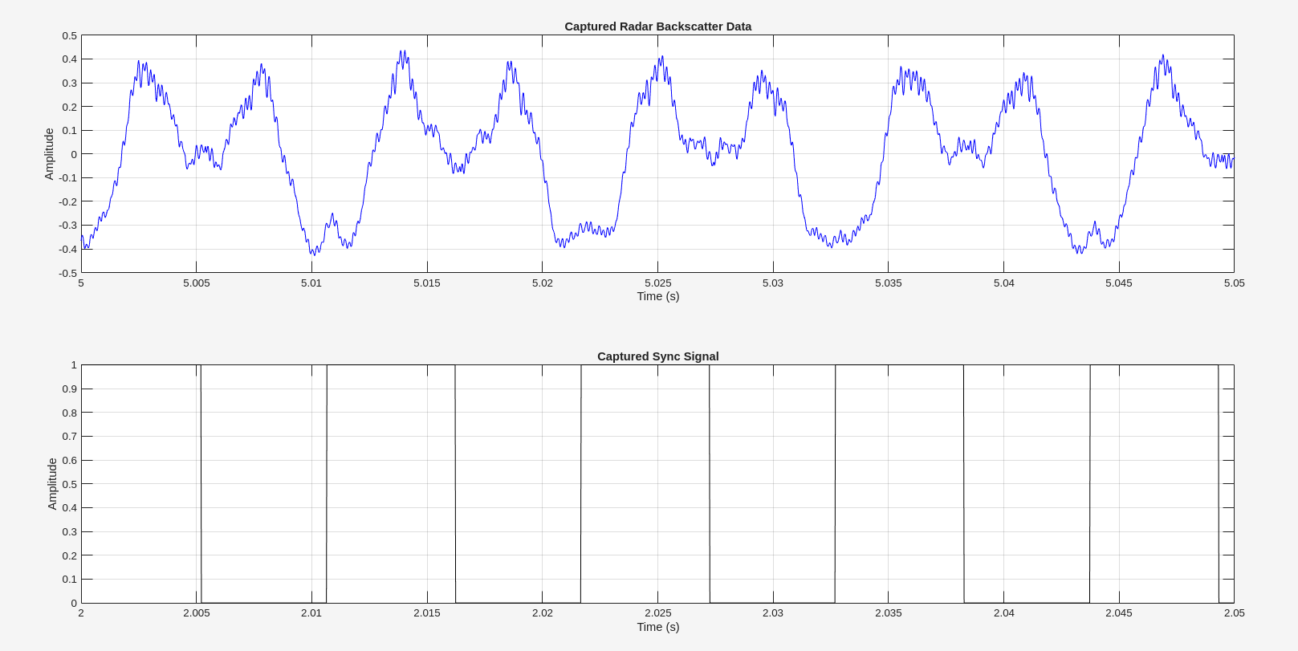
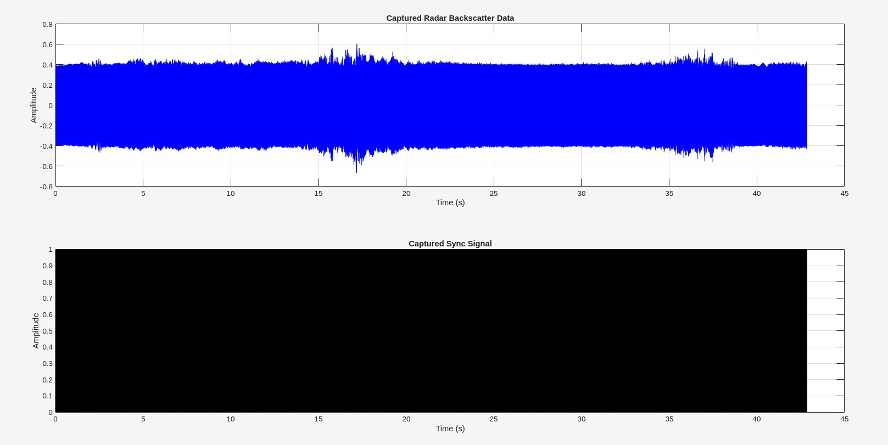
2. Range Measurements in FMCW mode. (Sub-group 1): Two targets
Range measurements of multiple targets: show captured data plot, captured sync plot (also
show zoom in)

Slide 14
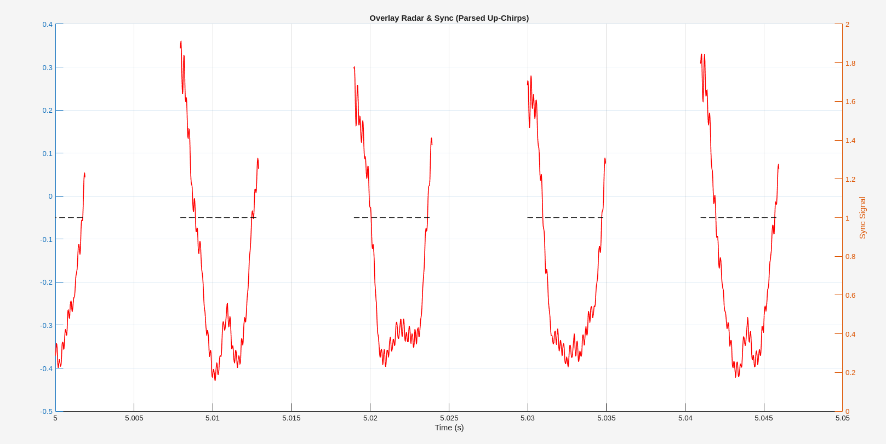
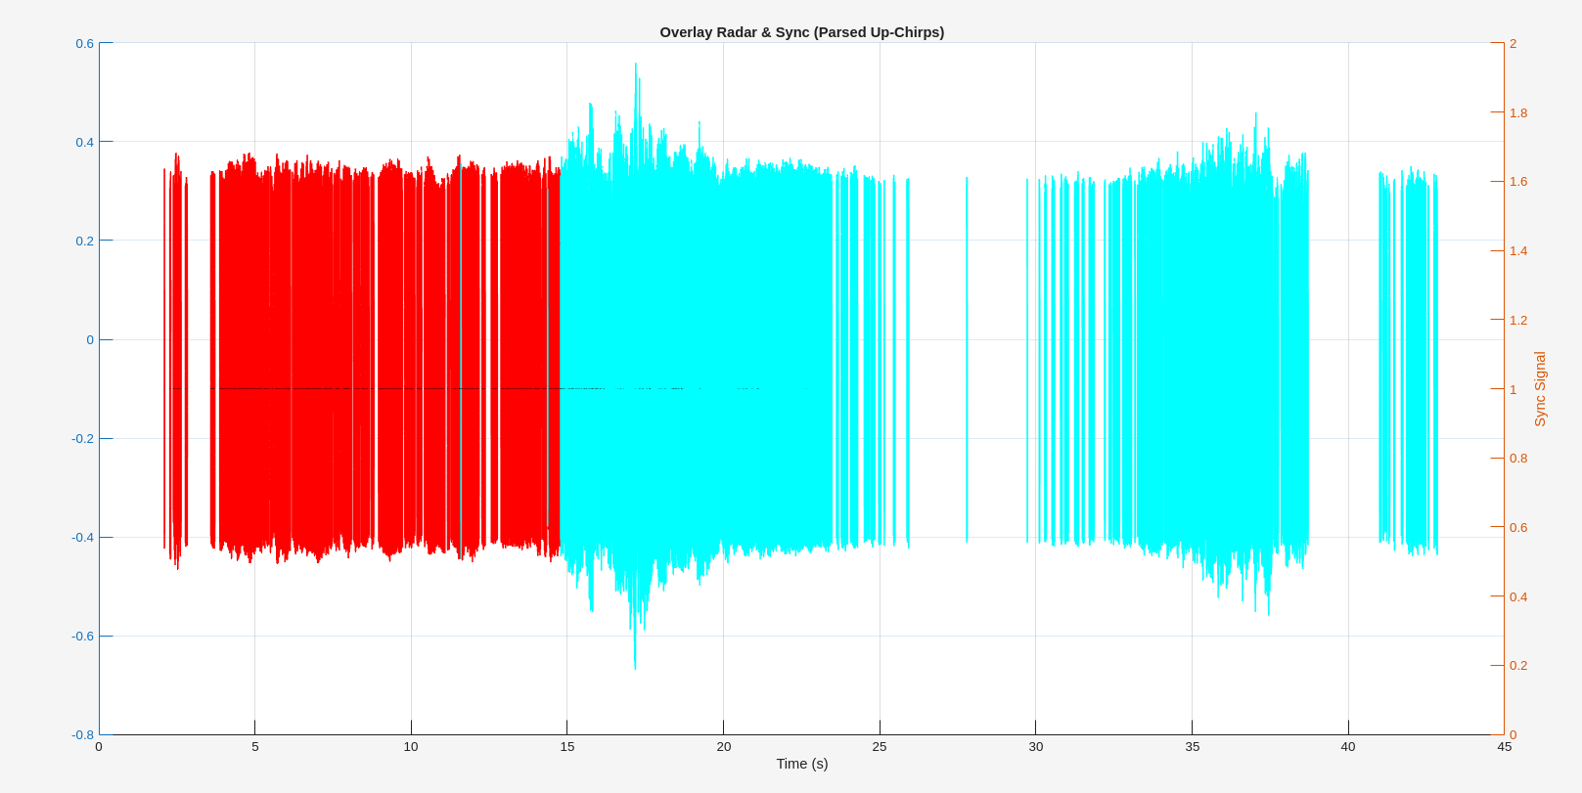
2. Range Measurements in FMCW mode. (Sub-group 1):
captured parsed up-chirp data overlayed over the sync plot (also show zoom in)

Slide 15
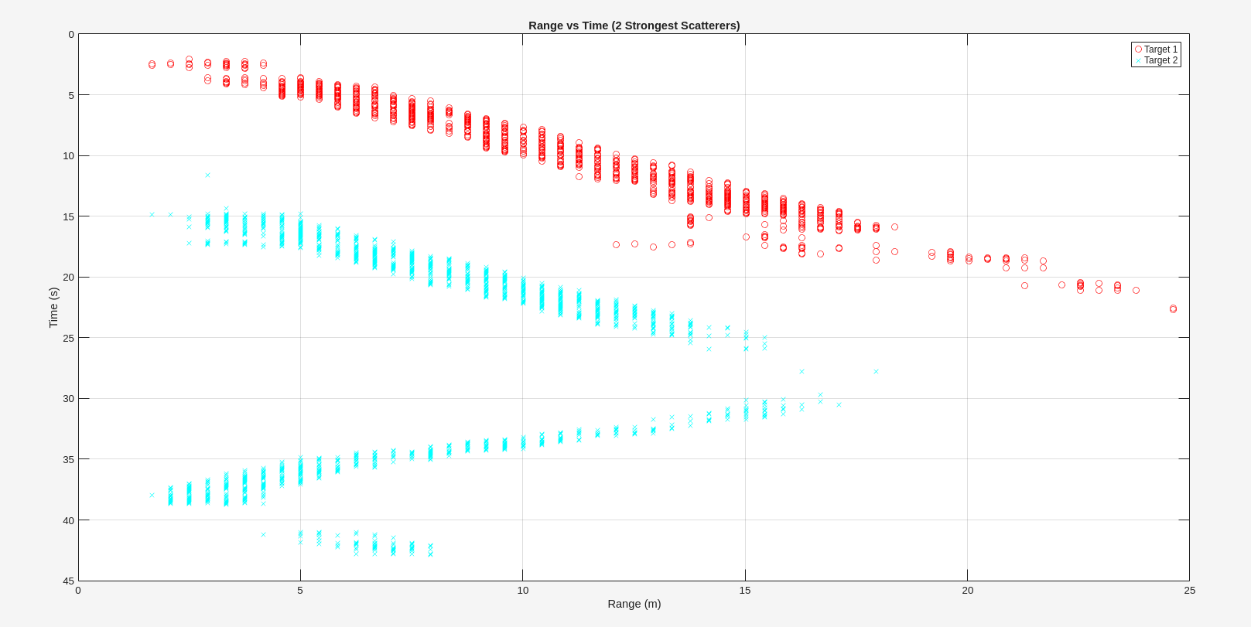
2. Range Measurements in FMCW mode. (Sub-group 1):
range vs time plot (hint: take the two strongest scratterers for two targets, multiple
local maximas is used by [pks, locs] = findpeaks(row, 'MinPeakDistance', min_sep_bin);)

Slide 16
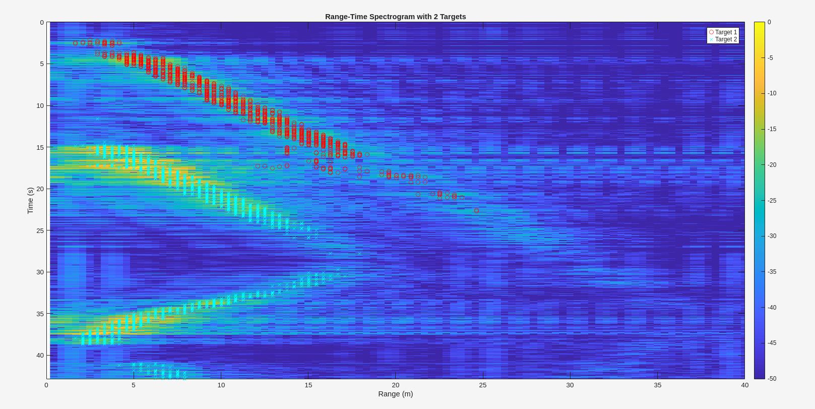
2. Range Measurements in FMCW mode. (Sub-group 1):
range vs time spectrogram

Slide 17
One target
Two targets

Slide 18
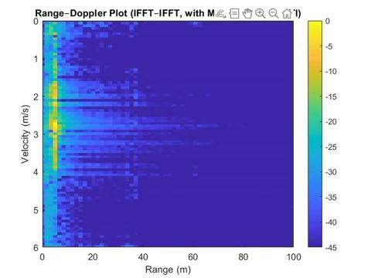
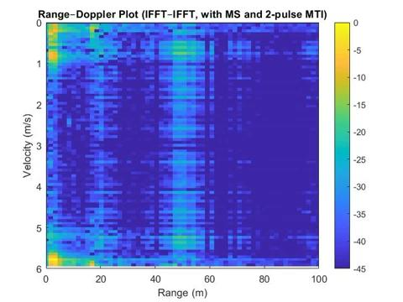
3. Range-Doppler Measurements in FMCW mode. (Sub-group 1 and 2 together):
Video of the range vs velocity spectrogram
1 Target
2 Target

Slide 19
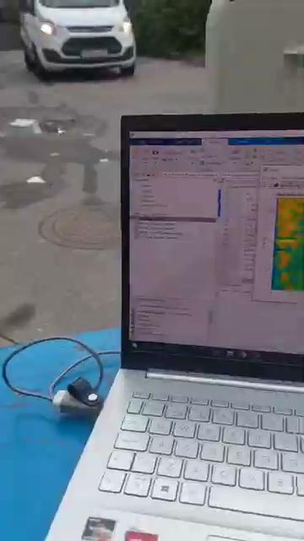
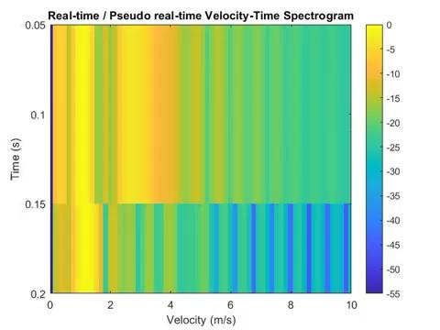
4. Real-time Measurements. (Optional Tasks)
CW Mode - Video 1

Slide 20
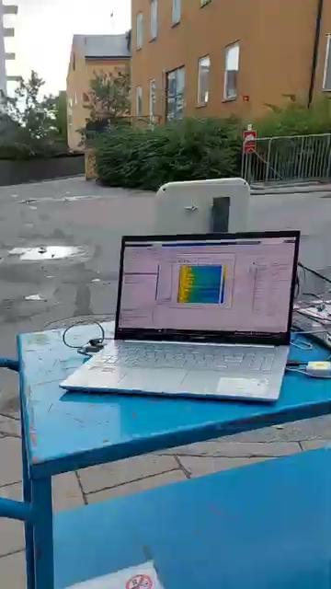
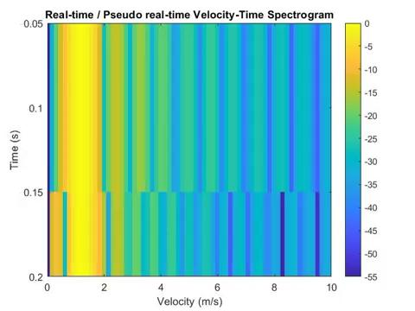
4. Real-time Measurements. (Optional Tasks)
CW Mode - Video 2

Slide 21
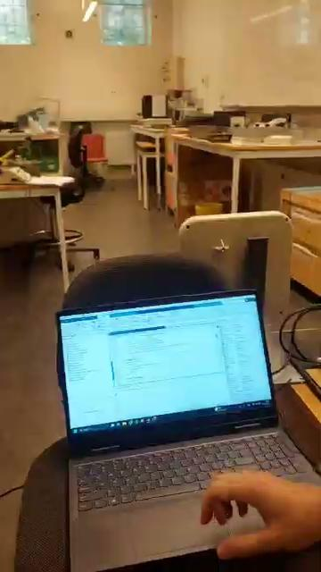
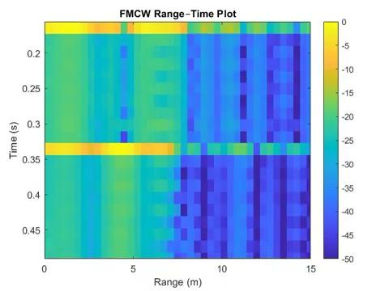
4. Real-time Measurements. (Optional Tasks)
FMCW Mode - Video

Slide 22
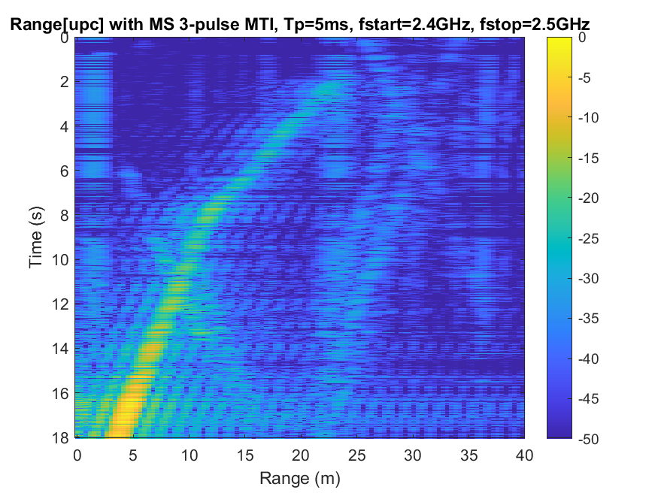
5. FMCW Radar Tasks. (Optional Tasks)
Extract velocity from range using two-point finite difference method and compare it to range-doppler measurements.

Slide 23
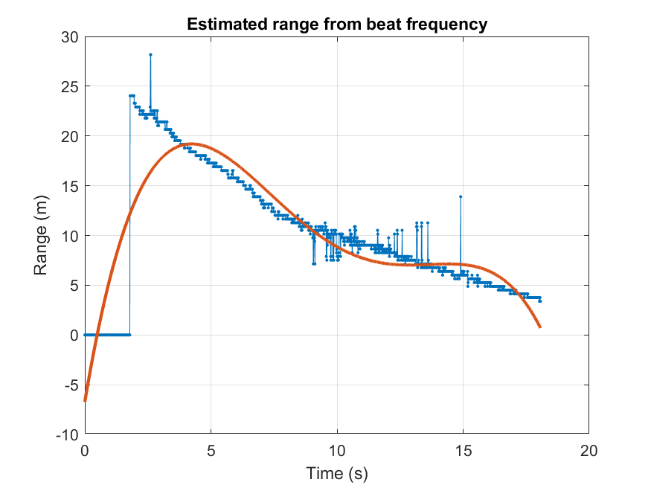
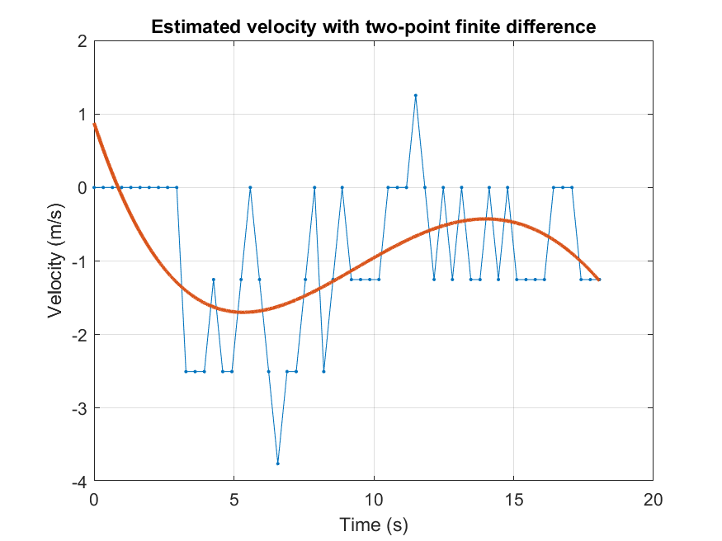
5. FMCW Radar Tasks. (Optional Tasks)
Extract velocity from range using two-point finite difference method and compare it to range-doppler measurements.

Slide 24
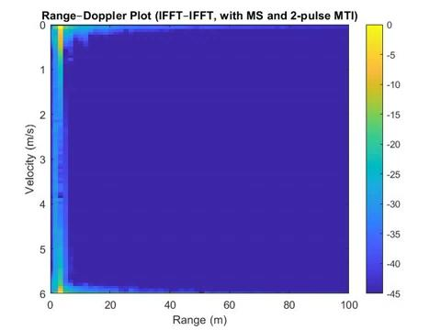
5. FMCW Radar Tasks. (Optional Tasks)
Comparison of two-point finite difference velocity estimate, with range doppler algorithm

Slide 25
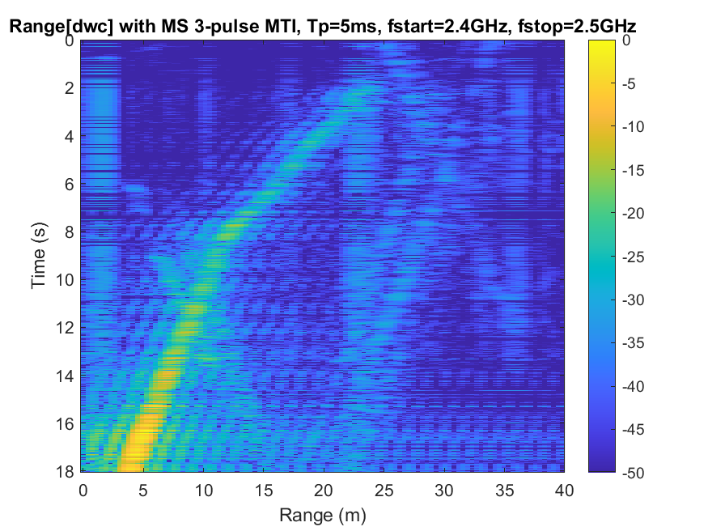
6. FMCW Radar Tasks. (Optional Tasks)
FMCW Mode: Simultaneous range and velocity estimation by only processing the up and down chirp for a single target.

Slide 26
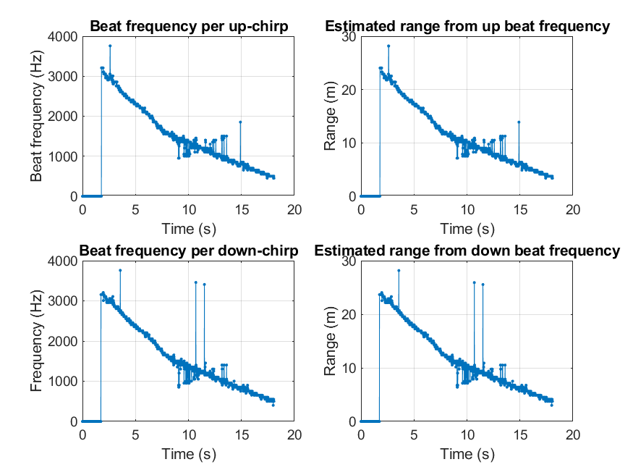
6. FMCW Radar Tasks. (Optional Tasks)
FMCW Mode: Simultaneous range and velocity estimation by only processing the up and down chirp for a single target.

Slide 27
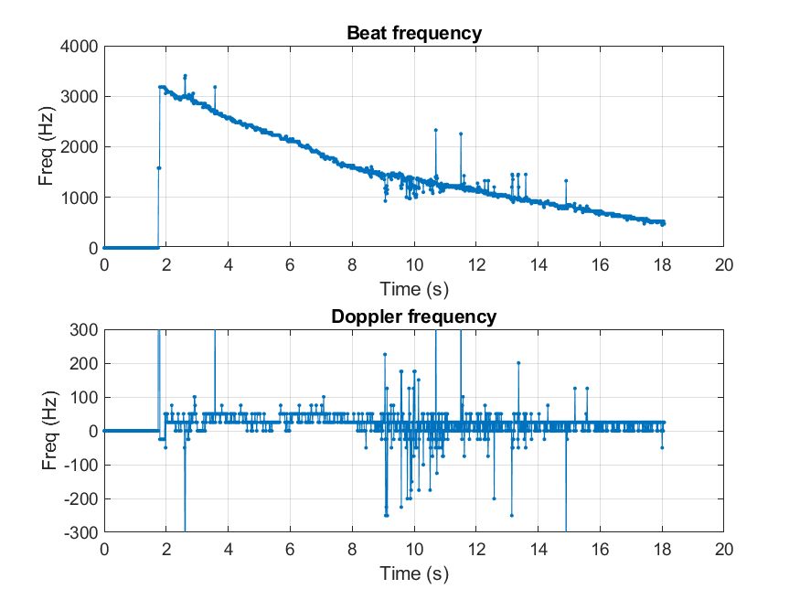
6. FMCW Radar Tasks. (Optional Tasks)
FMCW Mode: Simultaneous range and velocity estimation by only processing the up and down chirp for a single target.

Slide 28
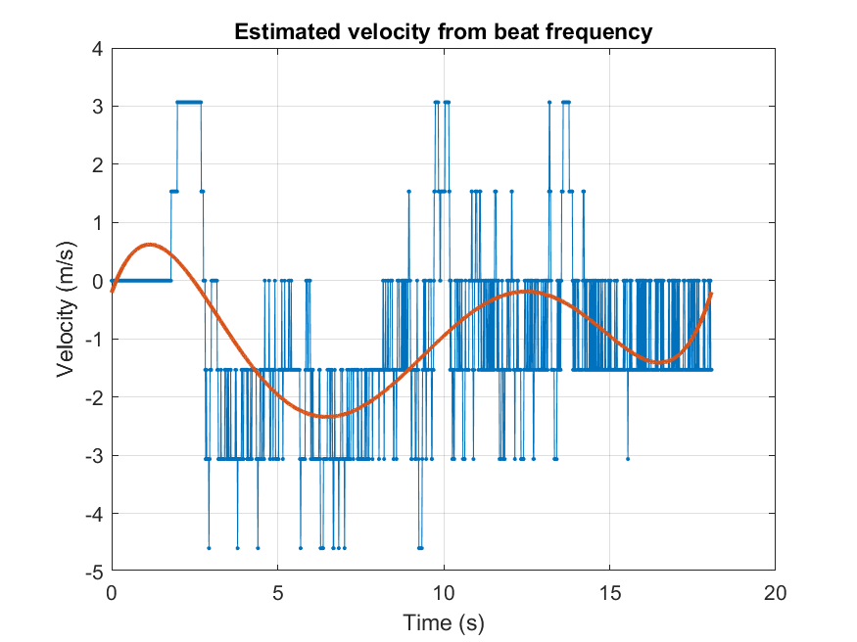
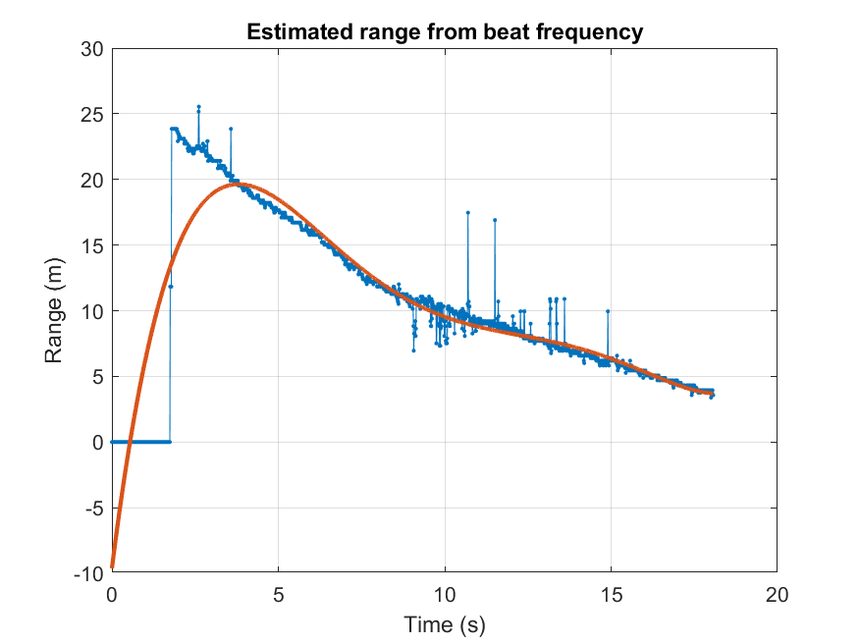
6. FMCW Radar Tasks. (Optional Tasks)
FMCW Mode: Simultaneous range and velocity estimation by only processing the up and down chirp for a single target.

Slide 29
Plan for Next Week (Sub-groups 1 and 2)
SAR image generation: Time Domain Correlation.
SAR image generation: Range Migration Algorithm (RMA).
SAR image generation using real targets: Range Migration Algorithm (RMA).
SAR image measurement: acquisition of the SAR image using the three available trihedral corner reflectors as targets.

