Slide 1
Search Results Evaluation
Bingyi Li

Slide 2
Overview
Search Results Evaluation
Given the input and resulting product descriptions from e-commerce sites, build a model to evaluate the relevance of search results
Relevance is measured by 1-4
1: Lowest relevance
4: Highest relevance
Workflow
Preprocessing
EDA
Feature Extraction: Count Vectorizer, TF-IDF Vectorizer
Model Selection: Random Forest, Support Vector Machine

Slide 3
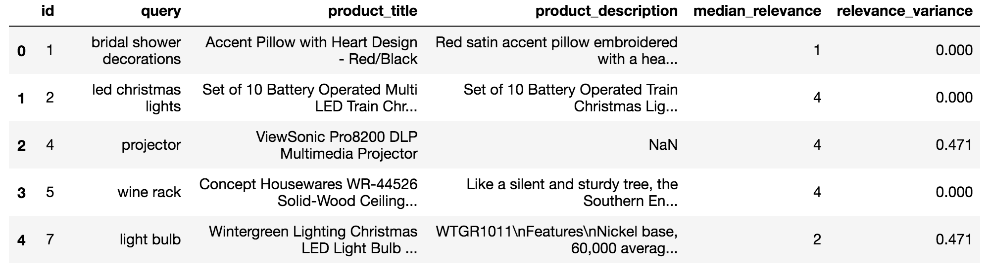
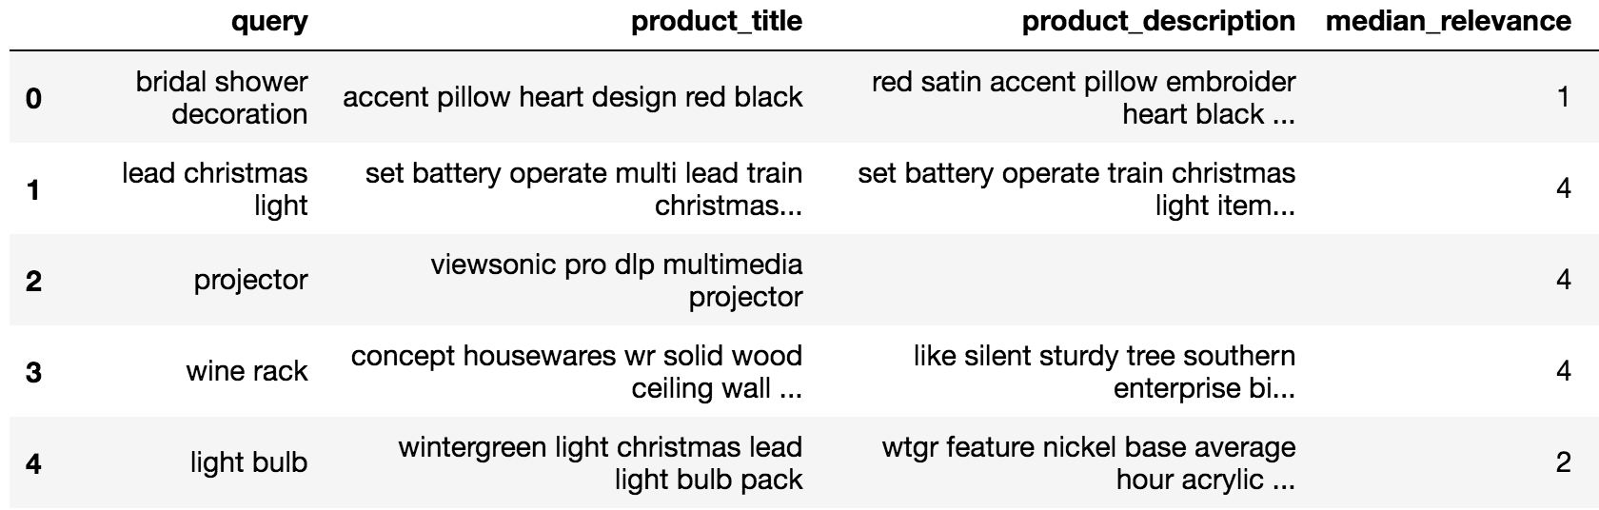
Data Preprocessing
Drop HTML format
Drop non-letters
Remove stop words
Lemmatize

Slide 4
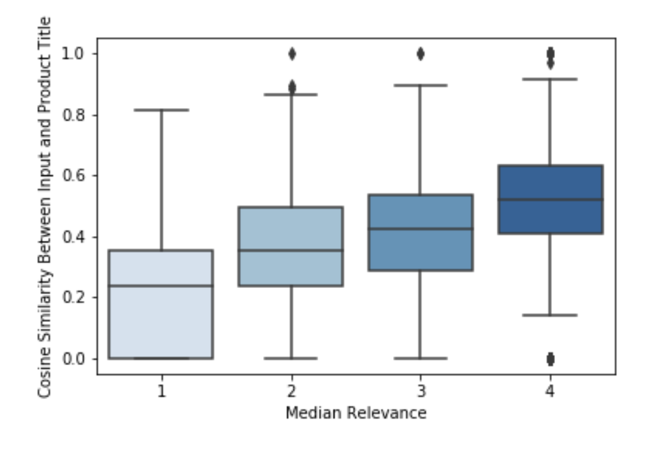
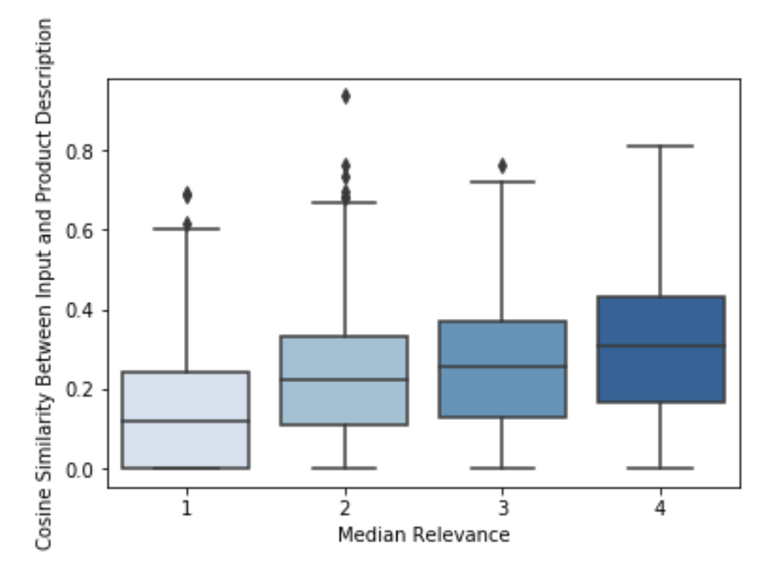
Early Exploratory Analysis
Cosine similarity between columns
Input vs. Product Title Input vs. Product Description

Slide 5
Modeling
Ideas
For each observation, combine ”input”, and ”product_title” to create a long text, then vectorize it. By doing so we can capture the similarities between these two columns
Example
Input: “projector”; Product_title: “viewsonic pro dlp multimedia projector”
Vectorized text will be longer in the dimension of “projector”
Input: “projector”; Product_title: “pillow with heart design”
Vectorized text will not be particularly longer in any dimension

Slide 6
Modeling
Result
Metric: Quadratic Weighted Kappa
Measures the agreement between two ratings
Typically varies from 0 to 1
0: Random agreement between raters
1: Complete agreement between raters
 | Count Vectorizer | TF-IDF Vectorizer
Random Forest | 0.43416 | 0.45534
SVM | 0.60345 | 0.59078

