Slide 1

FYP
APP MAKING
ShoPair
Technological and Higher Education Institute of Hong Kong
Faculty of Design and Environment
BSc (Hons) in Information and Communications Technology
Name: IU Cheuk Ying

Slide 2


-[
App Making - ShoPair
]-
Introduction
In the FYP project, an App is making to help Hong Kong citizen to have a platform to comparing the product price.
ShoPair
Searching system (APP)
Price comparing (APP)
Admin website

Slide 3
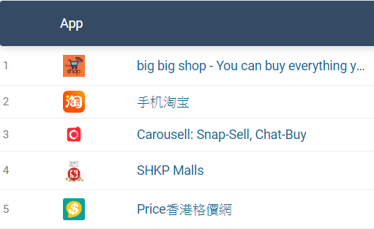
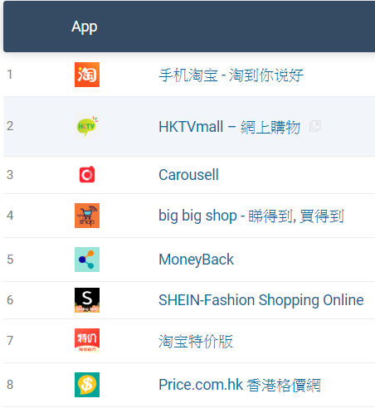
Literature Review
Price.com (in 2020):
Google Play Store → Top 5
iOS App Store → Top 8
Hong Kong People
most connected consumers in the world
Want competitive prices
iOS App Store
Google Play Store

Slide 4



Expedia
Price.com
Handy Lah
Expedia
Price.com
Handy Lah
Flight and hotel comparing website/App
Not for item compare
Not for local places
Product price comparing website/App
Not all category is included
Information only provided from the shop
Product price comparing website/App
Only 6 supermarkets is included
Information only provided from the shop

Slide 5

Project
-[
App Making - ShoPair
]-
Project Objectives
App (ShoPair)
Website (ShoPair)
Report

Slide 6




-[
App Making - ShoPair
]-
Decision of software tools
React Native
HBS
Mongodb
Node.js
Android App
Website
Database
Server

Slide 7
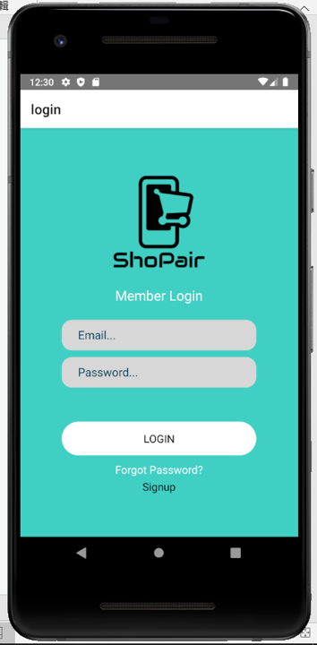
-[
App Making - ShoPair
]-
App
App Introduction
Client
Login, Searching, Create
Server
Linkage back and front end
API linage (APP)
Database
Saving all the data
Website
Admin
Login, Create, Update

Slide 8
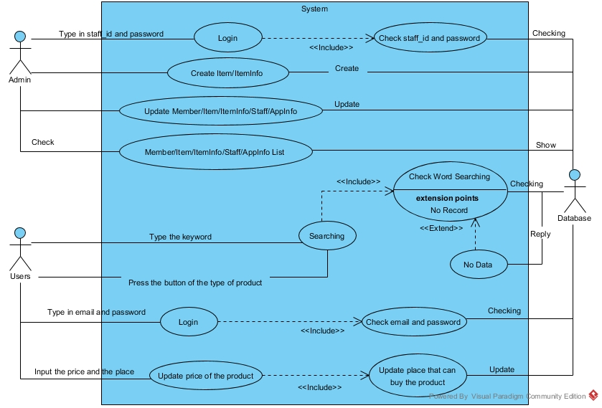
-[
App Making - ShoPair
]-
Use Case

Slide 9
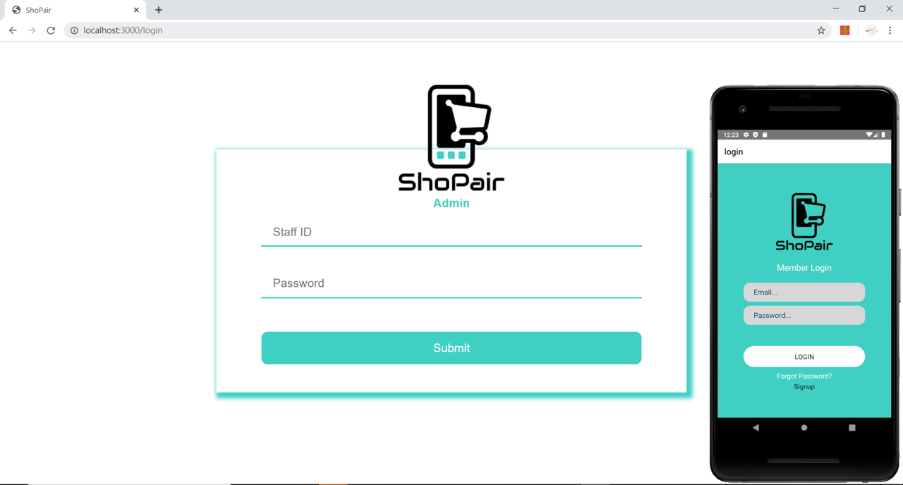
APP DEMO TIME
App Making ShoPair

Slide 10



-[
App Making - ShoPair
]-
Problems / difficulties encountered
Time
Limitation of time
Need great improvement
Knowledge
React native

Slide 11

-[
App Making - ShoPair
]-
Limitations of the system
Database
Not much data
Time to handle

Slide 12

-[
App Making - ShoPair
]-
Future Improvement
AI object recognition (App)
Mapping (App)
Top Item (App)
Recommendation (App)
History (App)
Image Improvement (App)
User Profile (App)
Dashboard (Website)
API (Database)

Slide 13


Slide 14

Q & A

