Slide 1
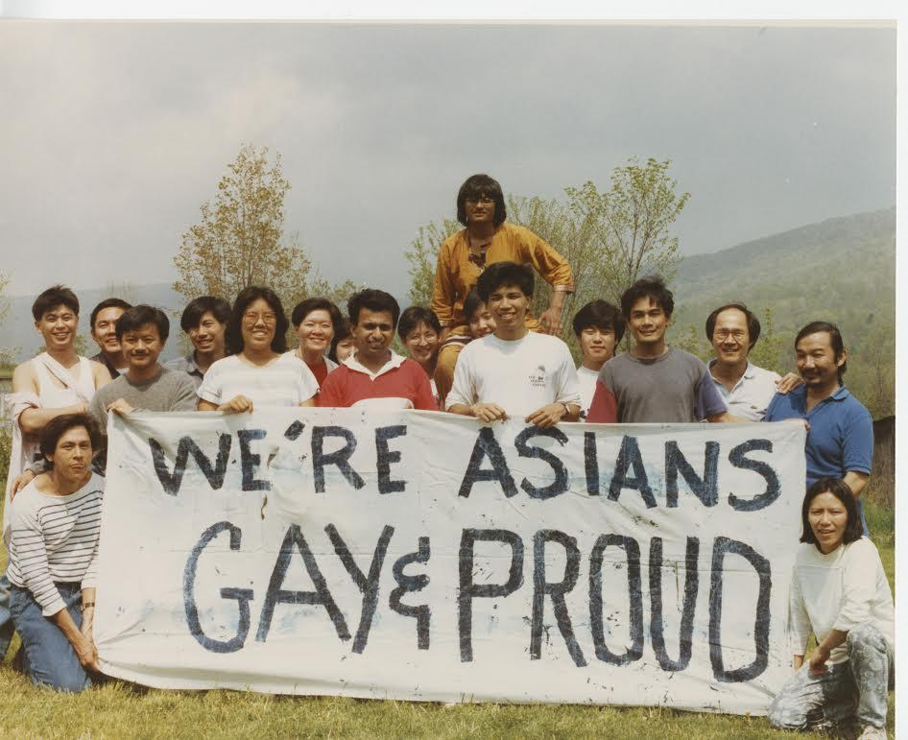
From despair to hope:
sentiment analysis of queer and trans API blogs
Binh Hoang

Slide 2


Introduction
Crowdsourced ideas from editors and contributors:
Engagement
Sentiment

Slide 3
Data
34
+
=
376 blogs
342

Slide 4
Methodology
Data
Storage
Analysis
Viz
BeautifulSoup
Google Analytics
MongoDB
NLTK
Spacy
Vader
Scikit-learn
Seaborn
Plotly

Slide 5
t-SNE: visualizing topic clusters

Slide 6
Topic popularity
Topic | Unique Pageviews/Month
Friendship | 3.14
Racism | 2.02
Family | 1.79
Career | 1.43
Body image | 0.97
Identity | 0.92
Intimacy/sex | 0.84
Relationships | 0.22

Slide 7

Topic sentiment using VADER
Why are these scores all positive? 😮
Topic | Mean Sentiment Score
Identity | 0.23
Career | 0.19
Relationships | 0.19
Friendship | 0.17
Body image | 0.17
Family | 0.10
Intimacy/sex | 0.10
Racism | 0.09
VADER
Score range: -1 to 1
😄 Positive sentiment: >=0.05
😐 Neutral sentiment: -0.05 – 0.05
😭 Negative sentiment: <= -0.05

Slide 8
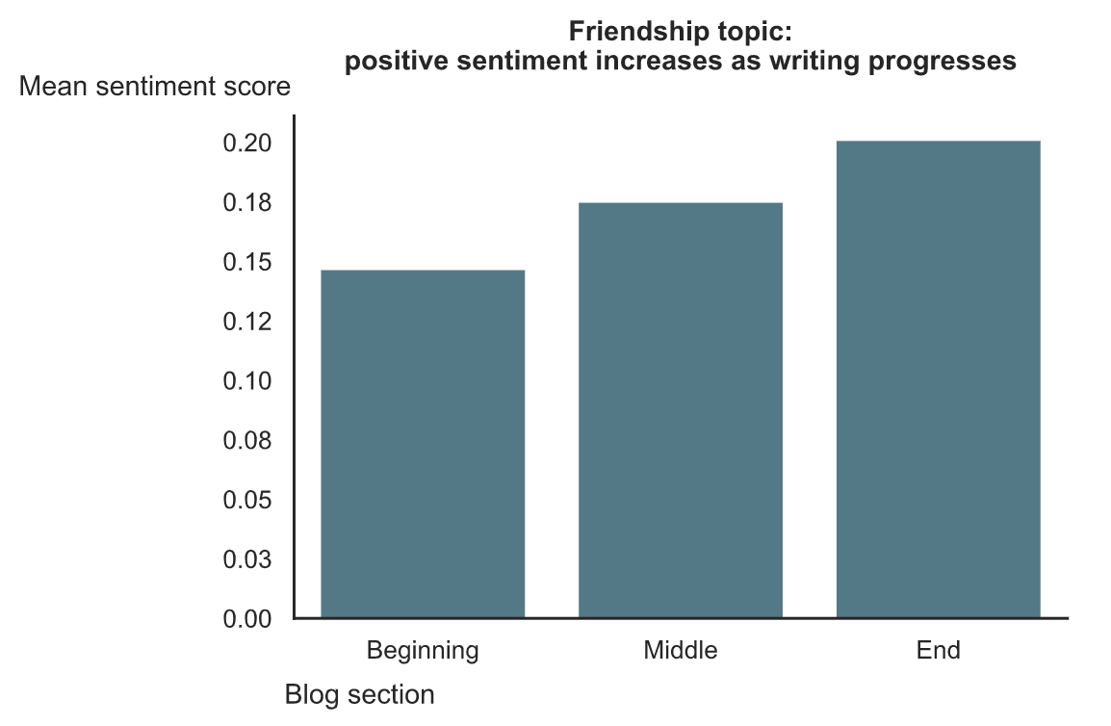
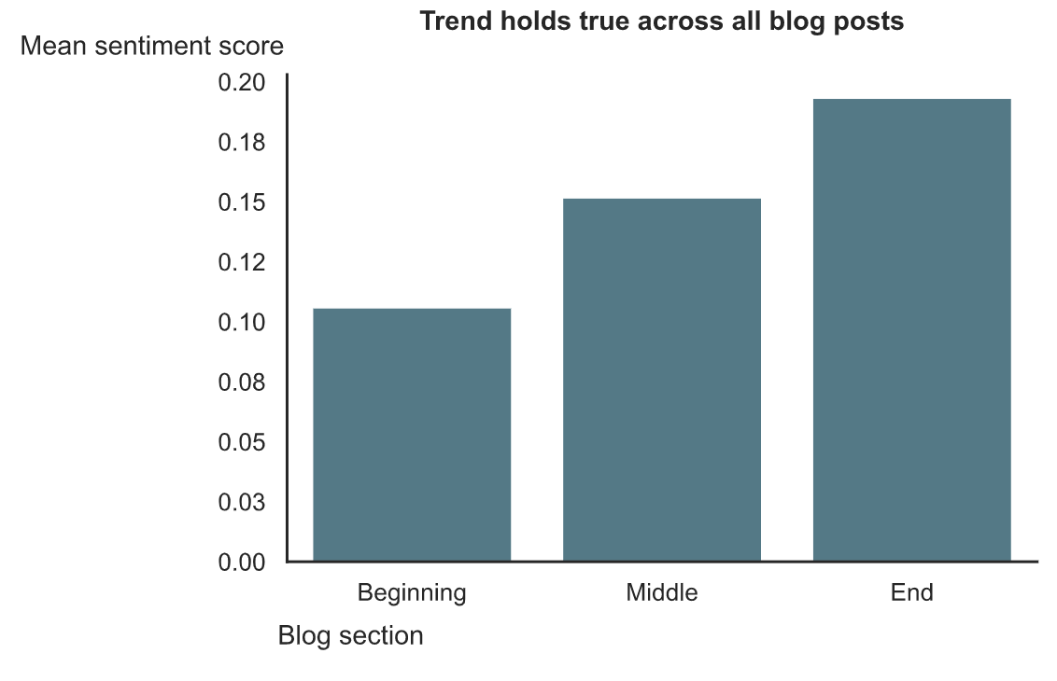
Sectional sentiment analysis

Slide 9
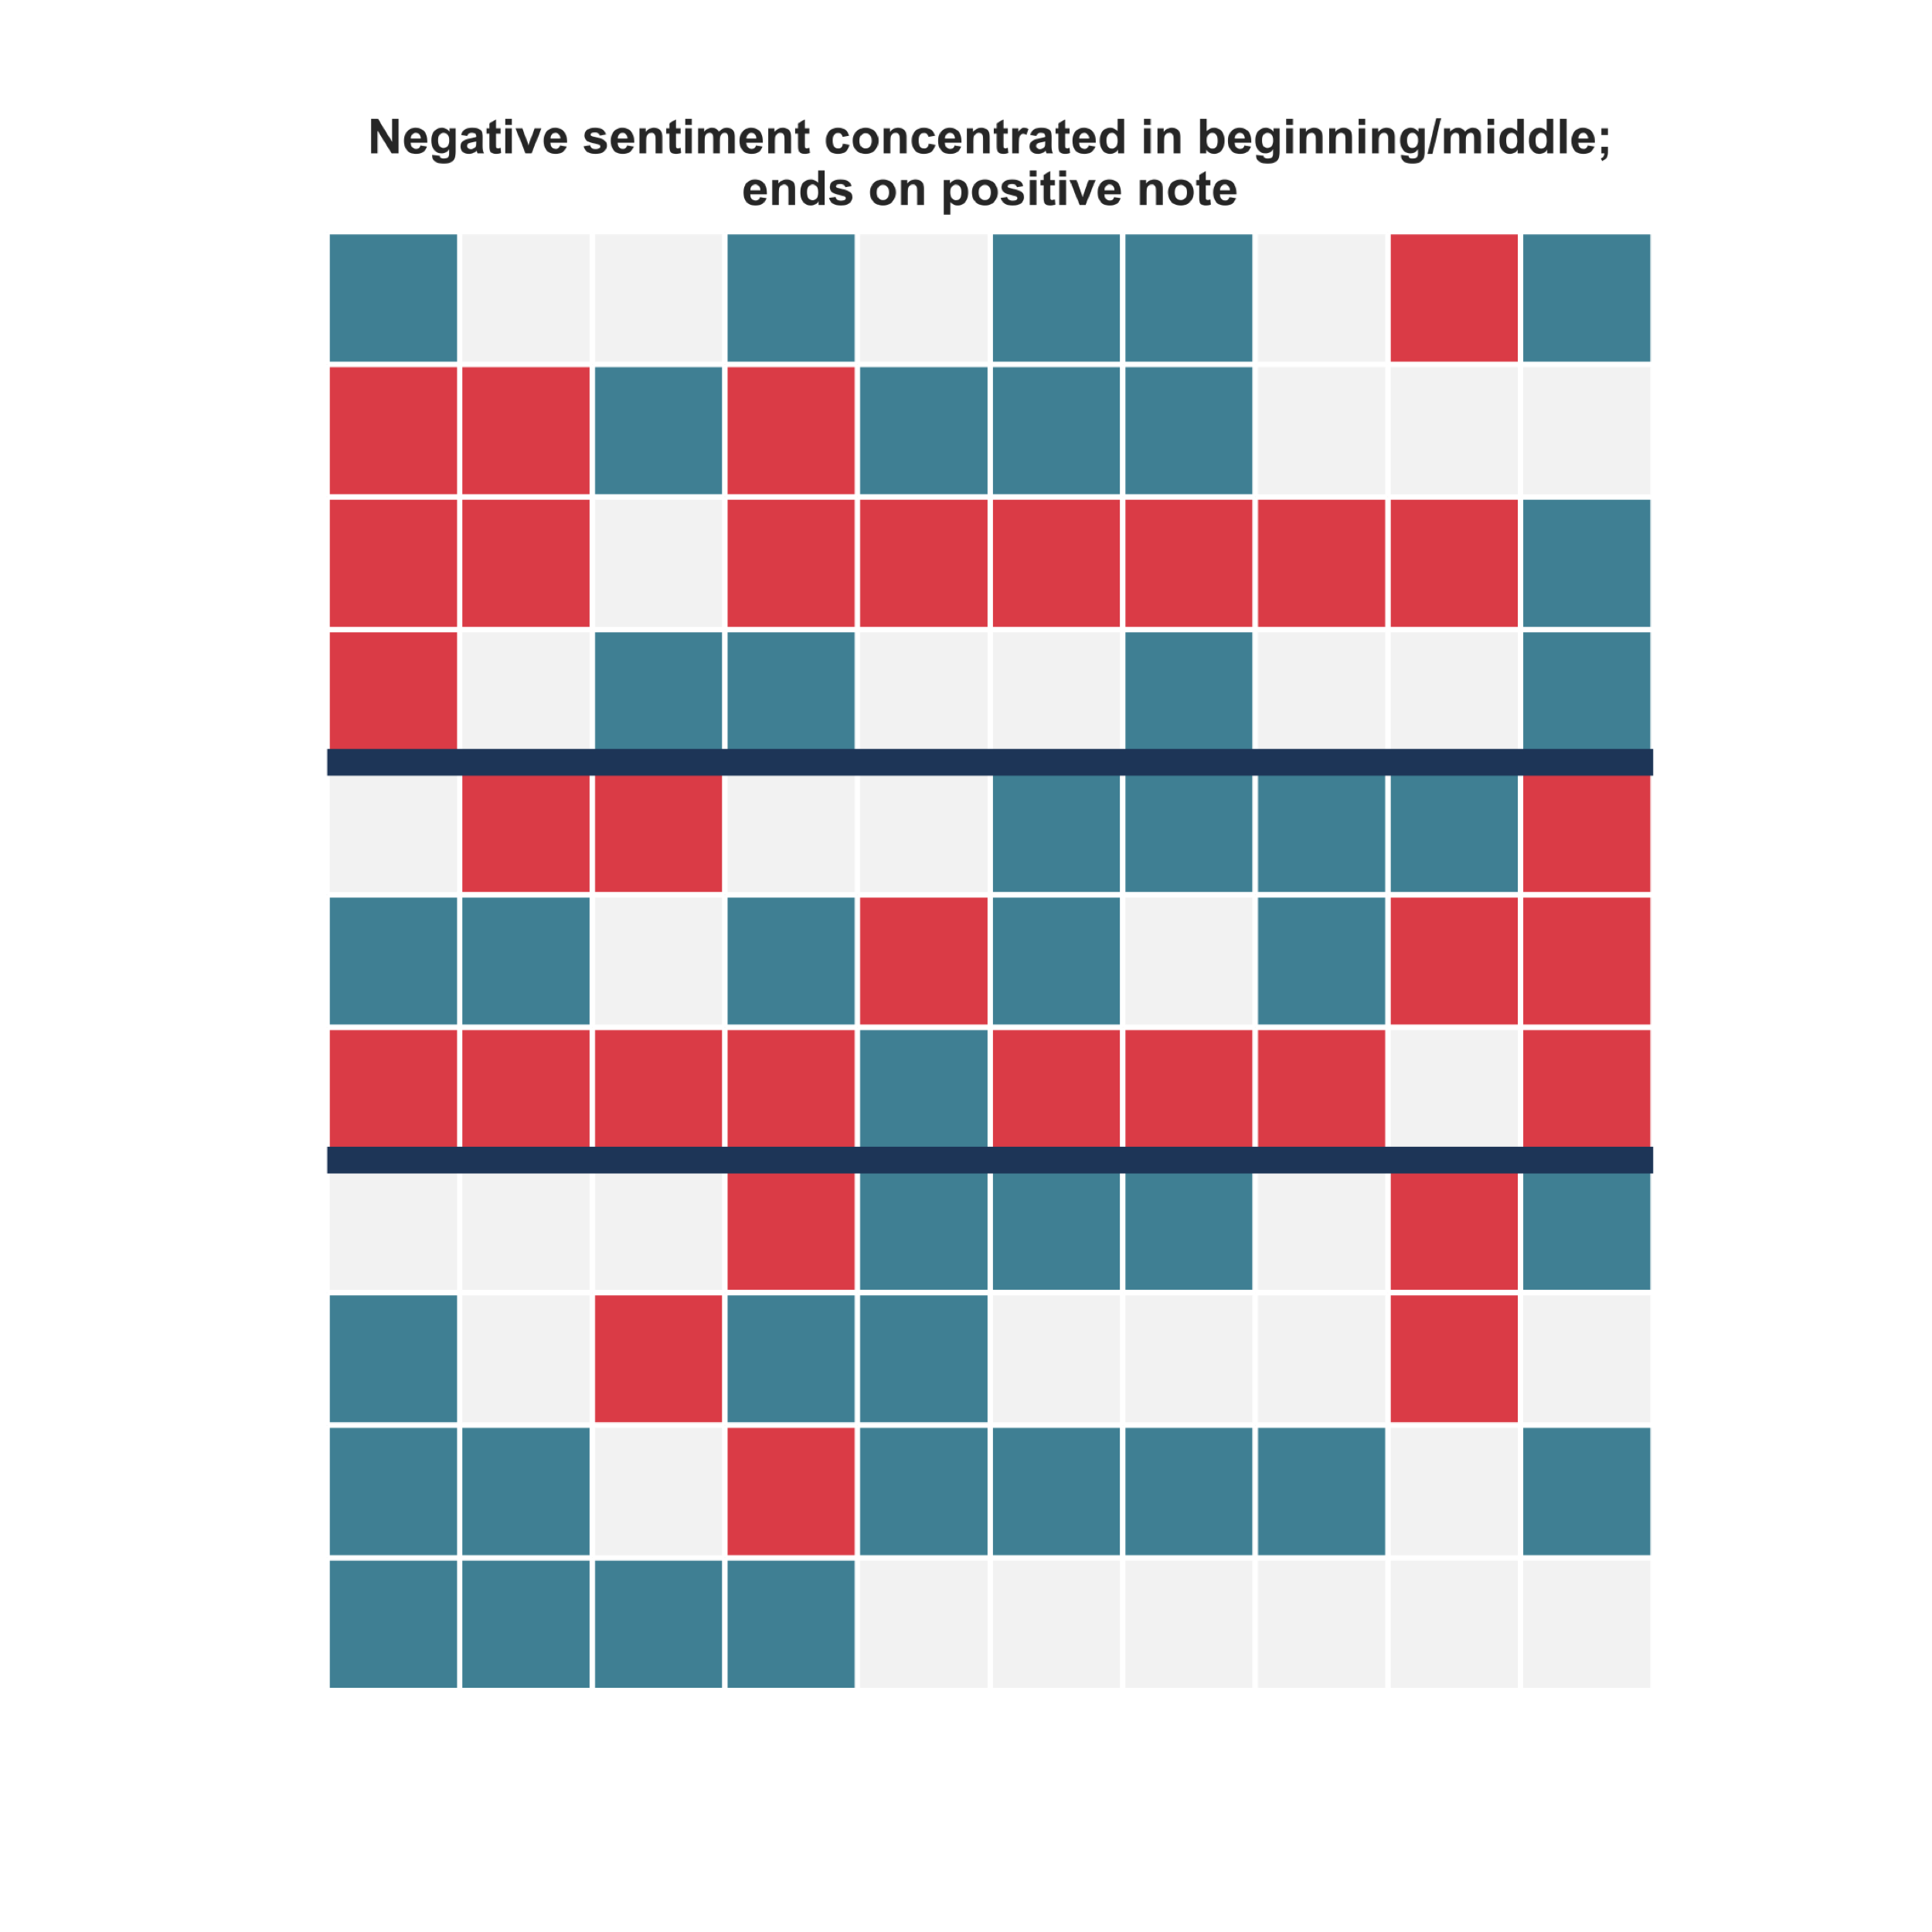
Sentiment map: gaysian diary entry #5
Sentence order: →↓
Instead, I found my first heartbreaks, shame, meaningless hookups and fear of catching some unwanted bugs.
Beginning
😄
😐
😭
I was hurt, jaded and cynical,
and I hated gay guys.
Middle
…I hope the next generation of gaysians coming to terms with their identities will have different, more positive and supportive “firsts”.
End

Slide 10


Conclusion
The upward trend in sentiment says something about the queer and trans API community (and possibly about humans in general), that despite the hardships that a marginalized community faces, many still hold hope for a better tomorrow.
Beginning
End

Slide 11
Future work
Scale up to include other social media posts: Twitter, Facebook, Reddit
Compare and contrast blogs of queer and trans API community with other queer and trans communities’

Slide 12
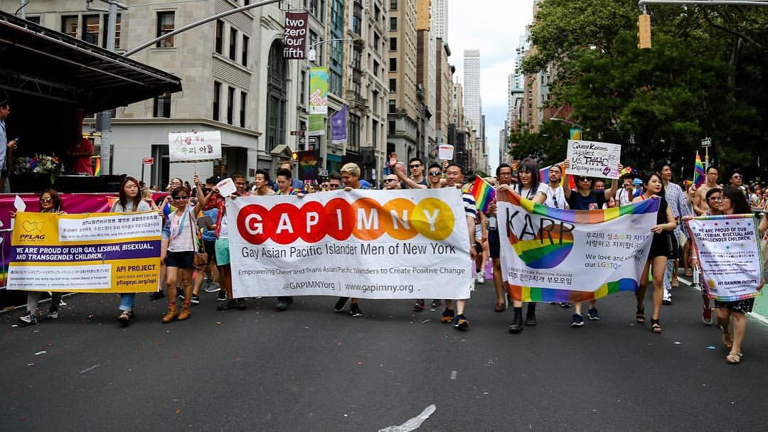
Thank you!

