Slide 1
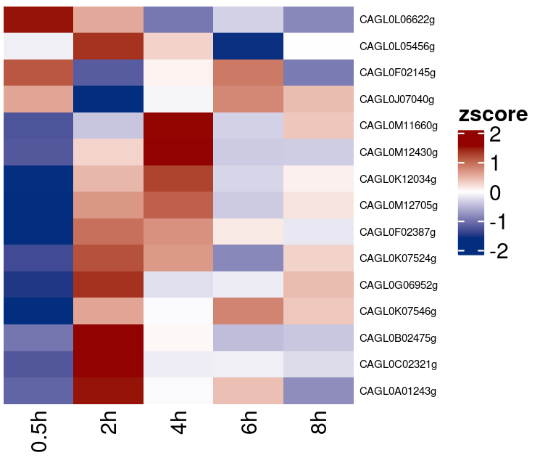
Table shows RPKM of the normalized RNA pol ii ChIPseq signals
Heatmap shows Z-score of the normalized RNA pol ii ChIPseq signals
gene | 0h | 2h | 4h | 6h | 8h
CAGL0B02475g | 32.1952 | 116.5871 | 63.9359 | 48.5536 | 50.7094
CAGL0A01243g | 8.868 | 10.7044 | 9.6167 | 9.9388 | 9.0841
CAGL0M11660g | 16.1961 | 21.6179 | 33.9129 | 22.0989 | 26.4362
CAGL0L05456g | 17.7263 | 27.5681 | 20.4232 | 8.0991 | 18.4136
CAGL0C02321g | 7.8456 | 50.2444 | 23.9024 | 24.1138 | 22.1506
CAGL0G06952g | 13.2202 | 24.0567 | 18.0341 | 18.3728 | 20.5772
CAGL0L06622g | 22.4617 | 20.3381 | 16.8661 | 18.3264 | 17.1482
CAGL0M12705g | 1.4408 | 27.082 | 31.2826 | 15.3328 | 21.3023
CAGL0F02145g | 16.2528 | 12.1414 | 14.3745 | 15.8338 | 12.58
CAGL0J07040g | 14.9456 | 6.2076 | 12.4889 | 15.6957 | 14.3507
CAGL0K12034g | 20.2943 | 31.5852 | 35.9469 | 27.4111 | 29.4889
CAGL0K07524g | 4.2808 | 20.3267 | 17.1907 | 7.4264 | 14.6469
CAGL0K07546g | 0 | 17.8386 | 13.1107 | 19.5153 | 16.092
CAGL0F02387g | 12.3625 | 33.7187 | 31.9366 | 27.0751 | 24.6927
CAGL0M12430g | 52.0388 | 96.2362 | 135.4975 | 77.3348 | 77.8468

Slide 2
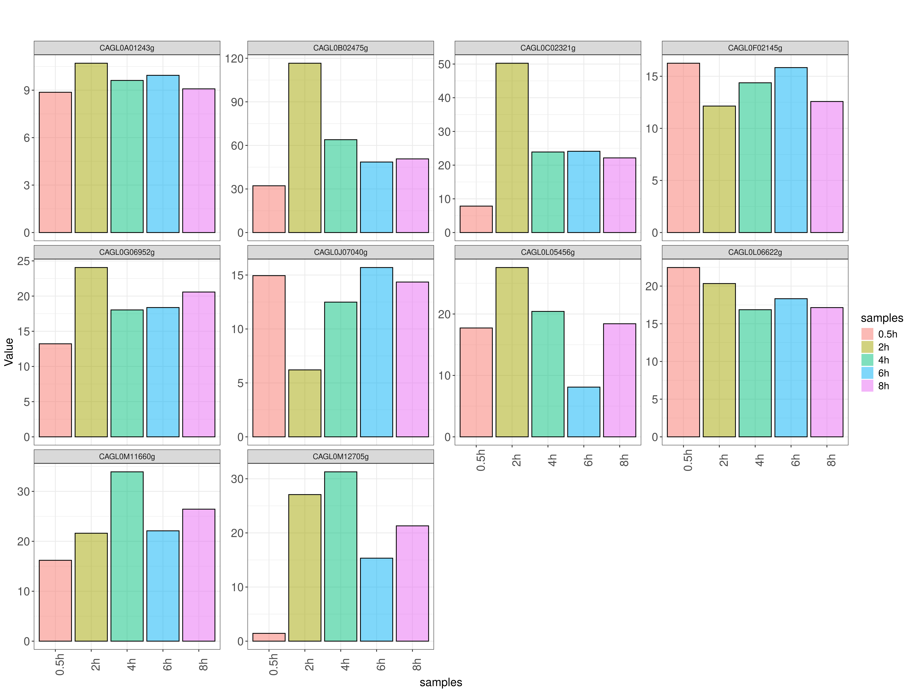
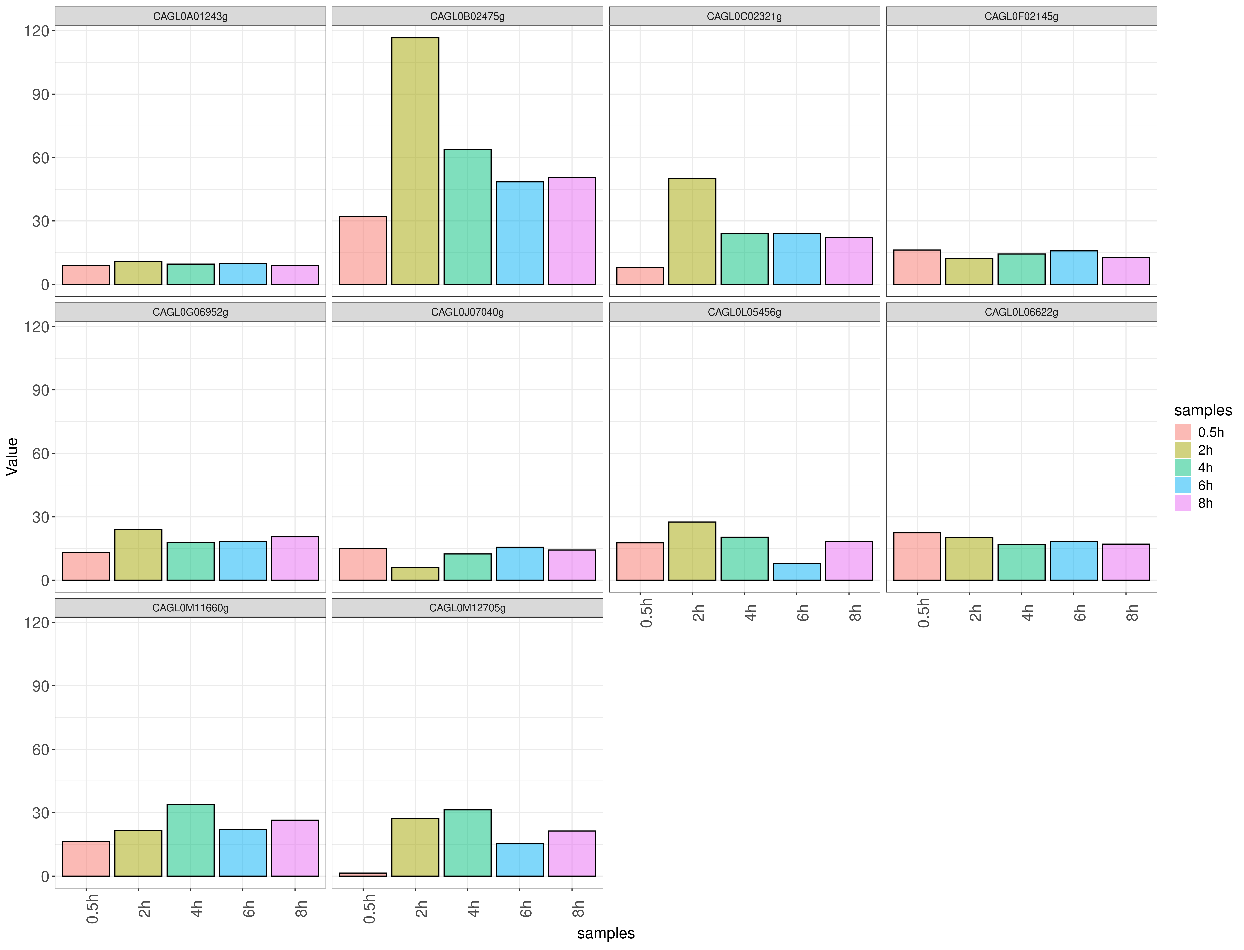
Bar chart with fixed Y-axis shows RPKM of normalized RNA pol II ChIPseq signals
Bar chart with free Y-axis shows RPKM of normalized RNA pol II ChIPseq signals

