Slide 1
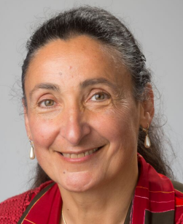
ChaLearn
HEP competitions
for
Isabelle Guyon, ChaLearn and
LRI, Université Paris Sud, Orsay
http://chalearn.org

Slide 2
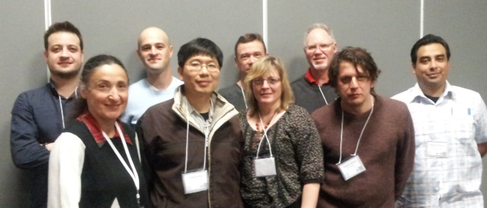
What is Chalearn?
California non-profit (US tax exempt).
Organizes challenges since 2005.
Funded by government grants and industry sponsors.
10 directors; 4 officers; dozens of collaborators.
CiML book series (JMLR reprints) and NIPS workshops.
Now 3 to 4 challenges per year in 4 main tracks:
  Automatic Machine Learning.
  Computer vision: Looking At People (LAP) challenges.
  Causality and network reconstruction.
  High Energy Physics.
Challenges in Machine Learning
http://chalearn.org

Slide 3
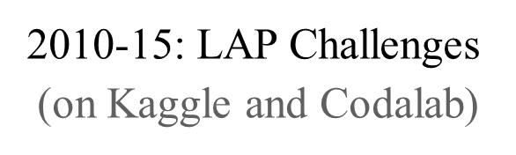
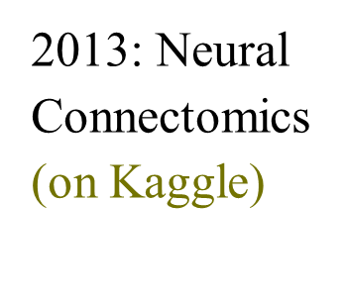

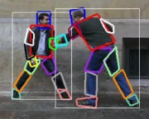
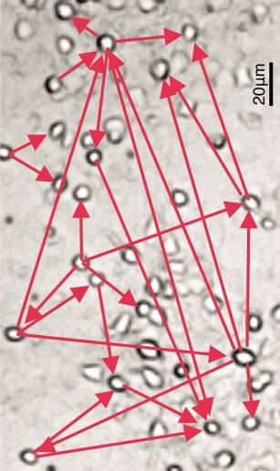


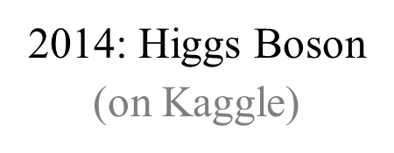
Recent challenges
Challenges in Machine Learning
http://chalearn.org

Slide 4
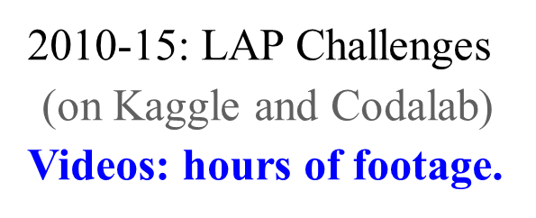
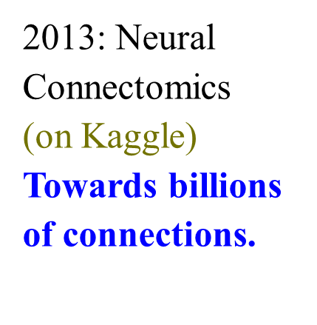
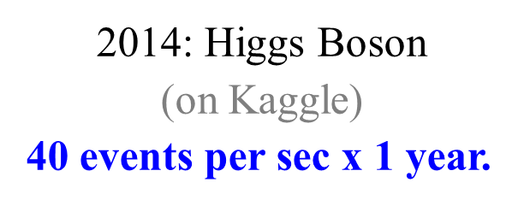
Result submission
Code
Challenges in Machine Learning
http://chalearn.org

Slide 5
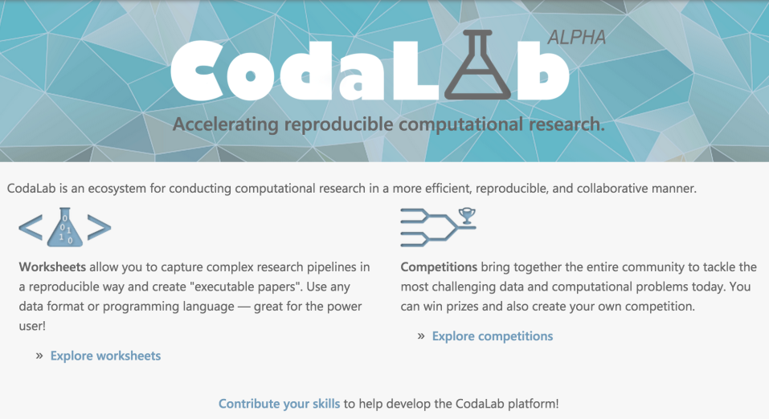



Code submission on Codalab
BIG
DATA
Tasks
Code
Scores
User
Results
Challenges in Machine Learning
http://chalearn.org

Slide 6


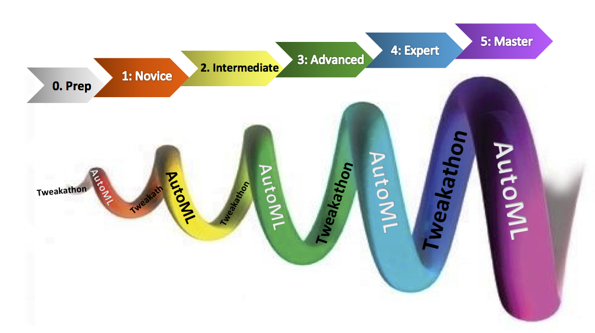






Testing code submission
AutoML Challenge
Fully automatic machine learning
without ANY human intervention
>500 participants
automl.chalearn.org
December 2014 – January 2016
$30,000 in prizes

Slide 7
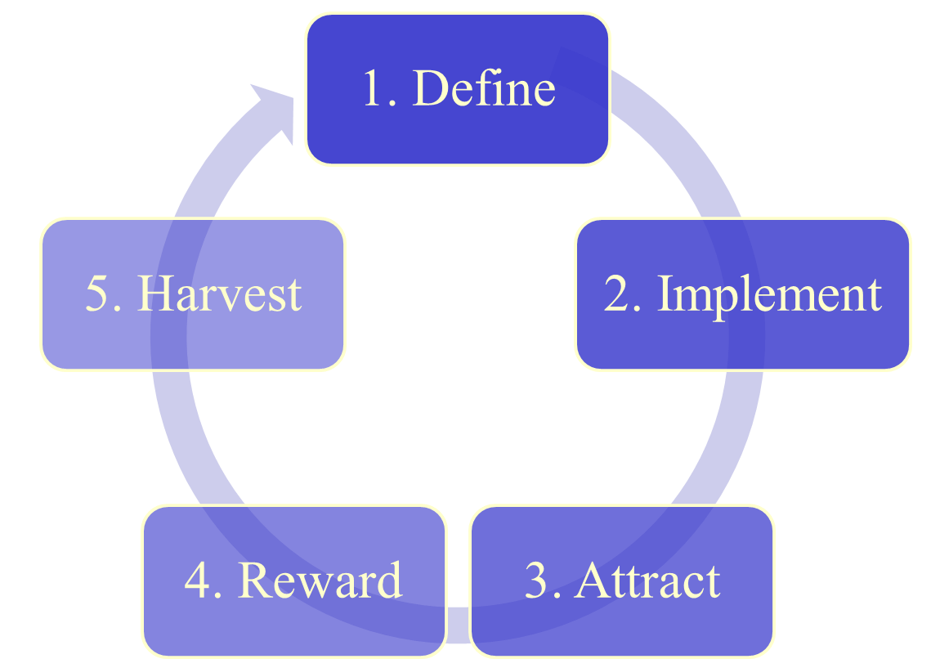





Challenge design
Challenges in Machine Learning
http://chalearn.org

Slide 8
1. Define
High impact problem.
Good data.
Enough data.
Clear objective.
Good metric.
Simple rules.
No IP contingencies
(except for winners).
Challenges in Machine Learning
http://chalearn.org

Slide 9
2. Implement
Three-way data split (train/valid/test):
  Immediate feed-back on validation set.
  Final results on test set.
Encourage sharing and novelty (coopetition):
  Forum.
  Worksheets or scripts.
  Monitor downloads / likes / thanks.
Type of submission:
  Result.
  Code.
Beta testing.
Challenges in Machine Learning
http://chalearn.org

Slide 10
3. Attract
Exciting problem description.
Tutorial.
Video.
Starting kit.
Bootcamp/hackathon.
Publication outlets.
Advertising.
Gamification.
Challenges in Machine Learning
http://chalearn.org

Slide 11
4. Reward
Multiple prizes (phases and/or tracks).
Medium size prize pool (~ $5000-$10,000).
Travel awards.
Best paper awards.
Give credit and rewards to all actors.
Challenges in Machine Learning
http://chalearn.org

Slide 12
5. Harvest
Open-source code (winners).
Fact sheets.
Post-challenge analyses.
Workshops (broader scope than just the challenge theme).
Proceedings.
Crowd-sourced paper.
Challenges in Machine Learning
http://chalearn.org

Slide 13
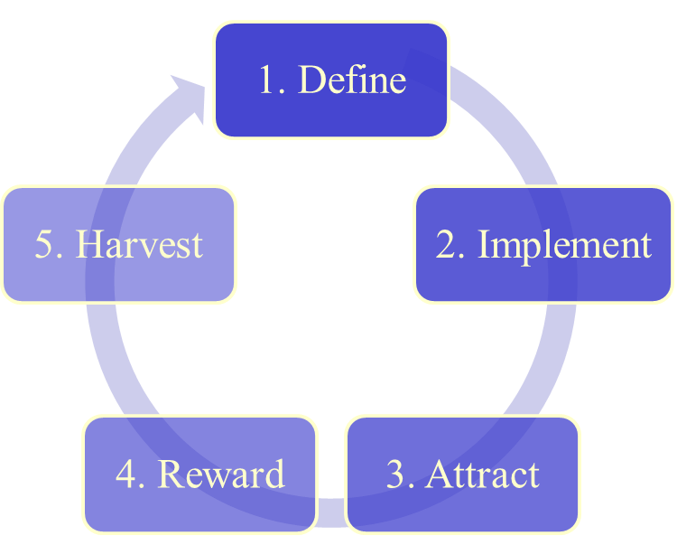
Build/maintain/expand
Create recurring events
Challenges in Machine Learning
http://chalearn.org

Slide 14








Thank you!
Directors
Kristin Bennett, Rensselaer Polytechnic Institute, New-York, USA
Gideon Dror, Academic college of Tel-Aviv Yaffo, Israel
Hugo-Jair Escalante Balderas, Nat. Institute of Astrophysics,
Optics and Electronics (INAOE), Mexico
Sergio Escalera, University of Barcelona, Spain
Chih-Jen Lin, National Taiwan University, Taiwan
Florin Popescu, Fraunhofer Institute, Berlin, Germany
Mehreen Saeed, FAST, National University of Computer and Emerging Sciences, Lahore Campus, Pakistan
Danny Silver, Acadia University, Canada
Alexander Statnikov, New York University, New-York, USA
Ioannis Tsamardinos, University of Crete, Greece
Officers
President: Isabelle Guyon, ClopiNet, California, USA
Vice-president: Gideon Dror, Academic college of Tel-Aviv Yaffo, Israel
Secretary: Vincent Lemaire, Orange Labs, France
Treasurer: Kristin Bennett, RPI, USA
Sponsors
http://automl.chalearn.org

