Slide 1





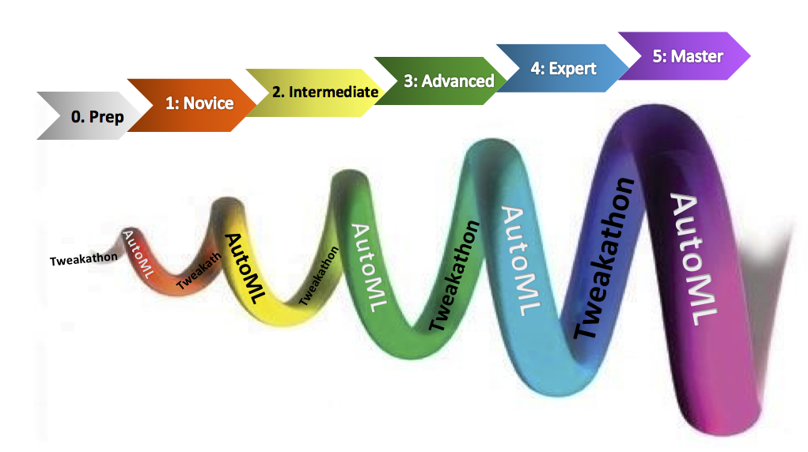
AutoML challenge
Isabelle Guyon
automl@ChaLearn.org

Slide 2
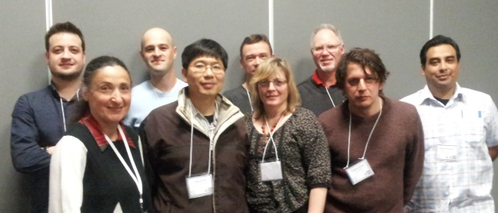
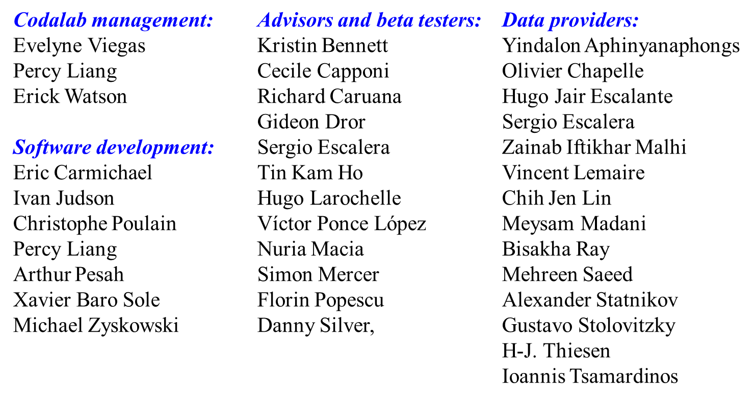
ChaLearn &
Codalab
Challenges in Machine Learning
http://chalearn.org

Slide 3
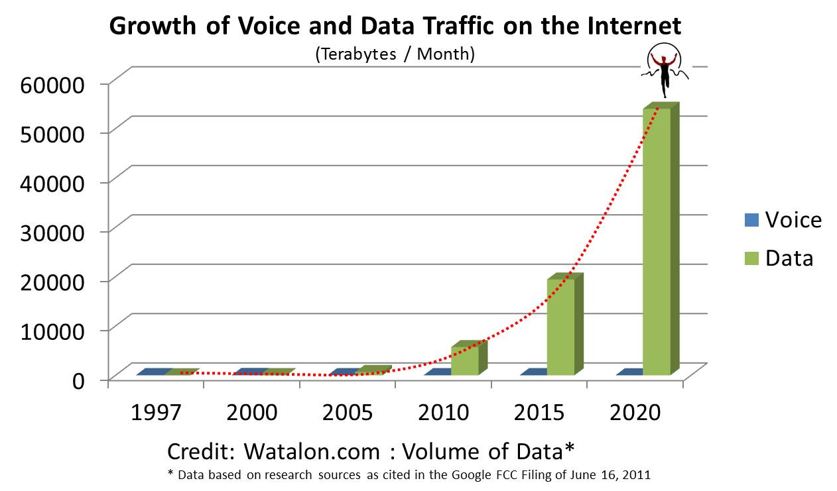
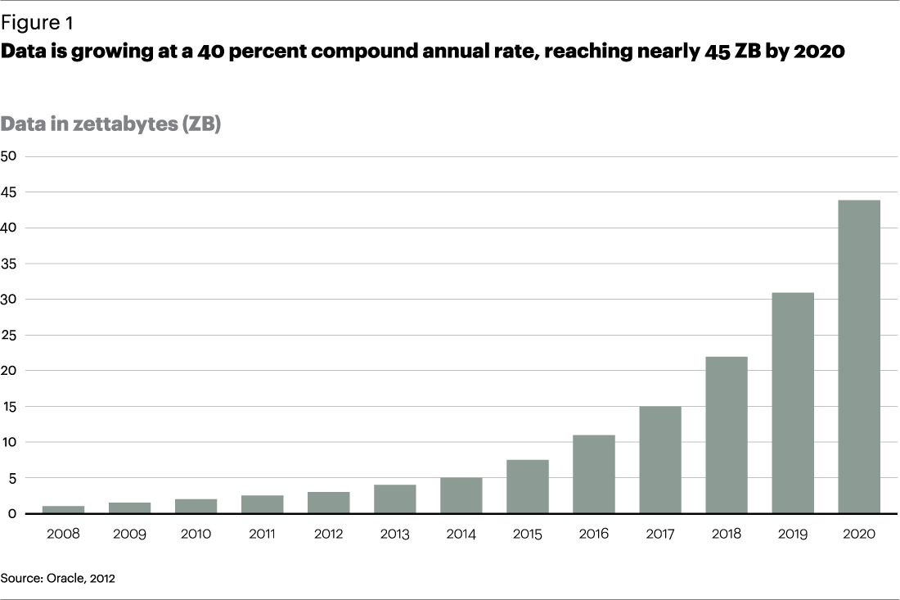
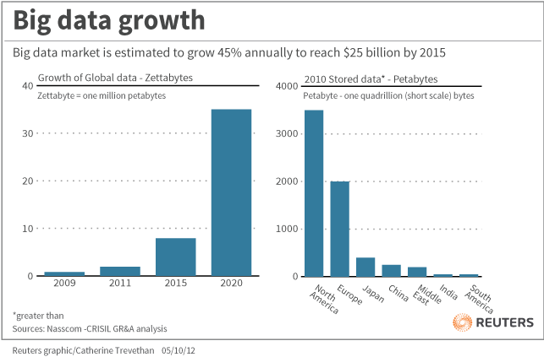
Big data growth
ChaLearn AutoML challenge
http://automl.chalearn.org

Slide 4
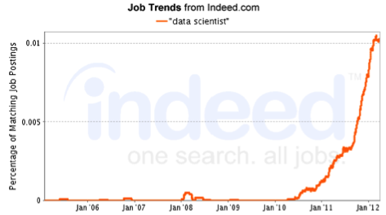
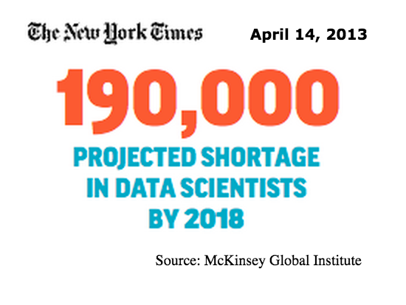
Data scientist is the sexiest job of the 21st century
ChaLearn AutoML challenge
http://automl.chalearn.org

Slide 5
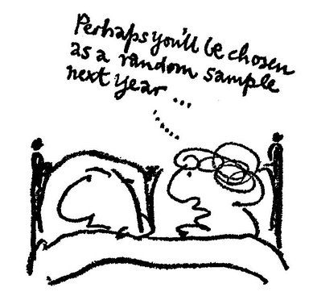
Data scientist is the sexiest job of the 21st century
Davenport and Patil, Harvard Business Review, 2012
ChaLearn AutoML challenge
http://automl.chalearn.org

Slide 6
The dream
AutoML
black box
Trained
model
TRAINING
DATA
Answer y
?
Query x
ChaLearn AutoML challenge
http://automl.chalearn.org

Slide 7
The dream
AutoML
black box
Trained
model
TRAINING
DATA
Answer y
?
Query x
ChaLearn AutoML challenge
http://automl.chalearn.org

Slide 8

The REALITY
Hyper-parameter tuning
Trained
model
TRAINING
DATA
Answer y
?
Query x
ChaLearn AutoML challenge
http://automl.chalearn.org

Slide 9
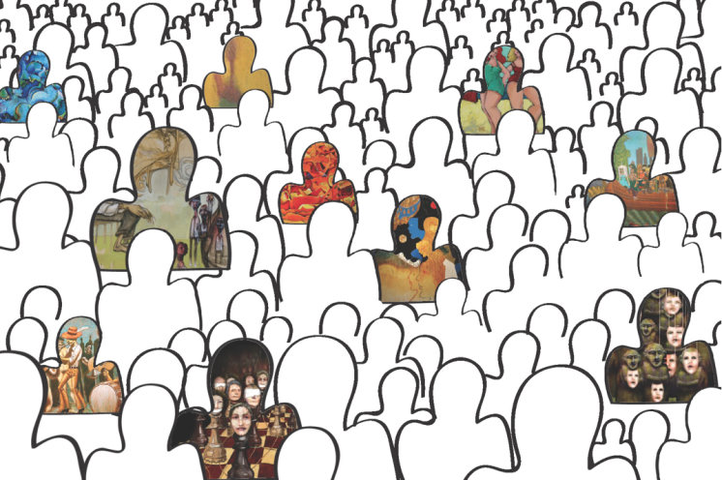
ChaLearn ML challenges
Trained
model
Crowd
TRAINING
DATA
Answer y
?
Query x
ChaLearn AutoML challenge
http://automl.chalearn.org

Slide 10

AutoML challenge
AutoML
black box
Trained
model
Crowd
TRAINING
DATA
Answer y
?
Query x
ChaLearn AutoML challenge
http://automl.chalearn.org

Slide 11

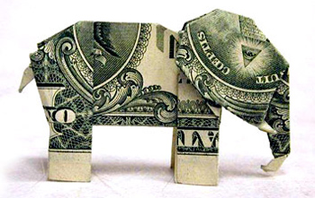

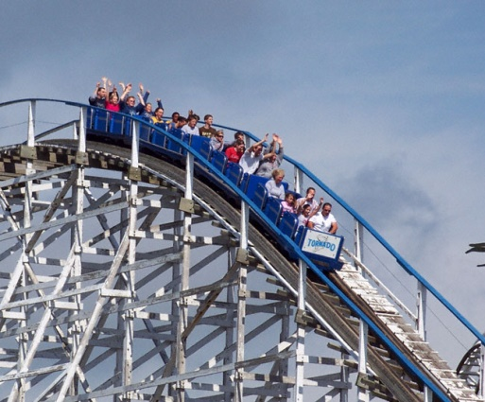

Why would the crowd do that?
$30000
Learning
Fame
Fun
Workshop
Dream
ChaLearn AutoML challenge
http://automl.chalearn.org

Slide 12
What tasks?
INPUT = I.I.D. data in feature representation, but:
  Sparse or full matrices.
  Numerical/categorical/binary variables.
  Missing values or not.
  Noisy data or not.
  Various proportions Ntrain / Nfeat.
OUPUT = one target, but:
  Binary (two-classes, balanced or not).
  Categorical (multi-class: tens, hundreds of classes)
  Multi-label.
  Regression.
OBJECTIVE = miscellaneous loss funtions.
COMPUTATIONAL RESOURCES = fixed.
Challenges in Machine Learning
http://chalearn.org

Slide 13
What data?
30 datasets spanning various domains:
pharmacology, medicine, marketing, ecology, text, image, video and speech processing.
6 rounds (x 5 datasets).
Early phases: partially
“recycled data”.
Late phases: novel data.
Medium hard tasks (10-20% error) to separate algorithms best.
Large test sets (~>10,000 examples) to ensure statistical significance.
Challenges in Machine Learning
http://chalearn.org

Slide 14

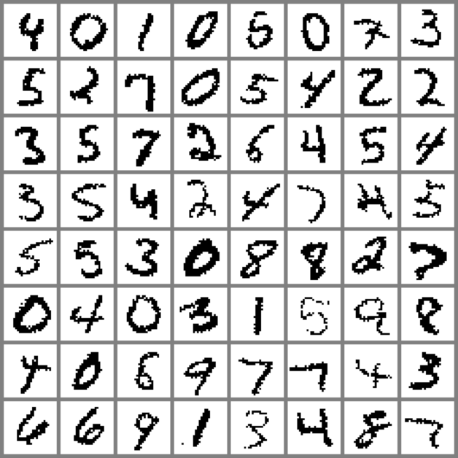
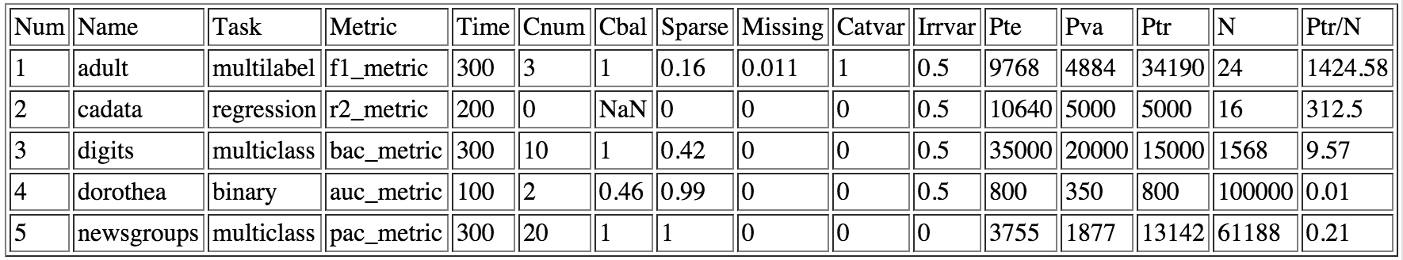
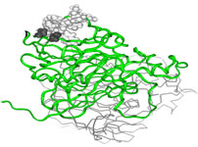
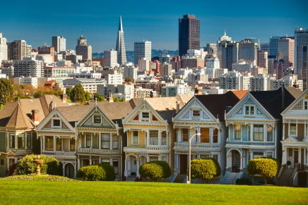
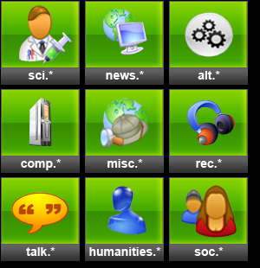
Round O: sample data
MNIST HWR.
LeCun, Cortes, and Burges (1998)
US census 1994 (Kohavi and Becker)
20 NewsGroups.
Lang and Mitchell
(1997)
Pharmacology.
DuPont Pharmaceuticals (2001)
House prices.
Pace and Barry (1997)
ChaLearn AutoML challenge
http://automl.chalearn.org
Notes:
adult = Dense data; categorical variables; multilabel classification: A rehash of the Adult 1994 census dataset (from UCI repository), donated by Ronny Kohavi and Barry Becker.
cadata = Regression data: LibSVM dataset originally from Statlib house prices, Pace and Barry (1997).
digits = Semi-dense data; multiclass classification: A dataset carved out of the MNIST dataset from LeCun, Cortes, and Burges (1998) of handwritten digits, extracted from a larger benchmark collected by the US National Institite of Standards and Technologies (NIST).
dorothea = Sparse binary data; binary classification: Dataset prepared for the NIPS 2003 feature selection challenge from one of the KDD (Knowledge Discovery in Data Mining) Cup 2001 tasks. DuPont Pharmaceuticals graciously provided this data set for the KDD Cup 2001 competition. All publications referring to analysis of this data set should acknowledge DuPont Pharmaceuticals Research Laboratories and KDD Cup 2001.
newsgroups = Sparse data; multiclass classification: The 20 NewsGroups data set (Ken Lang and Tom Mitchell (1997)). One of the most used data sets for text categorization available in the UCI repository.

Slide 15
Next rounds
NOVICE: Binary classification..
INTERMEDIATE: Multiclass classification.
ADVANCED: Multiclass and multilabel.
EXPERT: Classification and regression.
MASTER: All of the above.
ChaLearn AutoML challenge
http://automl.chalearn.org

Slide 16
What’s exciting?
Intellectually challenging:
  Completely autonomous learner
  Beat the “no free lunch theorem”
  Model selection
  Meta learning
  Two-level objectives
  Any overall objective
  Any time
Practically important:
  Improve cost effectiveness
  Improve reliability
  Reach out to more applications
Challenges in Machine Learning
http://chalearn.org

Slide 17
How?
AutoML: Automatic code execution on Codalab platform.
Tweakathon: Result or code submission.
To earn prizes: code should be made open source.
Challenges in Machine Learning
http://chalearn.org

Slide 18
How?
ROUND
PHASE
SUBMISSION /
EVALUATION
n-1
n
n+1
Challenges in Machine Learning
http://chalearn.org

Slide 19
How?
ROUND
n-1
Blind test on fresh data
AutoML [+]
n
n+1
Challenges in Machine Learning
http://chalearn.org

Slide 20
How?
ROUND
PHASE
SUBMISSION /
EVALUATION
n-1
Code
Blind test on fresh data
AutoML [+]
n
n+1
Challenges in Machine Learning
http://chalearn.org

Slide 21
How?
ROUND
PHASE
SUBMISSION /
EVALUATION
n-1
Code
Blind test on fresh data
AutoML [+]
Data
release
n
n+1
Challenges in Machine Learning
http://chalearn.org

Slide 22
How?
ROUND
PHASE
SUBMISSION /
EVALUATION
n-1
Code
Blind test on fresh data
AutoML [+]
Data
release
Tweakathon
n
n+1
Challenges in Machine Learning
http://chalearn.org

Slide 23
How?
ROUND
PHASE
SUBMISSION /
EVALUATION
n-1
Code
Blind test on fresh data
AutoML [+]
Data
release
Tweakathon
n
Code and/or Results
Validation set
n+1
Challenges in Machine Learning
http://chalearn.org

Slide 24
How?
ROUND
PHASE
SUBMISSION /
EVALUATION
n-1
Code
Blind test on fresh data
AutoML [+]
Data
release
Tweakathon
n
Code and/or Results
Validation set
Final [+]
Test set
n+1
Challenges in Machine Learning
http://chalearn.org

Slide 25
How?
ROUND
PHASE
SUBMISSION /
EVALUATION
n-1
Code
Blind test on fresh data
AutoML [+]
Data
release
Tweakathon
n
Code and/or Results
Validation set
Final [+]
Test set
Blind test on fresh data
AutoML [+]
Test set
n+1
Challenges in Machine Learning
http://chalearn.org

Slide 26
How?
ROUND
PHASE
SUBMISSION /
EVALUATION
Data
release
Tweakathon
n-1
Code and/or Results
Validation set
Final [+]
Test set
Blind test on fresh data
AutoML [+]
Test set
Data
release
Tweakathon
n
Code and/or Results
Validation set
Final [+]
Test set
Blind test on fresh data
AutoML [+]
Test set
n+1
Challenges in Machine Learning
http://chalearn.org

Slide 27
How?
We provide sample submissions.
We provide a starting kit in Python using the scikit-learn library.
The platform accepts:
  Python scripts.
  Linux executables.
  Java JRE executables.
ChaLearn AutoML challenge
http://automl.chalearn.org

Slide 28
When?
2014
Start: December 2014.
------ NIPS 2014, Montreal (December) ------
2015
Phase 0 ends: Mid February.
Phase 1 ends: Mid March.
Phase 2 ends: Mid April.
Phase 3 ends: Mid May.
Phase 4/5 end: Mid June.
------ IJCNN 2015, Ireland (July)
(and CiML2 Paris, and ICML Lille?) ------
Challenges in Machine Learning
http://chalearn.org

Slide 29
Data scientist is the sexiest job of the 21st century
Davenport and Patil, Harvard Business Review 2012.
ChaLearn AutoML challenge
http://automl.chalearn.org

Slide 30
How to lie with statistics
Darrell Huff, 1954
ChaLearn AutoML challenge
http://automl.chalearn.org

Slide 31
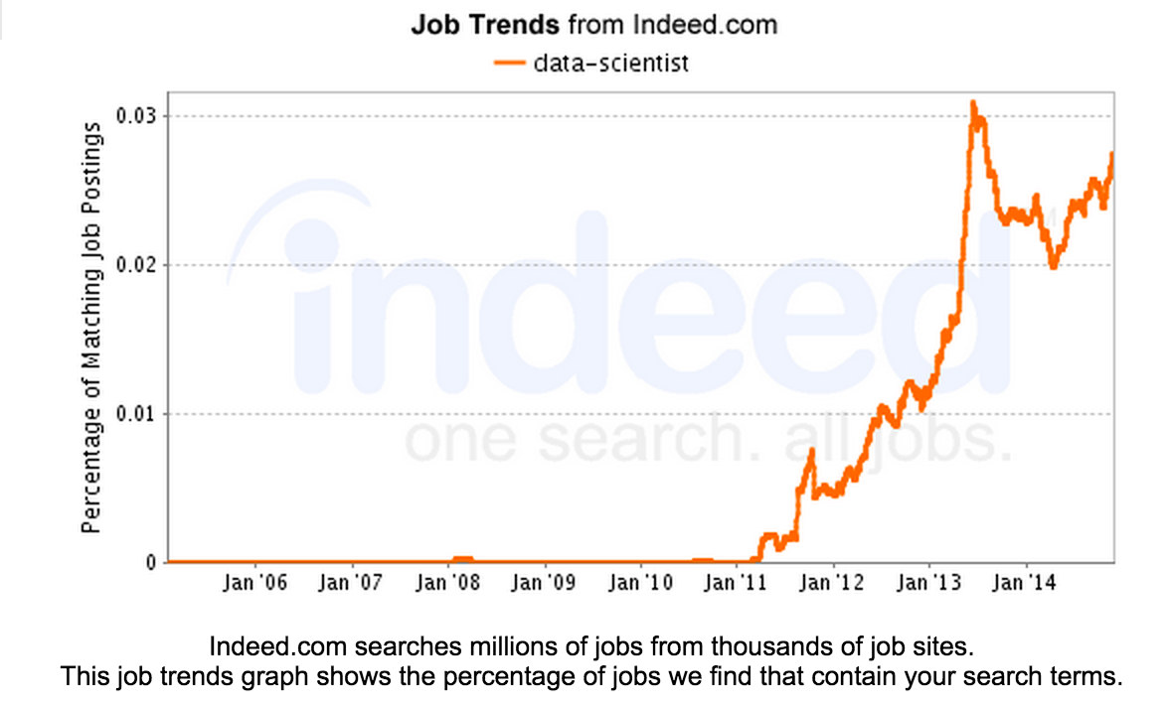
Recent trends
ChaLearn AutoML challenge
http://automl.chalearn.org

Slide 32
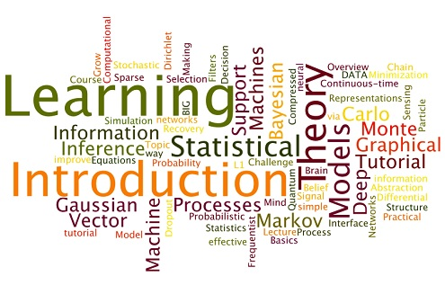
We are not AutoML (yet)
Videolectures word cloud, Grant Marshall, KDnuggests, Sept 2014
ChaLearn AutoML challenge
http://automl.chalearn.org

Slide 33
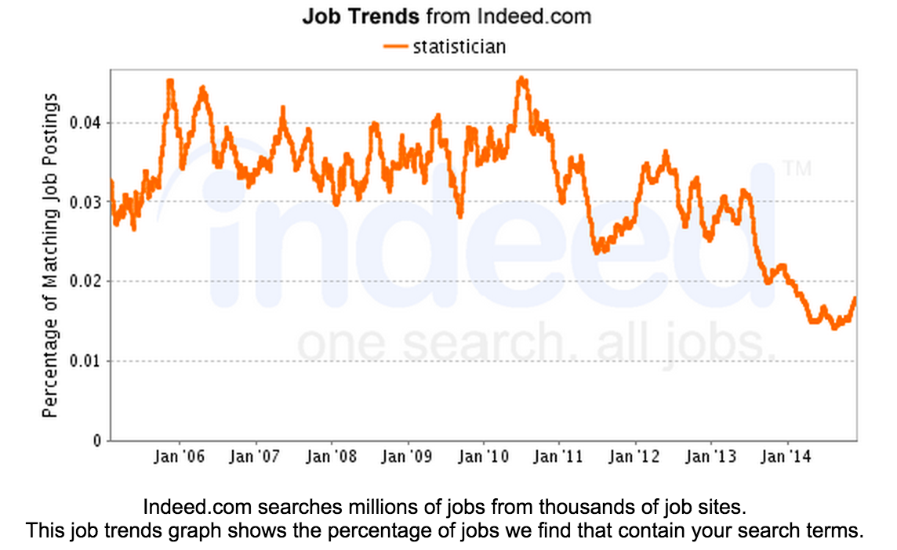
ChaLearn AutoML challenge
http://automl.chalearn.org

Slide 34
AutoML challenge
Thank you
http://automl.chalearn.org

