Slide 1
ECE 599/692 – Deep Learning
Lecture 6 – CNN: The Variants
Hairong Qi, Gonzalez Family Professor
Electrical Engineering and Computer Science
University of Tennessee, Knoxville
http://www.eecs.utk.edu/faculty/qi
Email: hqi@utk.edu
Notes:
AICIP stands for Advanced Imaging and Collaborative Information Processing

Slide 2
Outline
Lecture 3: Core ideas of CNN
  Receptive field
  Pooling
  Shared weight
  Derivation of BP in CNN
Lecture 4: Practical issues
  The learning slowdown problem
    Quadratic cost function
    Cross-entropy + sigmoid
    Log-likelihood + softmax
  Overfitting and regularization
    L2 vs. L1 normalization
    Dropout
    Artificial expanding the training set
  Weight initialization
  How to choose hyper-parameters
    Learning rate, early stopping, learning schedule, regularization parameter, mini-batch size,
    Grid search
  Others
    Momentum-based GD
Lecture 5: The representative power of NN
Lecture 6: Variants of CNN
  From LeNet to AlexNet to GoogleNet to VGG to ResNet
Lecture 7: Implementation
Lecture 8: Applications of CNN

Slide 3
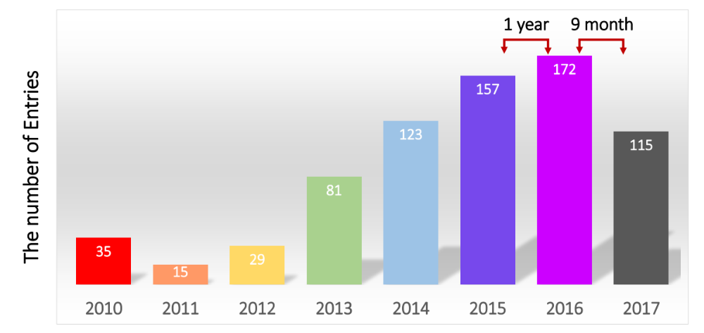
Participation in ILSVRC over the years
Data from ImageNET Large Scale Visual Recognition Challenge (ILSVRC) 2017

Slide 4
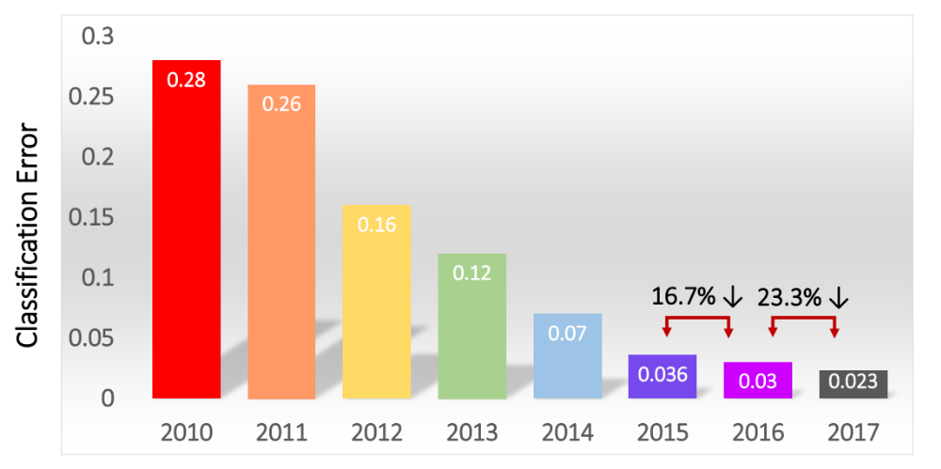
Classification results
Data from ImageNET Large Scale Visual Recognition Challenge (ILSVRC) 2017

Slide 5
ImageNet Large Scale Visual Recognition Challenge (ILSVRC)
Year | Top-5 Error | Model
2010 winner | 28.2% | Fast descriptor coding
2011 winner | 25.7% | Compressed Fisher vectors
2012 winner | 15.3% | AlexNet (8, 60M)
2013 winner | 14.8% | ZFNet
2014 winner 2014 runner-up | 6.67% | GoogLeNet (22, 4M) VGGNet (16, 140M)
2015 winner | 3.57% | ResNet (152)
2016 winner 3% Ensembled approach - CUImage
2017 winner 2.3% SENet () – Momenta
Nov. 2017, Google AutoML outperform all human-constructed models, NASNet
Human expert: 5.1%
https://www.independent.co.uk/life-style/gadgets-and-tech/news/google-child-ai-bot-nasnet-automl-machine-learning-artificial-intelligence-a8093201.html

Slide 6
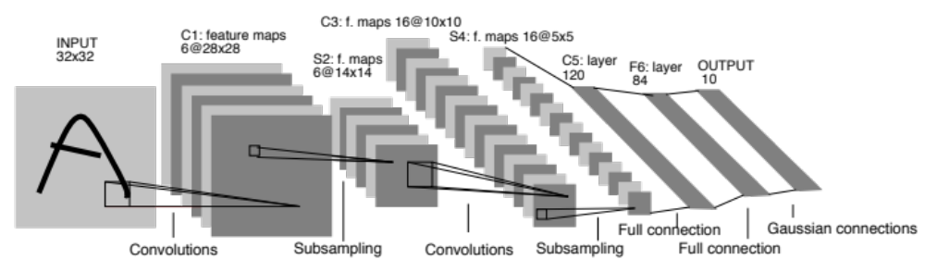
LeNet-5 (1989 or 1998)

Slide 7
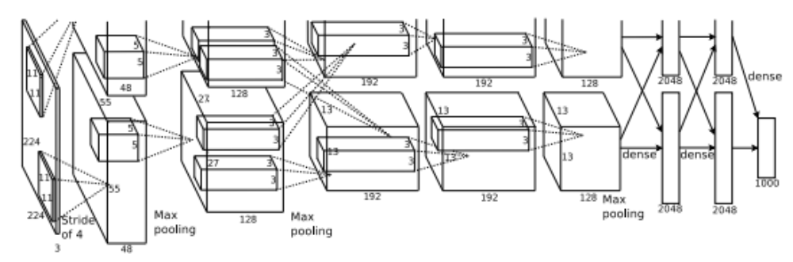
AlexNet (2012)

Slide 8
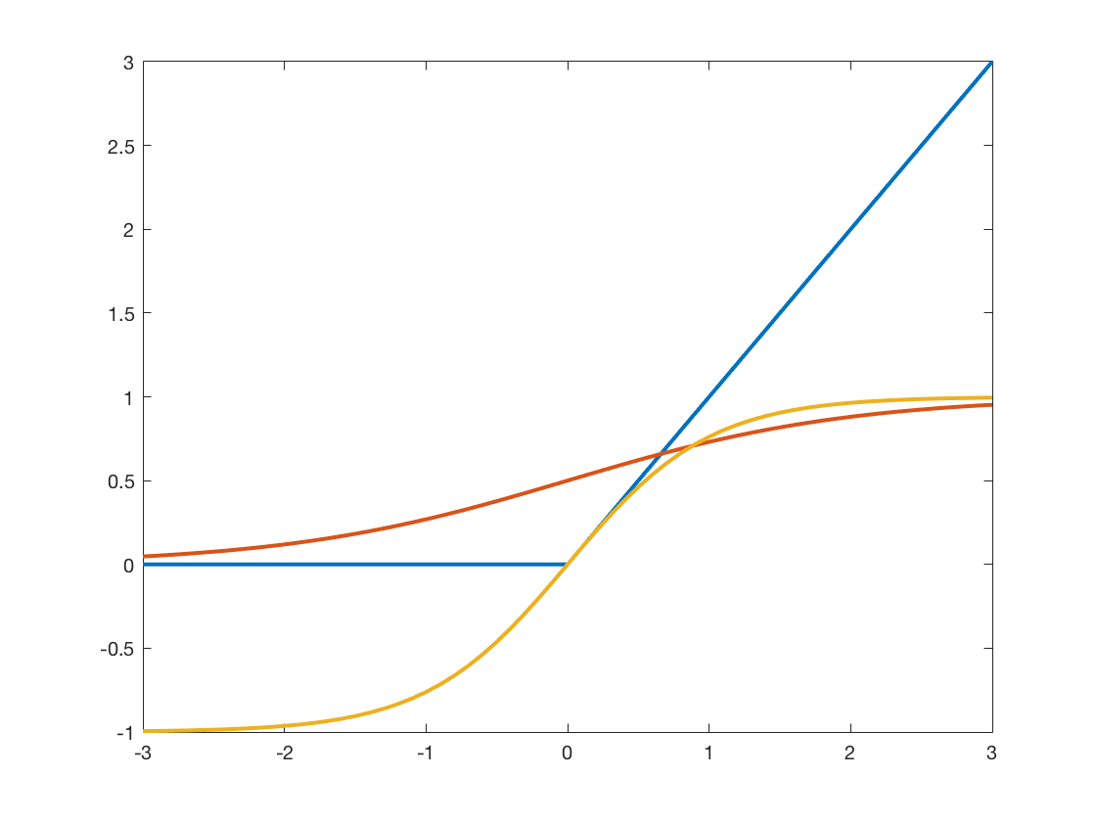
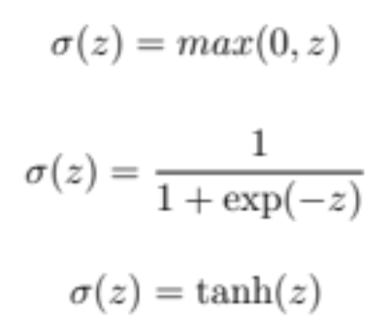
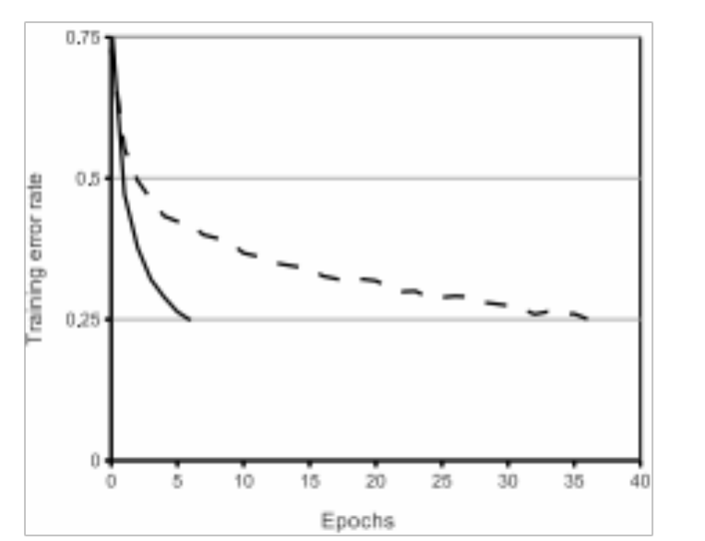
AlexNet – Cont’
Improvements
  Bigger network
    8 layers (5 conv + 3 fc)
    Layer 1: Conv+norm+relu+max-pooling
    Layer 2: Conv+norm+relu+max-pooling
    Layer 3: Conv+relu
    Layer 4: Conv+relu
    Layer 5: Conv+norm+relu
    …
  ReLU vs. Sigmoid or tanh(x)
  Training on multiple GPUs
  Local response normalization
  Overlapping pooling
Reduce overfitting
  Data augmentation
    Translation and horizontal mirror
    Adding principal components from PCA
  Dropout

Slide 9
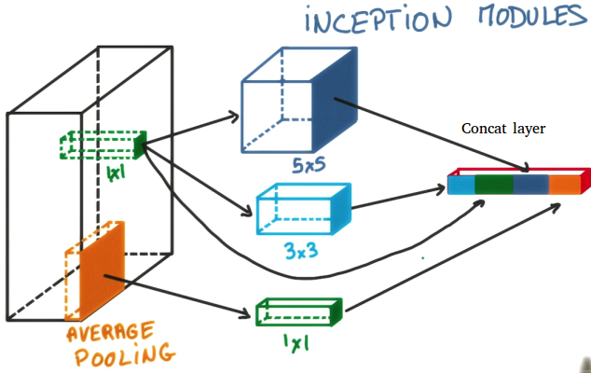
GoogLeNet (2014)
Inception-v4
Moving from fully connected to sparsely connected
Finding optimal local construction and repeat spatially
22 layers

Slide 10
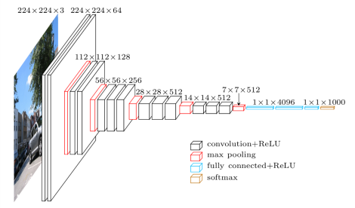
VGGNet
The extreme homogeneity in architectural design

Slide 11
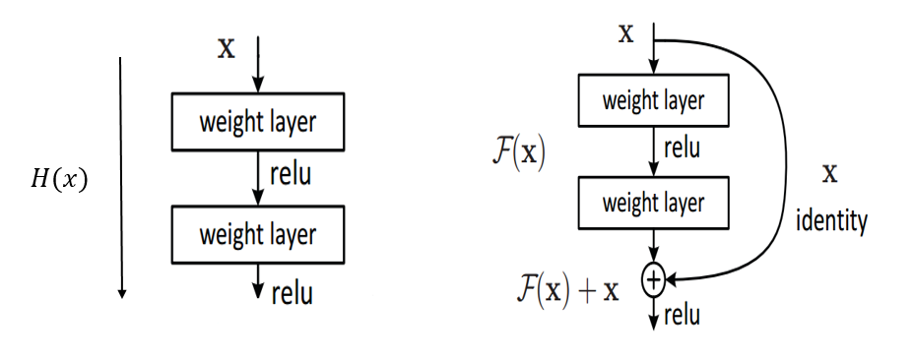
ResNet
Residual connection

