Slide 1
FUNCTIONAL PROGRAMING
01 What is FP
02 Purity
03 Immutability
04 Higher Order Functions
05 Currying
06 Practices
07 References
Created by BinhPT
Updated 07/2021

Slide 2
01
What is FP
Reported by BinhPT
Updated 07/2021

Slide 3
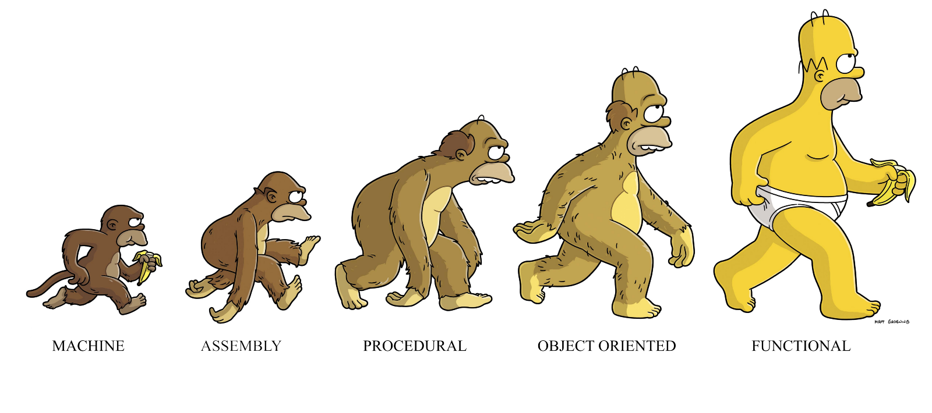
Use Cases:
Distributed System
Mathematical Programming
High concurrency
...
Benefits:
Declarative
Scalability
Testability
Composability
Simplicility
…

Slide 4
OOP vs FP
OO
BASIS FOR COMPARISON | Functional Programming | OOP
Definition | Functional programming emphasizes an evaluation of functions. | Object-oriented programming based on a concept of objects.
Data | Functional programming uses immutable data. | Object-oriented uses mutable data.
Model | Functional programming does follow a declarative programming model. | Object-oriented programming does follow an imperative programming model.

Slide 5
Support | Parallel programming supported by Functional Programming. | Object-oriented programming does not support parallel programming.
Execution | In Functional programming, the statements can be executed in any order. | In OOPs, the statements should be executed in a particular order.
Iteration | In Functional programming, recursion is used for iterative data. | In OOPs, loops are used for iterative data.
Element | The basic elements of functional programming are Variables and Functions. | The basic elements of object-oriented programming are objects and methods.
Use | Functional programming is used only when there are few things with more operations. | Object-oriented programming is used when there are many things with few operations.
OO

Slide 6
02
Purity/Mathematical Function
Reported by BinhPT
Updated 07/2021

Slide 7
const sum = (a) => {
return Math.random() + a; // not pure
}
const sum = (a, b) => {
return a + b;
}
Act on their parameters
Have NO side effects
Will always produce same output for given parameters

Slide 8
03
Immutability
Reported by BinhPT
Updated 07/2021

Slide 9
var x = 0;
if (cond === 3) x = cond;
// convert
const x = cond === 3 ? cond : 0;
NO “variables”
all “variables” should be considered as constants

Slide 10
04
High Orders Function
Reported by BinhPT
Updated 07/2021

Slide 11
const twice = (f, v) => f(f(v));
const add3 = v => v + 3;
twice(add3, 7); // ?
Can take function as parameters
Can return functions

Slide 12
05
Currying
Reported by BinhPT
Updated 07/2021

Slide 13
const sum = (a) => {
return 1 + a; //
}
Only take a SINGLE PARAMETER at a time
Functions: Map, Reduce, Filter,... in Javascript is curried functions

Slide 14
06
Practices
Reported by BinhPT
Updated 07/2021

Slide 15
Example: Array Functions
let languages = [
{name: 'VueJS', isActive: true, total: 100},
{name: 'ReactJS', isActive: false, total: 120},
{name: 'NodeJS', isActive: true, total: 130}
];
// Imperative
let activeLanguages = [];
for (var i = 0; i < languages.length; i++) {
let item = languages[i];
if (item.isActive) {
activeLanguages.push(item);
}
}
console.log(activeLanguages)
// Declarative
// Use filter
let activeLanguages = [];
activeLanguages = languages.filter((item) => {
return item.isActive;
});
console.log(activeLanguages)
//Use map
let activeLanguages = [];
activeLanguages = languages.map((item) => {
return item.isActive;
});
console.log(activeLanguages)

Slide 16
Example: Function Chaining
let languages = [
{name: 'VueJS', isActive: true, total: 100},
{name: 'ReactJS', isActive: false, total: 120},
{name: 'NodeJS', isActive: true, total: 130}
];
let sum = languages.filter((item) => {
return item.isActive;
})
.map((item) => {
return item.total;
})
.reduce((i, item) => {
return i + item;
}, 0);
// Output will 230

Slide 17
07
References
https://viblo.asia/p/tim-hieu-ve-functional-programming-trong-javascript-phan-1-RQqKLYdzZ7z
https://www.educba.com/functional-programming-vs-oop/
Reported by BinhPT
Updated 07/2021

Slide 18
Thanks for watching!
Reported by _______
Updated 06/2020

