Slide 1
SCALA INTRODUCTION
Created by BinhPT
Updated 07/2021

Slide 2
01
SCALA = Scalable Language
Reported by BinhPT
Updated 07/2021

Slide 3
02
Review Exercises
Reported by BinhPT
Updated 07/2021

Slide 4
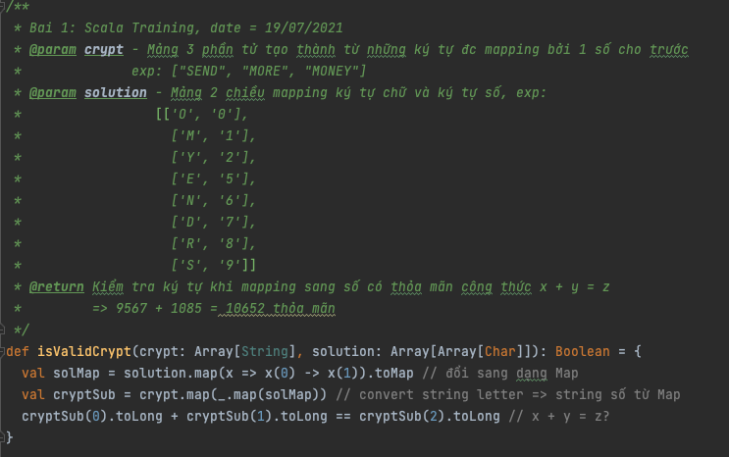

Slide 5
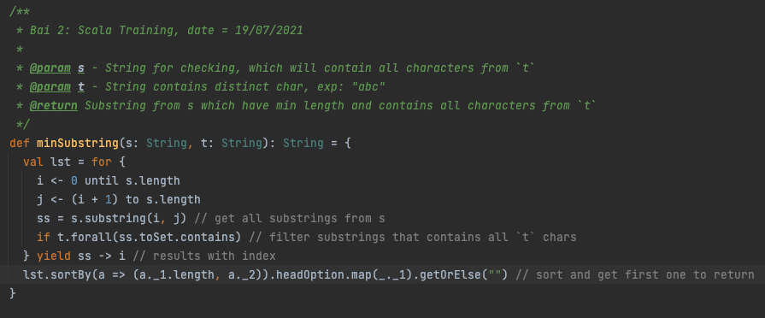
OO

Slide 6
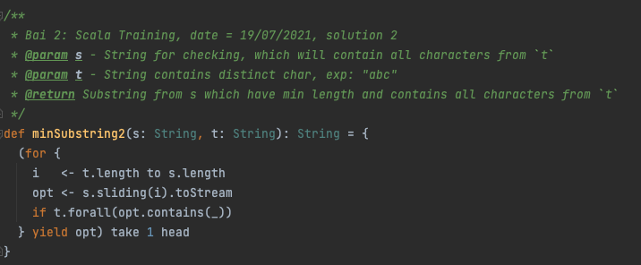
OO

Slide 7
03
For Comprehensions
Reported by BinhPT
Updated 07/2021

Slide 8
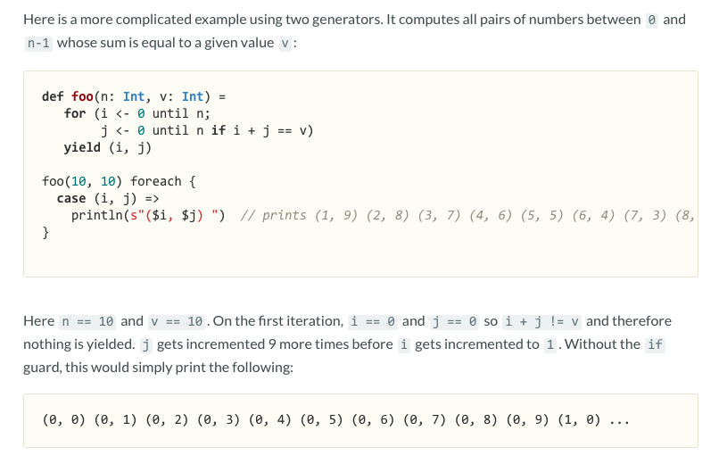
SYNTAX:
for (enumerators) yield e

Slide 9
04
Pattern Matching
Reported by BinhPT
Updated 07/2021

Slide 10
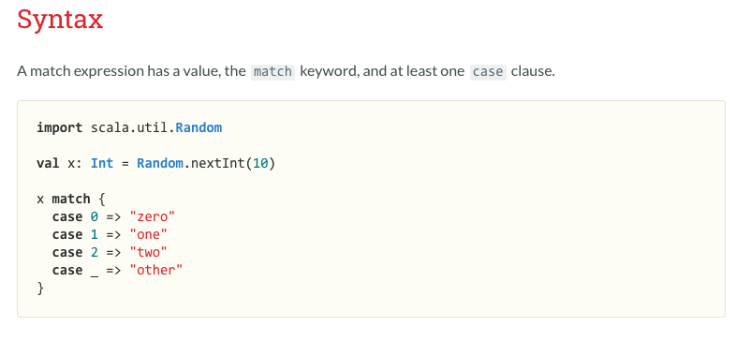
case “a” | “b” => // adadadad

Slide 11
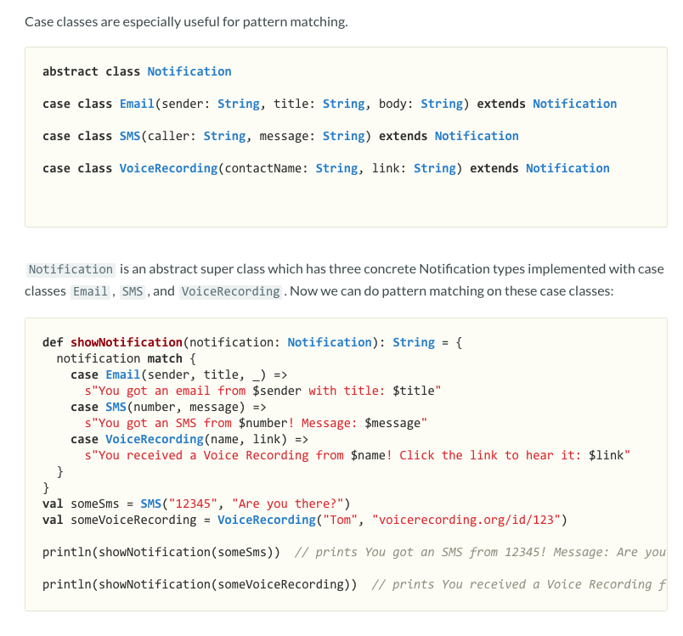

Slide 12
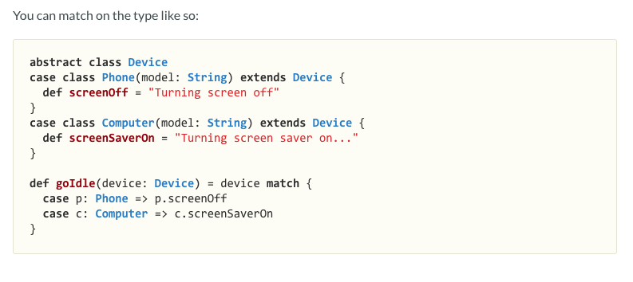

Slide 13
05
Singleton Objects / Companion Objects
Reported by BinhPT
Updated 07/2021

Slide 14
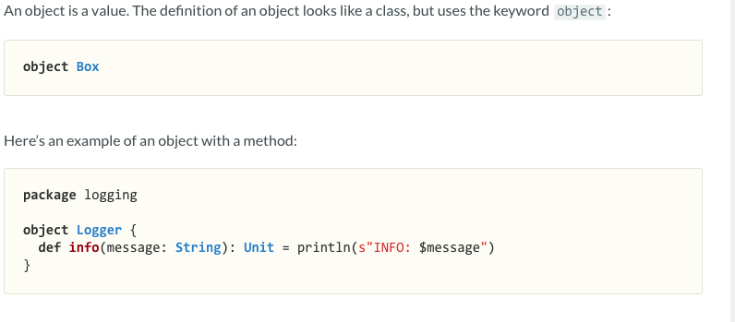
SINGLETON OBJECT

Slide 15
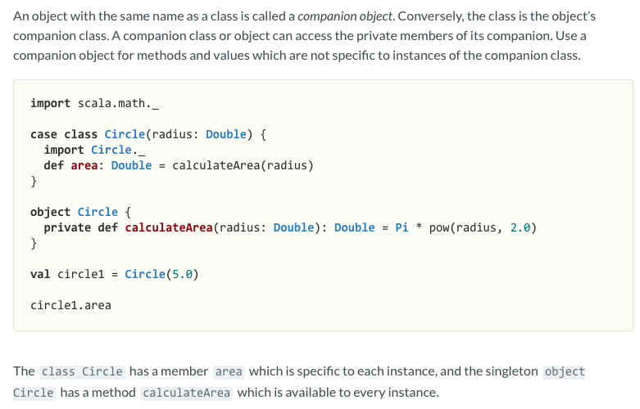
COMPANION OBJECT

Slide 16
06
Built-in Common Functions
Reported by BinhPT
Updated 07/2021

Slide 17
map(), flatern(), flatMap()
filter(), reduce(), fold()
...
References: - https://www.geeksforgeeks.org/scala-list-forall-method-with-example/?ref=lbp

Slide 18
06
Practices
Reported by BinhPT
Updated 07/2021

Slide 19
07
References
https://docs.scala-lang.org/tour/pattern-matching.html
https://www.geeksforgeeks.org/scala-flatmap-method/?ref=lbp
Reported by BinhPT
Updated 07/2021

Slide 20
Thanks for watching!
Reported by BinhPT
Updated 07/2021

