Slide 1
Cell style
1
(highest priority)
Column style
2
Row style
3
Background style
4
(lowest priority)
Combined style

Slide 2
Root
atomic CellStyle
200c1ad8 (HEADER_STYLE)
f6b4e6eb (DATA_STYLE)
atomic CellStyle
combined CellStyle
983763d7 (MISSING_ONE)
95fe1259 (FAVORITE_ONE)
combined CellStyle
5a261550 (VCENTER)
combined CellStyle
e34dab8e (HIGH_RATE)
combined CellStyle

Slide 3
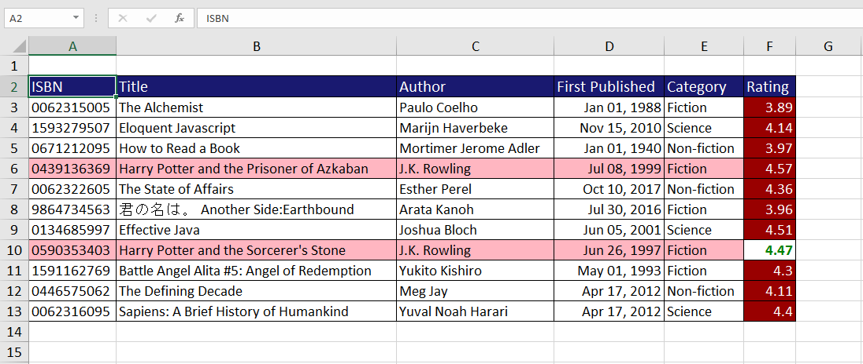
Column style
Row style
Cell style
Background style

