Slide 1
MOSA: A Mobile Offloading Architecture using Software-defined network
Binh Nguyen and Junguk Cho
Mentors: Kobus Van der Merwe and Robert Ricci

Slide 2
Outline
Motivation & related works.
Architecture.
Implementation.
Evaluation.
Conclusion.

Slide 3




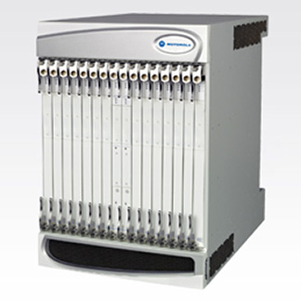
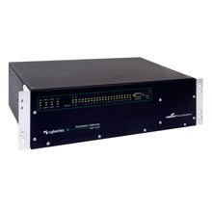
Motivation
User device
(UE)
Base station
(eNodeB)
dominated
GameA
server
Packet gateway
(PGW)
Service gateway
(SGW)
GTP
tunnel
GTP
tunnel
GTP
tunnel
m.youtube.com
Delay reduces
Radio Access Network
(RAN)
Cellular core network
Internet
Quality of service (QoS) requirement.
End-to-end delay
Flat core design leads to a dominance of the Internet delay (the speed of light constraint).
Inside the core: hierarchical routing issue.
Business model.
=> An approach that is able to “deeply” reduce the end-to-end delay.

Slide 4
MOCA
An Architecture for Mobile Offloading using Cloud.
Offloading traffic by creating new tunnels to a local SPGW instance and server.
Modifying the control plane (Mobility Management Entity - MME) of the network
to realize the above goal.
User device
(UE)
MME
Base station
(eNodeB)
GameA
server
Packet gateway
(PGW)
Service gateway
(SGW)
GTP
tunnel
GTP
tunnel
GTP
tunnel
m.youtube.com
Local S-PGW instance
+ GameA server
Radio Access Network
(RAN)
Cellular core network
Internet

Slide 5
MOSA
Question: an offloading architecture using SDN without modifying the current components?
Only snooping the control plane is needed.
SDN substrate
(core network equivalence)
User device
(UE)
MME
Base station
(eNodeB)
GameA
server
Packet gateway
(PGW)
Service gateway
(SGW)
GTP
tunnel
GTP
tunnel
GTP
tunnel
m.youtube.com
GameA server
Radio Access Network
(RAN)
Cellular core network
Internet

Slide 6
Architecture overview
2
2
1
2
3
Ipv4
Ipv4
Tcp/udp
Ipv4
Ipv4
Tcp/udp
payload
Tcp/udp
Tcp/udp
payload
payload
payload
Gtp-u
Gtp-u
Udp
Udp
Ipv4
Ipv4

