Slide 1
COMP30810 Intro to Text Analytics
Dr. Binh Thanh Le
thanhbinh.le@ucd.ie
Insight Centre for Data Analytics
School of Computer Science
University College Dublin

Slide 2
Installation Instructions
Anaconda
Python 3.6
Jupyter Notebook

Slide 3
Install Python3.6 with Anaconda
Anaconda: Free Python distribution, includes popular Python packages for science, engineering, data analysis
Overview of main Python DA packages:
– https://www.anaconda.com/distribution/
Download Python 3.6 distribution:
– https://www.anaconda.com/download
Installing Anaconda for Python3.6 for your Operating System (or basic Miniconda):
– https://docs.anaconda.com/anaconda/install/
Go to the shell/command line, check version of Python installed (you should see python3.6):
python --version

Slide 4
Python Virtual Environment
Conda: package and environment manager
A virtual environment is a folder on your computer where you can install all the required packages
You can keep different projects in different virtual environments (e.g., some projects may require Pyhon2.7, some Python3.6)
To create a new Python virtual environment named comp30810 and to install some packages run in the shell:
conda create --name comp30810py36 python=3.6 numpy matplotlib scipy pandas scikit-learn nltk

Slide 5
Activate Virtual Environment
Activate the newly created virtual environment:
[source] activate comp30810py36
Install other required packages:
conda install requests
If package not available with conda, install with pip:
pip install nltk
To deactivate (i.e., get out of) this virtual environment:
source deactivate

Slide 6
Virtual Environment
If you get an error that a Python package or function is not known, but you remember having installed it, most likely you forgot to activate the required virtual environment
Activate the virtual environment:
[source] activate comp30810py36
Run needed packages, e.g.:
jupyter notebook
If not installed, install needed package, e.g.,:
conda install jupyter
If you are done with your work, de-activate the virtual environment:
[source] deactivate
To check list of already installed packages:
pip list
conda list

Slide 7
Pro TIP: Exporting a Virtual Environment
If you work with Python and need to run your code/project later on, or on a new machine, export your virtual environment using:
pip freeze --all > pip-freeze-venv_name-date.txt
Example:
pip freeze --all > pip-freeze-venv_comp30810py36-100918.txt
This exports all Python packages and their exact version installed at that time (when your code was working) in your virtual environment
To setup the virtual environment on a new machine do:
pip install -r pip-freeze-venv_comp30810py36-100918.txt
You can call your file whatever you want, e.g., requirements.txt, required packages.txt, etc.

Slide 8
How to run Python Code
From the shell (aka command line) type: python
To stop the Python interpreter type: quit()
From the shell, run a full Python file/script.
python <your_script_file_name.py>
For file
“.py”
Using IDE, e.g. Pycharm, Spider, … to open
Run using IDE. Note that python should be installed in IDE platform
From a browser: to use the web-based interactive Jupyter Notebook in the browser, in the shell run:
jupyter notebook
Then click and open that file with notebook
For file
“.ipynb”
best

Slide 9
Interactive Python: Jupyter Notebook
Jupyter Notebook (aka Ipython Notebook): Web application to create and share documents that contain code, equations, visualizations and text <https://try.jupyter.org>
Great for reproducible data analysis: self-contained record of a computation
Notebooks can be exported as HTML or PDF (nbconvert) and shared online (nbviewer)
Notebooks are rendered by Github (i.e., can be visualized with a browser)
We will use Jupyter Notebooks for most of our labs, and homeworks.

Slide 10
Installing Jupyter Notebook
Make sure to be in the virtual environment for the module:
[source] activate comp30810py36
If not installed already, install the Python package for Jupyter Notebook:
conda install jupyter
Start a Jupyter Notebook: jupyter notebook
Opens a web browser at: http://localhost:8888/tree
Notebook example: Python crash course http://nbviewer.ipython.org/github/ipython-books/minibook-2ndcode/blob/master/chapter1/14-python.ipynb

Slide 11
Notebook Dashboard
The IPython dashboard provides a mini filesystem interface for creating and accessing notebooks.
Note: The dashboard shows notebooks in the directory where you launched the notebook server.
To start writing code, create New → Python 3 Notebook
Click to create a new notebook
List of existing notebooks in current directory

Slide 12
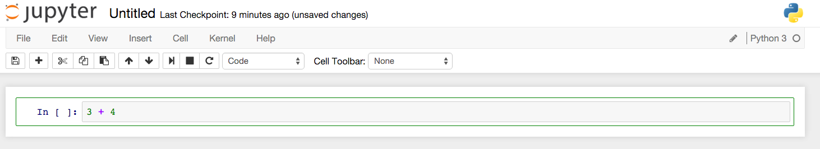
Notebook Interface
When you create a new notebook, you will be presented with the notebook name, a menu bar, a toolbar and an empty code cell.
Notebook name
Menu
Toolbar
Code cell
IPython notebooks have two fundamental types of cells:
1. Markdown cells: Contain text content for explaining a notebook.
2. Code cells: Allow you to type and run Python code.
Every new cell starts off being a code
cell. But this can be changed by using
the drop-down on the toolbar

Slide 13
Basics for Jupyter Notebook
Two types of cells: code and markdown
Code: Writing and running Python code
Markdown: Text for describing the problem and the code
Jupyter documentation:
http://jupyter.readthedocs.io/en/latest/
http://nbviewer.ipython.org/github/ipython/ipython/blob/3.x/examples/Notebook/Index.ipynb
Jupyter tips and tricks:
https://www.dataquest.io/blog/jupyter-notebook-tips-tricksshortcuts/

Slide 14

Code Cells
In a code cell, you can enter one or more lines of Python code. Run the code by hitting Shift-Enter or by pressing the Play button in the toolbar.
Change cell order
Restart the kernel
Start
Stop
You can modify and re-run code cells multiple times in any order.
When a code cell is executed, the code it contains is sent to the kernel associated with the notebook - i.e. the Python instance running in the background.
The results returned from this computation are displayed as the cell’s output. Note that some code will not have an output.
Code
cells
Outputs
No visible
output cell

Slide 15
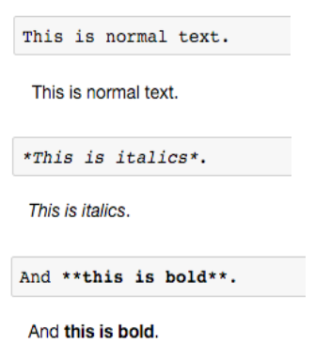
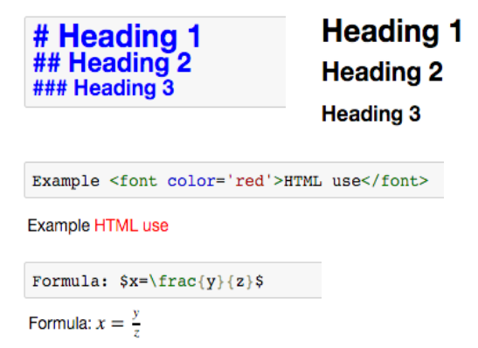
Markdown Cells
It can be helpful to provide explanatory text in notebooks.
Markdown is a lightweight type of markup language with plain text formatting syntax which can be rendered as HTML.
IPython supports a set of common Markdown commands. HTML tags and LaTeX formulae can also be included.

Slide 16
Using Notebooks
Can download any Notebook from the Web and open it with your local Jupyter Notebook installation
Useful for showing all the steps of a data analysis, tutorial style
Very handy tip: use Tab for auto-completion of your Python commands in Jupyter Notebook, e.g., type pd.D and press Tab (it will show you a popup box with auto-completion options)

Slide 17
Backing Up
Get used to backup your work every day (using a backup hard-drive or Github)
Jupyter Notebook has versioning (saves intermediate work) but you may still loose the homework right before submission (e.g., if accidentally deleting the .ipynb file)
Use Github and push your work to Git every day! It is worth the extra effort, and it forces you to structure your work better.

Slide 18
References
Python 3
Official documentation: https://docs.python.org/3/
Jupyter Notebook
Official documentation:
http://jupyter.readthedocs.io/en/latest/
Markdown
Guide to Markdown:
https://help.github.com/articles/markdown-basics
Original Markdown syntax specification:
http://daringfireball.net/projects/markdown/syntax/
Conda
Official documentation: http://conda.pydata.org/docs/index.html

