Slide 1

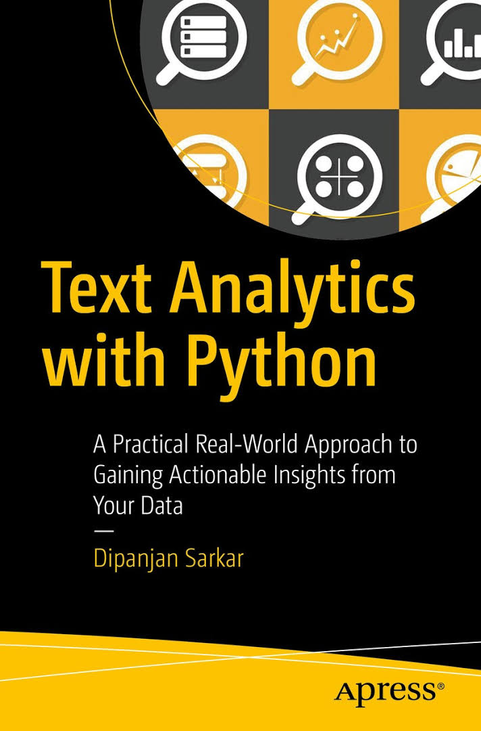
Module: COMP47600 Introduction to Text Analytics
Module Coordinator: Binh Thanh Le
Semester: 1
Credits: 5
Reference Material:
Lecture Notes
Recommended Books
Sample Code/Notebooks
Sample Solutions
Worked Examples
Learning Objectives:
1. Have a clear understanding of the core concepts in text analytics and be familiar with a range of common analytics techniques in this area.
2. Be familiar with common representations used to represent textual data.
3. Have developed a knowledge of the main application areas in which these techniques prove useful.
4. Be able to collect, pre-process and analyse textual datasets using Python.
Delivery:
22 x 1h lectures
10 x 2h labs
2h topic seminar
Assessment:
2 Individual Assignments: 100% (2 x 50% each)
Resit: Re-submit Project and Assignment(s)
Repeat: Take the module again next time it is offered

Slide 2
Week | COMP47600: Weekly plan | Lab | Assess
1 | Installation: Python Environment | v
2 | Introduction about Data Analytics and Text Analytics: CRISP-DM project lifecycle | v
3 | Data Preparation: Understand Data, Feature Extraction | v | Hw1 out
4 | Data Preparation: Data Visualisation | v
5 | Data Preparation: Data Cleaning, Data Reduction | v
6 | Similarity and Distance Measurement | v | Hw1 due
7 | Text Classification: Naïve Bayes, Decision Tree | v | Hw2 out
8 | Text Classification: Support Vector Machine | v
9 | Text Clustering: K-Means Clustering | v
10 | Text Clustering: Hierarchical Clustering | v | Hw2 due
11 | Discussion: Review and Future Plans

