Slide 1
COMP30810 Intro to Text Analytics
Dr. Binh Thanh Le
thanhbinh.le@ucd.ie
Insight Centre for Data Analytics
School of Computer Science
University College Dublin

Slide 2
Today Goals:
Module Overview
Learning Objectives
Module Topics
Marking Process
Late Submission Policy
Marking to grades mapping used in this module
Questions & E-mail

Slide 3
Overview
Module materials/announcements on Moodle
Moodle Website:
https://csmoodle.ucd.ie/moodle/course/view.php?id=701
Self-enroll with your user name and password: comp30810181
Schedule:
laptop required!
Course Lecturer:
Dr. Binh Thanh Le (https://www.insight-centre.org/users/thanh-binh-le)
Office hours: by appointment; @UCD- Insight C17 (O’Brien Centre)
Support team: Iulia Ilie (iulia.ilie@insight-centre.org)
John Sloan (john.sloan.1@ucdconnect.ie)
 | Monday (LAB) | Wednesday (LEC) | Thursday (LEC)
Time | 10:00 (110mins) | 12:00 (50mins) | 10:00 (50mins)
Room | A109 ART | 129 SCN | G80 NEWST

Slide 4


Module: COMP30810 Introduction to Text Analytics
Module Coordinator: Dr. Binh Thanh Le
Semester: 1
Delivery:
22 x 1h lectures
10 x 2h labs
2h topic seminar
Reference Material:
Lecture Notes
Recommended Books
Notebooks
Worked Examples

Slide 5
Learning Objectives
1. Have a clear understanding of the core concepts in text analytics and be familiar with a range of common analytics techniques in this area.
2. Be familiar with common representations used to represent textual data.
3. Have developed a knowledge of the main application areas in which these techniques prove useful.
4. Be able to collect, pre-process and analyze textual datasets using Python.

Slide 6
Marking Process
Marks distributed over 4 components with different weight
(40% H1, 45% H2, 5% attendance, 5% discussion)
Homework: 85%
H1: Document Understanding; out in week 3 , due in week 6
H1: individual homework
H2: Model & Evaluation; out in week 7 , due in week 10
H2: competition from groups.
2 presentations for the top results
Discussion: 10%
Good questions, good answers (moodle forum)
Researching and discussing in front of class
Attendance: 5%

Slide 7
Late Submission Policy
Up to 1 week late, 10% marks lost
Between 1-2 weeks late, 10% - 20% marks lost
2 weeks cut-off (no submissions accepted after 2 weeks)

Slide 8
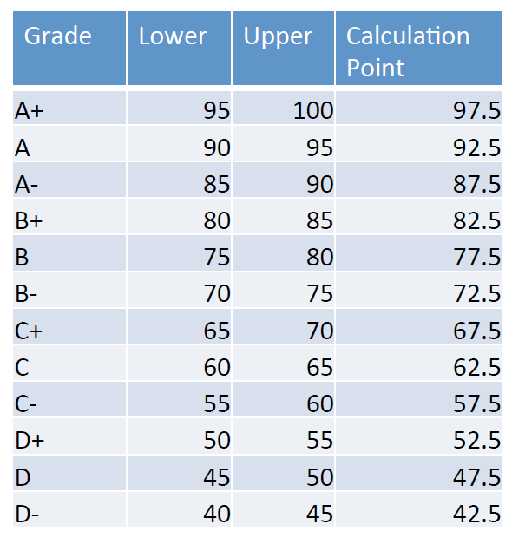
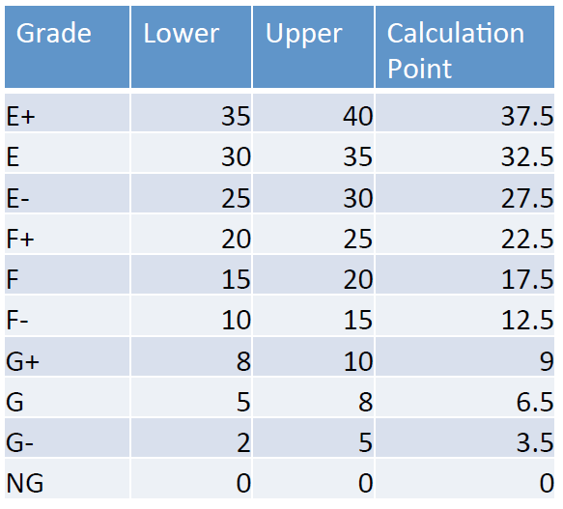
Marking to grades mapping used in this module

Slide 9
Questions & E-mail
If you have a technical question, discuss in the lecture/lab or post to Moodle
Only send e-mail to TA/lecturer if of personal nature (e.g., health or grade related)
If you need to discuss with the TA/lecturer outside the lecture/lab hours, please set an appointment

