Slide 1
COMP30810 Intro to Text Analytics
Dr. Binh Thanh Le
thanhbinh.le@ucd.ie
Insight Centre for Data Analytics
School of Computer Science
University College Dublin

Slide 2
Today Goals:
Where do Data come from? Big Data?
Related concepts in Data Science?
CRIPS-DM?
Text analytics?

Slide 3
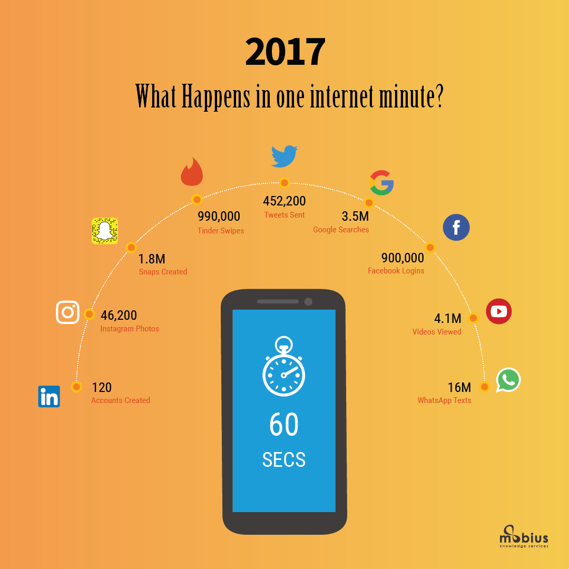
WHERE DO DATA COME FROM?
LinkedIn
Instagram
Snap chat
Tweet
Google engine
Facebook
YouTube
WhatsApp
Etc.

Slide 4

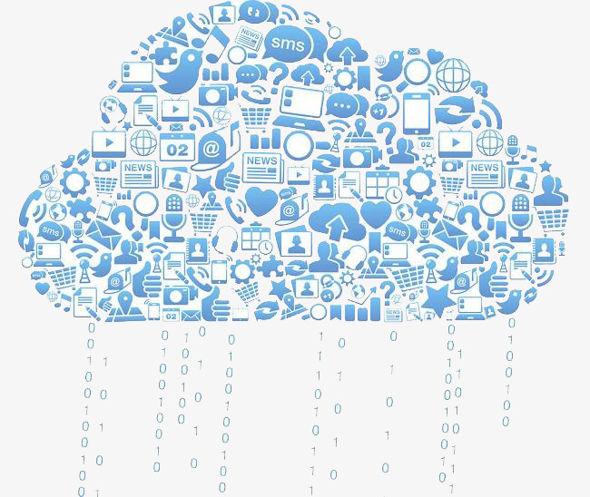
What is Big Data?

Slide 5
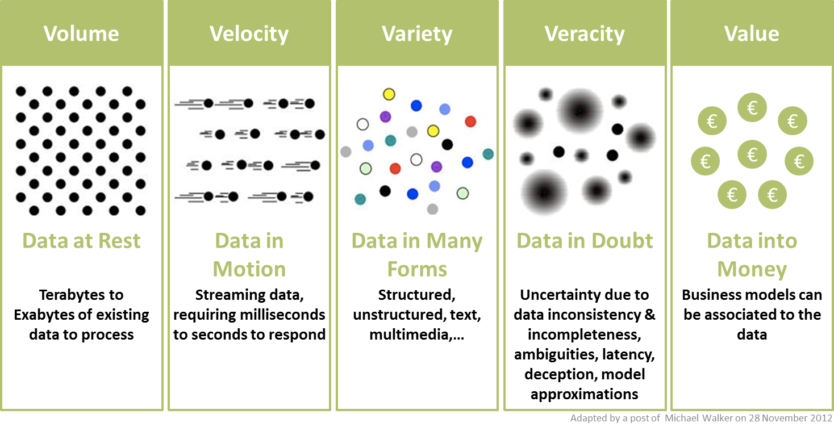
What is Big Data?
Big data is a term that describes the large volume of data – both structured and unstructured – that inundates a business on a day-to-day basis. (from sas)
http://informationcatalyst.com/vision-experience/big-data-value/

Slide 6
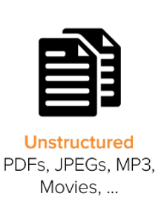
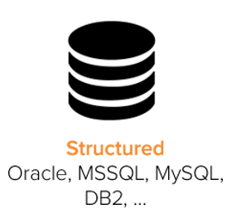
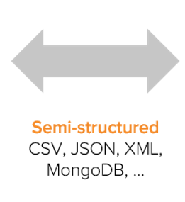
Types of Data used in Analytics
Data are organized in three categories: Structured, Semi-structured, and Unstructured Data.
Highly organized
~ 20 %
~ 80%

Slide 7
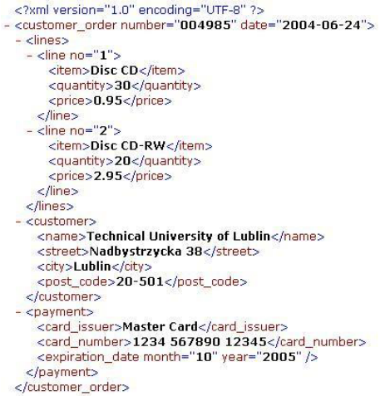
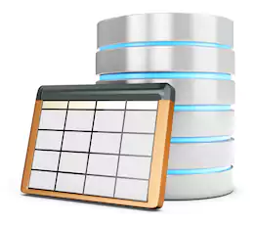

Types of Data used in Analytics
However, the data types can be transferred
Example:
<Tag>
organize
Text file
Relational
Database

Slide 8
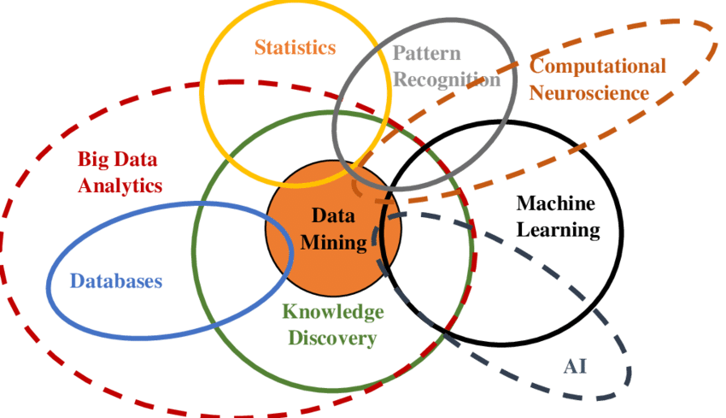
Multidisciplinary nature of Big Data analytics
[*] Bilal, M., Oyedele, L. O., Qadir, J., Munir, K., Ajayi, S. O., Akinade, O. O., ... & Pasha, M. (2016). Big Data in the construction industry: A review of present status, opportunities, and future trends. Advanced engineering informatics, 30(3), 500-521.

Slide 9
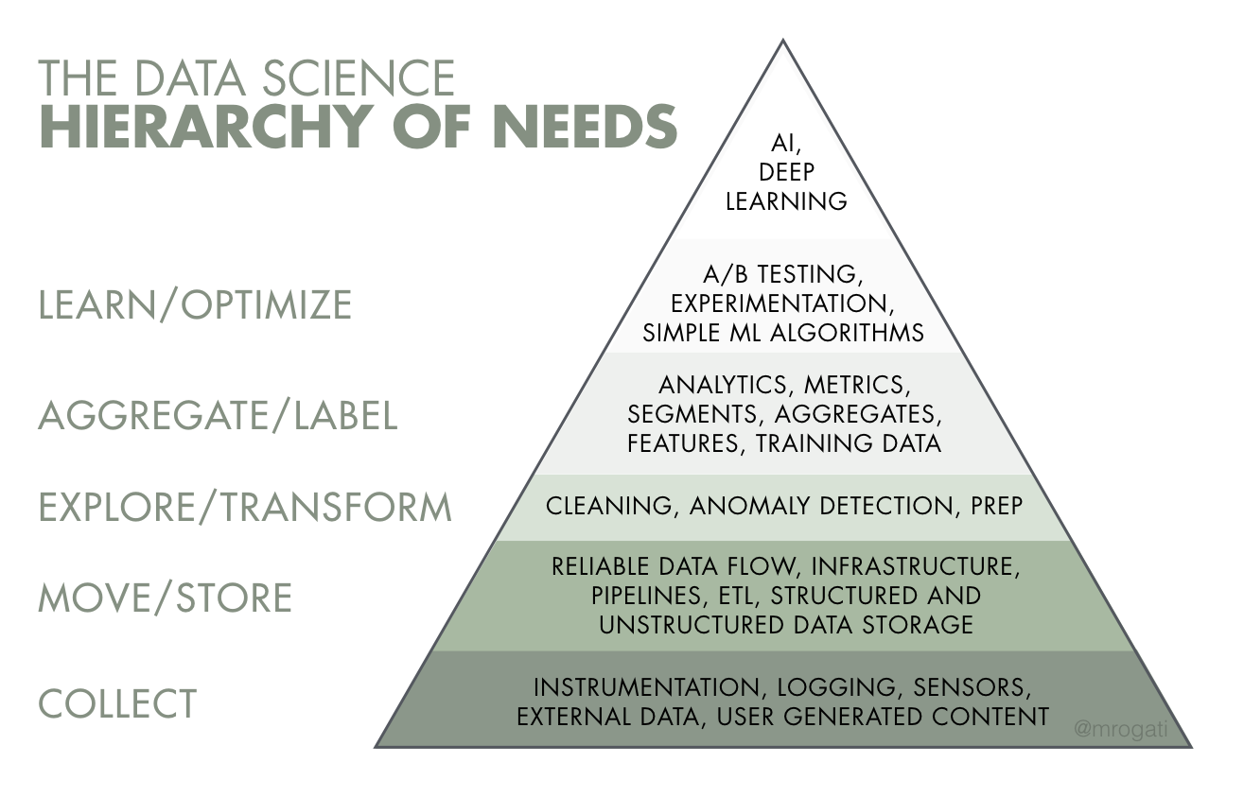
Strategy
Data Analyzing &
Modeling
Data
Understanding
Data Collecting
& Storage

Slide 10
SMALL COMPANY
- STARTUP -
Data
Scientist

Slide 11
MEDIUM COMPANY
Data Scientist
Data
Engineer
Software
Engineer

Slide 12
LARGE COMPANY
Research Scientist
Data Scientist Core
Machine Learning Engineer
Data
Analyst
Data
Engineer
Software
Engineer

Slide 13
Methodology for Data Analytics
http://www.kdnuggets.com/2014/10/crisp-dm-top-methodology-analytics-data-mining-data-science-projects.html

Slide 14
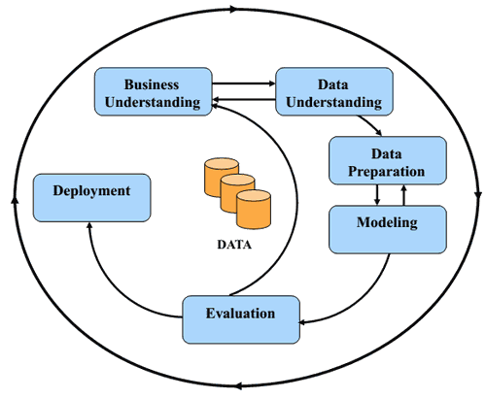
What is CRIPS-DM?
CRISP-DM: CRoss-Industry Standard Process for Data Mining (1996)
1. Business Understanding: What is the business problem?
2. Data Understanding: What is the data required to solve the business problem?
3. Data Preparation: Where is the data, how should it be
collected, transformed and stored?
4. Modeling: What data analytics algorithms should be used?
5. Evaluation: How well do the algorithms work?
6. Deployment: How can the analytics results be integrated
into the work process (specific to the organization)?

Slide 15
CRISP-DM: Business Understanding
Converting the Business Problem into Analytics
Solutions
– What is the business problem?
– What are the goals that the business wants to
achieve?
– How does the business currently work?
– In what ways could a predictive analytics model help
to address the business problem?
• Describe the predictive model, how will it be used, how will
it help solve the original business problem, what is the
metric for success (high model accuracy, increase in sales)?

Slide 16
CRISP-DM: Business Understanding
• Assessing Feasibility
– Data: Is the data required by the solution
available, or could it be made available?
– Capacity: What is the capacity of the business to
utilize the insights that the analytics solution will
provide? (e.g., Integration: How does the analytic
solution fit into the existing business process?)
– Impact: How do we know the solution is
successful? (e.g., model accuracy, impact on
business)

Slide 17
CRISP-DM: Data Understanding
• Designing the Analytics Base Table (e.g., the CSV
file describing examples via descriptive features)
• Designing & Implementing Features
– Different Types of Data
– Different Types of Features
– Handling Time
– Legal Issues
– Implementing Features

Slide 18
CRISP-DM: Data Preparation
Changing the original data to make it more compatible with some machine learning algorithms
• Normalization
• Binning
• Sampling

Slide 19
CRISP-DM: Modeling
• Modeling:
–How to build models
–How to evaluate prediction models
• Regression: predicting a numeric target feature
• Classification: predicting a categorical target feature
• Clustering: group data into several clusters the add new data into the suitable pool

Slide 20
CRISP-DM: Model Evaluation
Experiment Design
• Underfitting/Overfitting
• Out-of-sample Testing
• Cross-Validation
Evaluation Measures
• Regression
• Classification
• Clustering

Slide 21
Example: Human Resource helper
1. Business Understanding: How to help HR to find the best candidates for a job using the old portfolio of employees in the company.
2. Data Understanding: Curriculum Vitae, LinkedIn profile, academic transcript
3. Data Preparation: Data from old employees.
Old data files → structured data of (requirement of job + portfolio of applicants, target is accepted/decline)
4. Modeling: Classification problem? Regression problem? Ranking problem?
5. Evaluation: Error rate? Confusion Metric? AUC?
6. Deployment: The application| algorithm, which input are job description, applicant profiles, and output is the top 5 candidates for the job.
Discuss!
Think more and give me more examples for CRIPS-DM!

Slide 22



What is Text Analytics?
Text mining, also referred to as text data mining, roughly equivalent to text analytics, is the process of deriving high-quality information from text.
How?
high-quality information
Text

Slide 23
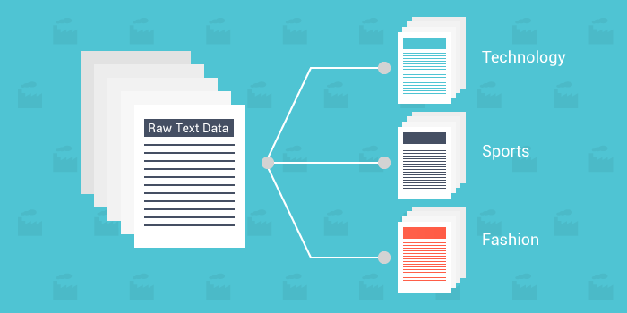
What is Text Analytics?
Text mining, also referred to as text data mining, roughly equivalent to text analytics, is the process of deriving high-quality information from text.
Example

Slide 24
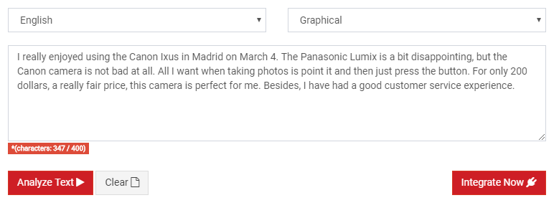
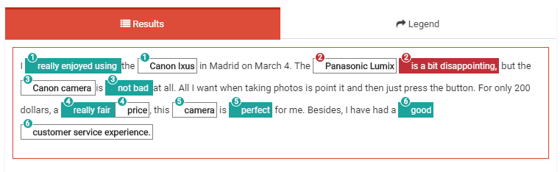
Text mining around us
Sentiment analysis
Positive
Negative

Slide 25
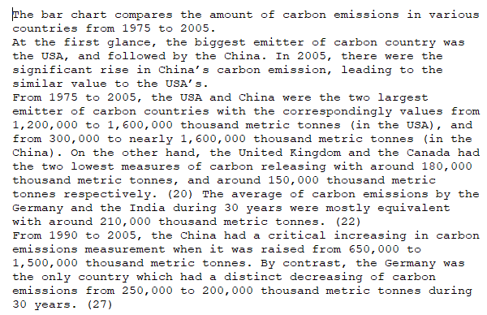
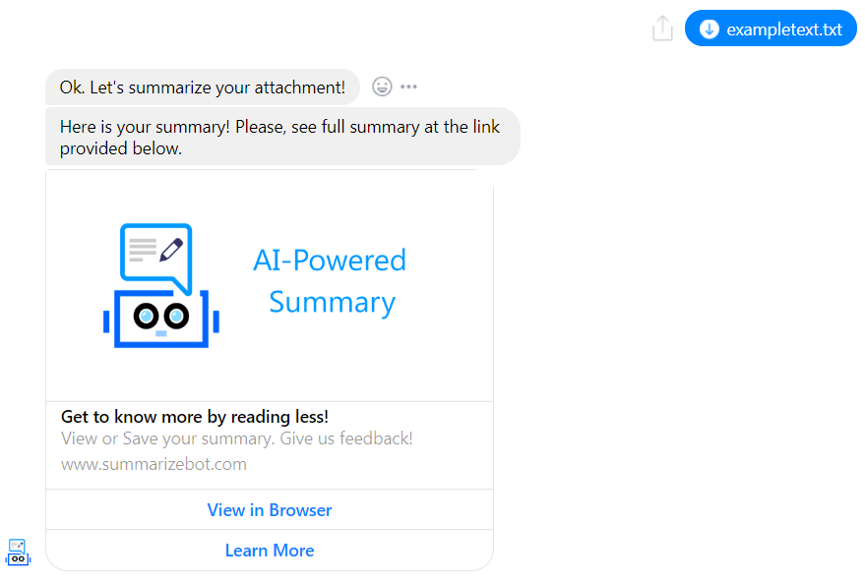
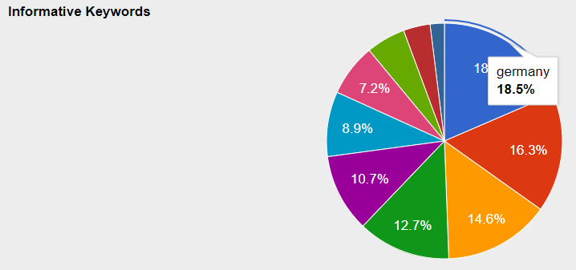
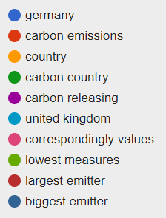
Text mining around us
Document summarization

Slide 26


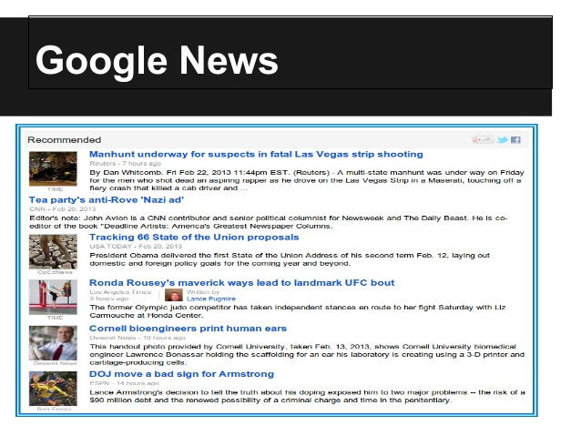
Text mining around us
Books, movies, news, hotel, career … recommendation

Slide 27
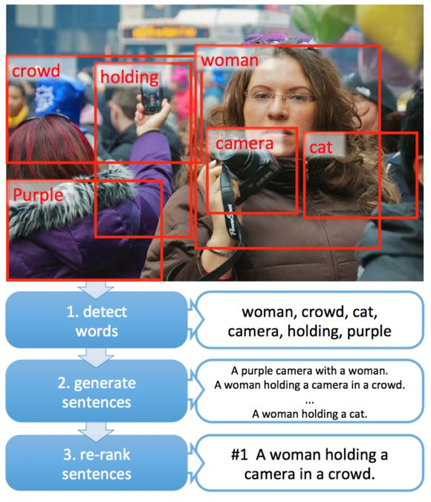
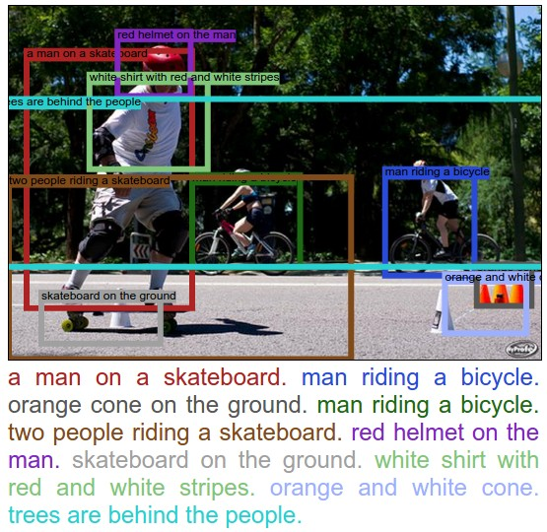
Interdisciplinary Tasks: Image Captioning

Slide 28
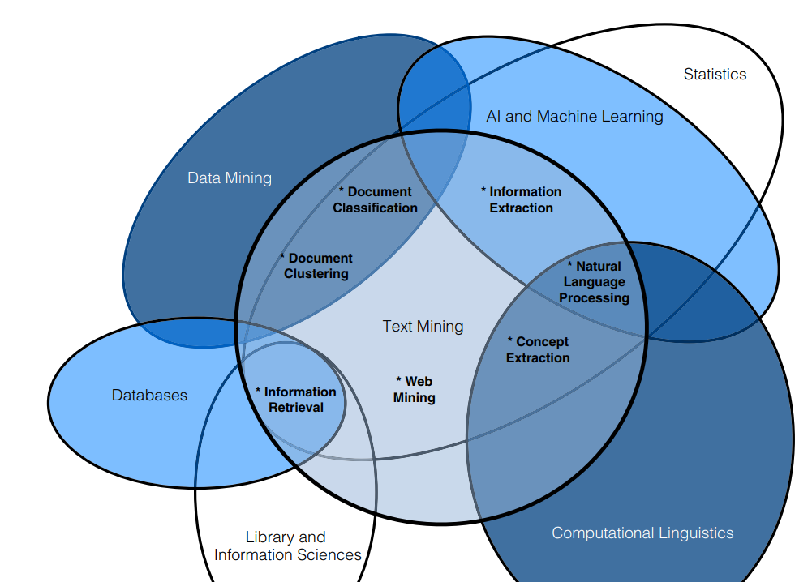
What can we do in Text Analytics?
http://www.textanalyticsworld.com/wp-content/uploads/2012/03/PracticalTextMining_Excerpt.pdf

Slide 29
What can we do in Text Analytics?
Search and information retrieval (IR): Storage and retrieval of text documents, including search engines and keyword search.
Document clustering: Grouping and categorizing terms, snippets, paragraphs, or documents, using data mining clustering methods.
Document classification: Grouping and categorizing snippets, paragraphs, or documents, using data mining classification methods, based on models trained on labeled examples.
Web mining: Data and text mining on the Internet, with a specific focus on the scale and interconnectedness of the web.
Information extraction (IE): Identification and extraction of relevant facts and relationships from unstructured text; the process of making structured data from unstructured and semi-structured text.
Natural language processing (NLP): Low-level language processing and understanding tasks (e.g., tagging part of speech); often used synonymously with computational linguistics.
Concept extraction: Grouping of words and phrases into semantically similar groups.
http://www.textanalyticsworld.com/wp-content/uploads/2012/03/PracticalTextMining_Excerpt.pdf

Slide 30
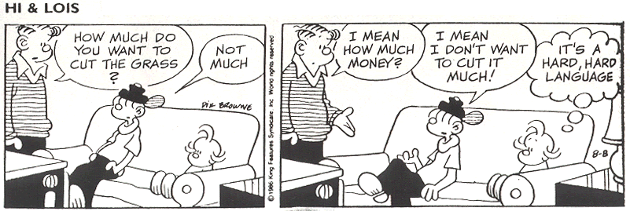
What makes Text Analytics so Hard?
Ambiguity
http://puterydelima.blogspot.com/2016/03/ambiguity.html

Slide 31
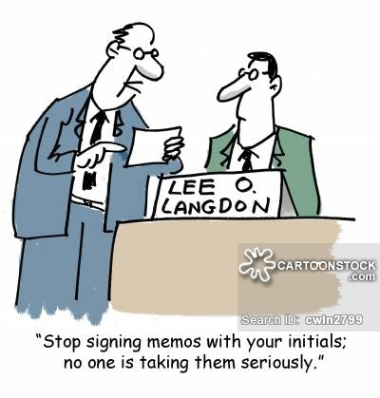

What makes Text Analytics so Hard?
Non-Standard Language
LOL
Lee O. Langdon
LOL
laugh(ing) out loud

Slide 32
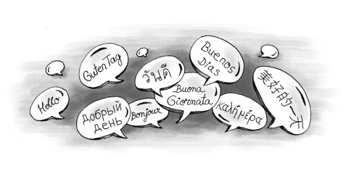
What makes Text Analytics so Hard?
More Complex Languages Than English
German: Donaudampfschiffahrtsgesellschaftskapitän (5 “words”)
Chinese: 50,000 different characters
Japanese: 3 writing systems
... … …

Slide 33
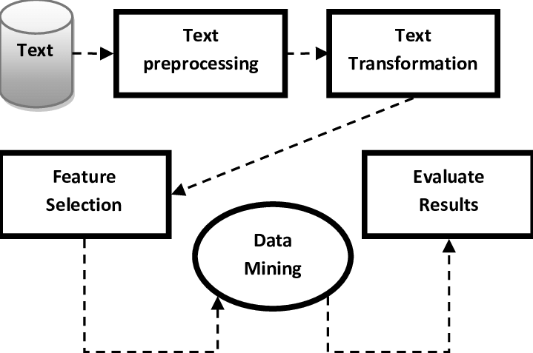
Text Mining | Analytics Process
Text → Words
RAW text → Structure data
Counting
Statistics
Classification
Clustering

Slide 34
Summary
Understanding about
Big Data, Data Analytics and concepts
CRISP-DM
Data Science and branches
Text Analytics and roles in Text Mining
Text Analytics Process

