Slide 1
COMP30810 Intro to Text Analytics
Dr. Binh Thanh Le
thanhbinh.le@ucd.ie
Insight Centre for Data Analytics
School of Computer Science
University College Dublin

Slide 2
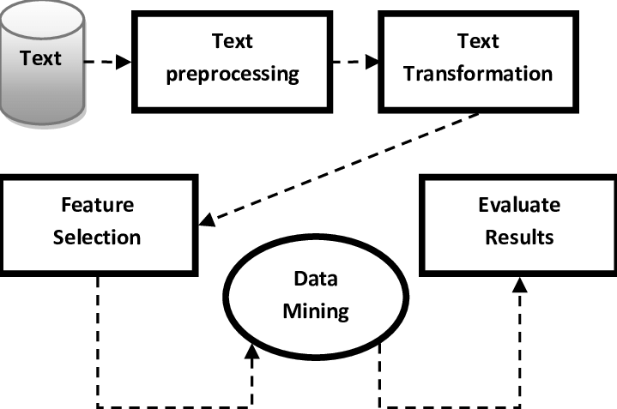
Text Analytics Process

Slide 3
Today Goals:
From RAW Data → Data frame
Why DataFrame?
Semi-structured data → the features are predefined by user
Many support from Python social network
Easy to manage the rows and columns
Easy to read and write in Python

Slide 4


RAW data
What are RAW data for Text Analytics?
Books
Academic journals
Papers
Customer feedbacks
Posters
Notes
Facebook’s post and comments
Electric newspaper
Webpage contents
Tweet
Google search
Movie recommendation
Amazon product’s descriptions
Can Audio files be RAW data in Text Analytics?
Any kind of Text

Slide 5
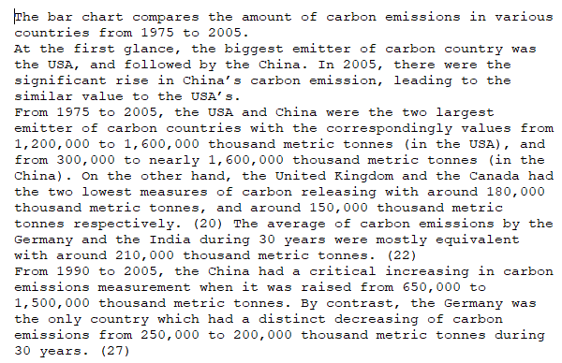


So, what can we do?
CRISP-DM
Business Understanding
Data Understanding
Classify documents to categories
Group documents into clusters
Find the most similar document to the input document
…

Slide 6

Extracting Data from RAW sources
RAW
DATA
Types of DATA
DATAFRAME
Kaggle
Texts
Blogs & Tweets
Comments
Surveys
…
txt, doc, pdf
xml, json
CSV, spreadsheet
SOURCE
Notes:
How many types of Text do you know?

Slide 7

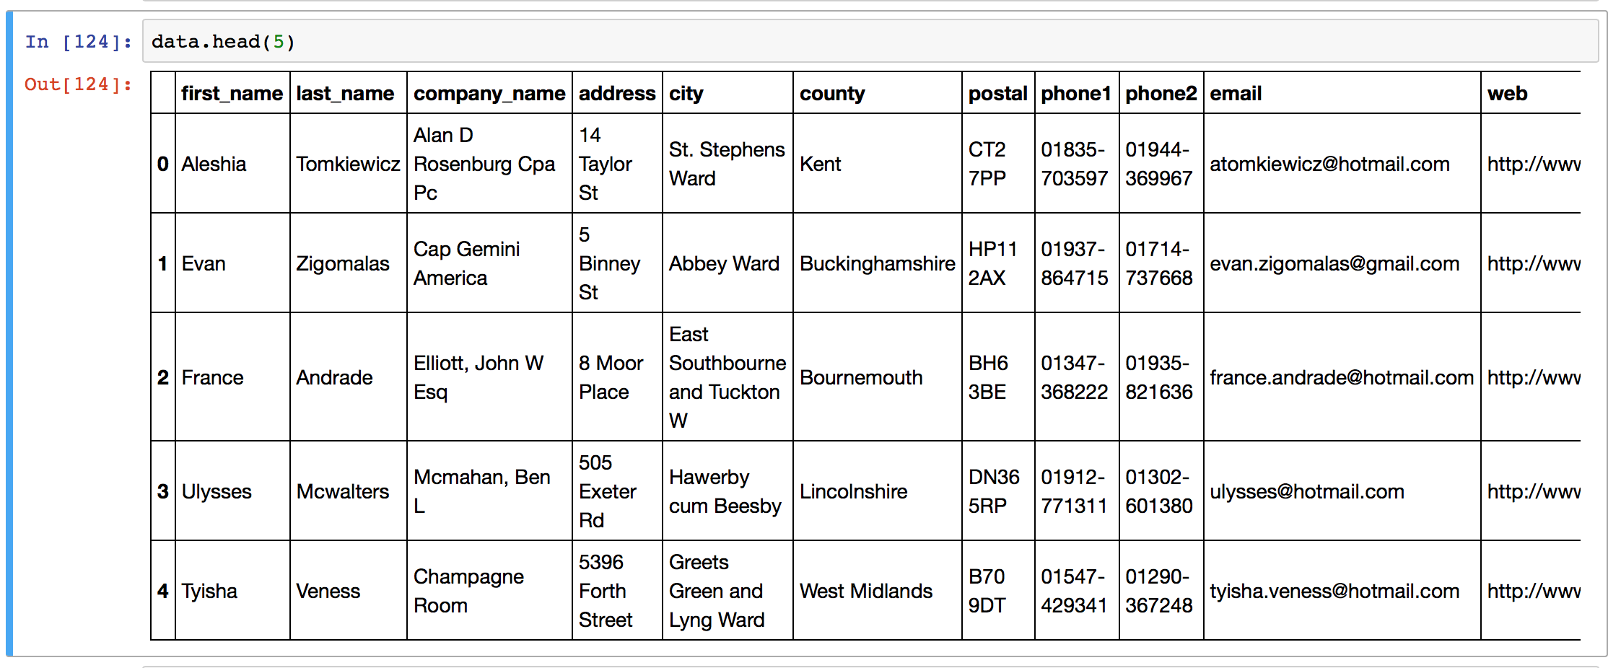
What are Pandas data frames?
DataFrame come with the python Pandas library, and they are defined as a two-dimensional labelled data structure with columns of potentially different types.
Installing
Using
or
Columns – features (data.columns)
Header
Rows - samples
Index
(data.index)

Slide 8
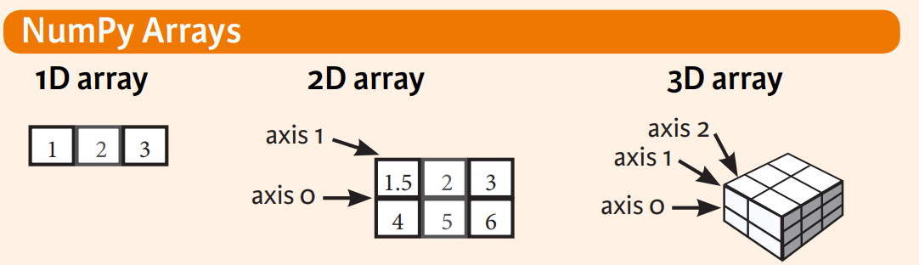
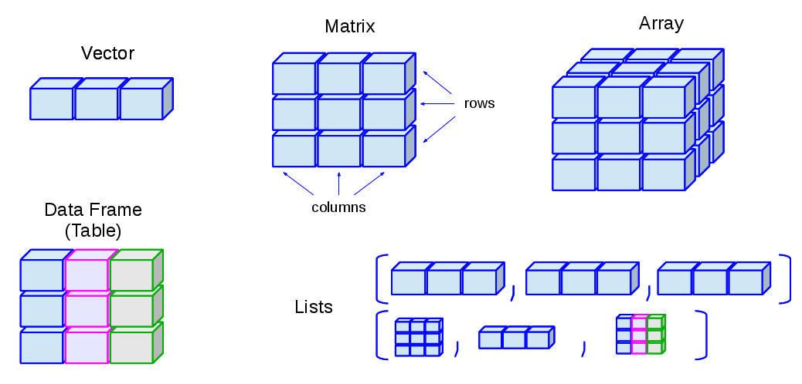
Let’s see …
[ numpy.array ]
Python
built-in data structure
pandas.DataFrame

Slide 9
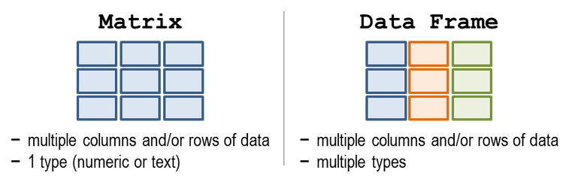
array vs DataFrame
There are some questions like:
numpy.array or pandas.DataFrame
Easier to handle:
select, concatenate, merge, apply functions …

Slide 10
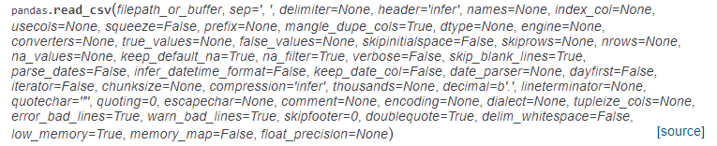
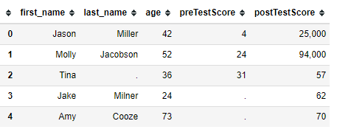
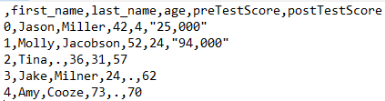
1) CSV RAW Source
Read CSV
header : determine the header of a data frame
filepath_or_buffer : path of file
index_col : determine the index column of the data frame
sep : string for separation, default ‘,’
na_values : determine the NaN values
“example.csv”
In text
https://pandas.pydata.org/pandas-docs/stable/generated/pandas.read_csv.html

Slide 11

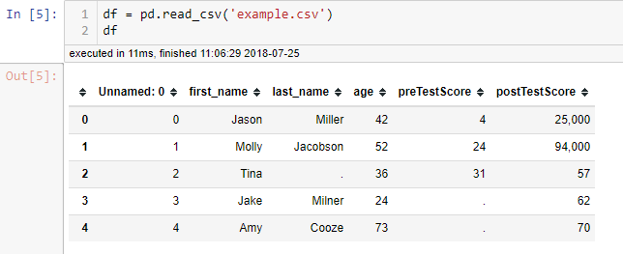
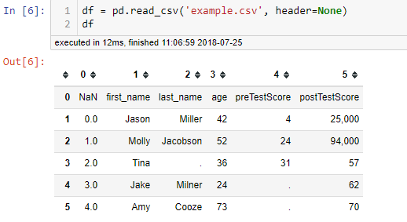

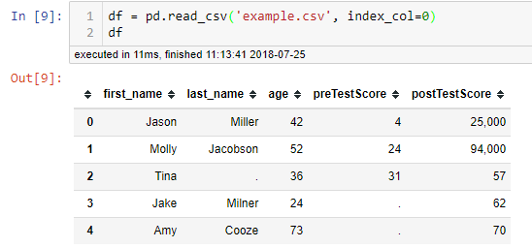

Load a csv no argument
Load a csv with no headers
Load a csv with index
https://chrisalbon.com/python/data_wrangling/pandas_dataframe_importing_csv/

Slide 12

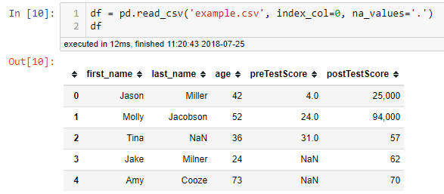
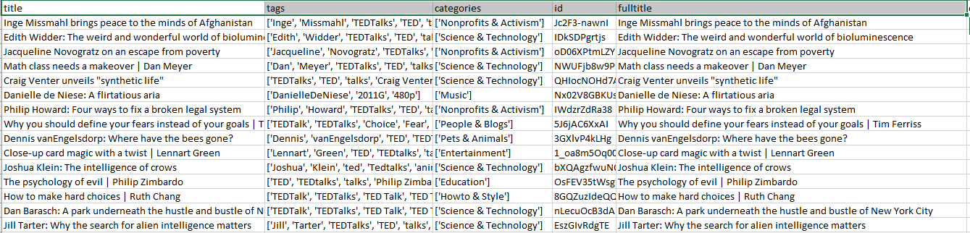
Load a csv with index, and NAN values
Example of Text Data in CSV
https://chrisalbon.com/python/data_wrangling/pandas_dataframe_importing_csv/

Slide 13
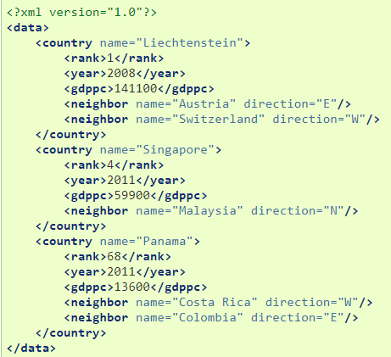
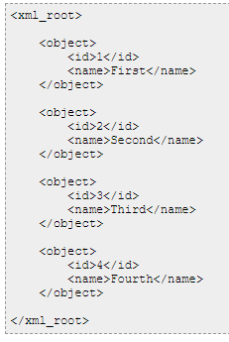
2) XML RAW Source
Sample of XML
Main point: parsing the content under the specific <tagname>
Tools in python: lxml , etree , BeautifulSoup

Slide 14


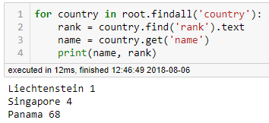
2) XML RAW Source
Open File
Get the root
Search <tag> from root
If meet <tag> then get value
Save value to variable (string, df’s column)

Slide 15
XML RAW Source
Open File
Get the root
Search <tag> from root
If meet <tag> then get value
Save value to variable (string, df’s column)
Note:
1) Should overview the structure of XML before parsing
2) Save different variables for different <tags> → increase memory, but safer for parsing
3) Should handle the type of values before saving
4) Be careful with NAN values → should be replaced by some default value

Slide 16

3) TXT RAW Source
We will think that inside one text file, we need:
Determine the separation, e.g. comma, enter, or page break … ?
Determine the end of paragraph, file ?
Ignored the blank sentences ?
Ignored the special characters?
DO NOT THINK ABOUT THEM SO EARLY
This is the most difficulty parsing!
One sentence is one column ??? → No, it generates a large feature space
Title of text file has its own meaning, also the path → Yes, have to check those before parsing.

Slide 17
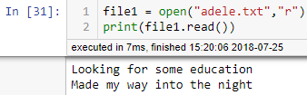
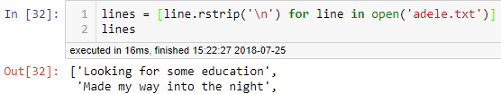
3) TXT RAW Source
Read whole TXT from python:
Read line-to-line TXT from python:
Read Only (‘r’) : Open text file for reading. The handle is positioned at the beginning of the file. If the file does not exists, raises I/O error. This is also the default mode in which file is opened.
Read and Write (‘r+’) : Open the file for reading and writing. The handle is positioned at the beginning of the file. Raises I/O error if the file does not exists.
Write Only (‘w’) : Open the file for writing. For existing file, the data is truncated and over-written. The handle is positioned at the beginning of the file. Creates the file if the file does not exists.
Write and Read (‘w+’) : Open the file for reading and writing. For existing file, data is truncated and over-written. The handle is positioned at the beginning of the file.
Append Only (‘a’) : Open the file for writing. The file is created if it does not exist. The handle is positioned at the end of the file. The data being written will be inserted at the end, after the existing data.
Append and Read (‘a+’) : Open the file for reading and writing. The file is created if it does not exist. The handle is positioned at the end of the file. The data being written will be inserted at the end, after the existing data.
File Handle
https://docs.python.org/2/tutorial/inputoutput.html

Slide 18
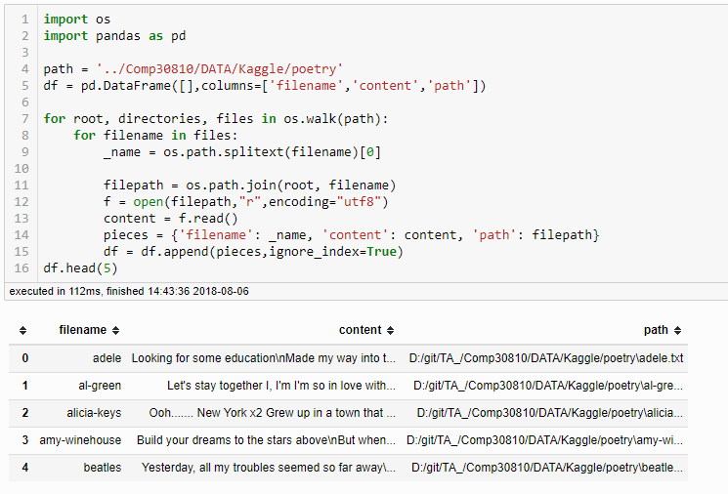
Example:
We will manage the content in next lecture!

Slide 19
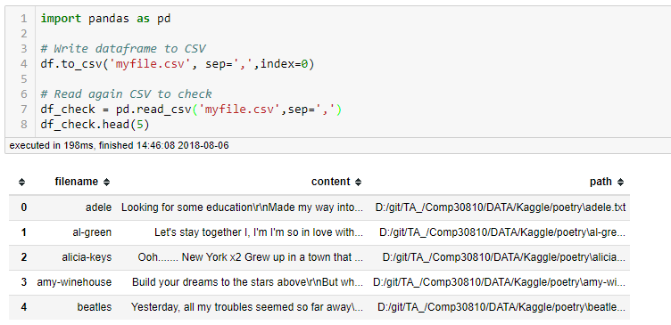
Write to CSV file

Slide 20
Summary
What RAW text data is.
How to extract data from RAW source:
CSV
XML
Text file (.txt)
How to save raw data as CSV dataframe.

