Slide 1
COMP30810 Intro to Text Analytics
Dr. Binh Thanh Le
thanhbinh.le@ucd.ie
Insight Centre for Data Analytics
School of Computer Science
University College Dublin

Slide 2
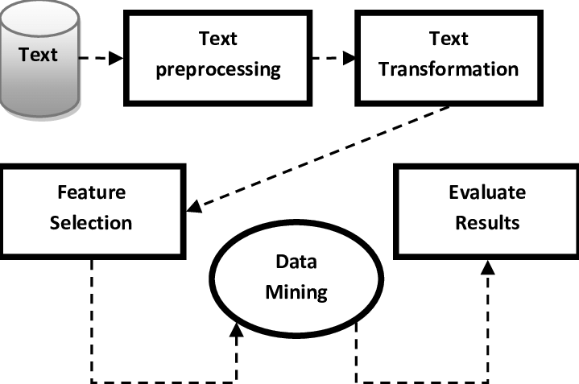

Last lecture …
Text Analytics
Process

Slide 3
Today task

Slide 4
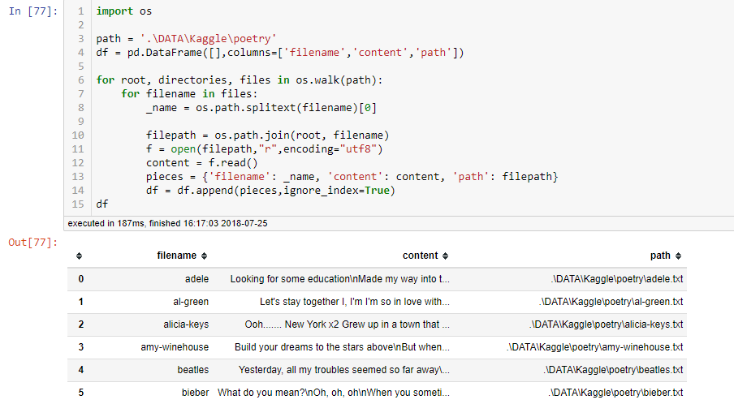
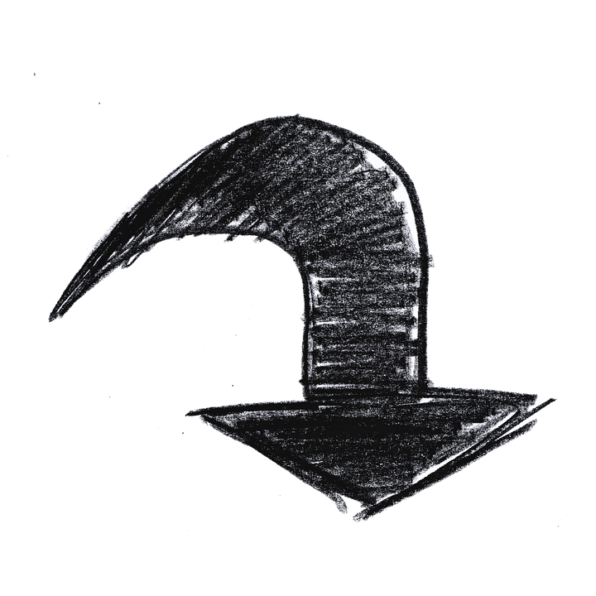
We will handle this content

Slide 5

The Quick Brown Fox -- The Rest of the Story
The quick brown fox jumps over the lazy dog. He lands head first on a rotting maple log. Knocked unconscious, fox sleeps with shallow breath until the lazy dog awakes and worries him to death.
https://allpoetry.com/poem/1063961-The-Quick-Brown-Fox----The-Rest-of-the-Story-by-JennyLee

Slide 6
Today Goals:
From text → List of tokens
The quick brown fox jumps over the lazy dog.
[The] [quick] [brown] [fox] [jumps] [over] [the] [lazy] [dog][.]
[The]
[over]
[jumps] ➔ [jump]
[.]
[quick] [brown] [fox] [jump] [lazy] [dog]

Slide 7

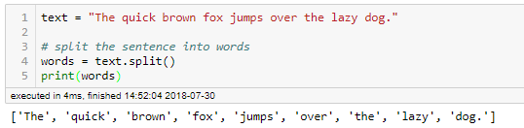
1) Splitting text into words
Python code
Split words using <space>
The quick brown fox jumps over the lazy dog.
[The] [quick] [brown] [fox] [jumps] [over] [the] [lazy] [dog.]
Python code

Slide 8
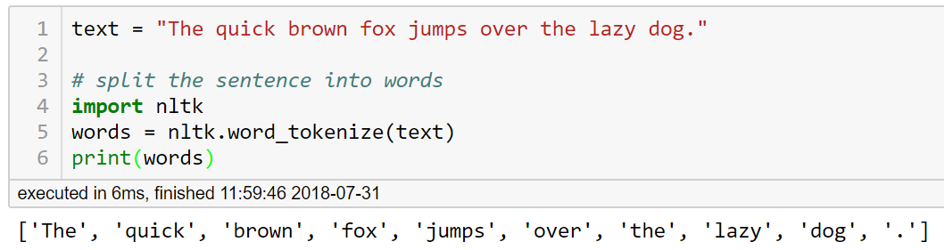
Better way: Tokenization
The quick brown fox jumps over the lazy dog.
[The] [quick] [brown] [fox] [jumps] [over] [the] [lazy] [dog][.]
Python code

Slide 9
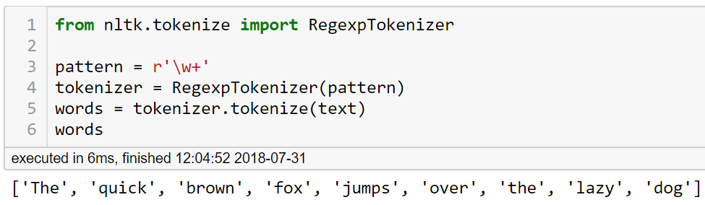
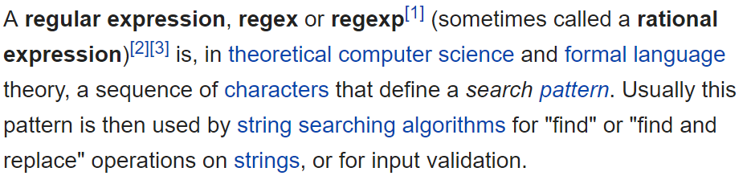
Even better way: Tokenization + Filtering
The quick brown fox jumps over the lazy dog.
[The] [quick] [brown] [fox] [jumps] [over] [the] [lazy] [dog]
Python code
Regular-Expression
Tokenizers
REG_EXP_cheatsheet.jpg
‘\w+’
: Refer to word only
r’abc’ = raw string “abc”
u’abc’ = unicode string “abc”

Slide 10
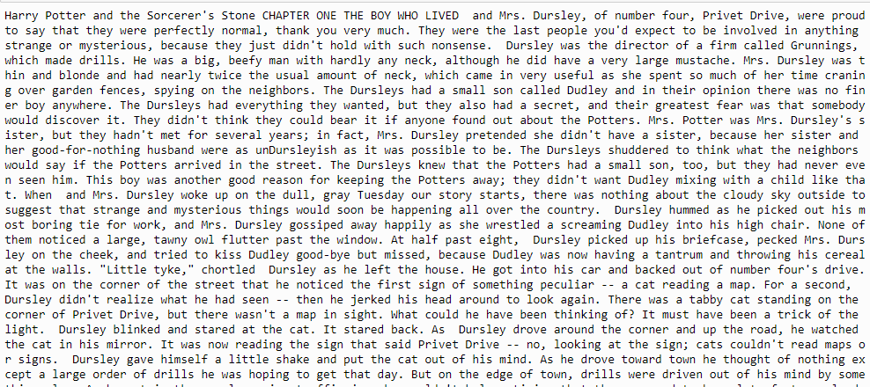
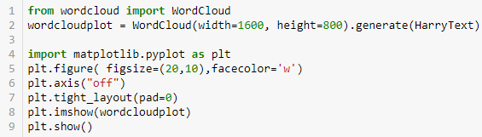
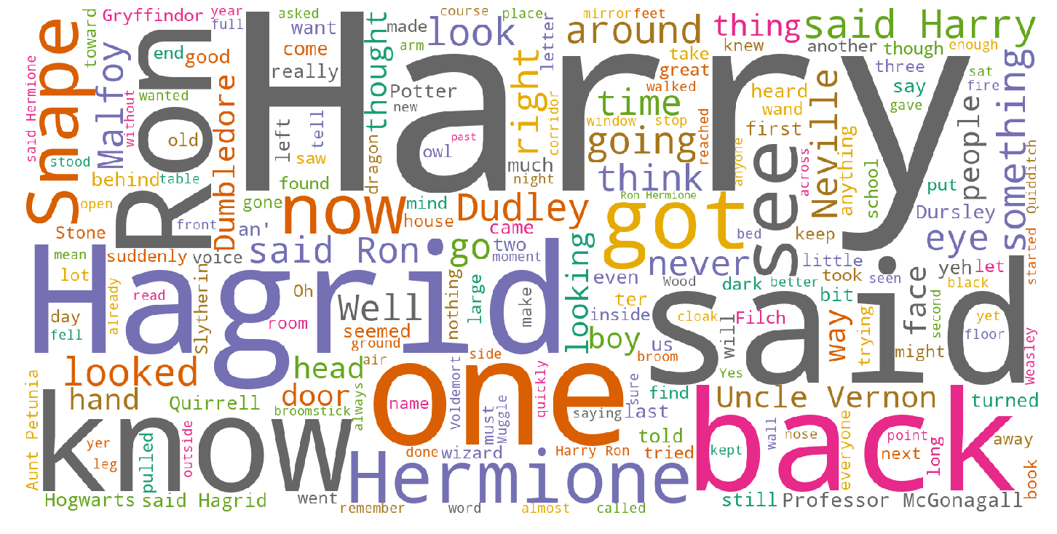
Example:
RAW text
Harry Potter
Words (wordcloud)
We need to clean the words

Slide 11
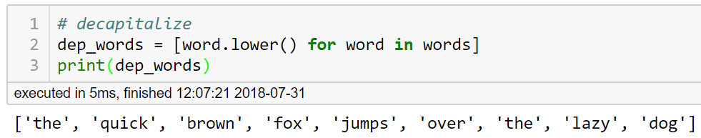
2) Decapitalizing the words
This step helps to turn words in the same form
[The] [quick] [brown] [fox] [jumps] [over] [the] [lazy] [dog]
[the] [quick] [brown] [fox] [jumps] [over] [the] [lazy] [dog]
Python code

Slide 12
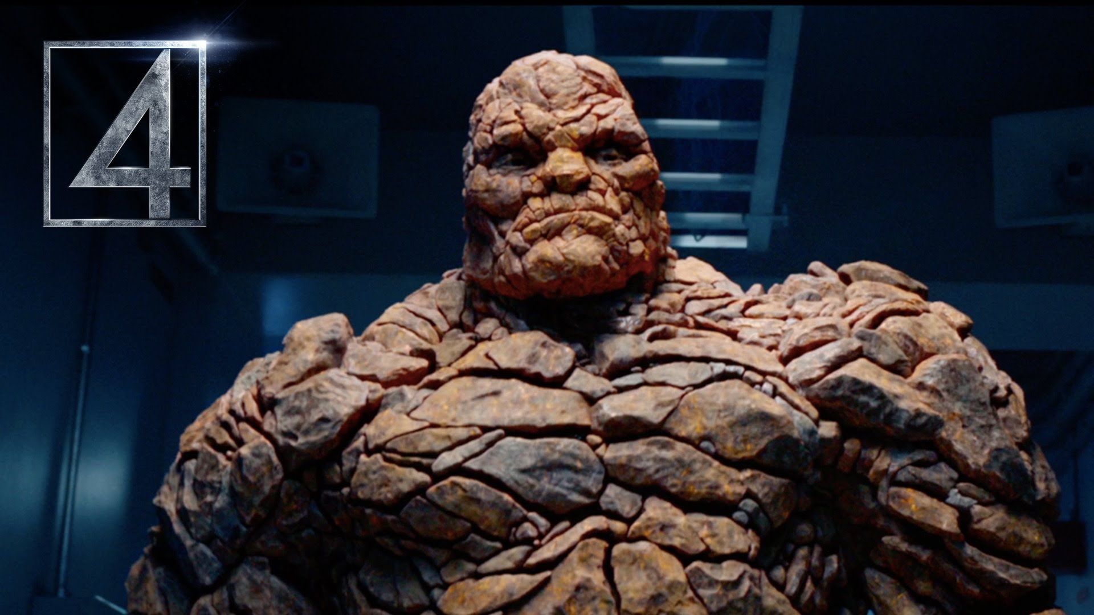
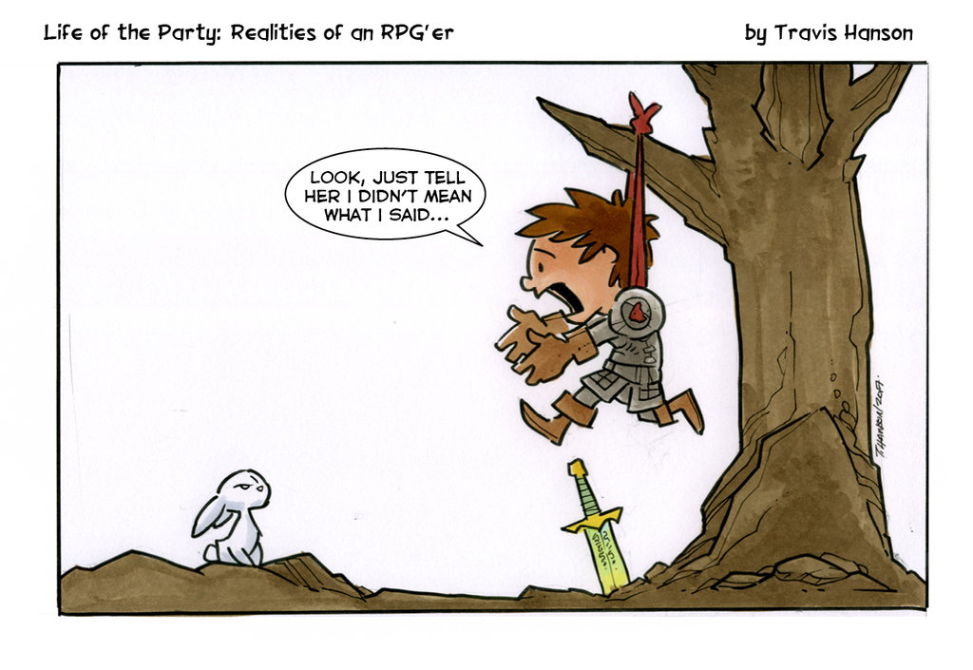
2) Decapitalizing the words
This step helps to turn words in the same form.
Be careful about the proper nouns
The Thing is going to help them.
The thing you just said was wrong

Slide 13
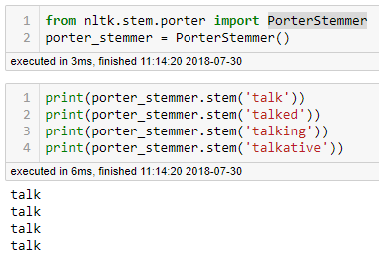
3.1) Stemming
Stemming is a technique used to find out the root/stem of a word.
Python code
talk
talked
talk
talking
talkative

Slide 14
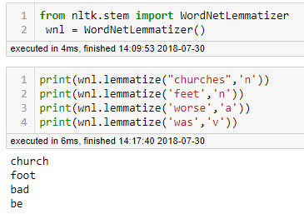
3.2) Lemmatization
Lemmatization is a technique used to find out the lemma of a word.
Python code
churches
church
feet
foot
worse
bad
was
be
part-of-speech

Slide 15
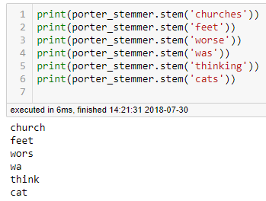
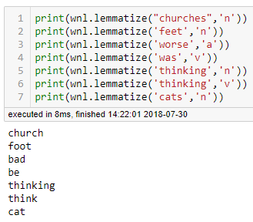
3.3) Stemming vs Lemmatization
Stemmer
Lemmatizer
Words → word’s form
Words → word’s form
Removing prefixes and suffixes
Use a corpus
➔ The result might not be an actual dictionary word.
➔ The result is always a dictionary word.
Faster than lemmatizers
Need extra info about the part of speech

Slide 16
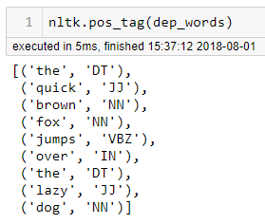
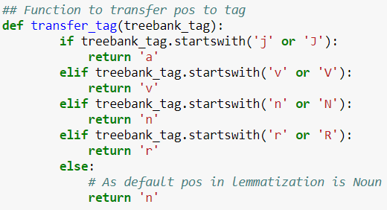
3.4) TAG and LEM
Get the TAG of part-of-speech (POS)
Python code
Transfer POS into word's tag (adjective, verb, noun, adverb)

Slide 17
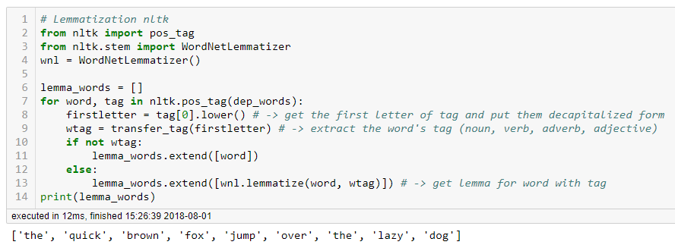
3.4) TAG and LEM
Get the TAG of part-of-speech
Return the lemma with corresponding TAG
Python code
dep_words = [the] [quick] [brown] [fox] [jumps] [over] [the] [lazy] [dog]

Slide 18
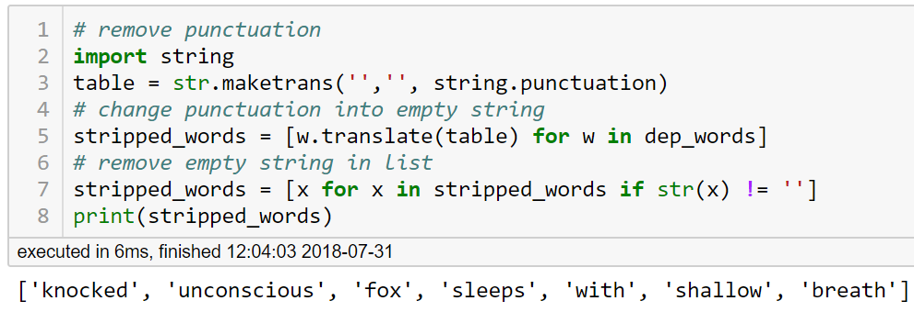
4) Remove punctuations (if necessary)
Split and remove will give you the exactly words in list.
If we used the Regular-Expression Tokenizers, we do not need to worry about this
[knocked] [unconscious][,] [fox] [sleeps] [with] [shallow] [breath]
[,]
[knocked] [unconscious][fox] [sleeps] [with] [shallow] [breath]
Python
code

Slide 19

5) Remove stop words (if necessary)
Stop words are words which are filtered out before or after processing of text.
Python code
[the] [quick] [brown] [fox] [jumps] [over] [the] [lazy] [dog]
[the]
[over]
[quick] [brown] [fox] [jumps] [lazy] [dog]

Slide 20
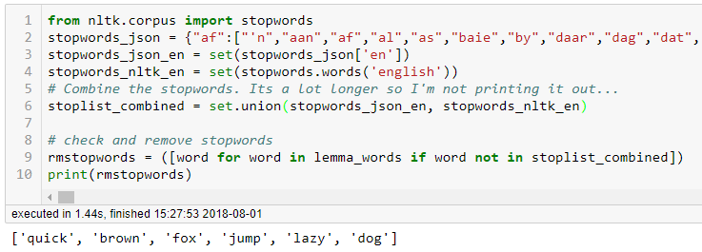

Remove stop words: Better way !
We can combine the stop words we have in NLTK with other stop words list we find online.
https://github.com/6/stopwords-json
Python code
Why do we need to decapitalize
before removing stop words?

Slide 21
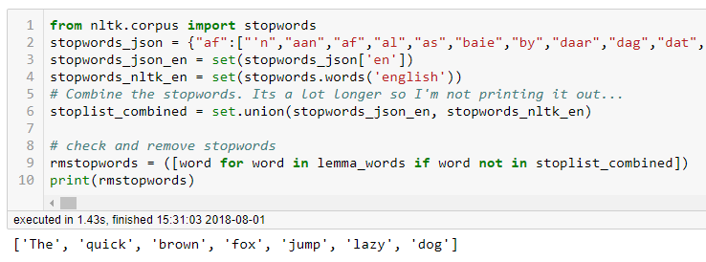
Answer:
Python code
Why do we need to decapitalize
before removing stop words?

Slide 22
Finally we get…
The quick brown fox jumps over the lazy dog. He lands head first on a rotting maple log. Knocked unconscious, fox sleeps with shallow breath until the lazy dog awakes and worries him to death.
List of key tokens

Slide 23
Summary
Tokenization
< Split words >
< lowercase words >
Decapitalization
Text
List of
key tokens
Remove Punctuations
< remove .,:?! …>
Lemmatization
< word’s form >
Remove Stop Words
< get key words >

Slide 24
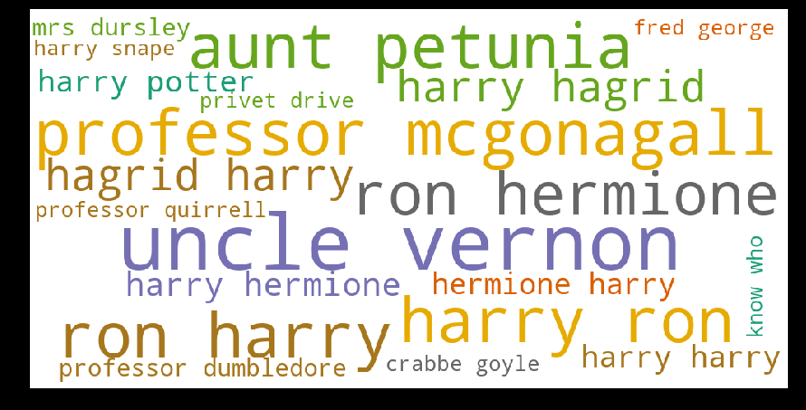
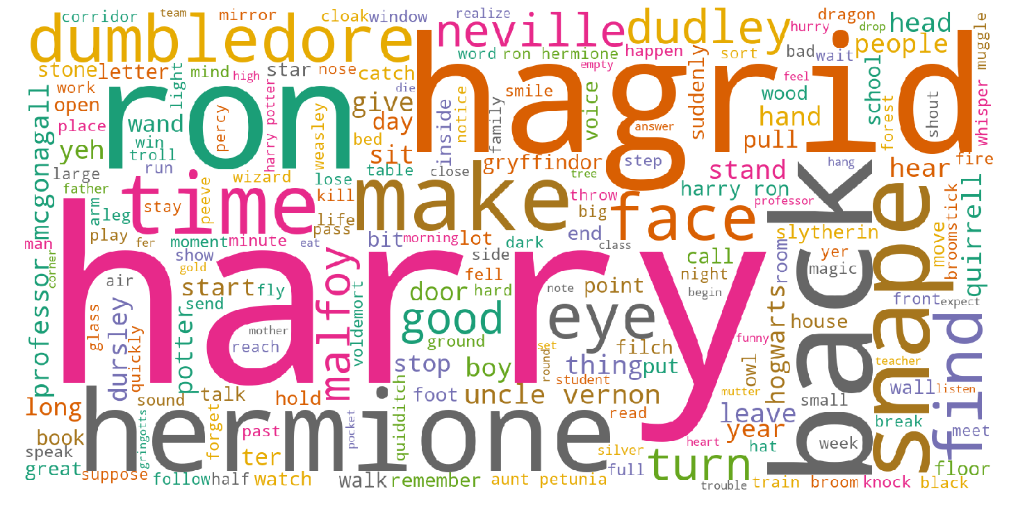
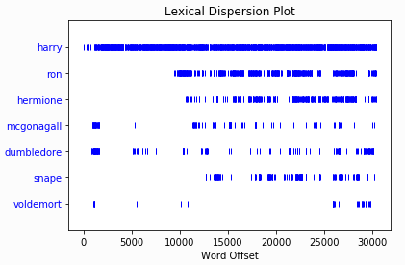
Back to Harry Potter :
Next lecture:
N-gram
Lexical Dispersion Plot

