Slide 1
COMP30810 Intro to Text Analytics
Dr. Binh Thanh Le
thanhbinh.le@ucd.ie
Insight Centre for Data Analytics
School of Computer Science
University College Dublin

Slide 2
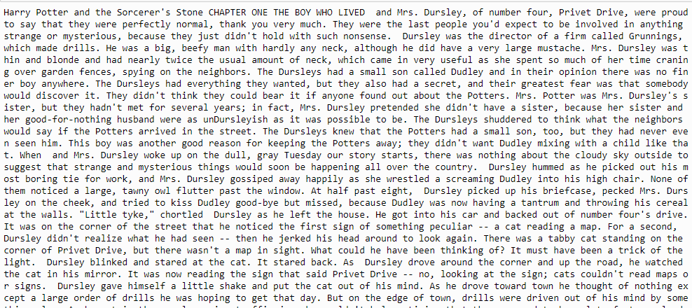
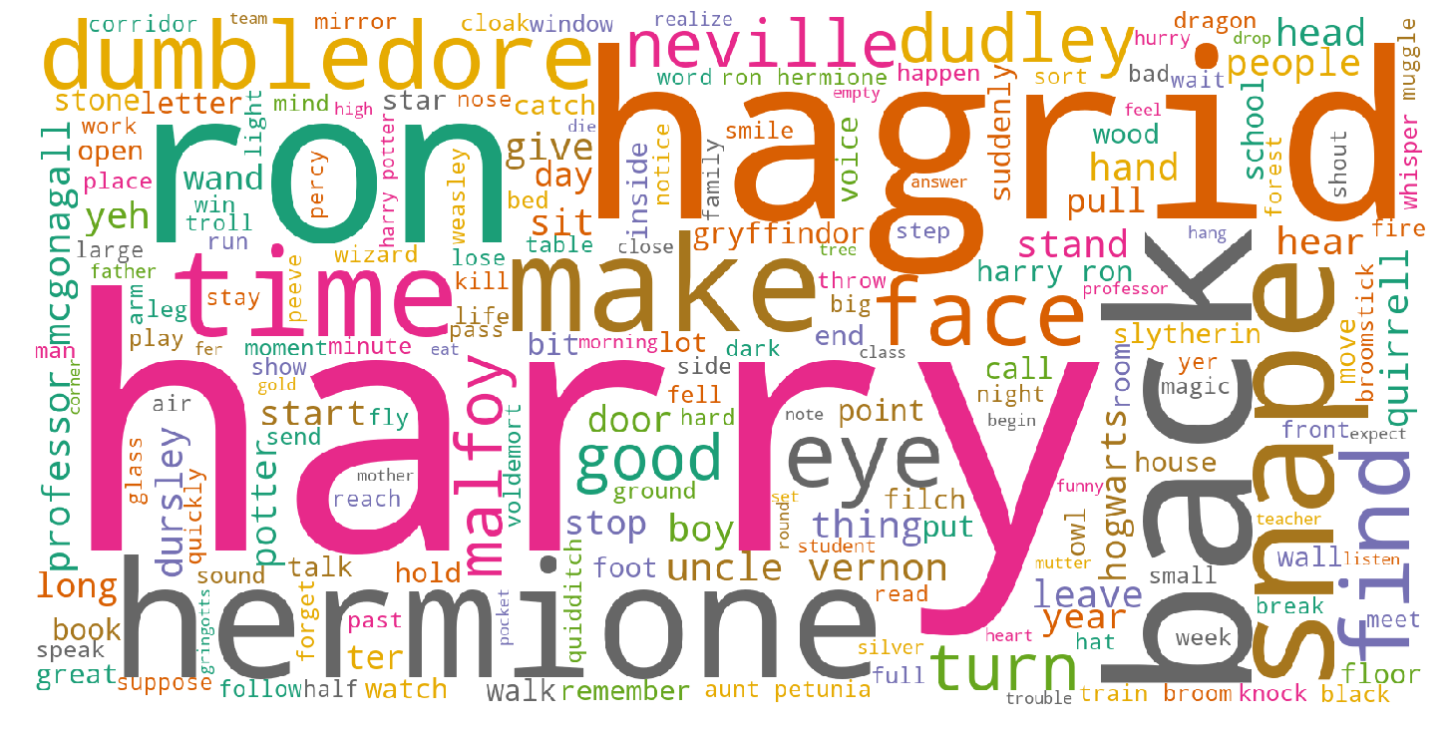
Previous lecture
CLEAN-UP
Remove punctuation
Remove stop words
Normalize the case
Stemming | Lemmatization
Key wordlist

Slide 3
Today tasks
Understand the text:
Find the most common words in text
N-gram
Frequency
Document summarization

Slide 4
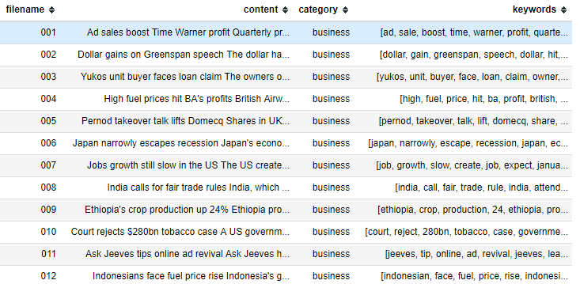
Observation from a big scale
News Corpus
Last time, we learned how to extract the keywords (tokens)

Slide 5
Observation from a big scale
News Corpus
How to get the meaning refer to this?

Slide 6


Technologies in Text Mining
Part of speech
Word
Sentence
Paragraph
Document
Corpus
Find word
Concordance
Tokenization
Remove stopwords
Lemma and Steem
Wordcloud
Frequency
N-gram
Sentiment
Classification
Clustering

Slide 7
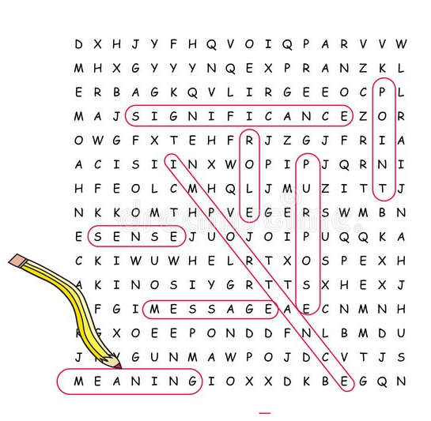
1) Find a word, Concordance
Helping us reduce the time of analysis.
Extracting information from context
Building the first understanding of document
Making the first statistic for further analysis

Slide 8
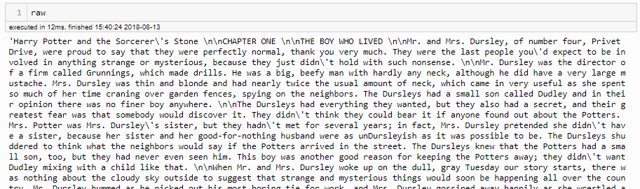

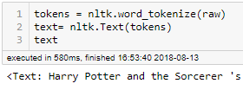
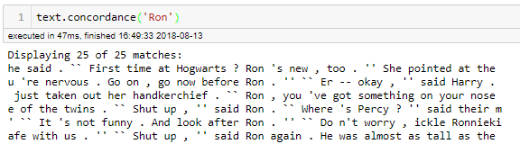
1) Find a word, Concordance
Return the first index of that word
Return concordance in text
Get tokens and Text type

Slide 9
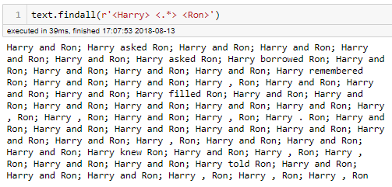
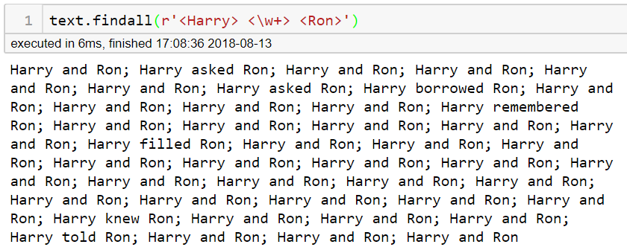
1) Find a word, Concordance
‘findall’ : find the multi-word, using Regular Expression
Or:
Different?

Slide 10

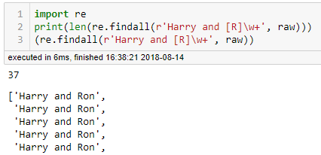
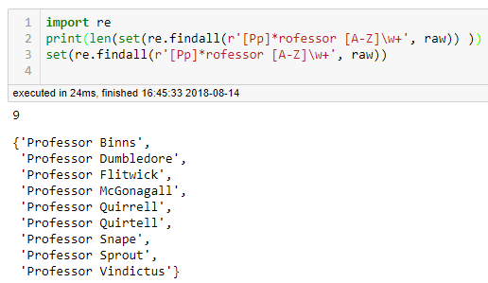
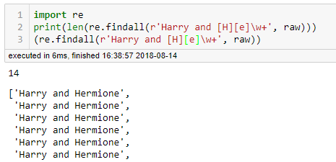
Example for extracting information
Who is the Harry’s best friend?
How many professors are in Harry Potter 1?
Regular Expression
Regular Expression source
https://docs.python.org/2/howto/regex.html
Regular Expression Test script
https://regex101.com/

Slide 11

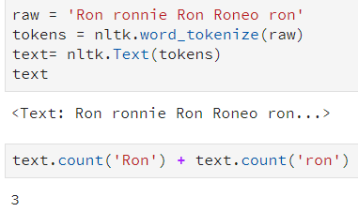

2) Top most common words in Text
We can count the occurrence of a word in text
nltk.Text
ron? → ronnie?
However, we don’t want to use this for all words in text file. [Right?]
and now we want to make some statistic analysis for further task.
How?
Frequency

Slide 12
2) Top most common words in Text
Frequency
How many time?
Main topic?
Main subject?
Most common?
Collocation?
Special Proper Noun?
How?
<NLTK> FREQDIST
Frequency Distribution
How it works...
Count
….
Frequency
The greatest count
Total number of samples

Slide 13
2) Top most common words in Text
Frequency Distribution
Count
Increase the count
Frequency
The greatest count
Total number of samples
FreqDist functions:
fdist = FreqDist(samples) → Create a frequency distribution containing the given samples
fdist[‘word’] → Count of the number of times a given sample occurred
fdist.freq(‘word’) → Frequency of a given sample
fdist.max() → Sample with the greatest count
fdist.tabulate() → Tabulate the frequency distribution
fdist.plot() → Graphical plot of the frequency distribution
fdist1 < fdist2 → Test if samples in fdist1 occur less frequently than in fdist2
fdist.inc(sample) → Increment the count for this sample
…

Slide 14
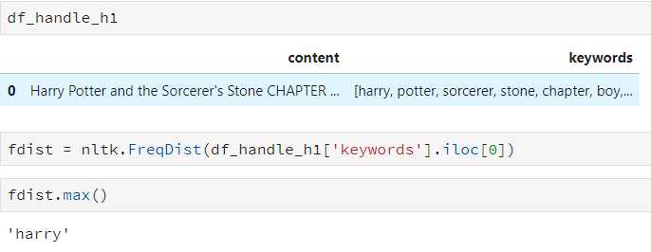

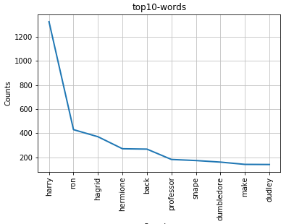
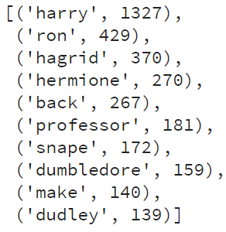
Example:
Create a
frequency distribution
Find the greatest count word
main subject

Slide 15
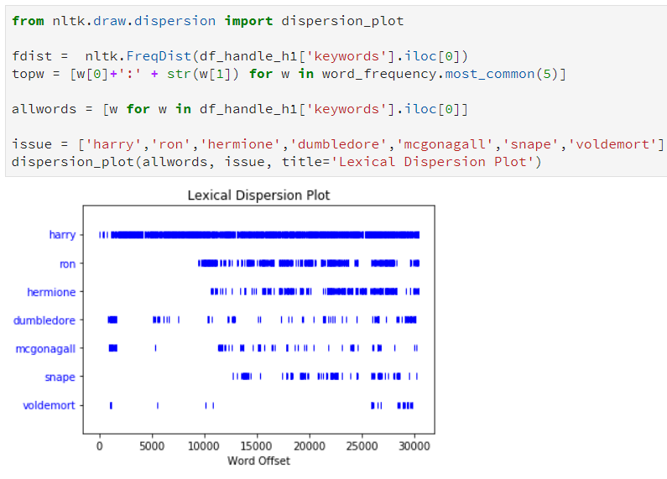


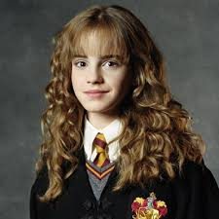
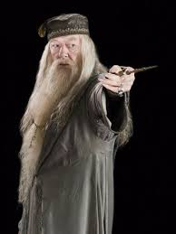

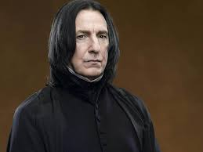
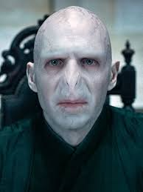
3) Dispersion plot
From nltk: this is an utility for displaying lexical dispersion.

Slide 16
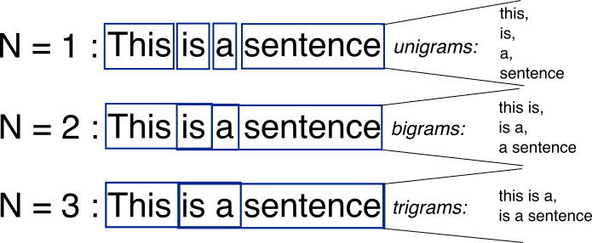
3) N-gram
Sometimes collocations are a problem for splitting words
e.g. Fast food, pay attention, catch a cold, …
Conjunctions, connecting words are also an another problem
e.g. In case, in spite of, even though…
The proper names are also a problem
e.g. “Harry Potter”, “White House”, “Burger King”, …
➔ To manage multi-words together: n-gram
An n-gram is a contiguous sequence of n items from a given sample of text or speech
<Wikipedia>

Slide 17

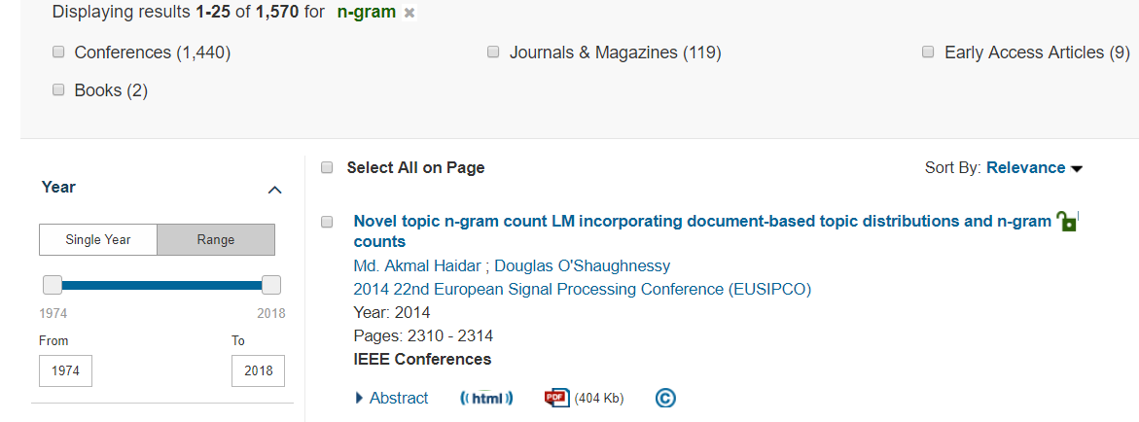
3) N-gram
Why use n-gram?
- Can capture all possibility of word’s combination
Better coverage (e.g. collocations, proper noun, noun phrases,…)
Higher precision (more data → more information)
Why n-gram can work?
Because words are in order.

Slide 18
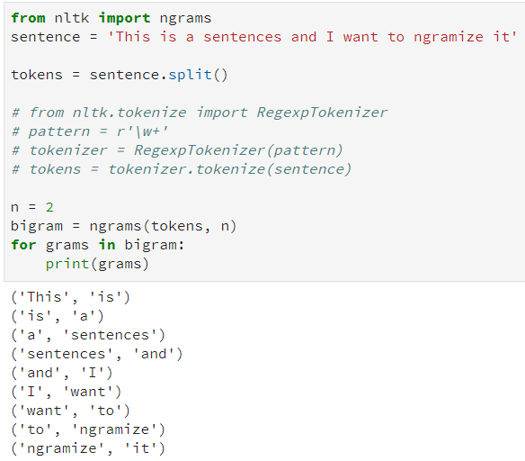
3) N-gram
Python code:
< In case having punctuations>

Slide 19
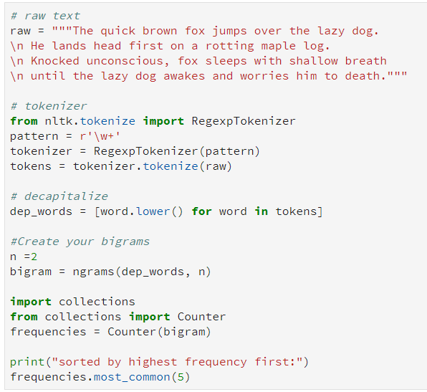
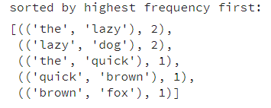
4) Frequency for n-gram
Python code:
Out:

Slide 20
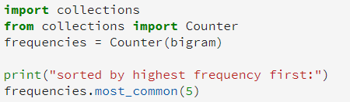
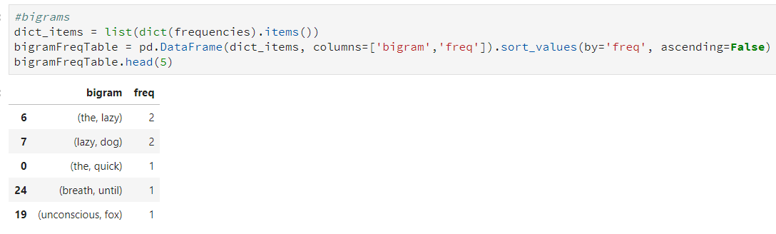
5) N-gram + POS structure
To improve the accuracy of n-gram words, we can add POS structure to the n-gram
Example: Bigrams: (Noun, Noun), (Adjective, Noun)
<previous slide>
<create dataframe>

Slide 21
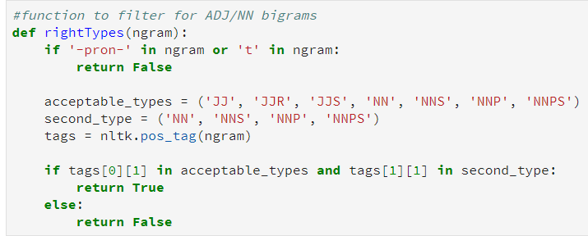
5) N-gram + POS structure
To improve the accuracy of n-gram words, we can add POS structure to the n-gram
Example: Bigrams: (Adjective, Noun), (Noun, Noun)
< Adj | Noun >
< Noun >

Slide 22
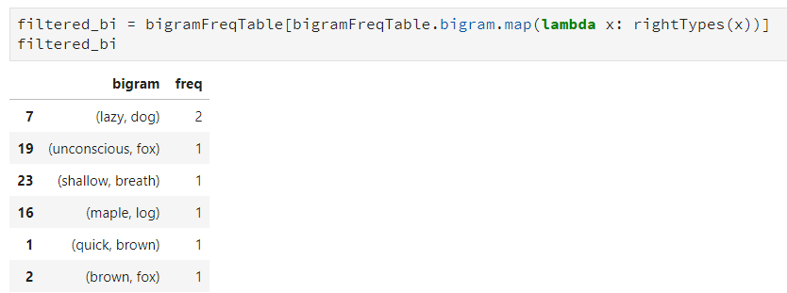
5) N-gram + POS structure
To improve the accuracy of n-gram words, we can add POS structure to the n-gram
Example: Bigrams: (Adjective, Noun), (Noun, Noun)
<It’s better now!>

Slide 23
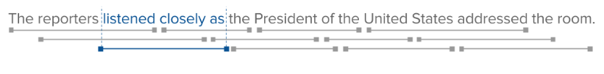
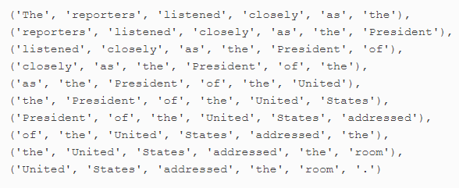
6) Note about N-gram
Choosing the Right n-Gram Window
To identify all of the n-grams from our text, we simply slide a fixed-length window over a list of words until the window reaches the end of the list.
Unfortunately, if we build a model based on an n-gram order that is too high, it will be very unlikely that we’ll see any repeated entities.
In order to capture the entirety of the phrase “the President of the United States,” we would have to set n=6:

Slide 24
6) Note about N-gram
Choosing the Right n-Gram Window
To identify all of the n-grams from our text, we simply slide a fixed-length window over a list of words until the window reaches the end of the list.
Unfortunately, if we build a model based on an n-gram order that is too high, it will be very unlikely that we’ll see any repeated entities.
Too large of an n may add too much noise by overlapping independent contexts.
If the window is larger than the sentence, it might not even produce any n-grams at all.

Slide 25
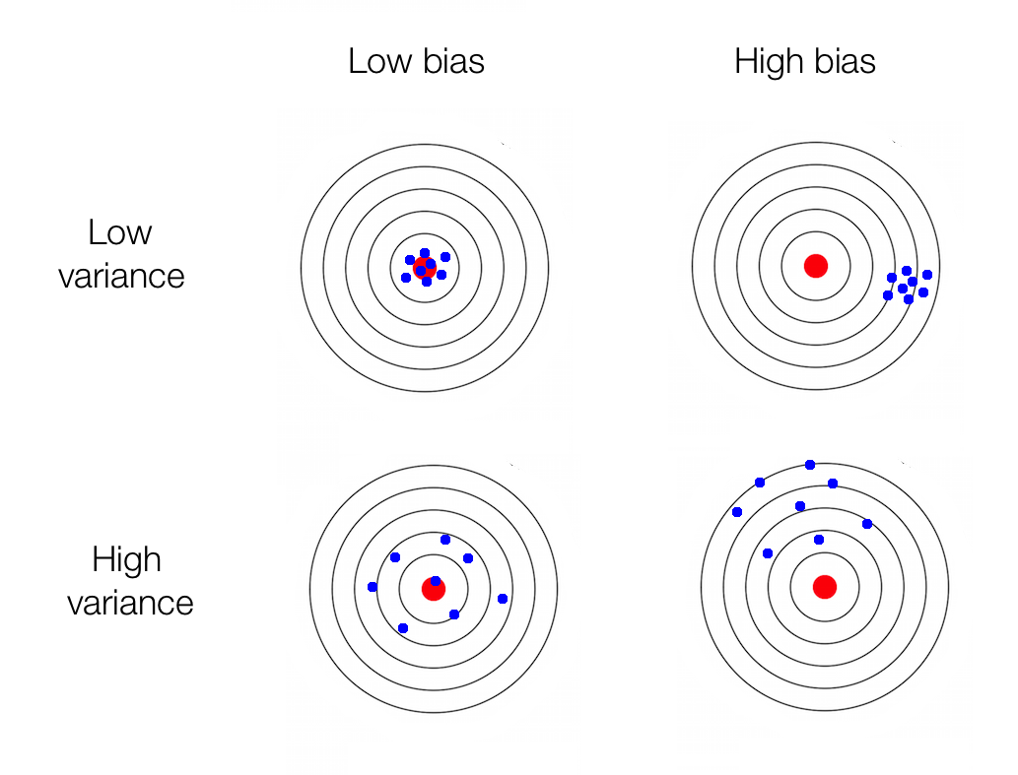
6) Note about N-gram
Choosing the Right n-Gram Window
To identify all of the n-grams from our text, we simply slide a fixed-length window over a list of words until the window reaches the end of the list.
Unfortunately, if we build a model based on an n-gram order that is too high, it will be very unlikely that we’ll see any repeated entities.
Choosing n can also be considered as balancing the trade-off between bias and variance.
A small n leads to a simpler (weaker) model, therefore causing more error due to bias.
A larger n leads to a more complex model (a higher-order model), thus causing more error due to variance.

Slide 26


Summary
Document
Raw text
Corpus
Most common words
Document
Summarization
Frequency
N-gram
<Meaning>
➔Next lecture⬅
POS
wordlist

Slide 27
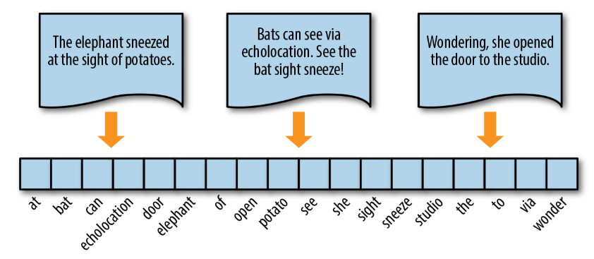
Next lecture

Slide 28
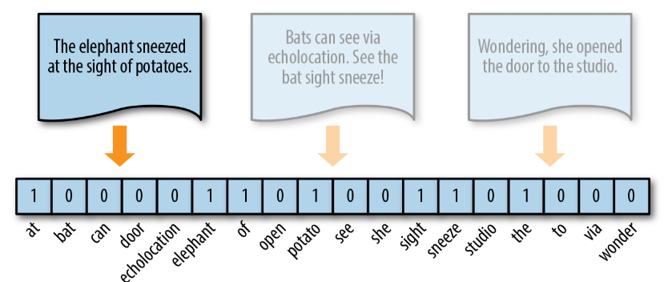
Next lecture

Slide 29
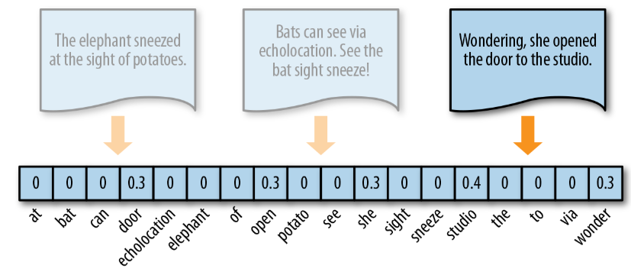
Next lecture

